Slide 1
A Low Cost, Portable Platform for Information Assurance and Security Education
Dan C. Lo, Kai Qian Department of Computer Science and Software Engineering Kennesaw State University, Marietta, GA {clo, kaiqn}@spsu.edu | Wei Chen Department of Computer Science Tennessee State University Wchen@tnstate.edu

Slide 2
Motivations
Massive growth in mobile devices
Security raised to national concerns
Lack of mobile application development workforce
Hard to maintain a network lab
Lack of educational materials, especially hands-on teaching modules
High demands in online delivery

Slide 3
Some Figures in Year 2014
A survey in University of Florida shows 98% of students with mobile devices. (1/2014)
Worldwide shipments of smart phones will reach 1.9 billion in 2015.
Worldwide shipments of tables (300 million) will exceed PCs after 2014.
Android 1.9 billion vs. IOS (iPhone OS) 682 million (2014).
App downloads will reach 269 billion in 2017.
Mobile APP development jobs are best through 2020.
Mobile payment transactions to $1 trillion by 2015.
SPSU ranked top 7 for the 2015 best colleges for online CS degrees (ComputerScienceOnline.org)

Slide 4
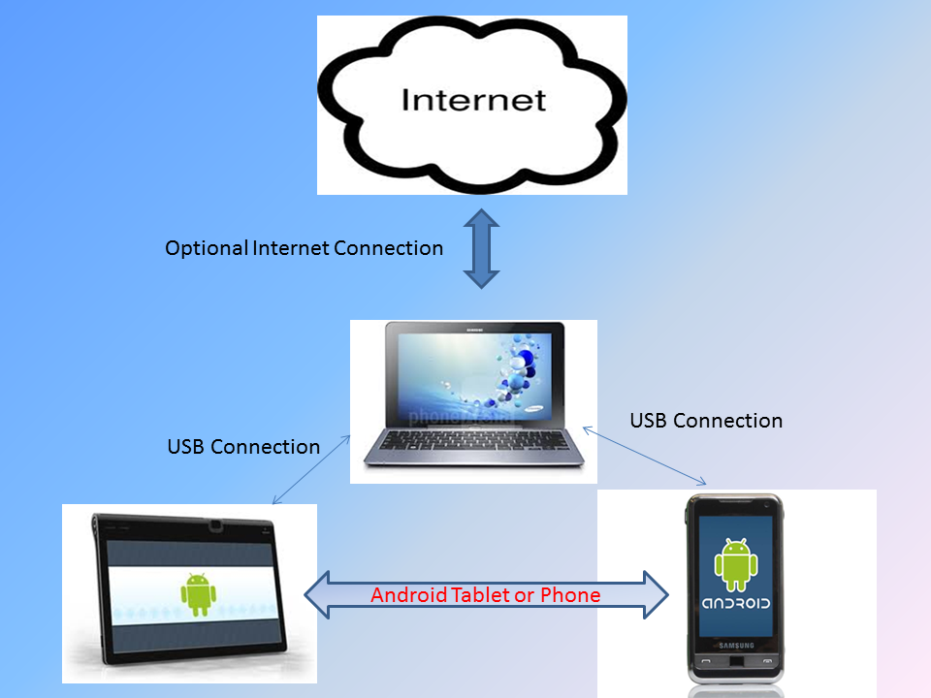
PLab Learning Platform

Slide 5
Rationales in our Learning Model
Communicate young generations using their language and approach
Hands-on learning materials engage students in subjects such as networking and security
The best defense is attack.
Curriculum with real world applications will better prepare students for the workforce.
Portable isolated networking platform

Slide 6
Isolated Network
A network that does not connect to Internet.
it must keep the isolated information inaccessible to users on the Internet,
it must ensure that authorized users can access only the type of information they are authorized to access

Slide 7
Reasons Why Isolated
users are prevented from inadvertently releasing sensitive data or vulnerability information to the Internet.
users are prohibited to bring in malicious software, such as “programs with Trojan horses or other malicious logic.”
users within the isolated network are prevented from intentionally passing information to the Internet, and prevented from running an attack against an Internet host.
training systems can be created in an isolated network that should not be used elsewhere.
administrative limitations can be placed on the systems that may not be feasible on departmental machines.
isolation of the lab denies external attackers a launch platform from within the department.

Slide 8
How about online courses?
High demand in online delivery that requires a low cost learning platform.
Also the need to learn anytime anywhere – portable.

Slide 9
PLab Setups
Reverse Tethering on Rooted Devices (sharing PC internet connection) via a USB Cable
Connecting Android Devices to a Laptop Computer Using a Virtual Router
PLab Configuration Using USB Tethering
PLab Configuration Using WiFi Hotspot

Slide 10
Reverse Tethering on Rooted Devices via a USB Cable

Slide 11
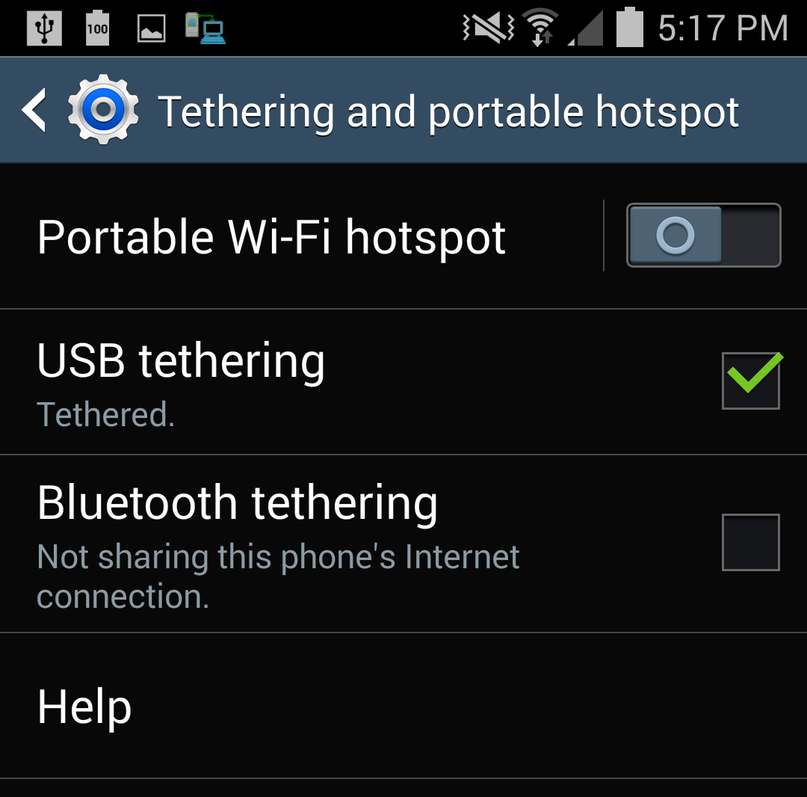
PLab Configuration Using USB Tethering

Slide 12
A Comparison Among Different PLab Configurations
PLab Configuration | Power Consumption | Rooted Devices | Needed Software
USB Reverse Tethering | Low | Yes | Reverse tethering tool
Virtual Router | Medium | No | Virtual router software
USB Tethering | Low | No | No if there is one in the device
WiFi Hostspot | High | No | No

Slide 13
Labware Design
We host labware in a Google site: https://sites.google.com/site/iasoncs
Each contains the following:
1 Overview
2 Learning Objectives
3 Ethics
4 Suggested Targeting Courses
5 Activities
5.1 Pre-Lab Activities
5.2 Lab Activities
5.3 Post-Lab Activities
6 Review questions and answers
7 Assignments
8 Projects
9 References

Slide 14
Proposed Learning Modules
Network Security
Database Security
Defensive Programming
Web Security
Systems Fundamentals

Slide 15
Network Security
Internet protocol (IP)
IP Spoofing and countermeasures
TCP 3-way handshaking protocol, TCP SYN flood attack, Man-in-the-middle attacks and countermeasures
Sniffing and traffic redirection (routing) attack with their countermeasures
Network intrusion detection and prevention
Cryptography (secure/unsecure channels, attackers and their capabilities, encryption, decryption, keys, signatures, cipher types, public key infrastructure, etc.)

Slide 16
Database Security
Security challenges for databases
Access Control (authentication, verify who you are, and authorization, verify that you have access to something)
Data protection with encryption
SQL Injection
Attack examples
Preventing attacks

Slide 17
Web Security
Web App security
Cross-site scripting
Custom Application Scripting
HTTP/HTTPS
Authentication
Cookie Manipulation
Frames busting
Browser security

Slide 18
Defensive Programming
Secure input validation and output handling
Buffer overflow attack and prevention
Access Control and Confidential Information
Injection and Inclusion
Accessibility and Extensibility
Mutability
Serialization and Deserialization

Slide 19
Systems Fundamentals
Root of Trusts
Secure Application Programming Interfaces
Policy Enforcement Engine
Memory protection hardware (DEP)
Instruction set architecture: privileged instruction and dual mode operation
Encryption/decryption hardware
Assembly programming

Slide 20
Acknowledgment
This material is based in part upon work supported by the National Science Foundation under Grant Numbers 1438858, 1438924, 1244697, and 1241651. Any opinions, findings, and conclusions or recommendations expressed in this material are those of the author(s) and do not necessarily reflect the views of the National Science Foundation.

