Slide 1
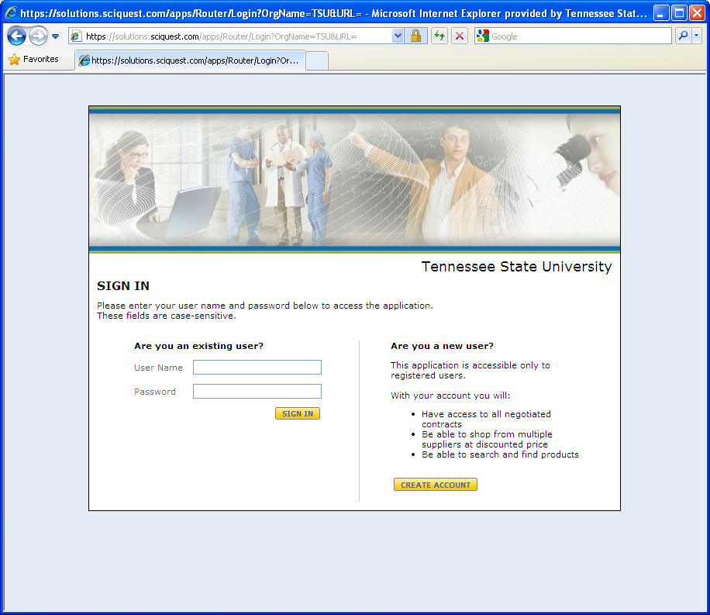
Log In to SciQuest

Slide 2
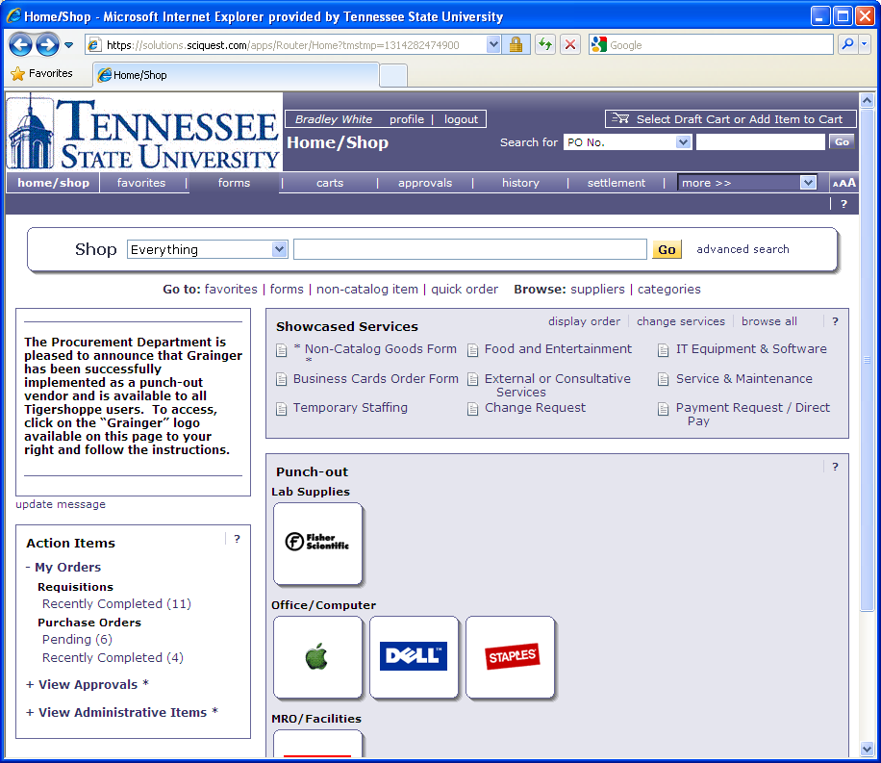
Select Forms
1. Sign in to SciQuest

Slide 3
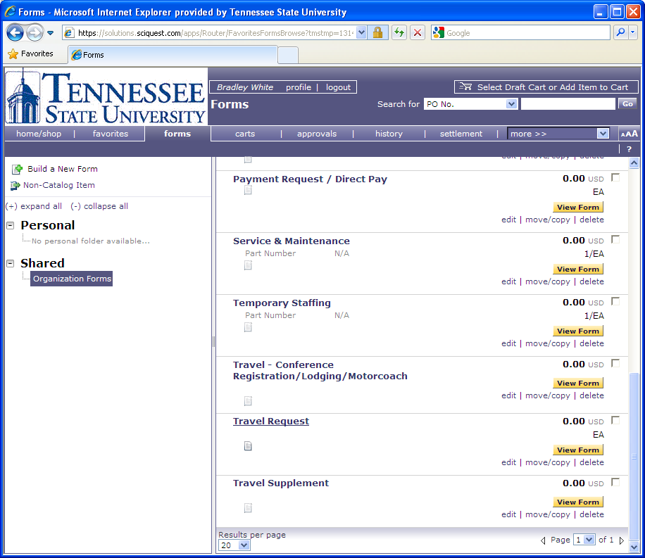
Scroll Down to the Appropriate Travel Form

Slide 4
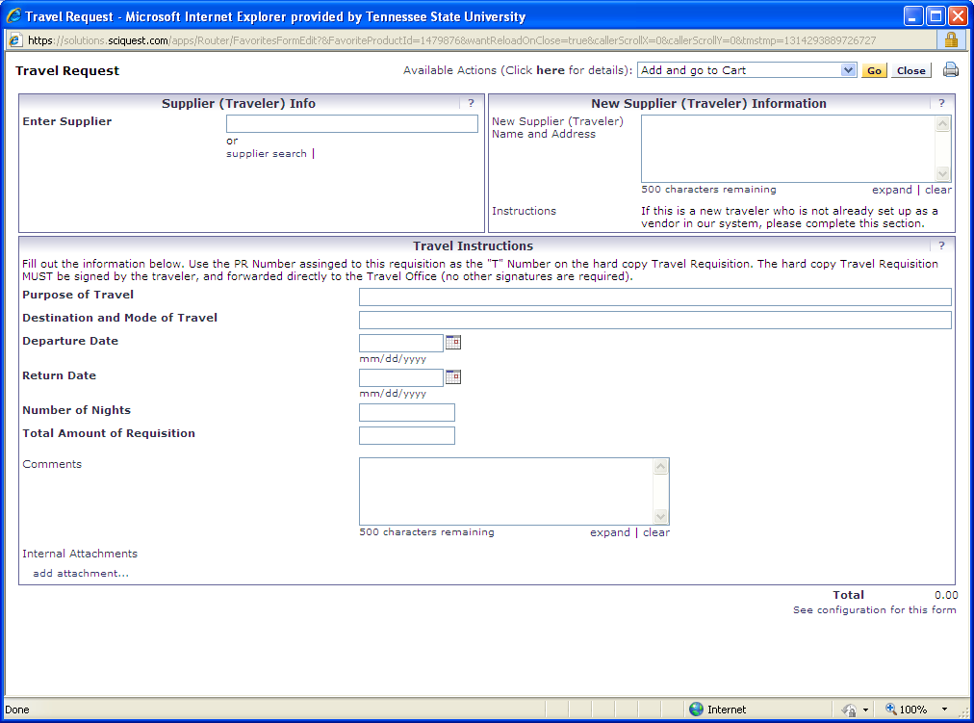
Complete the Appropriate Form

Slide 5
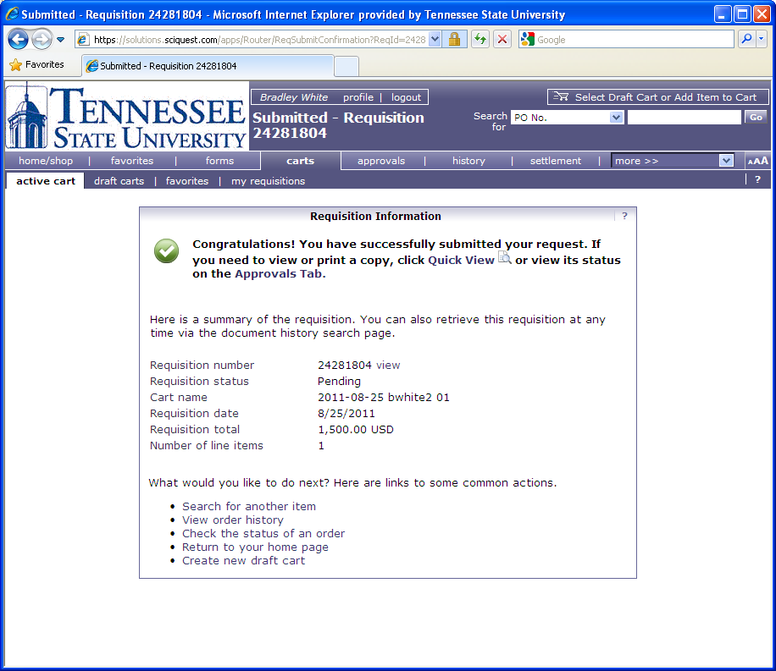
Use the SciQuest PR Number as your Travel Requisition Number

Slide 6
Click on the PR Number or View

Slide 7
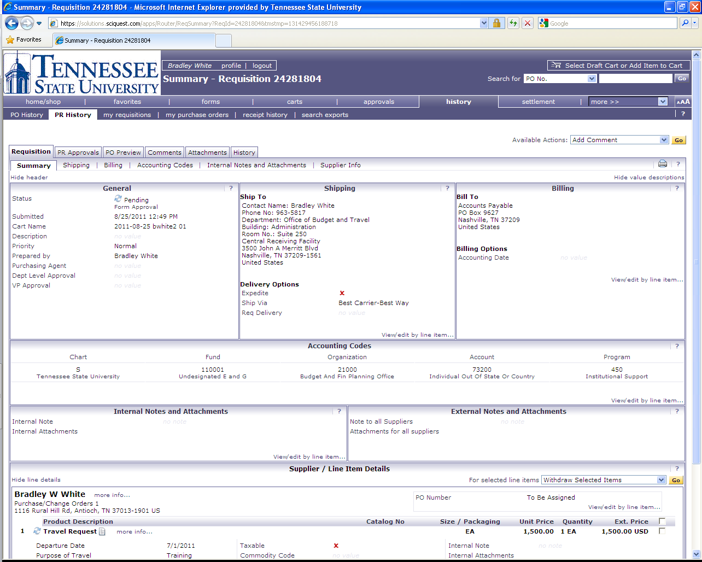
Click on Comments

Slide 8
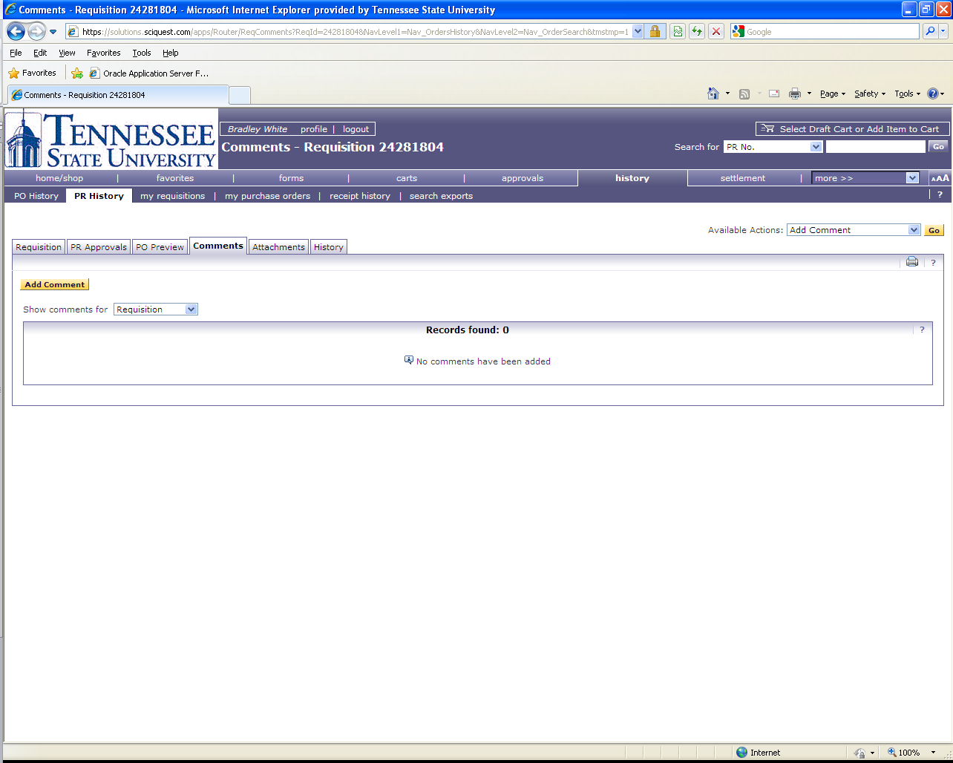
Click on Add Comment

Slide 9
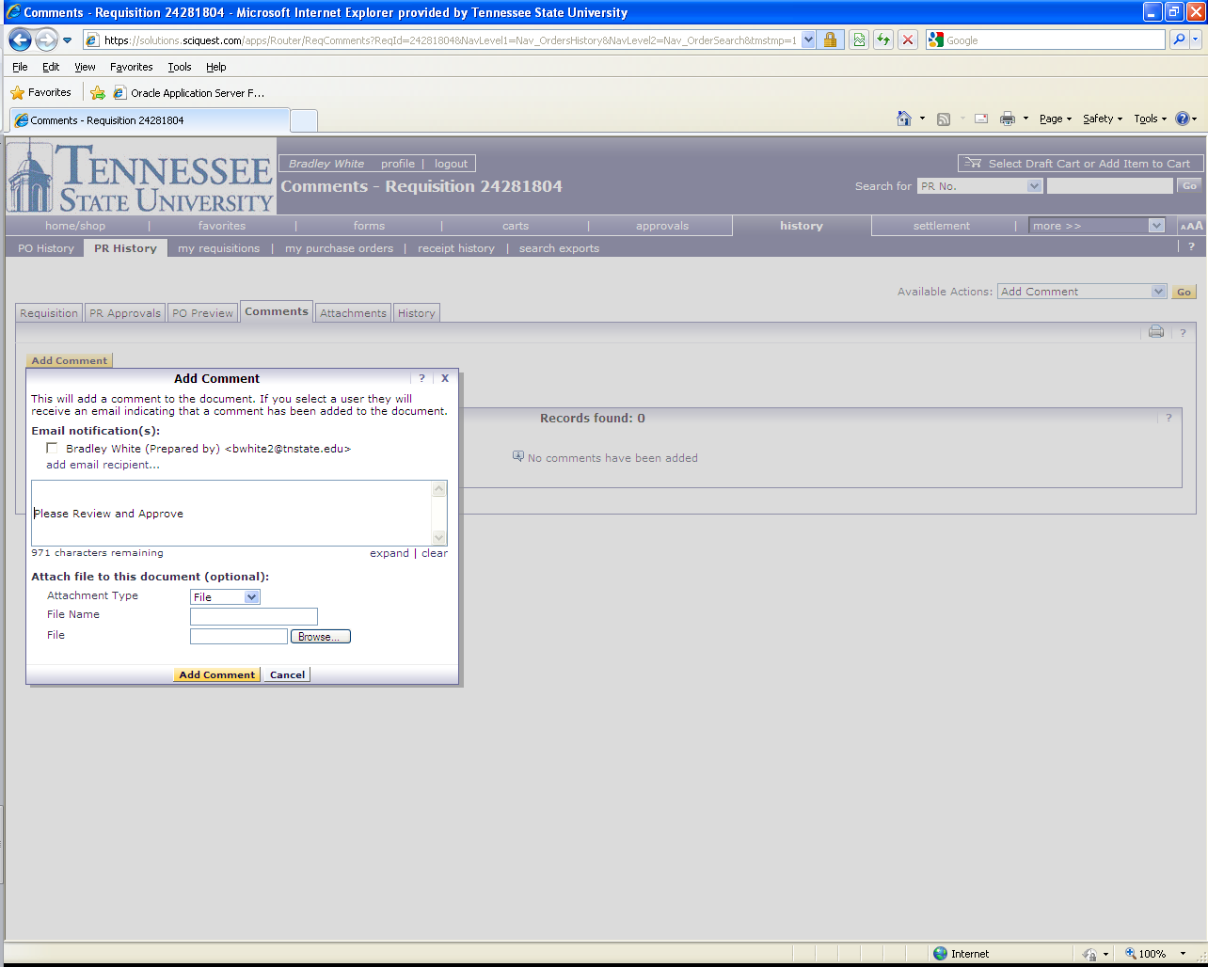
Select E mail Recipient(s) (approver(s)) and type “Please Review and Approve” in the text box

Slide 10
Other Information
There is no need to attach copies of the SciQuest generated PR to the hard copy.
Attachments are NOT required but may be submitted if you choose.
The hard copy Travel Requisition should be signed by only the traveler, and submitted to the Travel Office with all supporting documents attached.

