Slide 1
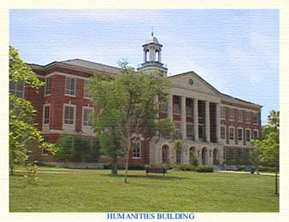
Tennessee State
University
Service Learning and Civic
Engagement

Slide 2

Workshop # 1
Developing a “True” Service-Learning Course

Slide 3
Importance of service-learning
This country cannot afford to educate a generation that acquires knowledge without ever understanding how that knowledge can benefit society or how to influence democratic decision-making.
(From The Campus Compact Presidents’ Declaration on the Civic Responsibility of Higher Education.)

Slide 4
Preliminary Understandings
Learning is a process---that has measurable outcomes.
It starts with where you are now and what you want to learn about service-learning.
You are the expert in your course and your discipline.

Slide 5
Sending students to do community service is easy!
Why do we need A workshop?
For the development of QUALITY pedagogy. Service by itself does NOT make a service-learning course.
To enhance the quality of the courses
To get the most from the service experience--both for ourselves and for our students

Slide 6
OVERVIEW OF Workshop #1
I. Theoretical model behind service- learning
II. What exactly is service-learning?
III. What is the faculty role?
IV. Benefits of service-learning
V. 7 elements of effective practice
VI. Common concerns
Support and resources available to faculty
Identifying your goals?

Slide 7
Theoretical Model
Based in John Dewey’s belief that we reflect and use prior knowledge from experiences to further our growth.
Led to new ways of thinking about education as actively connecting knowledge to experience through engagement in and reflection on the world outside the classroom.

Slide 8
National Commission on
Service-Learning definition
“…a teaching and learning approach that integrates community service with academic study to enrich learning, teach civic responsibility, and strengthen communities.”

Slide 9
Service-Learning
…….is a method of teaching that enriches
learning by engaging students in meaningful
service to the university or community through
careful integration with established curricula.
A unique aspect is that it incorporates
structured reflections on the interactions and
activities of both the learning and community
objectives (Flecky, 2009).

Slide 10
What distinguishes service-learning from other forms of experiential education?
Service-Learning involves a balance between learning goals and service outcomes.

Slide 11
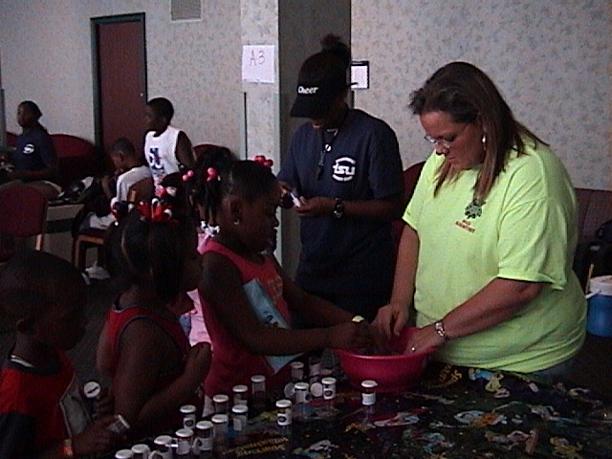
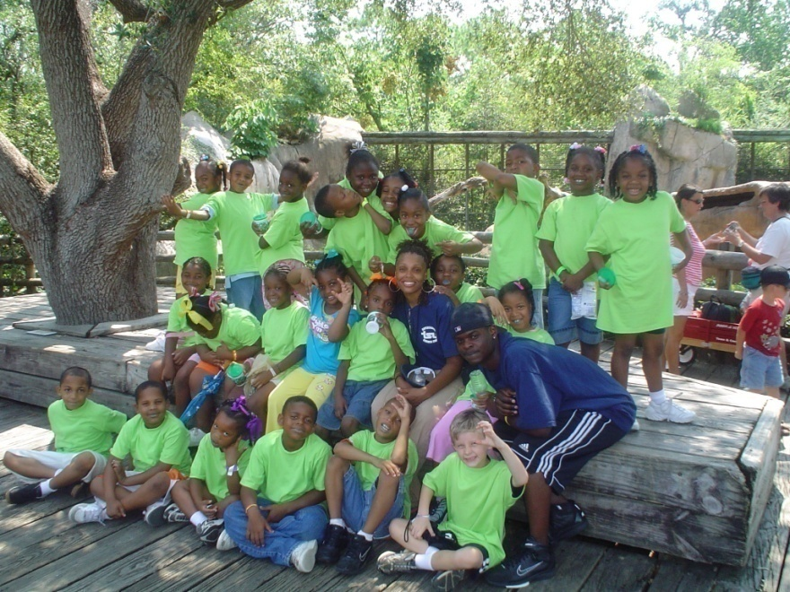
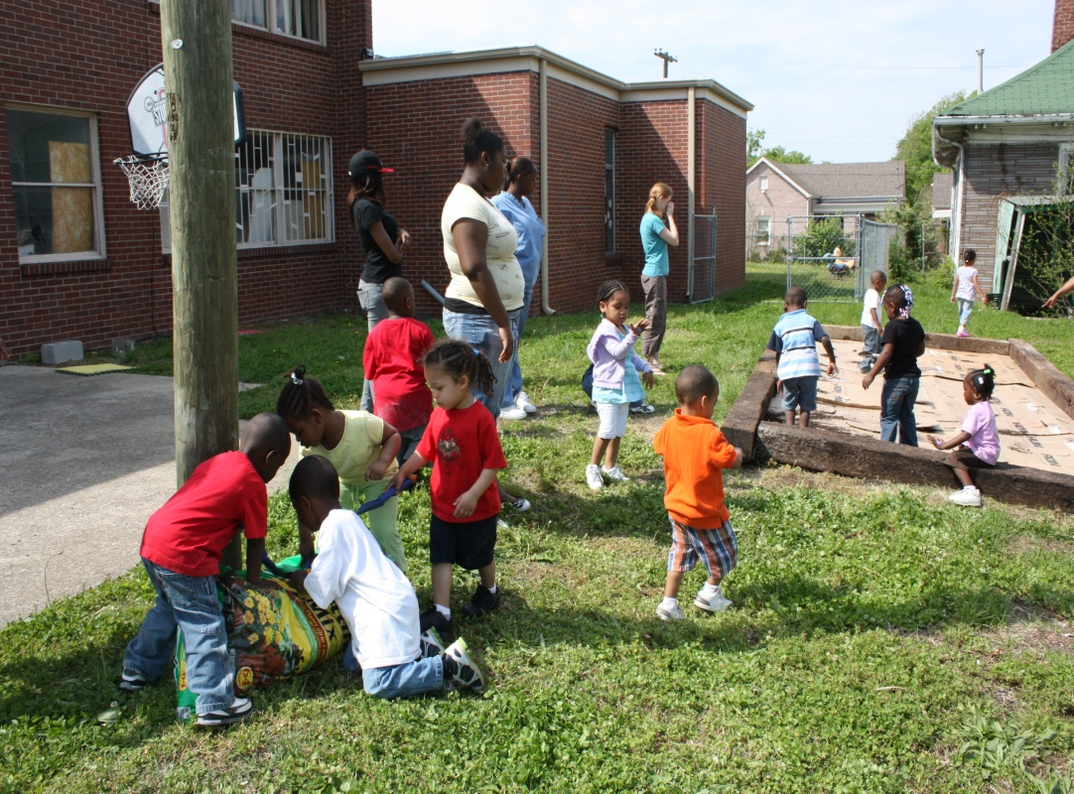
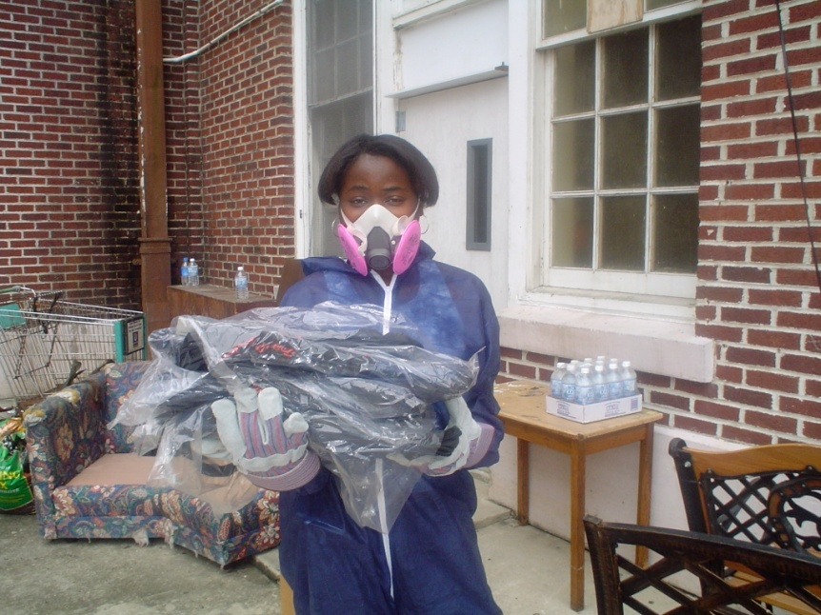
THIS is Service-Learning

Slide 12
What is the faculty role in a service-learning course?
Faculty | Directs Makes decisions Presents knowledge | Leads and learns Partners with community Works with students Asks questions to stimulate learning
Meet with Center staff to discuss implementation options & interests
May apply for Service-Learning mini-grant (see website)
Provide course description and syllabus
Work with Center for Service Learning to assist in the selection of community partners
Meet with community agencies
Introduce service-learning to students and facilitate reflection
Maintain relationship with the Center and community partners
Complete evaluations and/or reports for the grant

Slide 13
Rank your service-learning knowledge, skills, and experience
On a scale from 1 to 10
1 = You have heard the term “service-learning”
5 = You have taught SL classes
10 = You could be teaching this workshop

Slide 14
WHY SERVICE-LEARNING??
When effectively implemented,
service-learning has many
benefits for students, faculty,
community members, and the
University.

Slide 15
STUDENT BENEFITS – research has found
Increased student learning and motivation
Deeper understanding of subject matter and complex social issues
Ability to apply course material in “real life” situations
Opportunity to learn from classmates’ experiences
Opportunities for collaboration and leadership experiences
Teaches job skills and prepares students for careers after college
Promotes deeper learning instead of looking for "right answers" in the back of the book!

Slide 16
FACULTY BENEFITS
New areas for research and publication
Increased opportunities for recognition and rewards
Improved student discussion and participation
Enriched approach for fostering learning
Increased opportunity to engage students of all learning styles
New relationships with students and community members
Improved understanding of how learning occurs

Slide 17
COMMUNITY BENEFITS
Additional energy, enthusiasm, and resources for problem-solving
Improved relationship with university and access to university resources
Opportunity to recruit students as long term volunteers
Future staff potential

Slide 18
UNIVERSITY BENEFITS
Opportunity to be a model service-learning program for other universities
Improved student retention
Improved school-to-work transition
Improved standing in the community
Demonstrate action for the public good

Slide 19
Service-Learning
contributes to civic learning
encourages a sense of civic responsibility
reduces stereotypes
strengthens the ability to empathize with others
promotes a more democratic citizenry

Slide 20
Teaching
Research
S-L as
Research
S-L as Community Development
Service
S-L in
YOUR COURSE
S-L as Civic
Engagement
S-L as Content
and Pedagogy
S-L as Service
Why Service-Learning in the Academy?

Slide 21
How does SL change your course?

Slide 22
Service-learning is not:
An episodic volunteer program
An add-on to an existing school or college curriculum
Completing minimum service hours in order to graduate
Service assigned as a form of punishment
Only for high school or college students
One-sided: benefiting only students or only the community

Slide 23
The Seven Elements of High-Quality Service-learning
1.Integrated Learning- clearly articulated learning outcomes
2. High Quality Service- meet actual community need
3. Collaboration- all partners benefit and contribute
4. Student Voice- students actively plan & participate
5. Civic Responsibility- contribute to and impacts the community
6. Reflection- connect service & academic learning
7. Evaluation- measure learning & service goals

Slide 24
1. Integrated Learning
– clearly articulated connection to course goals
The service-learning project has clearly articulated knowledge, skill, or value goals that arise from broader academic and/or developmental learning goals of the program.
The service informs the learning content, and the learning content informs the service.
Life skills learned in the community setting are integrated into program-based learning.
Notes:
Seven elements

Slide 25
2. High-Quality Service
– meet actual community needs
The service responds to the actual community need that is recognized by the community.
The service is age-appropriate and well organized.
The service is designed to achieve significant benefits for students and community.

Slide 26
3. Collaboration
- all partners benefit and contribute
The service-learning project is a collaboration among as many of these partners as is feasible: students, parents, community-based organization staff, after-school program staff, school and program administrators, teachers and recipients of the service.
All partners benefit from the project and contribute to its planning.

Slide 27
4. Student Voice
-students actively plan & participate
choosing and planning the service project;
planning and implementing the reflection sessions, evaluation, and celebration;
taking on roles and tasks that are appropriate to their age.

Slide 28
Civic Responsibility
- contribute to and impact the
community
The service-learning project promotes students’ responsibility to care for others and to contribute to the community.
By participating in the service-learning project, students understand how they can affect their community in positive ways.

Slide 29
6. Reflection
- connect service & academic learning
Reflection establishes connections between students’ service experiences and the academic/developmental learning curriculum.
Reflection occurs before, during, and after the service-learning project.

Slide 30
7. Evaluation
- measure learning & service goals
All the partners, especially students, are involved in evaluating the service-learning project.
The evaluation seeks to measure progress toward the learning and service goals of the project.

Slide 31
Planning for High Quality
Service-Learning
Develop and improve course syllabi and service-learning components over time
Collaborate with community partners to improve practices
Use the Center as a resource

Slide 32
Logistics and Support
Before the semester begins:
  Modify your course syllabi
  Consult with S-L staff to discuss support needs if any
  Identify criteria for partner agencies and S-L activities
  Identify partner agencies and S-L activities
  Meet with community partners to discuss mutual needs

Slide 33
Resources
Campus Compact (www.compact.org)
  Sample syllabi in a wide variety of disciplines
  Curriculum guides and publications
  Professional development opportunities
  Grants and awards
  Service Learning Center & Staff (www.tnstate.edu/servicelearning)
  Assistance with projects
  Class presentations
  Community partner database
  Evaluation instruments
  Service-learning mini-grants

Slide 34
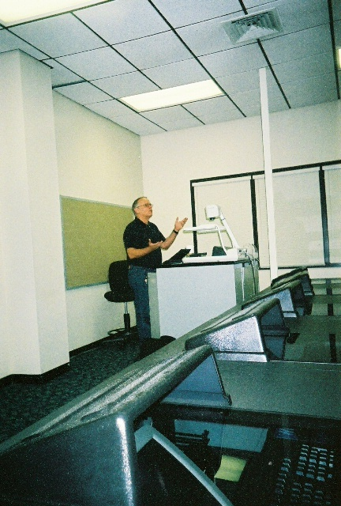
Diversity of Service Learning Projects
Consumer
Sciences
Institute
of
Government
Arts &
Sciences
Engineering
Service
Learning
Business
Education
Nursing
Health
Sciences

Slide 35
EXAMPLE OF Cross-Disciplinary
Collaborations
Dental
Screening
& Cleaning
Nursing
Speech &
Hearing
Grace
Eaton
Daycare
Health
Education
Physical
Therapy
Early
Childhood
Education

Slide 36
Cross Disciplinary
Education Programs
Literacy
Programs
Tutoring
Computer Skills
After-School
Education
Community
Chorus
Mentoring

Slide 37
“The true challenge in creating a culture of service is not merely about engaging students in service, but about creating an institutional culture that is itself committed to the community outside of its walls.”

