Slide 1
Service-learning: Learning through doing
Center for Service Learning and Civic Engagement

Slide 2
What exactly is “service-learning”
It is a structured learning experience within an academic course.
  Service work is directed toward achieving course learning objective/s and toward making meaning contributions.
  Service activity is used to clarify, illustrate, challenge, or stimulate additional thought about academic content of the course.
  Structured written and/or oral reflection ties the service experiences to academic content.

Slide 3
Planned reflection is necessary in the service-learning process.
Course learning objectives should be linked to meaningful human, safety, educational, and environmental needs.
Course materials such as lectures, readings, and discussions are then applied by students directly to support or enhance community needs.

Slide 4
Service-learning takes different approaches

Slide 5
Types of Service-learning
Direct Service-learning
  Person-to-person, face-to-face service projects
Indirect Service-learning
  Working on broad issues, environmental projects
Advocacy Service-learning
  Educating others about topics of public interest
Research-based Service-learning
  Gathering and presenting information on areas of interest and need
Notes:
Direct service to people in need; policy analysis; community outreach and education; program assessment and improvement of community resources; organization for action on social, health, safety, or environmental issues; applied research

Slide 6
Direct Service-learning
Examples:
  Tutoring other students and adults
  Conducting art/music/dance lessons for younger students
  Helping other students resolve conflicts
  Creating life reviews for Hospice patients
  IMPACT on/skills practiced: caring for others, dependability, interpersonal skills, problem-solving, “big picture” learning

Slide 7
Indirect Service-learning
Examples:
  Compiling a town history
  Restoring historic structures or building low-income housing
  Restoring ecosystems
  Preparing preserve areas for public use
  IMPACT on/skills practiced: cooperation, teamwork skills, playing different roles, organizing, prioritizing, project-specific skills

Slide 8
Advocacy Service-learning
Examples:
  Planning and putting on public forums on topics of interest in the community;
  Conducting public information campaigns on topics of interest or local needs;
  Working with elected officials to draft legislation to improve communities;
  Training the community in fire safety or disaster preparation.
  IMPACT on/skills practiced: understanding rules, systems, processes; engaged citizenship, working with adults.

Slide 9
Research-based
Examples:
  Writing a guide on available community services;
    Translating it into Spanish or other languages of new residents
  Conducting longitudinal studies of local bodies of water; water testing for local residents;
  Gathering information and creating brochures or videos for non-profit or government agencies;
  Mapping state lands and monitoring flora and fauna;
  Conducting surveys, studies, evaluations, experiments, interviews, etc.
  IMPACT on/skills practiced: learn how to learn/get answers/find information, make discriminating judgments, work systematically, organizational skills, how to assess, evaluate and test hypotheses.

Slide 10
How much time should be allotted to the service learning portion of the course?
  The “rule of thumb” is that for the student it includes:
    the preparation and analysis time,
    the time for written and oral reflection, and
    the actual time spent in the community. (Actual time is suggested that service be at least 20 hours).

Slide 11
What % of final grade should the service learning activity?
To qualify as a service-learning course, 15% of the student’s grade should be based on this activity.

Slide 12
Best practices for grading service-learning assignments:
A well-structured grading rubric!
Evaluation of student’s ability in meeting course learning objectives – grade for their learning – not their service.
Do not have a “service” grade and a “just learning” grade.
Do grade on the final, tangible project deliverable/s which demonstrates the students’ learning.
Notes:
Tells what is expected, how held accountable, clarify confusion/anxiety, and reinforce role of service-learning in course.

Slide 13
Setting standards in advance! Developing a rubric!
Structured
Specific
Concrete
Provide examples of past good work

Slide 14
Components of the grade
Major assignment:
papers, presentations, test questions can connect service experience to course content.
Supporting reflection assignment:
Use guided questions to compel students to think critically and share through blogs, reflection papers, class discussions.
Additional feedback:
Seek feedback from community partner where student is providing service
Compliance with deadlines:
Handing in forms on time, communicating with faculty, completing the Service learning evaluation at end of semester

Slide 15
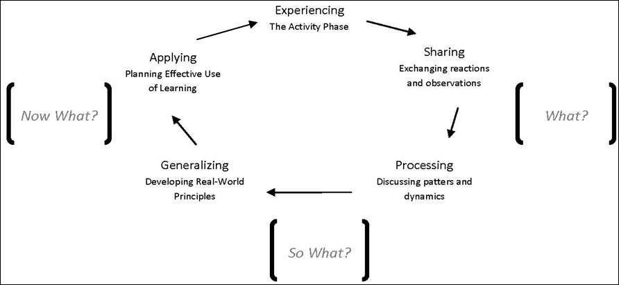
Reflection is the key to the experiential learning cycle

Slide 16
Review your syllabus
What learning objectives would best be augmented by service-learning?

