Slide 1
S.i.r.
Modeling Epidemics with Differential Equations
Ross Beckley, Cametria Weatherspoon, Michael Alexander, Marissa Chandler, Anthony Johnson, Ghan Bhatt
Notes:
Introduce the group and what SIR is

Slide 2
Topics
The Model
  Variables & Parameters, Analysis, Assumptions
Solution Techniques
Vaccination
Birth/Death
Constant Vaccination with Birth/Death
Saturation of the Susceptible Population
Infection Delay
Future of SIR
Notes:
Go over the different topics of discussion- please do not simply read the slide. These people can read.

Slide 3

Variables & Parameters
$S+I+R=1$
  [S] is the susceptible population
  [I] is the infected population
  [R] is the recovered population
  1 is the normalized total population in the system
The population remains the same size
No one is immune to infection
Recovered individuals may not be infected again
Demographics do not affect probability of infection
Notes:
The population remains the same size for the basic SIR model, until birth/death are introduced
No one is immune to infection until vaccination is incorporated
Talk about these assumptions, paying special attention to how demographics is not incorporated in this model
Talk about how we will attempt to eliminate most of these assumptions by adding in birth/death, vaccination

Slide 4

Variables & Parameters
$\frac{∂S}{∂t}=−αSI$
  [α] is the transmission rate of the disease
$\frac{∂I}{∂t}= αSI − βI$
  [β] is the recovery rate
$\frac{∂R}{∂t}= βI$
The population may only move from being susceptible to infected, infected to recovered:
$$S→I→R$$
Notes:
Explain these formulas and what they mean
The changing rate of the susceptible population is proportional to α, the transmission rate of the disease. Why?
The changing rate of the infected population is proportional to the transmission rate, α, and the recovery rate, β.
Initially, this is a closed system: the population may only be moved from S to I to R. Later, we will incorporate a certain % of newborns being vaccinated, moving them directly into the Recovered pool.

Slide 5

Variables & Parameters
$R_{0}$ is the Basic Reproductive Number- the average number of people infected by one person.
Initially, $R_{0}= \frac{αS}{β}= \frac{α}{β}$
The representation for $R_{0}$ will change as the model is improved and becomes more developed.
[$R_{0}$] is the metric that most easily represents how infectious a disease is, with respect to that disease’s recovery rate.
Notes:
Talk about R_0 and why it is important for our model
S

Slide 6

Conditions for Epidemic
An epidemic occurs if the rate of infection is > 0
  If $I^{′}>0$, and $R_{0}= \frac{α}{β}$
    $I^{′}= αSI − βI>0$
    It follows that an epidemic occurs if $R_{0}>1$
  Moreover, an epidemic occurs if $S> \frac{β}{α}$
Notes:
Talk about what it means for an epidemic to occur- if the rate of infection is positive, people are infected at a positive rate, therefore epidemic.

Slide 7

Solution Techniques
Determine equilibrium solutions for [I’] and [S’]. Equilibrium occurs when [S’] and [I’] are 0:
  $\frac{∂S}{∂t}=−αSI=0$
  $\frac{∂I}{∂t}= αSI − βI=0$
  Equilibrium solutions in the form ($S_{1}, I_{1})$ and $(S_{2}, I_{2})$:
    $\left(0,0\right) and (\frac{β}{α}, 0)$

Slide 8

Solution Techniques
Compute the Jacobian Transformation:
  General Form: $J= \left[\begin{matrix}f_{x} & f_{y} \\ g_{x} & g_{y}\end{matrix}\right]$
  $$J=\left[\begin{matrix}−αI & −αS \\ αI & αS−β\end{matrix}\right]$$

Slide 9
Solution Techniques
Evaluate the Eigenvalues.
  Our Jacobian Transformation reveals what the signs of the Eigenvalues will be.
  A stable solution yields Eigenvalues of signs (-, -)
  An unstable solution yields Eigenvalues of signs (+,+)
  An unstable “saddle” yields Eigenvalues of (+,-)
Notes:
What does it mean to have a stable solution and unstable solution?

Slide 10
Solution Techniques
Evaluate the Data:
  Phase portraits are generated via Mathematica.
Susceptible Vs. Infected Graph
Unstable Solutions deplete the susceptible population
There are 2 equilibrium solutions
One equilibrium solution is stable, while the other is unstable
The Phase Portrait converges to the stable solution, and diverges from the unstable solution

Slide 11
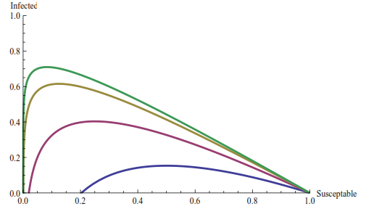



Solution Techniques
Evaluate the Data:
  Another example of an S vs. I graph with different values of [$R_{0}$].
12
9
5
2
Typical $R_{0}$ Values
  Flu: 2
  Mumps: 5
  Pertussis: 9
  Measles: 12-18
$$R_{0}$$

Slide 12

Herd Immunity
Herd Immunity assumes that a portion [p] of the population is vaccinated prior to the outbreak of an epidemic.
New Equations Accommodating Vaccination:
  $S^{′}=−α\left(1−p\right)SI$
  $I^{′}=$ $α\left(1−p\right)SI−βI$
An outbreak occurs if
  $I^{′}>0$, or
  $R_{0}> \frac{1}{1−p}$

Slide 13

Critical Vaccination
Herd Immunity implies that an epidemic can be prevented if a portion [p] of the population is vaccinated.
  Epidemic: $R_{0}> \frac{1}{1−p}$
  No Epidemic: $R_{0}< \frac{1}{1−p}$
  Therefore the critical vaccination occurs at $R_{0}= \frac{1}{1−p_{c}}$, or $p_{c}=1 − \frac{1}{R_{0}}$
    In this context, [$p_{c}$] is also known as the bifurcation point.

Slide 14

Sir with birth and death
Birth and death is introduced to our model as:
  The birth and death rate is a constant rate [m]
The basic reproduction number is now given by:
$$R_{0}= \frac{α}{β+m}$$

Slide 15
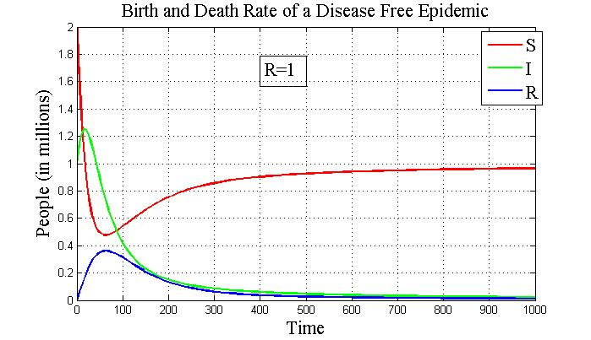
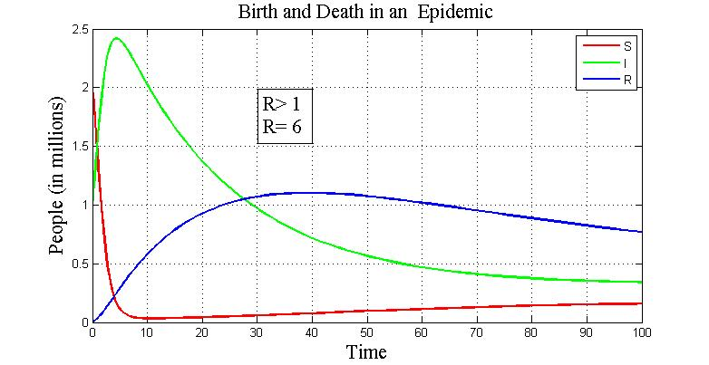


Sir with birth and death
Disease free equilibrium
($S_{1}$, $I_{1}$) $=$ $\left(1,0\right)$
Epidemic equilibrium
$(S_{2}$, $I_{2}$)$=(\frac{β+𝓂}{α}$, $\frac{𝓂}{α}(R_{0}−1)$

Slide 16

Sir with birth and death
Jacobian matrix
$J_{1}$($S_{1}$,$I_{1}$)$=\left(\begin{matrix} −m & −a \\ 0 & a−B−m\end{matrix} \right)$
$J_{2}$($S_{2},I_{2})=\left( \begin{matrix}−m−\left(Ro−1\right)m & \frac{−a}{Ro} \\ \left(Ro−1\right)m & 0\end{matrix} \right)$

Slide 17
Constant Vaccination At Birth
New Assumptions
  A portion [p] of the new born population has the vaccination, while others will enter the population susceptible to infection.
  The birth and death rate is a constant rate [m]

Slide 18

Constant Vaccination At Birth
Parameters
  $p= \% of newborn population vaccinated$
  $m=rate of newborn and death rate$
Susceptible
  $S′=\left(1−p\right)m−\left(αI+m\right)s$
Infected
  $I′=αsI−βI−mI$

Slide 19

Parameters of the Model
$R_{0}=$ The initial rate at which a disease is spread when one infected enters into the population. $R_{0}= \frac{α}{β+m}$
p = number of newborn with vaccination
  $$α\left(1−p\right)−β−m<1$$
$$α\left(1−p\right)<β+m$$
$1−p<\frac{β+m }{α}$
$1−p<\frac{1}{R_{0}}$
$R_{0}= \frac{1}{1−p}$ < 1 Unlikely Epidemic
$R_{0}= \frac{1}{1−p}$> 1 Probable Epidemic

Slide 20

Parameters of the Model
$p_{c}$= critical vaccination value
$$p_{c}=1−\frac{1}{R_{0}}$$
  For measles, the accepted value for $R_{0}=18$, therefore to stymy the epidemic, we must vaccinate 94.5% of the population.

Slide 21

Constant Vaccination Graphs
Susceptible Vs. Infected
Non epidemic
$R_{0}$ < 1
p > 95 %

Slide 22

Constant Vaccination Graphs
Susceptible Vs. Infected
Epidemic
$R_{0}$ > 1
$p$< 95 %

Slide 23
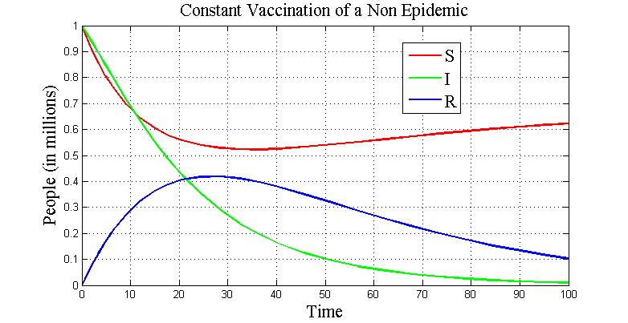
Constant Vaccination Graphs

Slide 24
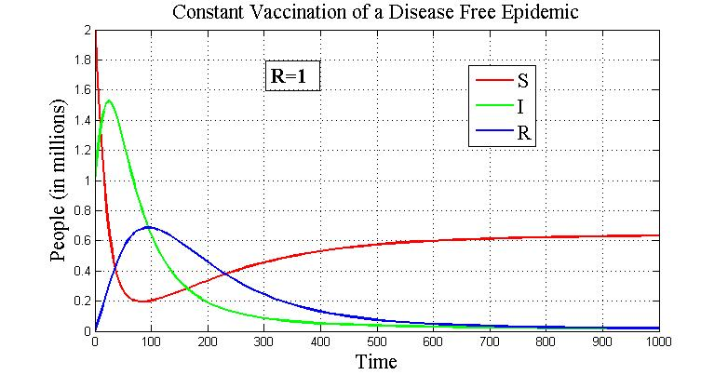
Constant Vaccination Graphs
Constant Vaccination Moving Towards Disease Free

Slide 25

saturation
New Assumption
We introduce a population that is not constant.
S + I + R ≠ 1
$r$is a growth rate of the susceptible
K is represented as the capacity of the susceptible population.

Slide 26

saturation
The Equations
Susceptible
$S^{′}=rs(1−\frac{s}{k}$)$−αsI$
$r$ = growth rate of birth
$k$= capacity of susceptible population
Infected
$I^{′}=αsI−βI−mI$
$m$= death rate

Slide 27

The Delay Model
People in the susceptible group carry the disease, but become infectious at a later time.
[r] is the rate of susceptible population growth.
[k] is the maximum saturation that S(t) may achieve.
[T] is the length of time to become infectious.
[σ] is the constant of Mass-Action Kinetic Law.
  The constant rate at which humans interact with one another
  “Saturation factor that measures inhibitory effect”
$S+I+R 1$
Saturation remains in the Delay model.
The population is not constant; birth and death occur.

Slide 28

The Delay Model
$S^{′}=rS−\frac{rS^{2}}{K}−\frac{αSI\left(t−T\right)}{1+σS}$
$I^{′}= \frac{αSI(t−T)}{1+σS}−mI−βI$

Slide 29
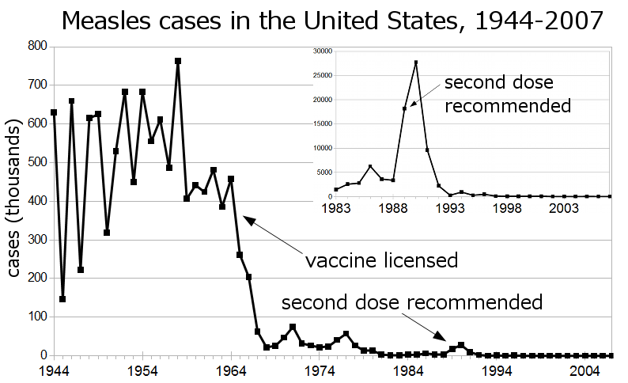
The Delay Model
U.S. Center for Disease Control

Slide 30
Future S.I.R. Work
Eliminate Assumptions
  Population Density
  Age
  Gender
  Emigration and Immigration
  Economics
  Race

