Slide 1
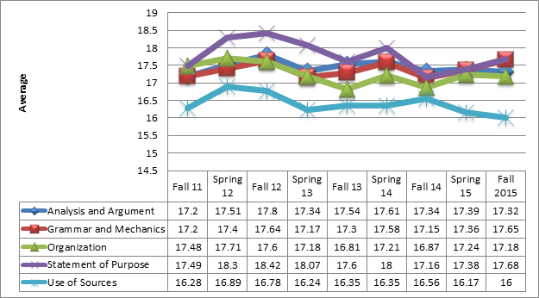
Sophomore History
This table highlights the results from the sophomore history rubric and also shows students’ improvement in writing and growth in the use of the rubric with 193 students being evaluated in fall 2011 to 450 students in fall 2015

