Slide 1
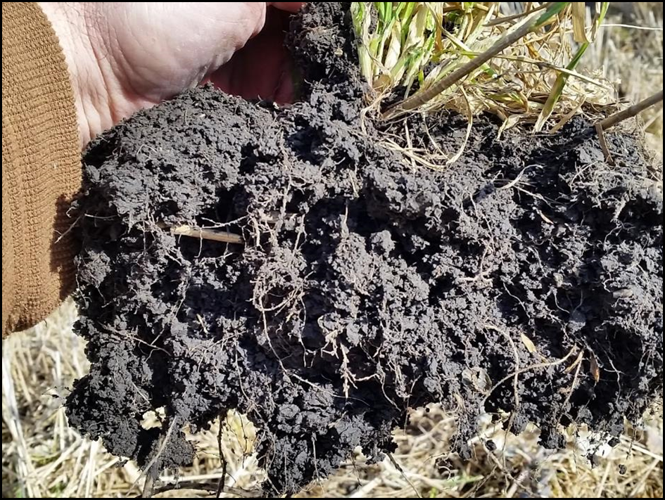
Module 4: Soil Health Indicators
Notes:
In this module we will be identifying soil health indicators that can be identified in the field to determine how well the soil health principles are being applied.

Slide 2
Learning objectives:
By the end of this lesson you will be able to:
Describe what soil health indicators are and which ones are used to evaluate soil health in the field and/or laboratory.
Describe how soil health indicators provide information about a range of critical soil processes, and build upon each other for an understanding of soil health status
Describe how key soil health indicators are linked to the soil health principles.
Discuss soil organic matter, the various SOM pools and their role in soil health.
Discuss aggregate stability, its role in soil function and how it can be affected by management.
Discuss how nutrient cycling is affected by degraded soil function
Describe the “Regenerative Systems” for healthy soils
Notes:
The learning objectives for this module.

Slide 3
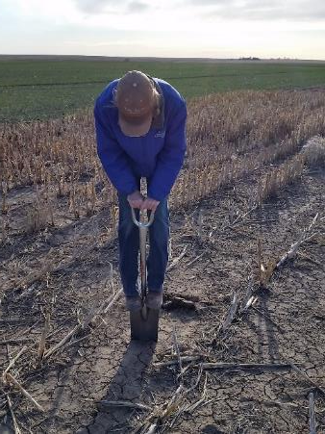
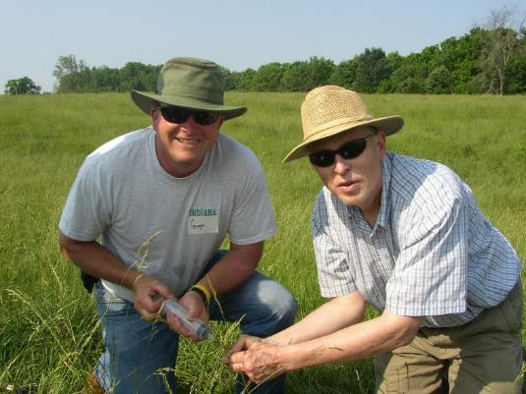
How will you know if you are on the right track?
There are many Soil Health Indicators
  Some are Qualitative
  Some are Quantitative
  Some are best measured in a lab
  Some can be observed or measured in the field
Notes:
There are many indicators of soil health and soil quality. Most of these can be measured and quantified in a lab or a field assessment. For example, indicators like organic matter content and water stable aggregates need to be measured in a lab but soil morphological features that relate to soil health along with testing for water infiltration or pH/EC can be done in the field with the right equipment. (This is the equipment that is part of your soil health test kits!).
Qualitative measurements are based more on observation and professional judgment whereas quantitative measurements are usually done with laboratory or field equipment.

Slide 4
Soil Health Indicators
As Conservation and Agriculture Professionals, we must have a clear understanding of key Soil Health Indicators.
These Key Soil Health Indicators link evidence-based knowledge to soil health.
Notes:
Again, these soil health indicators relate to how well the soil health principles are being applied.

Slide 5
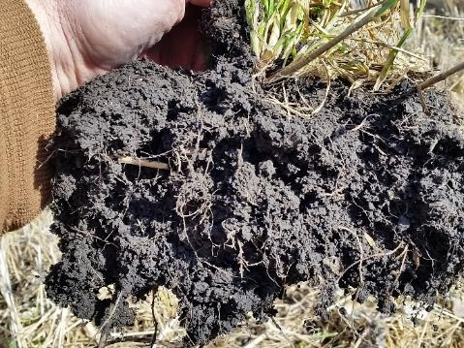
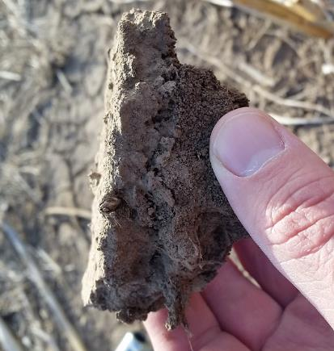
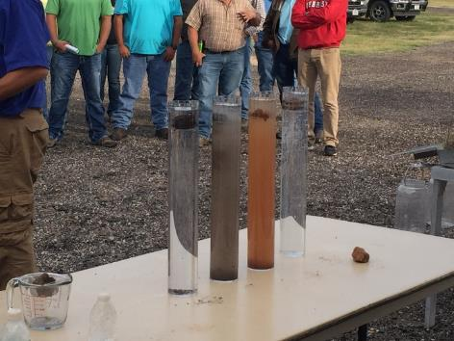
Making Soil Health a Priority!
What does Soil Health mean?
Soil Health Indicators =
  organic matter
  aggregate stability
  water infiltration
  available water capacity
  nutrient cycling
  soil biology
  erosion and ….
Notes:
There are many indicators of soil health and soil quality. Key indicators are broadly understood as important soil characteristics for production and ecosystem services.

Slide 6
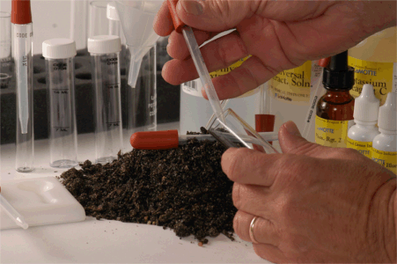
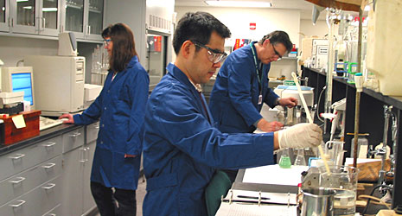
Making Soil Health a Priority!
What does Soil Health mean?
Soil Health Indicators =
  structure
  respiration
  enzymes
  CEC
  pH
  bulk density
  macro pores/earthworms….
  …+ more to come
Notes:
Soil health assessments are important to know where you are (a baseline). A soil quality assessment can also tell you what are the inherited soil traits as well as current levels of dynamic soil properties.
Standard soil tests provide some indicators related to the chemical side of the soils, but don’t give a complete analysis of what is taking place with the biology or the physical nature of the soil.

Slide 7
Making Soil Health A Priority=
Taking a Soil Health Journey
What does Soil Health mean?
Soil Health Indicator actions =
  Improving organic matter
  Improving aggregate stability
  Improving water infiltration
  Improving available water capacity
  Improving nutrient cycling
  Balancing and diversifying soil biology
  Eliminating erosion
Minimize Disturbance
Maximize Soil Cover
Maximize Biodiversity
Maximize Presence of Living Roots
Notes:
Soil health is a constant building process, and implementing conservation cropping and grazing systems that improve soil health should meet or fulfill all the objectives identified on the slide. These objectives will be relevant to farmers and most landowners. Looking at ways to “constantly” improve. These are actions that don’t stop. They build on each other.
Each one of these indicators relate to the soil health principles of 1) Minimizing disturbance, 2) Maximizing soil cover, 3) Maximizing biodiversity, and 4) Maximizing the presence of living roots. Measuring these indicators will indicate how well the soil health principles are being followed.

Slide 8
Linking Soil Health to the Literature:
Improved
Soil Organic Matter
Aggregate Stability
Soil Erosion <T
Biodiversity
Improved nutrient cycling
Increased available water
Increased water infiltration
Increased porosity
Improved air exchange
Improved Productivity
Environmental Quality
Notes:
While there is little scientific literature found that quantify the benefits of soil Health, journals contain a lot of evidence of benefits (production and environment) observed from the soil health indicators. The scientific basis for the pursuit of soil health is mostly found within the key indicators. The slide shows how these indicators are linked to these benefits.

Slide 9
Notes:
Many of these indicators are found in both qualitative and quantitative field assessments. Examples shown in the slide include lab analysis and field Soil Health Score Cards.

Slide 10
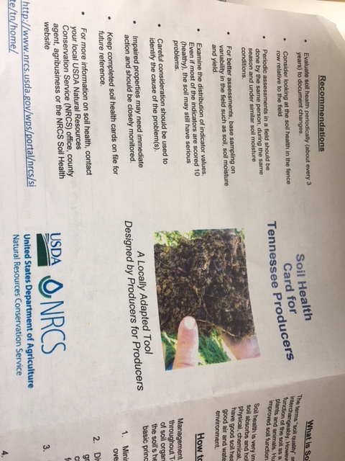
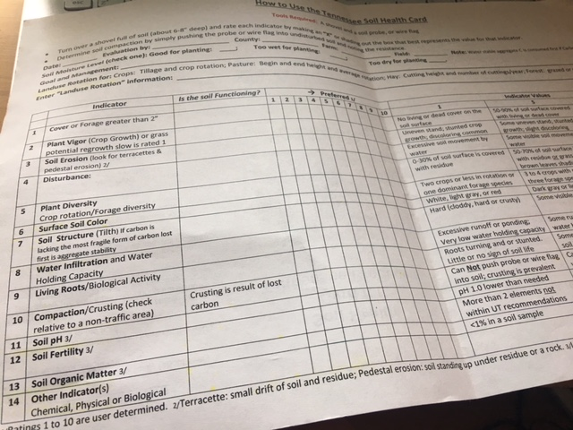
Notes:
These are examples of other soil health score cards (they vary by state) which provides a qualitative measure of soil health. An example for Tennessee is included in the Appendix of your curriculum binder.

Slide 11
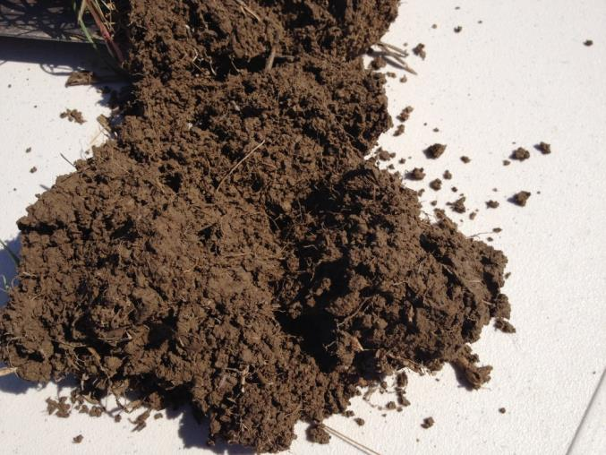
Building Management Around Soil Health Principles
We shouldn’t consider Soil Health a destination,
…but more of a journey.
Most soils aren’t in need of sustainability
…they must be regenerated.
As professionals….
  first and foremost…DO NO HARM!
You may need to remind them that a worthy goal is improving soil health
Notes:
In reality, producers who implement conservation cropping systems build soil rather than sustain or degrade it – our goal is for producers to go beyond sustainability.

Slide 12
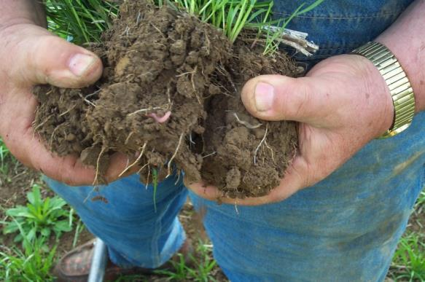
Making Soil Health A Priority = Taking a Soil Health Journey
What does Soil Health mean?
Soil Health Indicator actions =
  Improving organic matter
  Improving aggregate stability
  Increasing water infiltration
  Increasing available water capacity
  Improving nutrient cycling
  Balancing and diversifying soil biology
  Eliminating erosion
Notes:
The first soil health indicator we will focus on is organic matter.

Slide 13
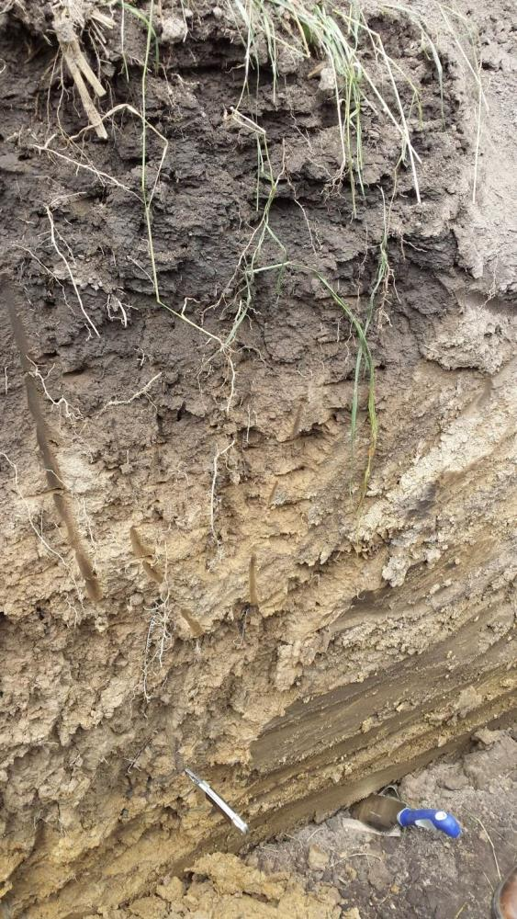
Taking the Soil Health Journey
Labile
  Increasing organic matter
  What kind
  Where
Humus
Notes:
Increasing organic matter (OM) is the foundation of improved soil health. All OM isn’t the same, however. Newer, more reactive carbon is referred to as labile and older, more stable OM is referred to as humus. Labile OM is closer to the surface while humus is distributed throughout the profile more evenly.

Slide 14
New(?) Classification of SOM Pools and Fractions
Soil Organic Matter
Labile Organic Matter
Rapid Turnover
*Humus
Protected or Slow Turnover C
Biomass
Living Organisms
Detritus
Free Identifiable dead plant material
Particulate OM
Free partially degraded plant material
Free or dissolved biomolecules, degradation products
Particulate OM
Protected bits of plant mat. & microbial cell walls
Protected biomolecules, degradation products
Char Black aromatic products of fire
*Protected on clay surfaces, soil aggregates and in ultramicropores
Adapted from: The Nature and Properties of Soils 15th Edition - Weil and Brady
Notes:
This slide depicts the different types of organic matter related to labile OM and humus. Labile OM is the most readily available for use by soil microbes. It is the first to be lost and is affected more by management, e.g. tillage
Humus is more protected
Some of these pools do not show up in standard soil test conducted in the lab

Slide 15
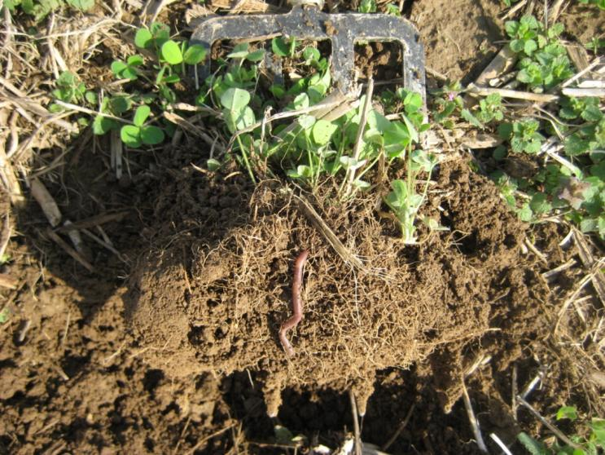
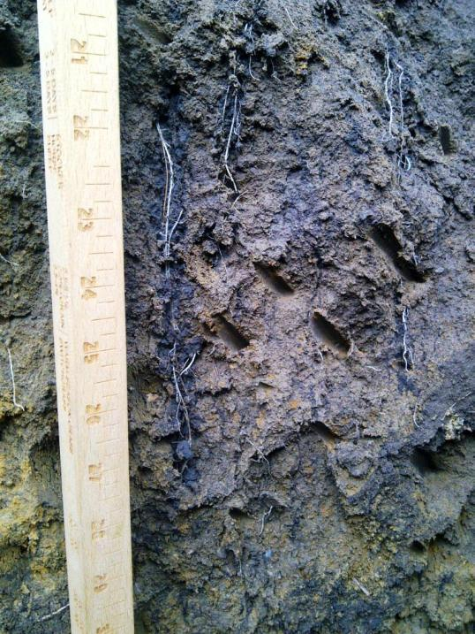
Where are Carbon Pools Building?
Maybe it occurs
6- 40 cm (16”)?
Most occurs 0-6 cm (2.36”)
previous bean root
rye root
and earthworm
Notes:
Historically, most studies and measurements of SOM have been performed using samples from the 6-8” depth. Spend much time at soil health field days - in soil pits that are in long term SHMS and you’ll find there is more to the story. Wherever SOM pools are being built, those new additions are very fragile. If we do even shallow tillage, most reactive carbon will be lost. If we do no tillage and add cover, then over time we can built a bank of reactive carbon deep in the soil profile as we expand the rhizosphere and drillosphere. This can eventually become more stable over time by transforming into humus.

Slide 16
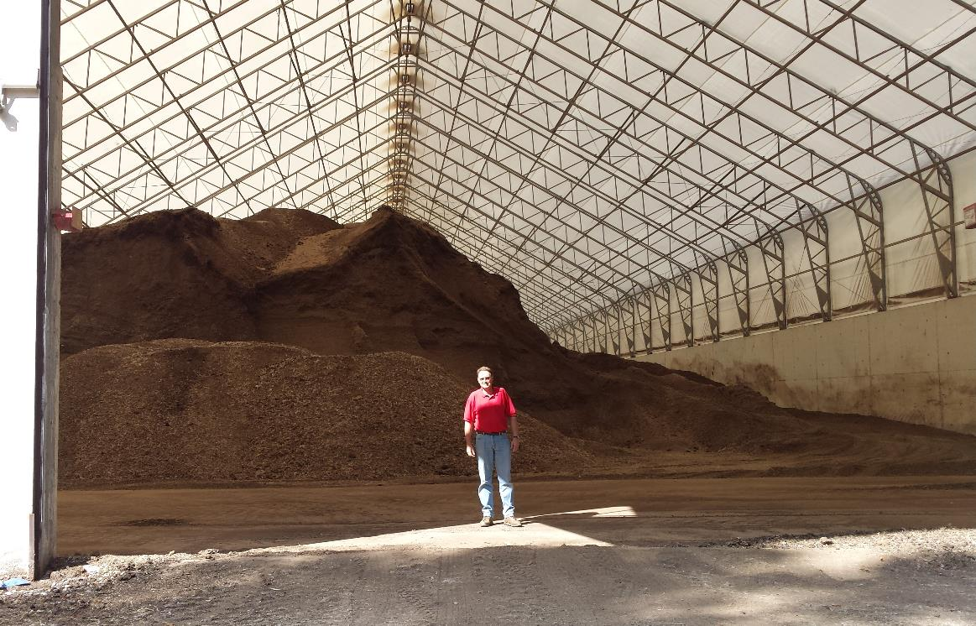
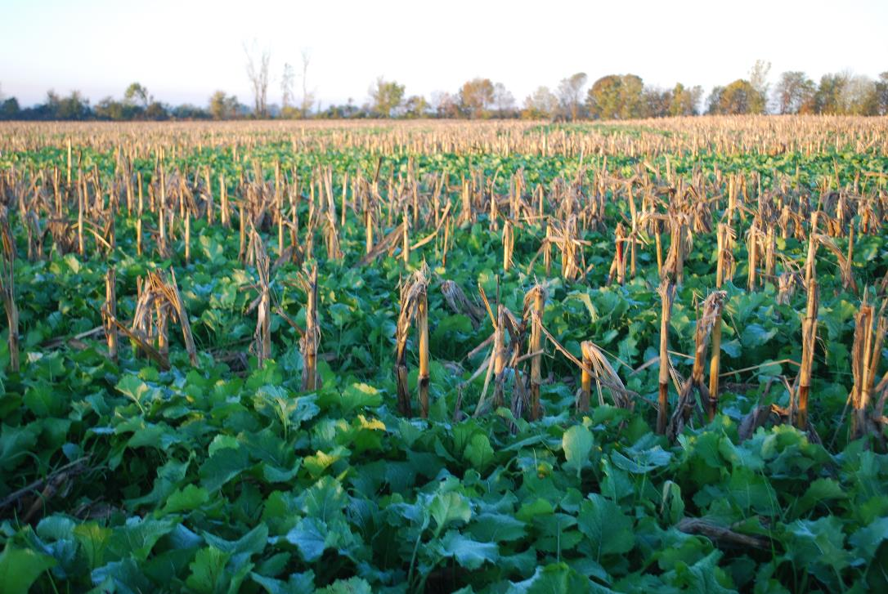
Artificial vs Systematic Improvements
Notes:
Both artificial and systematic options are available for improving soil function. We need to know more about sources to make sure we do no harm.
Artificial improvements are usually associated with applying amendments or hauling in biomass. They can be easily over applied, or in some cases contain undesirable materials.
Systematic tends more toward using management (Soil Health Management Principles) to enhance natural process like photosynthesis and biodiversity to enhance function. The latter tends to be more sustainable over the long haul.

Slide 17
Making Soil Health a Priority = Taking a Soil Health Journey
What does Soil Health mean?
Soil Health Indicator actions =
  Improving organic matter
  Improving aggregate stability
  Increasing water infiltration
  Increasing available water capacity
  Improving nutrient cycling
  Balancing and diversifying soil biology
  Eliminating erosion
Notes:
We will now focus on the importance of aggregate stability as a soil health indicator.

Slide 18
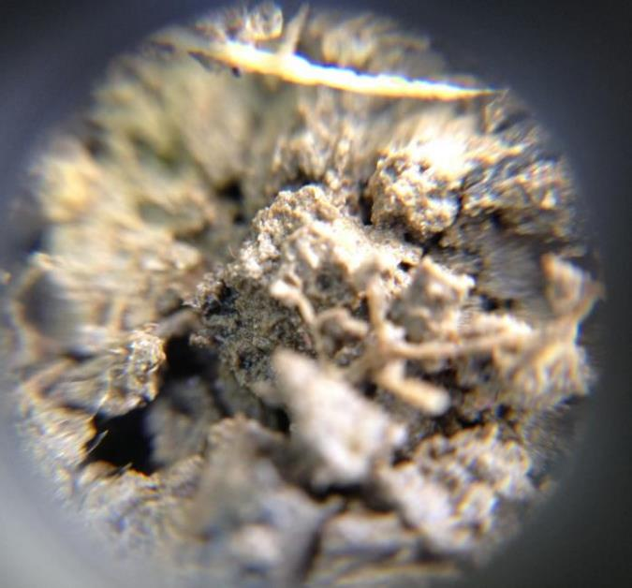
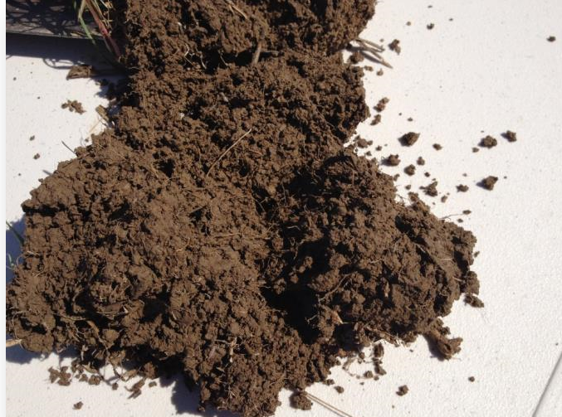
Making Soil Health A Priority!
Soil Health Key Indicators = Improving aggregate stability
  Critical for infiltration
  Water holding capacity
  Nutrient cycling
  Needs biology to improve
Notes:
Aggregate stability is critical for infiltration, water holding capacity, and nutrient cycling. It allows the soil to breathe, giving oxygen to diverse organisms. Field investigation with a shovel or maybe a field microscope can be very revealing. The only way to truly improve aggregate stability is by improving the soil biology.

Slide 19
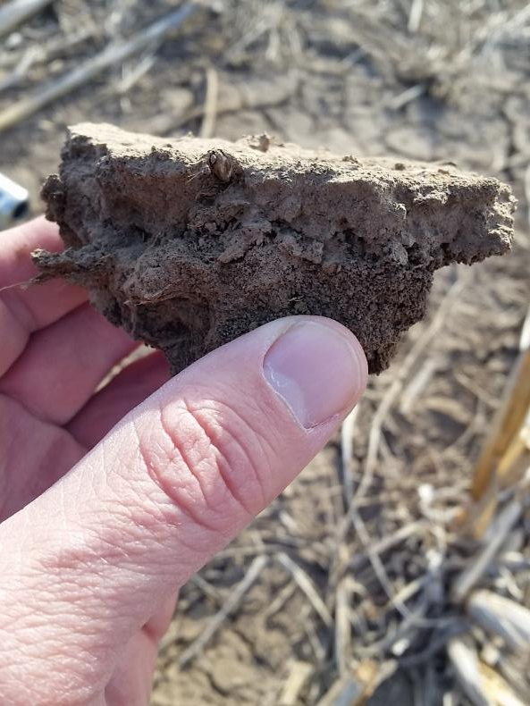
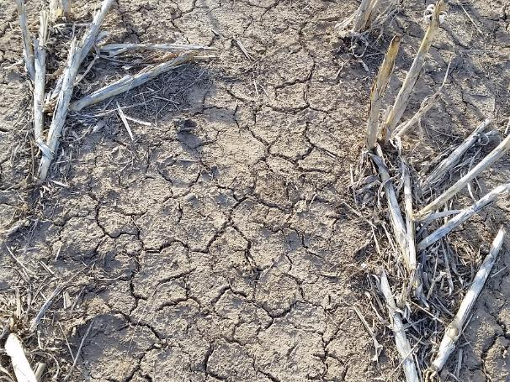
Structure and Compaction
Without these biological organisms, and the absence of roots, soils are subject to:
compaction
crusting
high bulk density
Loss of aggregate stability
Notes:
Fields saturated for long periods lose soil structure, especially at the surface. No-till by itself doesn’t increase aggregate stability, you need the roots and biological organisms to achieve water stable aggregates. Stable aggregates can withstand the impact of a raindrop and individual soil particles (sands, silts, clays) stay together.
Erosion problems occur when these particles are separated and can be transported by wind or water.

Slide 20
Aggregate Stability
Notes:
This slide shows how much more easily water can infiltrate into the soil when there is good aggregate stability (right). When there is not, the aggregates fall apart and plug pore spaces, leading to runoff under rain events where any kind of slope occurs (left).

Slide 21
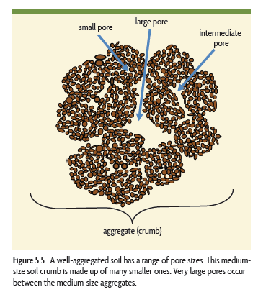

An Aggregate is like a House
The interesting stuff is going on in the “empty” spaces!
Bianca Moebius-Clune
Aggregate (crumb)
Notes:
Rebuilding water stable aggregates must be a top priority. Rebuild the house as opposed to cutting all the 2x4s into 6” pieces and tearing off the roof (i.e. tillage).

Slide 22
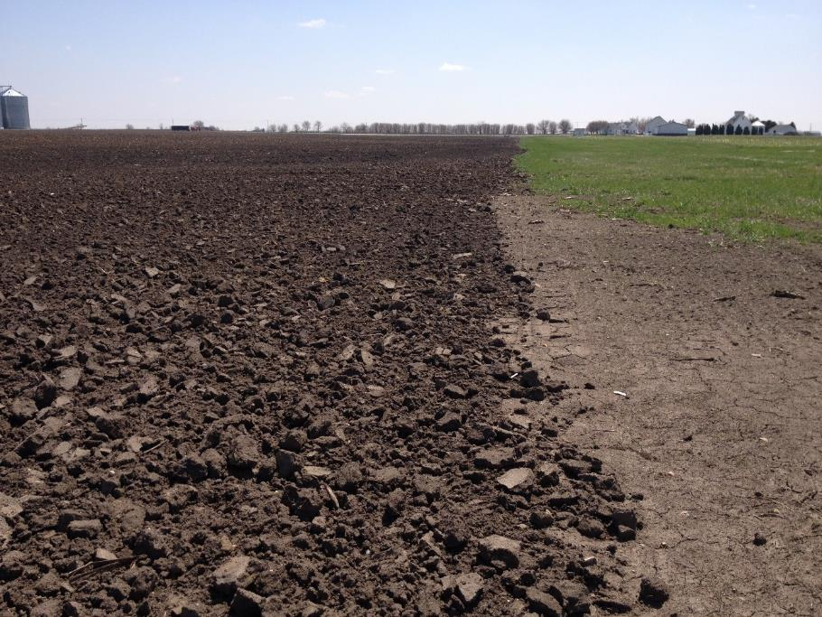
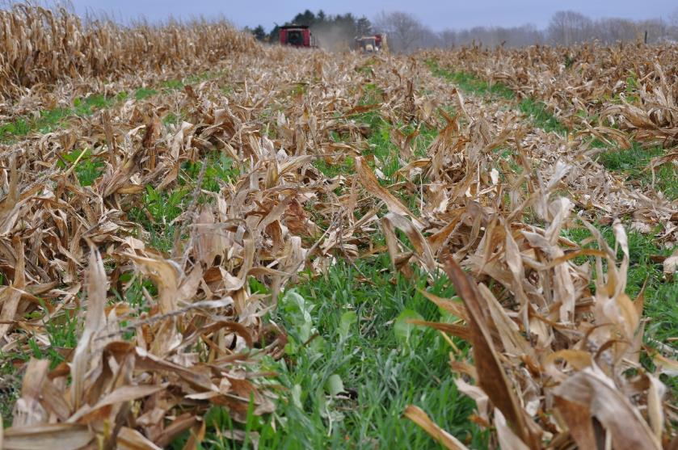
Notes:
There is an interrelationship between the amount of fines (silt and clay) in a soil and the amount of organic matter needed to produce stable aggregates. The higher
the clay and silt content, the more organic matter is needed to produce stable aggregates. This is because clay and silt have more surface area so more OM is needed to occupy the surface sites on the minerals during the process of organic matter accumulation. In order to have more than half of the soil composed of water stable aggregates, a soil with 50% clay may need twice as much organic matter as a soil with 10% clay (Building Soils for Better Crops).
You can’t improve aggregate stability with a piece of tillage equipment, you need to create a favorable habitat for those soil microbes that play a role in this process.

Slide 23

Making Soil Health a Priority = Taking a Soil Health Journey
What does Soil Health mean?
Soil Health Indicator actions =
  Improving organic matter
  Improving aggregate stability
  Increasing water infiltration
  Increasing available water capacity
  Improving nutrient cycling
  Balancing and diversifying soil biology
  Eliminating erosion
Notes:
Next, we will discuss water infiltration as an important soil health indicator.

Slide 24
Aggregate Stability
Notes:
As you remember, aggregate stability is directly related to water infiltration. We can measure water infiltration rate in the field (using equipment in your soil health test kit) which can help us assess this.

Slide 25
Making Soil Health a Priority = Taking a Soil Health Journey
What does Soil Health mean?
Soil Health Indicator actions =
  Improving organic matter
  Improving aggregate stability
  Increasing water infiltration
  Increasing available water capacity
  Improving nutrient cycling
  Balancing and diversifying soil biology
  Eliminating erosion
Notes:
Now we will focus on available water capacity as a soil health indicator.

Slide 26
> Soil Organic Matter > Available Water
Notes:
Soil health management systems can increase available water in several ways. Even old data confirms that more OM increases available water.
Studies looked only at top 6 inches and don’t account for plants being able to access deeper in the soil profile.

Slide 27
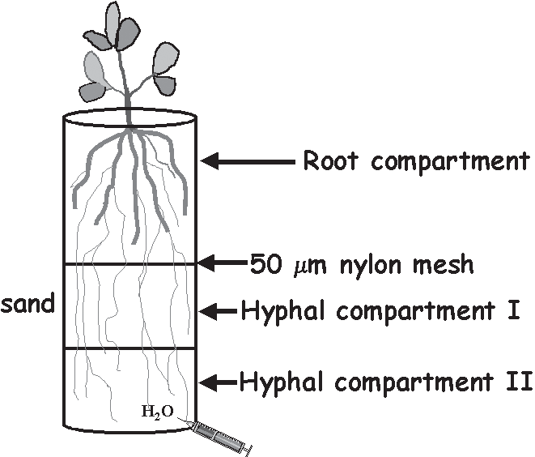
Access to water
Glomus fasciculatum
150%
more fresh weight
than the control
Glomus deserticola
215%
more fresh weight
than the control
P-fertilized
control
P-fertilized
control
Ruiz-Lozano & Azcon, 1995
Notes:
Soil fungi can also help to increase the amount of water available to plant roots. On the slide, the fungi that were added in the first two containers could access water that the plant roots couldn’t, thereby bringing water up the soil profile. This lead to greater water availability and greater fresh weight than in the container on the right that had no added fungi.

Slide 28
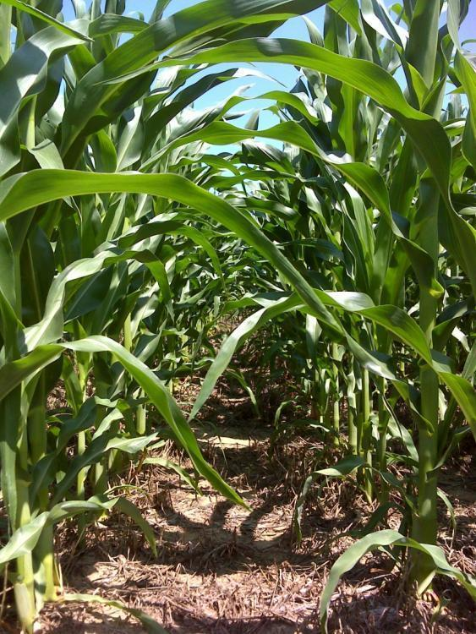
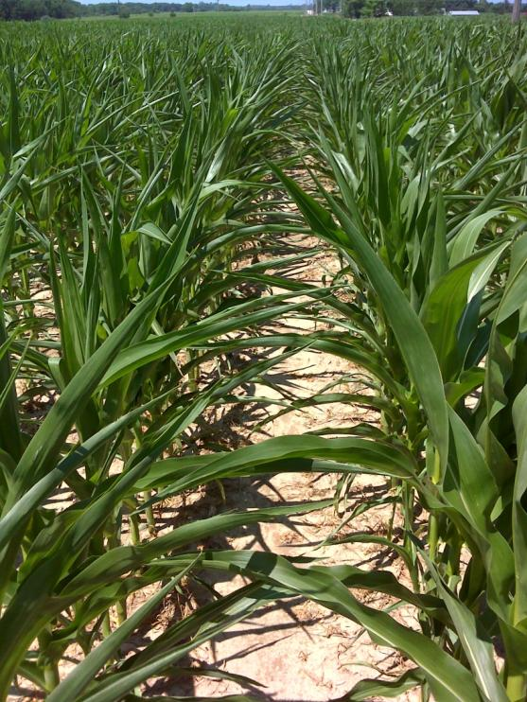
Quality NT Corn into Cover Crop
Minimum-Till Corn
Growth/Health - June 2012
Near the previous NT field
Notes:
Example: The minimum-till field on the right actually looked better early in the growing season but lacked the resilience to make it to the end. 2012 was the worst drought on record in Indiana (this drought also occurred here in Tennessee). In the end, the field on the left out-yielded the minimum-till field by 70 bu.

Slide 29
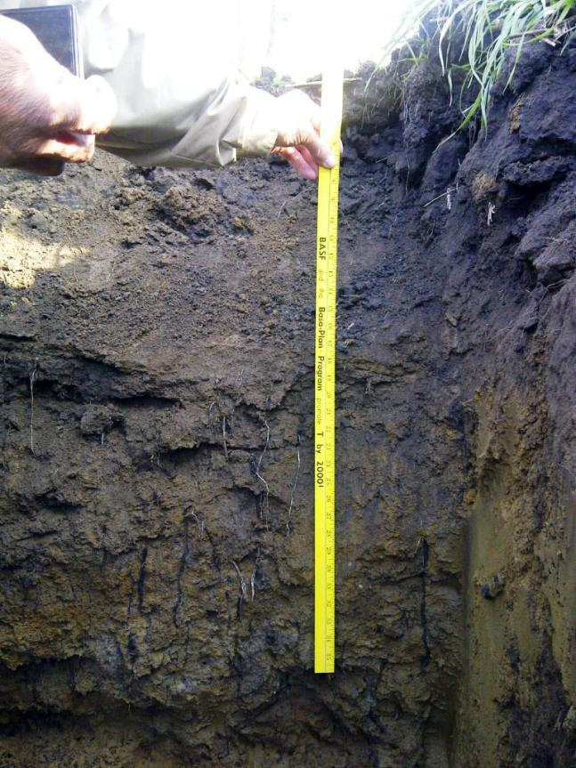
How was the deep rich soil of the prairie formed?
Nature has provided the template
10 Years of continuous No-Till and 2 years of cover crops
Larry Strole,
Brook IN
Notes:
The soil on the slide was put into no-till for 10 years and cover crops for 2 years. This helped to “rhizo-engineer” the soil at the sublevel, following similar processes that formed the deep rich prairie soils by using the 4 soil health principles.

Slide 30
Making Soil Health a Priority = Taking a Soil Health Journey
What does Soil Health mean?
Soil Health Indicator actions =
  Improving organic matter
  Improving aggregate stability
  Increasing water infiltration
  Increasing available water capacity
  Improving nutrient cycling
  Balancing and diversifying soil biology
  Eliminating erosion
Notes:
Next, we will discuss nutrient cycling as an important soil health indicator.

Slide 31
Notes:
Highly disturbed soil will continue to lose basic functions. We often overlook the offsite impact of loss of soil function on soils that have no erosion problems. Loss of nutrient cycling can lead to excess nutrients in water.

Slide 32
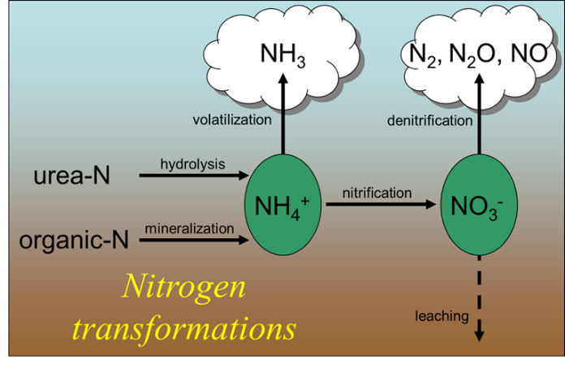
Understanding the extent of soil degradation on nutrient availability
Denitrification
Anaerobic conditions cause Losses of N₂, NO and N₂O
Leaching
Plenty of heat to convert ammonium to nitrate
Nitrate leaves with the water
Basically, applied and available nitrogen is gone
Notes:
Let’s take a look at the important soil functions/processes that are affected by these saturated conditions. We can have losses of N from the field when they are saturated through the processes of denitrification and leaching. Under denitrification, N is lost as a gas whereas with leaching it is lost through the water.

Slide 33
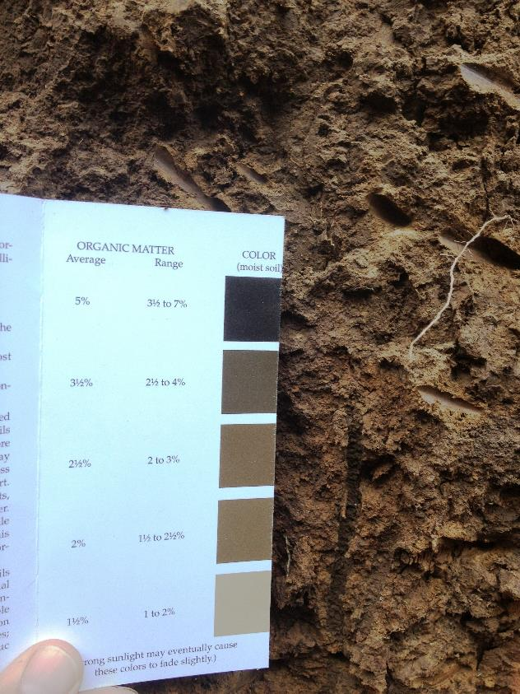
Mining Organic Matter Is Not An Option!
Each 1% of O.M. contains:
  10,000 lbs. of C
  1000 lbs. of N
  100 lbs. of P
  100 lbs. of S
  .3”-1” of H₂O
Notes:
Over much of our cropland, we have been living off the annual withdrawal of nutrients from SOM. We cannot afford to burn off our organic soil carbon if we intend to be sustainable. This is our production bank account. It is also our water bank due to its ability to retain moisture in the soil. When SOM is removed (erosion, volatilization, etc.), the elements needed to increase yields are at risk of being lost. These are also some of our most troublesome elements that impact air and water quality.

Slide 34
Relationship Between Organic Carbon and Total Nitrogen
(Silty soil, 130 years)
Martens et al
Notes:
As organic carbon increases in the soil, total soil nitrogen content also increases. Bottom line, it takes protein to increase life in the soil. Consider this your nitrogen bank account where every pound saved is quite literally one that didn’t get lost through erosion. There’s no better contamination filter than carbon, so we all benefit when we install the conservation practices that improve the earth’s filtration system.

Slide 35
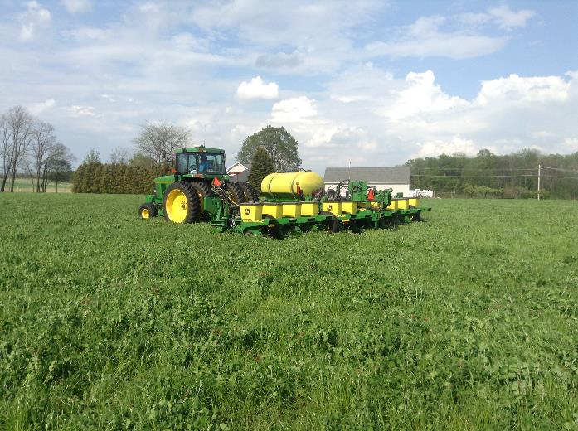
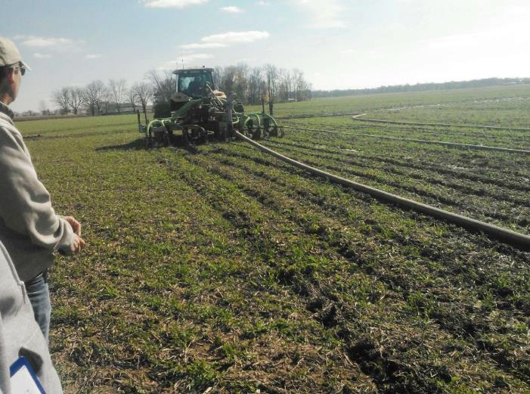
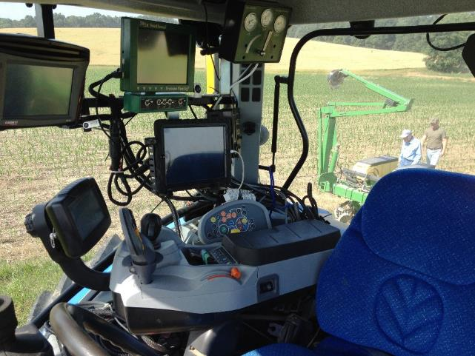
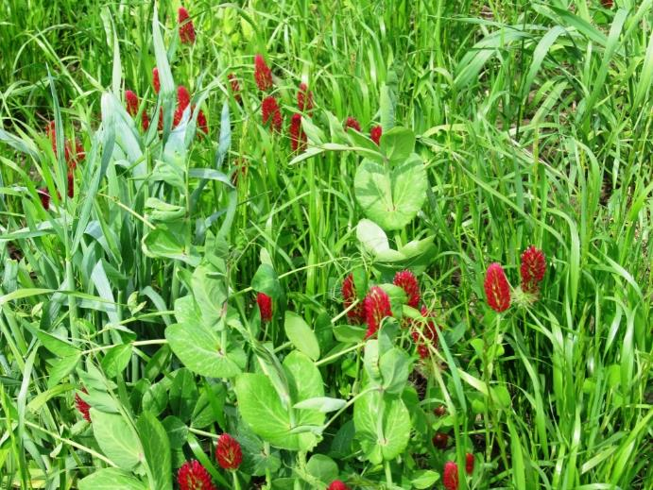
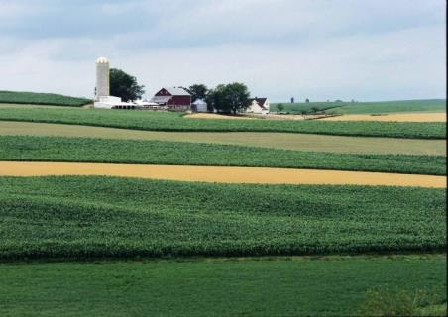

Quality No-Till
Adapted Nutrient Management
New Technology and Integrated Weed & Pest Management
We can package a system of practices that Improve Soil Health!
Prescribed Cover Crops
Diverse Crop Rotation
Notes:
As depicted in the slide, improving soil function is about optimizing and understanding all aspects of the conservation cropping system such that soil health is the central focus with every operation. Each practice should complement and enhance the others of the system.

Slide 36
Soil Organic Matter Matters!
So Where is this Active Carbon?
Most at 0”- 4”
Maybe at 4”- 24”-?”
previous bean root
annual ryegrass root
and earthworm
Notes:
As mentioned previously, if we do no-till and add cover, then over time we can built a bank of reactive carbon deep in the soil profile as we expand the rhizosphere. This will allow for better nutrient cycling.

Slide 37
Making Soil Health a Priority =
Taking a Soil Health Journey
What does Soil Health mean?
Soil Health Indicator actions =
  Improving organic matter
  Improving aggregate stability
  Increasing water infiltration
  Increasing available water capacity
  Improving nutrient cycling
  Balancing and diversifying soil biology
  Eliminating erosion
Notes:
We will now revisit the importance of soil biology briefly since this was mentioned in greater detail in Module #2.

Slide 38
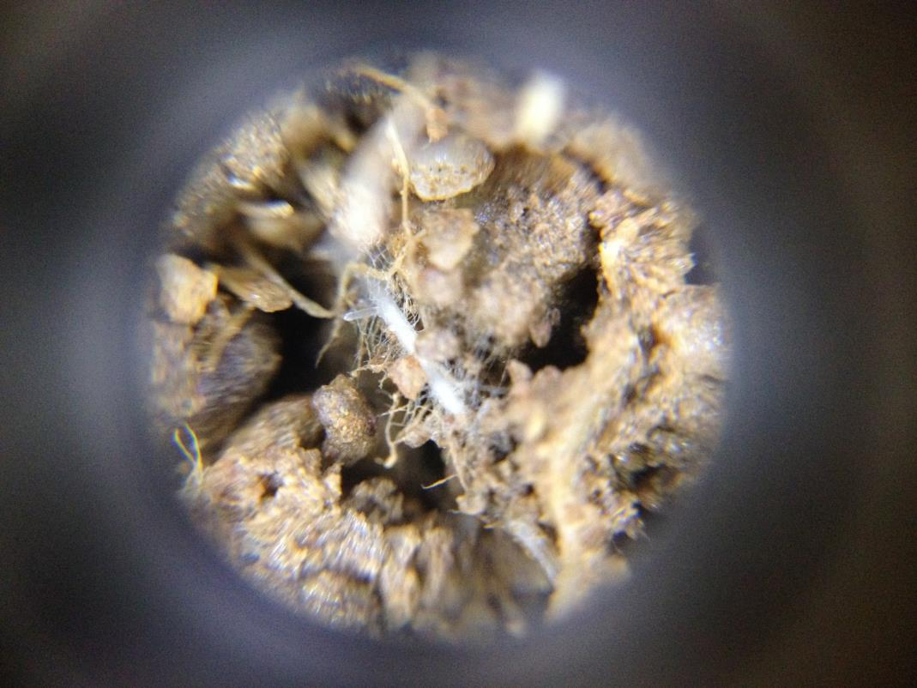
What other carbon pools are formed?
mycorrhizal fungi
Hyphae forming a symbiotic relationship with wheat root
Notes:
As we’ve already mentioned, soil biology is greatly important for creating/maintaining stable soil aggregates and increasing available water which provide important soil health functions. The slide shows a hyphae involved in “rhizo-engineering” at the sublevel through its symbiotic relationship with plant roots and binding ability within the soil.

Slide 39
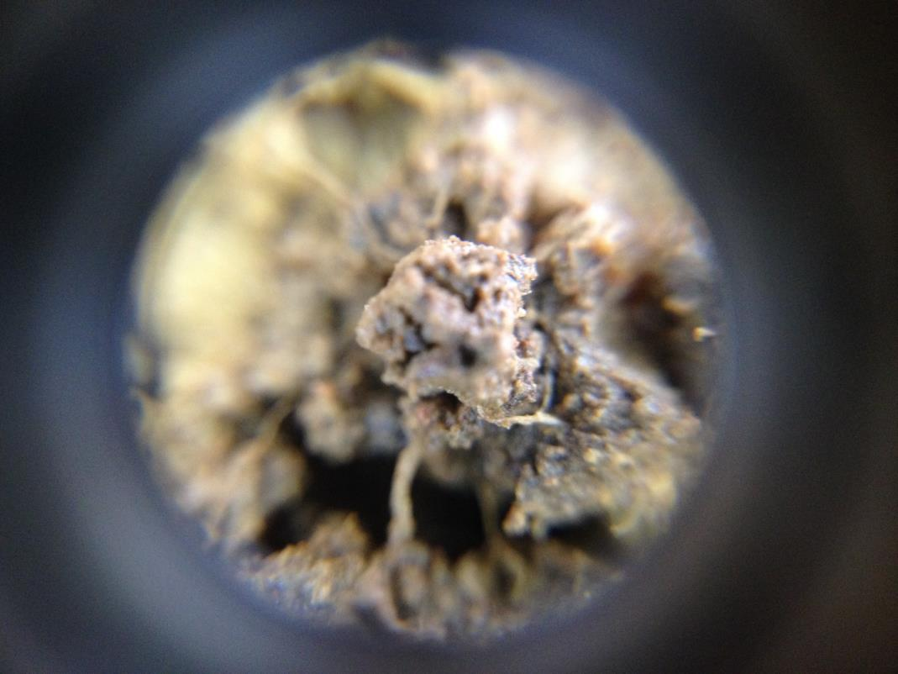
What other carbon pools are formed?
Soil Glue-polysaccharides, proteins and root exudates
form water stable aggregates that are nutrient rich
Notes:
Plant roots and microbes also engage in this “rhizo-engineering” at the sublevel by producing carbon compounds that can chemically bind soil to form aggregates.

Slide 40
Making Soil Health a Priority =
Taking a Soil Health Journey
What does Soil Health mean?
Soil Health Indicator actions =
  Improving organic matter
  Improving aggregate stability
  Increasing water infiltration
  Increasing available water capacity
  Improving nutrient cycling
  Balancing and diversifying soil biology
  Eliminating erosion
Notes:
Lastly, erosion is another soil health indicator whose complete elimination is part of the goals of soil health management systems.

Slide 41
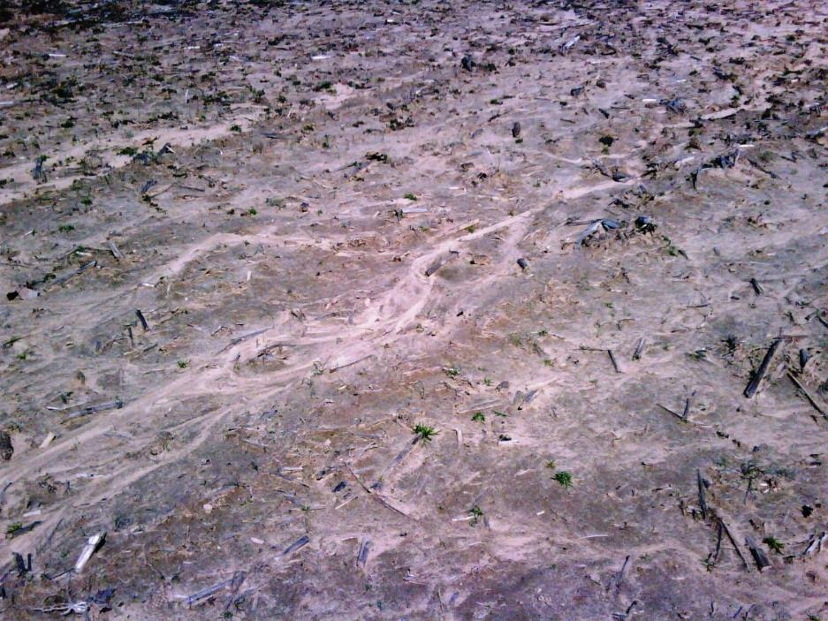
Erosion = T
Notes:
T refers to the soil loss tolerance rate which is the maximum rate of annual soil loss that will still allow sustainable crop productivity now and in the future. In the minds of many soil health producers there is no “tolerable” soil loss, they have moved beyond this. Identification of erosion in the field can involve evidence of disintegrated aggregates across a change in slope as well as rilling or gully formation on the soil surface.

Slide 42
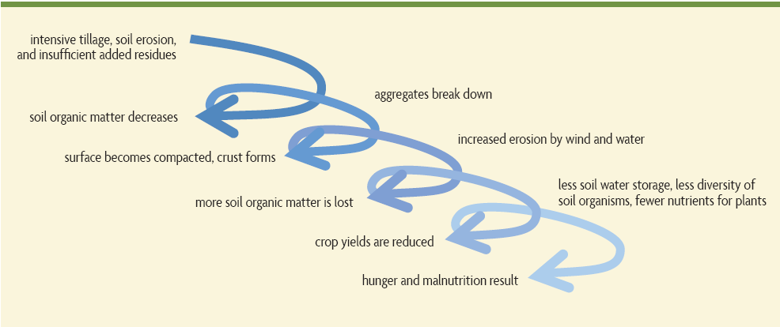
Regenerative Systems for Healthy Soils
9. Crop yields increase, lower cost, lower risk
8. Field conditions are more resilient and consistent
7. Less energy and tillage needed, more water stored, better rooting, more nutrient access, greater soil organism diversity, less disease
5. Infiltration increases, erosion by wind and water decreases
6. More soil organic matter, nutrients, and top soil built
4. Available water holding capacity increases, reduced compaction from rooting
3. Aggregates rebuild, soil organic matter increases
2. Soil biology returns, decreased erosion
1. Reduced tillage, increased biomass with more rooting, higher diversity, surface cover
Modified by Dr. Dorn Cox from Building Soils for Better Crops
Notes:
This slide shows the logical order of regeneration.

Slide 43
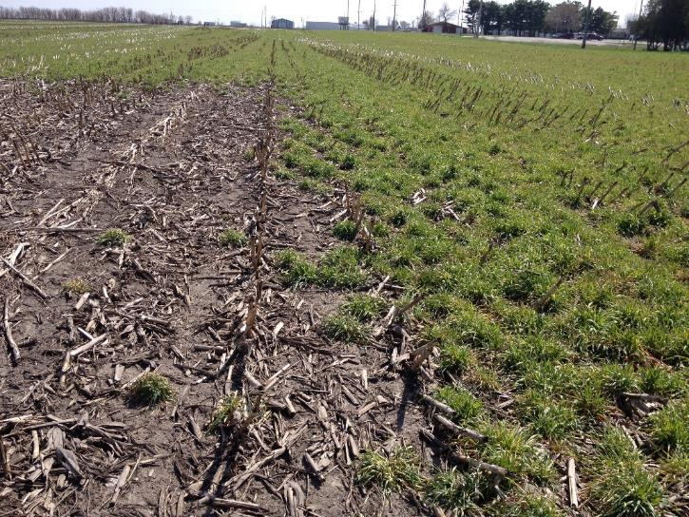

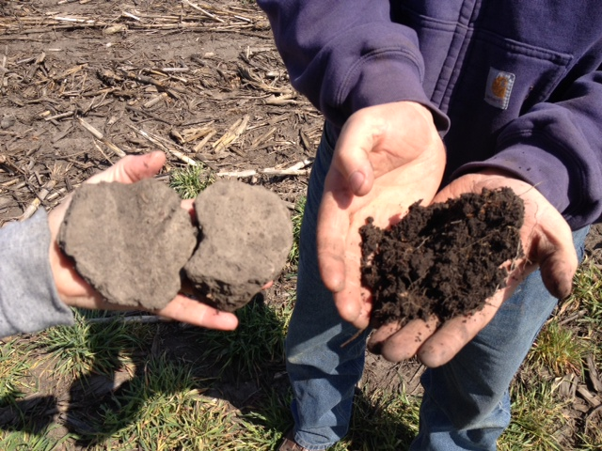
We need to Start Building Soil Life….ASAP!
Response to soil aggregates after
one season
Notes:
Selecting high biomass cover crop mixes will help rebuild organic matter in the topsoil. Cover crops, especially if part of a quality no-till system, will add organic biomass both above and below ground to rebuild topsoil quicker than if left to grow weeds, and especially if managed for no cover. The growing roots also feed the biology in the soil that is responsible for forming stable aggregates. This response can happen faster than you might think as shown in the slide after one season.

Slide 44
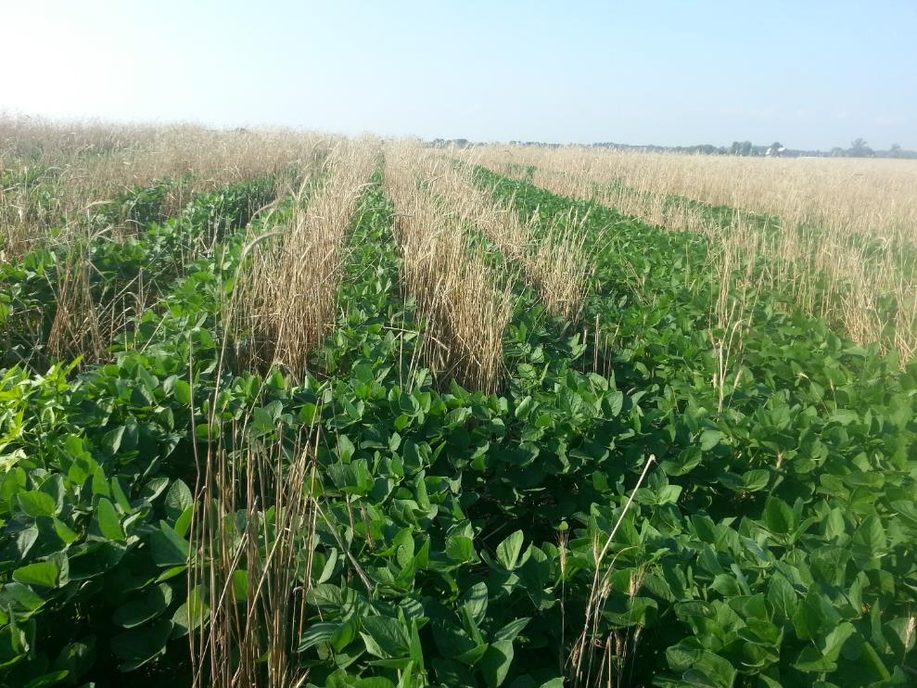
Cover the Why
Challenge Yourself/Producers-
How and What
Bill Legg, Lawrence county after just one year of cover crops with grazing and 4% OM his average corn yield in 2012 drought was 135 bushels where the county average was 70 bushels. The county average OM is less than 2%.
Notes:
These are just a few management strategies that could bring us a long way back to full production potential even under extreme conditions (see slide) and, if continued, soil health regeneration can be the path to greatly improved production, efficiency and resilience.

Slide 45
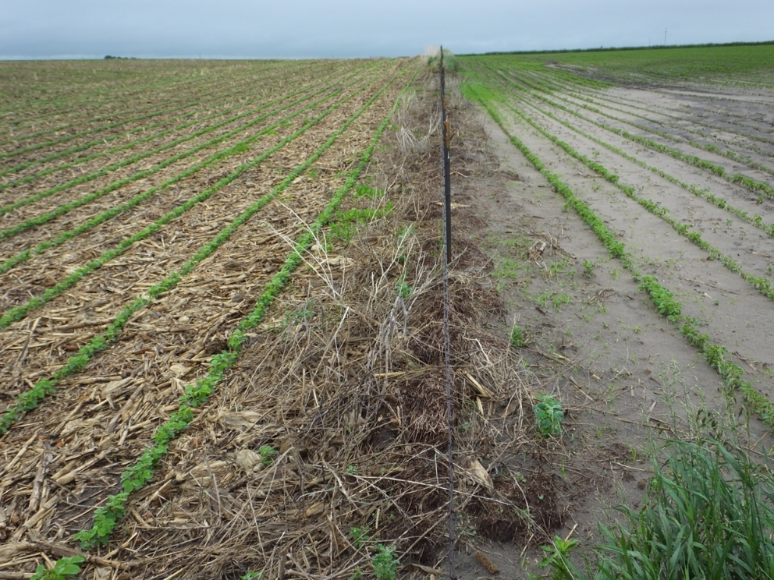
Next season…we’ll be ready!
Notes:
Preparation is key and there are a number of resources that can help.

Slide 46
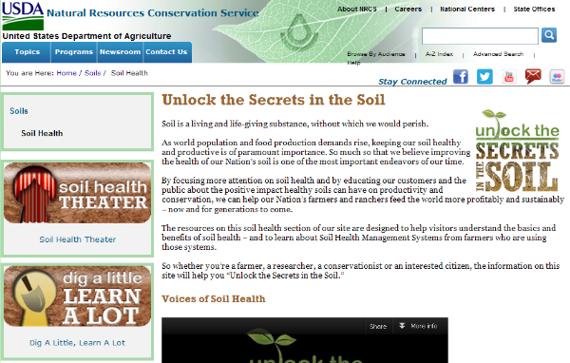

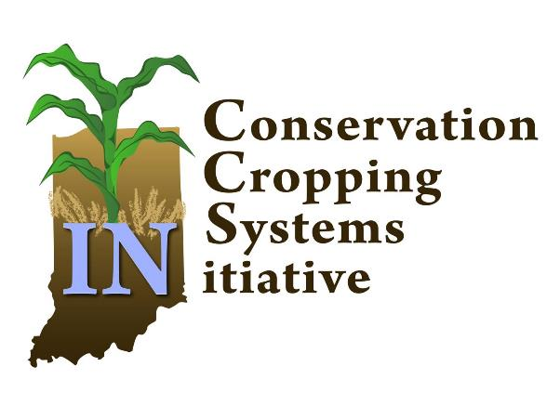

Tools to help decide what CCs to plant
SARE-Managing Cover Crops Profitably
http://ccsin.iaswcd.org/
http://mccc.msu.edu/
Notes:
These are some examples of available resources from the Natural Resources Conservation Service (NRCS) and Sustainable Agriculture Research and Education (SARE) Program among others.

Slide 47


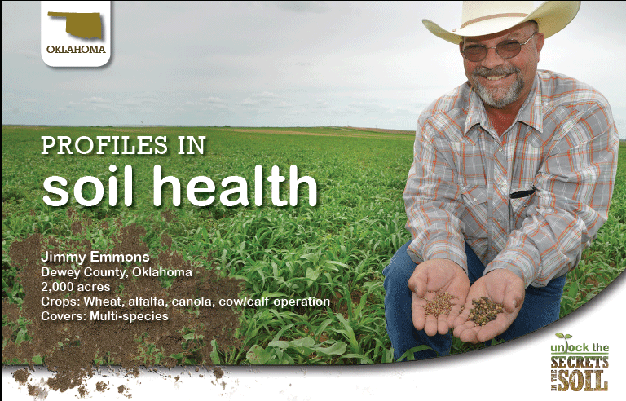
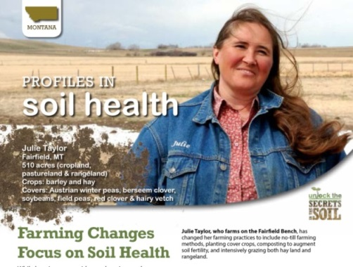

Soil Health Campaign
Google: NRCS Soil Health
Notes:
For additional information from the NRCS on soil health, search online for “NRCS Soil Health”.

