Slide 1
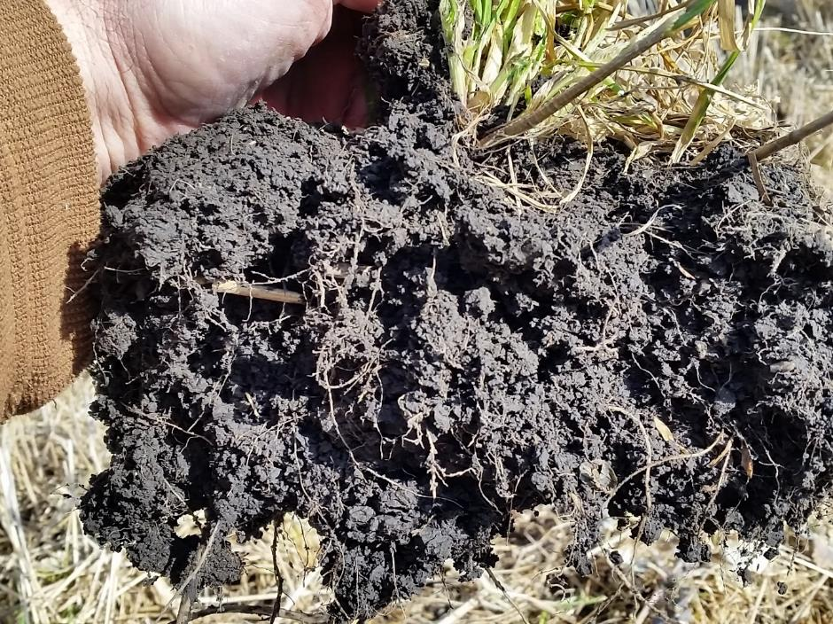

Module 3
Soil Health Principles
Notes:
This module covers soil health principles. When these principles are followed, we should be able to monitor key indicators (Module 4) to track our soil health regeneration.

Slide 2
Learning Objectives
By the end of this lesson you will be able to:
Define and describe soil health principles and their impact on soil health ecosystem functions
Understand key words within the soil health definition
Identify conservation practices and activities that address each soil health principle
Describe key soil health indicators

Slide 3
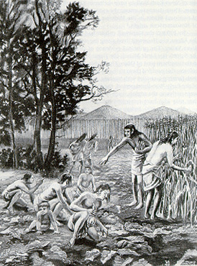
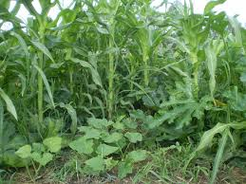
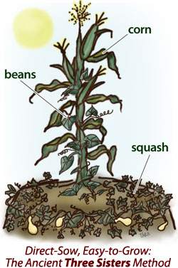
Historically, management principles have changed
Notes:
The Adena Indians (for example) used tools made of stone, animal bone, and tortoise shell to grow crops of squash, pumpkins, gourds, sunflowers and maize. The primary agricultural product of the Ohio Indians, shortly after the introduction of agriculture to Knox County, was maize.
We’ve all seen picture and renditions of “the 3 sisters”

Slide 4
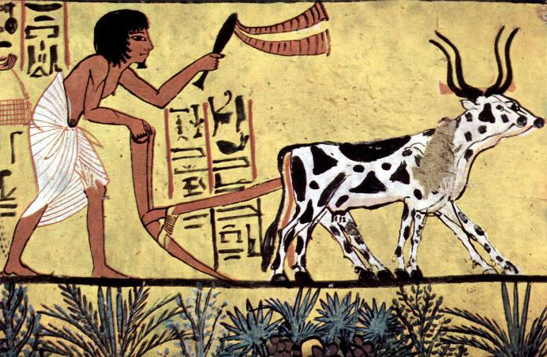
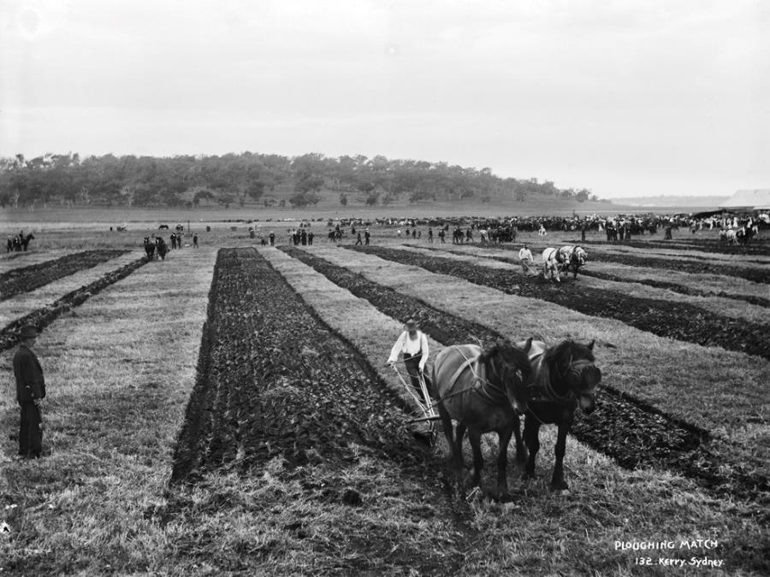
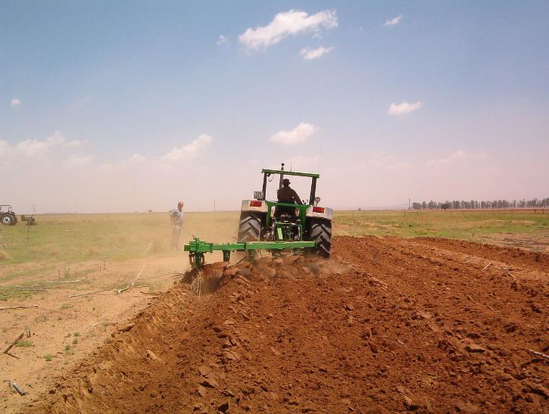
Our traditions in agriculture are deeply rooted.
Early management necessitated working with natural systems.
As mechanization advanced and scale and intensity grew, our management principles became focused on altering natural systems to meet our needs.
Notes:
As long as our tools involved wood and our horsepower was supplied by horses, or oxen, then we pretty much had to work with nature.
When the tools became steering wheels and push buttons and our power was supplied by hundreds of horses packed into a diesel engine, then our natural drive led us to management principles for controlling nature.
John Deere invented the steel plow in 1837 when the Middle-West was being settled. The soil was different than that of the East and wood plows kept breaking.

Slide 5
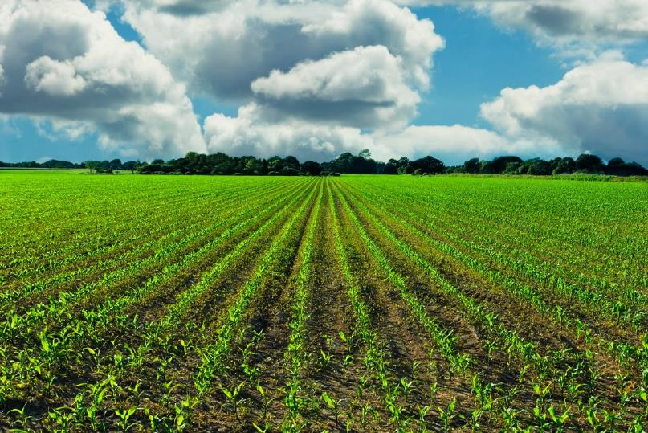
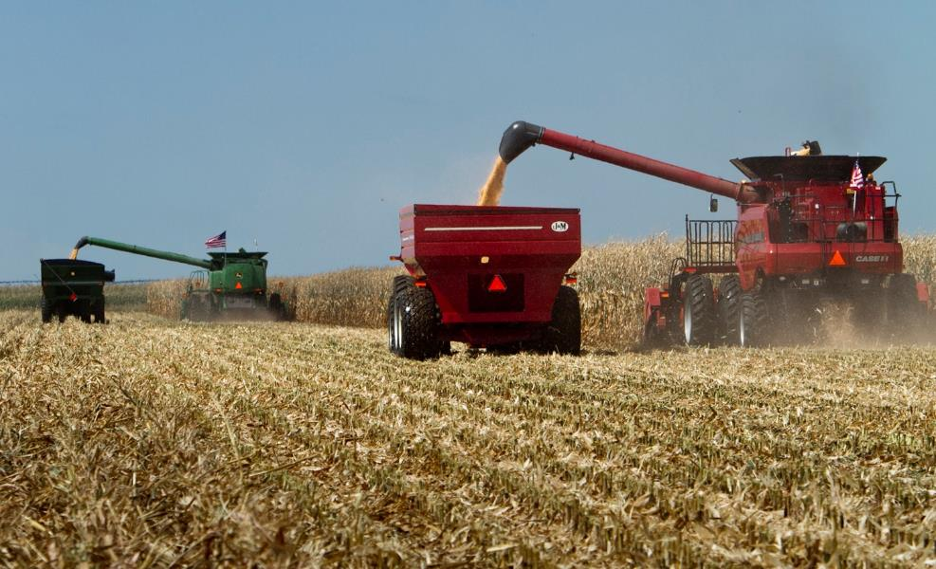
Intensive Crop Production
Notes:
In no way is this a judgement against tradition or agriculture as a whole, but speaks to why change isn’t easy for most of us. Some of the complacency among farmers (and some of our staff) for not changing management or looking harder into soil health systems, is that the deep prairie soils still reward them for the intensive tillage they have done or observed throughout their lifetime. We miss the realization that the Mediterranean and European style agriculture practices only arrived, in earnest, on this continent a couple of centuries ago.

Slide 6
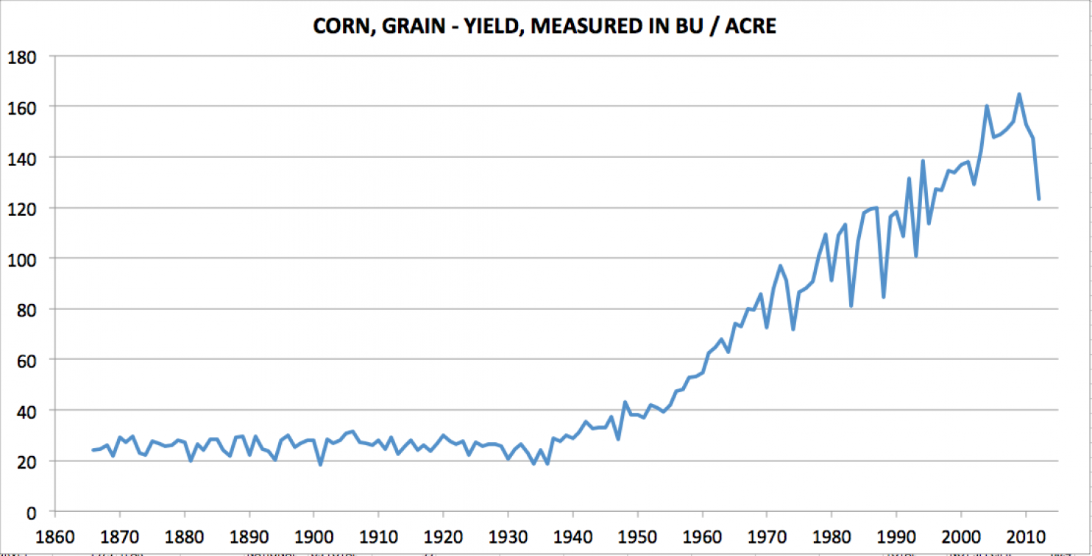
Notes:
The current agricultural intensification only took hold a few decades ago. So while our current methods seem to be working fine, that is largely due to the facts: that we haven’t been at them here for very long and cheap energy inputs, mostly from finite resources, are still readily available. If we look at regions of the world where these farming methods have been in place for millennia or on poorer soils to begin with, then we see what a totally depleted resource brings (hunger, disease and war).

Slide 7
Historic Loss of Soil Carbon
Conventional
Tillage
Reduced
Tillage
61% of 1907
53% of 1907
From Lal et al., 1998
Notes:
This graph shows simulated total soil carbon changes (0 - 20 cm depth) from 1907 to 1990 for the central U.S. corn belt and a portion of the Great Plains. This indicates that soil organic carbon levels dropped to 53% of precultivation levels in the 1960s and increased subsequently with the adoption of conservation tillage practices and the advent of higher yielding varieties which produce more crop residues (Lal et al., 1998). Not sure the increase has happened as predicted in this model.
Relate this loss in carbon to the potential of soil to sequester carbon. The soil has the potential to put back or store all this lost carbon. The potential is about 40% of the pre-cultivation soil carbon.
In general, the C content of soil organic matter is about 58%. Soil organic matter is a key indicator of soil quality and is an integrated measure of change in soil function. Generally, increases in soil organic matter reflect increases in soil quality. Soil can function as a sink for atmospheric carbon, and therefore has the potential to decrease atmospheric carbon and aid in mitigating global climate change.

Slide 8
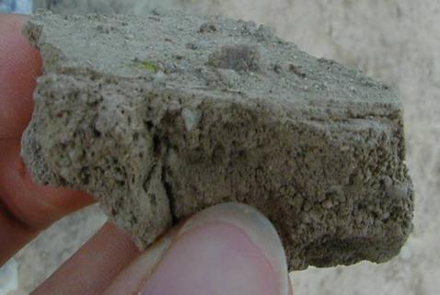
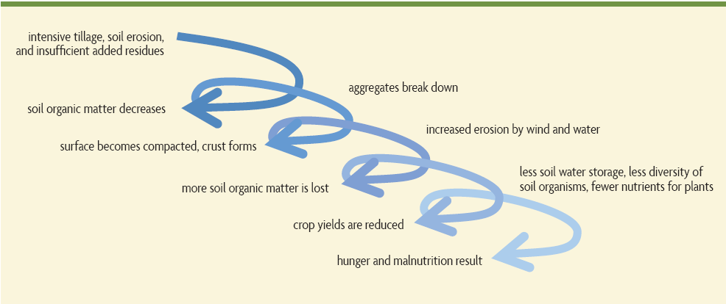
Downward Spiral of
Soil Degradation in annual systems
1. Intensive tillage, insufficient addition of residues, low diversity, no surface cover
2. Soil organic
matter decreases, erosion, subsoil compacted
3. Aggregates break down
5. Infiltration decreases
Erosion by wind and water increases, Yield consistency declines
4. Surface becomes compacted, crust forms
7. More soil organic matter, nutrients, and topsoil lost
6. MORE ponding & persistent wetness, but LESS soil water storage; less rooting; lower nutrient access efficiency; less diversity of soil organisms, more disease and pests
8. Crop yields decline
9. Hunger and malnutrition, especially if little access to inputs
Modified from Building Soils for Better Crops
Notes:
If current management principles include intensive tillage, insufficient addition of residues, low diversity, no surface cover….follow the graphics.
Over time, the way we manage our soil can, and has, led to degraded soil functions. (mention the functions that we discussed earlier)

Slide 9
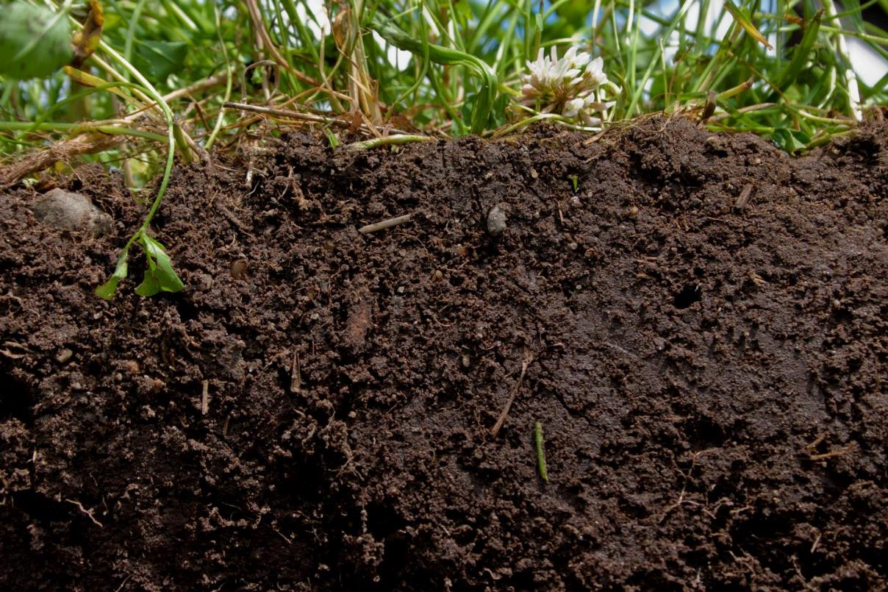
SOIL HEALTH:
The continued capacity of a soil to function as a vital, living ecosystem that sustains plants, animals, and humans.
Notes:
This definition which has been accepted by most stakeholders, focuses on the importance of soil function and the reality of soil as a living resource. When we speak of soil health, we are talking about improving the capacity of soil to function as a vital, living ecosystem that sustains plants, animals, and humans.
“Health” is usually used in the context of a living organism so managing soils for optimum health, in a way, ensures they are sustainable/alive for future generations.

Slide 10
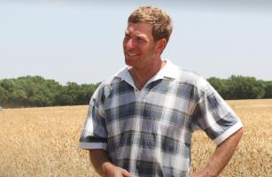
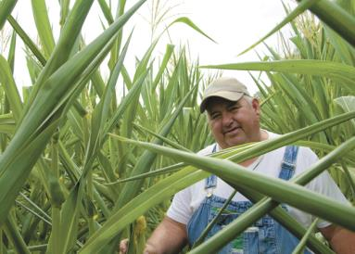
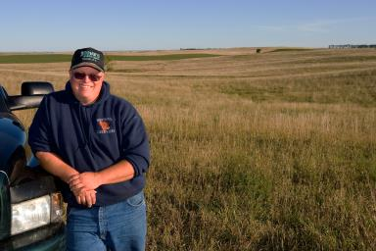
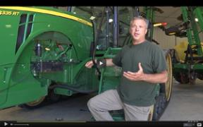
A changing vision of soil…
The concept of “fixed” soil properties has been shattered by soil health farmers.
They have CHANGED the health and function of their soil.
Notes:
Farmers like these all across the nation are now planning every operation and management decision around the guiding principles for soil health. They are leading many of the advancements in SH.

Slide 11
Soil Health Principles
Minimize Disturbance
Maximize Soil Cover
Maximize Biodiversity
Maximize Presence of Living Roots
Feed diverse, continuous inputs (C sources, energy)
Protect habitat (aggregates and organic matter)
Notes:
You were introduced earlier to the “principles” of soil health. To truly improve soil health, we must integrate 4 key management principles into every aspect of management decisions. So in this session we will dive deeper into why each principle is important and how each must be integrated into a system where it complements the rest.
By the end of this training, these principles should role off of your tongue when discussing soil health.
As part of the discussion we need to be pragmatic about these principles.
Principles tend to do one of two things, they either feed soil microbes by providing a continuous source of C or they protect the habitat

Slide 12
The fence row effect
Notes:
Most farmers who have studied yield maps have seen these principles at work. Ask- what happens to the yield map when you cross an old fence row, or maybe an old pasture that has been brought into production? … Most farmers in the room will start giving the thumbs up sign.
July 31, 2015 Aerial photo. In an extremely wet year why would this narrow part of the field look so much better?...Judging from this tract boundary line, there used to be a fence row there. The yield map would likely show an even greater advantage.

Slide 13
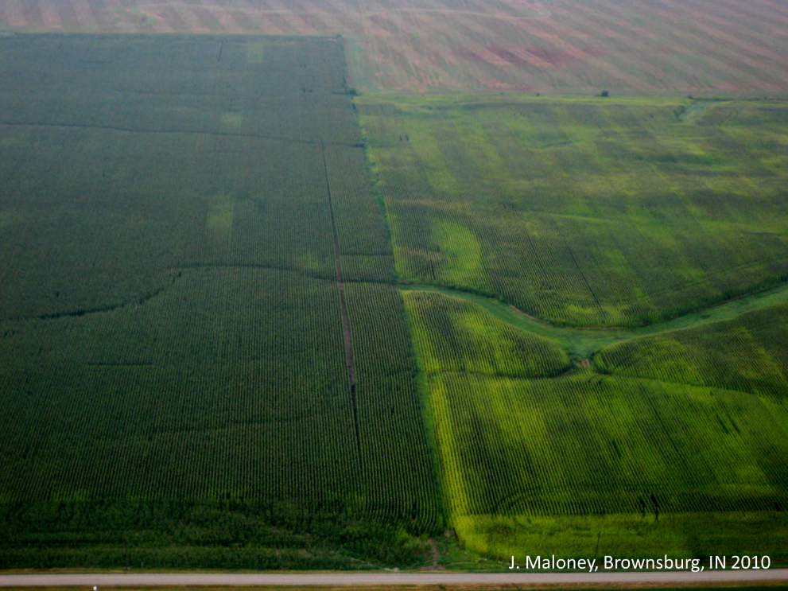
Principles at work
Notes:
Those fence rows that are now in production had all of the principles in place for longer that the rest of the field. The purpose of this section is to see if we can integrate management that regenerates soil function like the fence row all across the field…farm…landscape.

Slide 14
Minimize Disturbance
Maximize Soil Cover
Maximize Biodiversity
Provide Continuous Living Roots
Soil Health Principles
Notes:
To start we will focus on the minimize disturbance portion of these principles and work our way clockwise around the circle.

Slide 15
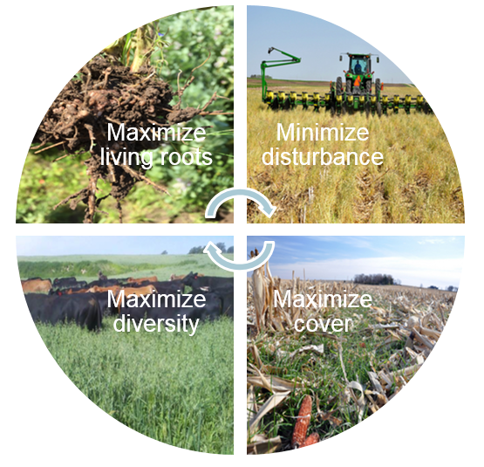
Soil Health Principles & Soil Function
Minimize Disturbance &
Maximize Soil Cover
Maintain stable aggregates
Reduce erosion and runoff risk
Buffer temperature
Reduce evaporation
Maintain soil organic matter
Protect Soil Habitat & SOM
Image courtesy of Barry Fisher, NRCS-SHD
Notes:
The first two principles focus on protection of the soil habitat: minimizing disturbance and maximizing soil cover maintains or increases stable soil aggregates and soil organic matter (SOM), and protects the fragile surface of the soil that is most susceptible to the degrading forces of wind and water. Covering the soil also buffers against extreme swings in temperature that stress plants and soil organisms, reduce evaporation rates, and increase water-use efficiency. SOM is highest at the soil surface and is critical for stabilizing soil aggregates. Maintaining SOM helps support additional soil functions including water infiltration and storage, nutrient-holding capacity and release, and habitat for soil biota.

Slide 16
Minimize Disturbance
Agricultural Disturbance can:
Disrupt or destroy the “soil spheres”
Destroy habitat for soil organisms
Creates a “hostile” environment
Three Types of Disturbance
  Physical (tillage)
  Chemical (fertilizer)
  Biological (overgrazing, pathogens, invasives)
Notes:
Who can name some types of disturbance? The kinds of disturbances we’ve become accustomed to seeing in much of agriculture, and thought of as “normal”, aren’t really normal in nature and weren’t occurring during the development of our great soils.

Slide 17
Manage More by Disturbing Soil Less
Protects habitat
Moderates temp and moisture
Maintains soil aggregates
Controls erosion
Reduces oxidation of soil carbon
Identify practices & activities
Notes:
We truly need to minimize disturbance to the extent possible and practical to realize these benefits.

Slide 18
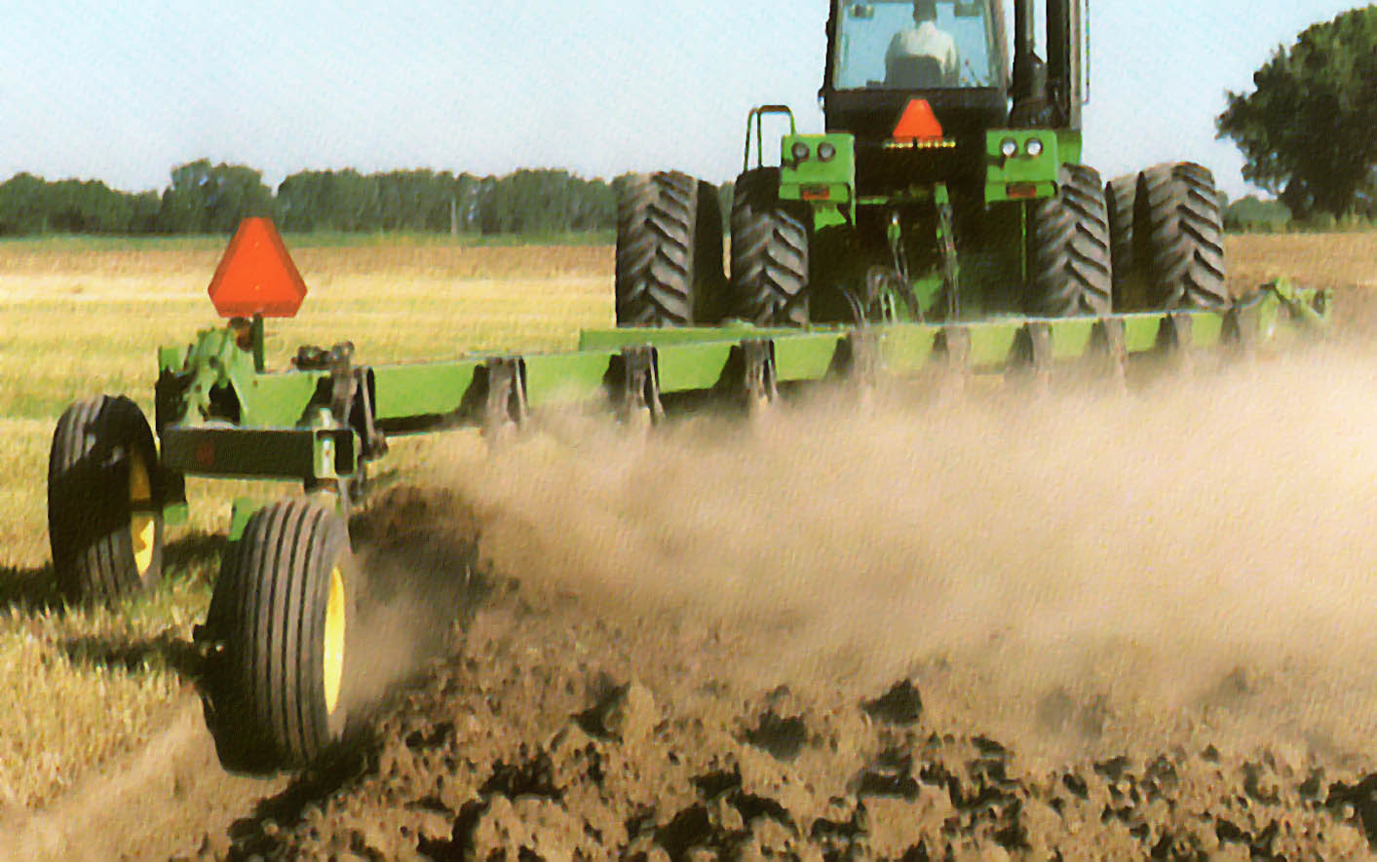

Agricultural Disturbance Destroys the “Soil Spheres”
PHYSICAL DISTURBANCE: Tillage induces the native bacteria to consume soil carbon; byproduct is C0₂.
CO₂
CO₂
CO₂
Loss of SOM as CO₂
Notes:
Tillage disrupts the pore space which impacts the water cycle. Physical disturbance causes native bacteria to consume soil carbon once the readily available food supply is exhausted. As the disturbance continues, the bacteria-driven soil can become adapted or “addicted” to the high disturbance environment.
This type of disturbance stimulates Zymogenous bacteria (rapid growing bacteria that flourish under nutrient rich environments) and also Autochthonous bacteria (organisms living in soils that contain more recalcitrant material- no abundant supply of easily oxidizable substrate- less food) . These organisms are stimulated by the influx of oxygen into the soil ecosystem. Once stimulated by the influx of oxygen, these organisms will consume the carbon based glues created by sugar like polysaccharidesa and other organic compounds. These organisms create compounds that form sticky networks that bind together individual soil particles and tiny microaggreates into larger agglomerations called macroaggreates. These aggregates are stabile in water and are storehouses for nutrient water and microorganisms. The gooey proteins and hyphae created by arbuscular mycorrhizae fungi form very effective cementing agents keeps the soil particles together. Bacteria also produce polysaccharides and other organic glues as they decompose plant residues. These compounds are very important for keeping the soil pores intact. The extent at which these aggregates are tied together is referred to as aggregate stability. No aggregate stability, no soil pores, no porosity, no water infiltration and no air exchange.

Slide 19
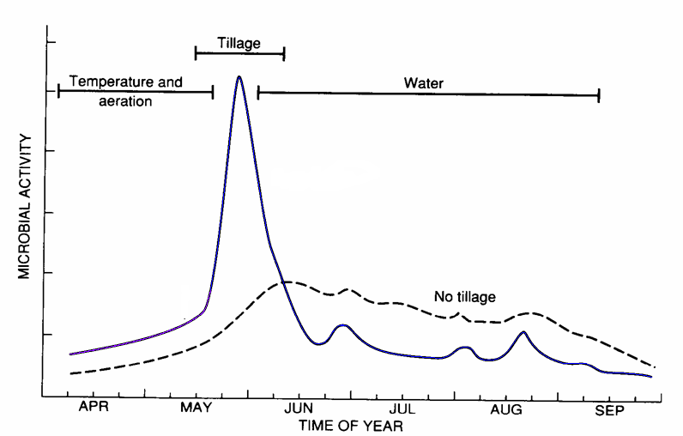
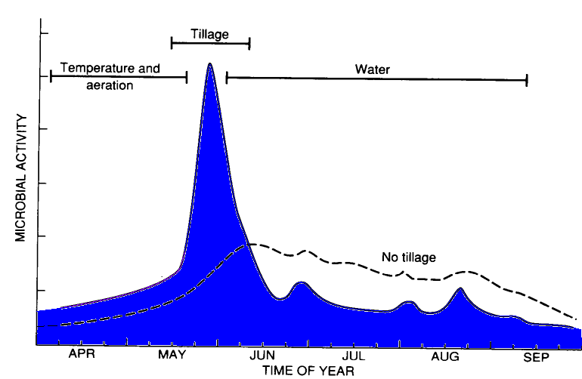
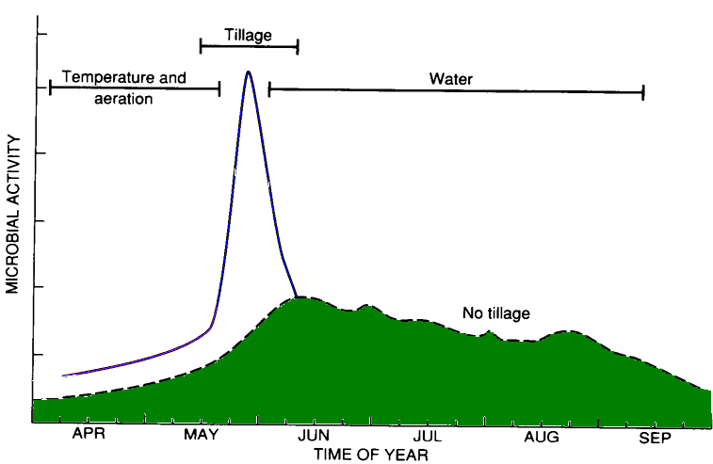
Effect of tillage on microbial activity
The primary factors controlling microbial activity vary with time
+ SOM
Which tillage system has more microbial activity ?
When does the activity occur ?
Soil respiration in CT system
CT
Soil respiration in NT system
NT
Havlin et al. (1999)
Notes:
To evaluate microbial activity, scientists often look to respiration or CO₂ production. Just like humans, microbes eat, drink and breathe. The more they eat, drink and breathe (or the more active they are, the more CO₂ they produce. The timing of this respiration is important- is it just lost or is it captured by the crop canopy and used for photosynthesis?

Slide 20
Notes:
You can see the difference in disturbance made by different tillage techniques. The more soil exposed, the greater the chance for the decomposition of carbon and loss through erosion.

Slide 21
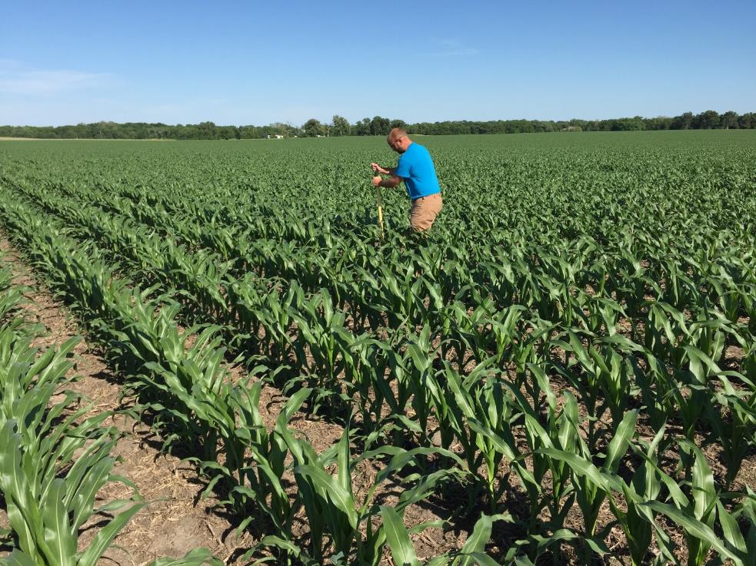
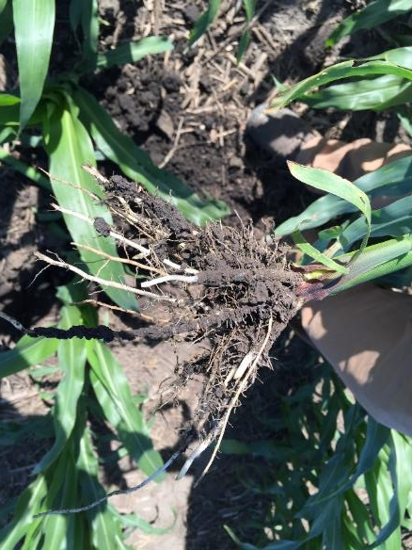
Crop Talk
Listen to what the crop is telling you…
I feeel goood…Thanks for the nice soil!
Notes:
No-till can be an important step toward building a soil health management system. In this slide the roots are happy because there is organic matter present and good aggregation in the soil.

Slide 22
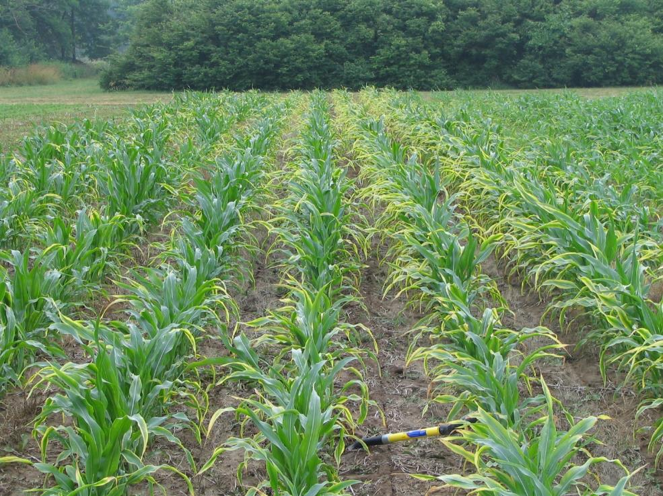
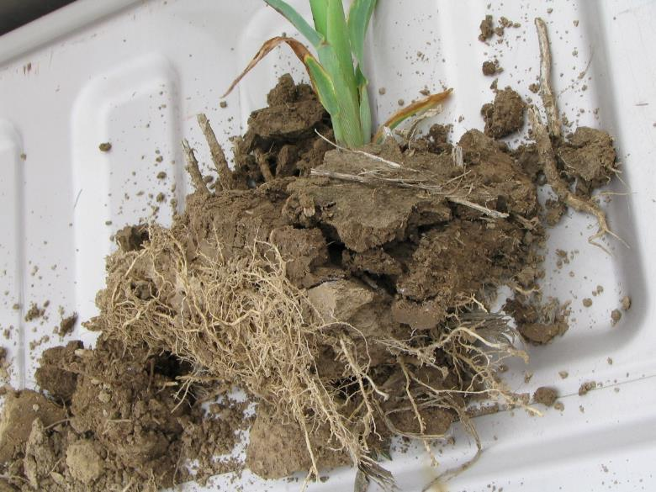
Crop Talk
Listen to what the crop is telling you…
…My feet are hurtin’ in these tight shoes!
Notes:
In this slide, however, even though no-till has been implemented, there are still issues with the soil. Eliminating disturbance alone will not always improve soil health. No-till can be an important step, however, not all no-till is created equal. There have been some studies that report no improvement in SOM, aggregate stability, or water infiltration. Few studies provide a detailed account or analysis of the no-till system. It would be a mistake to assume that the mere absence of tillage in a given year would achieve significant soil health benefits. The quality of the no-till system should be a part of any study. A “Quality No-till System” will integrate more than the single principles of reduced physical disturbance. It will be complemented by reductions in other types of disturbance and additional principles. We will cover more on practices and systems in a later session.

Slide 23
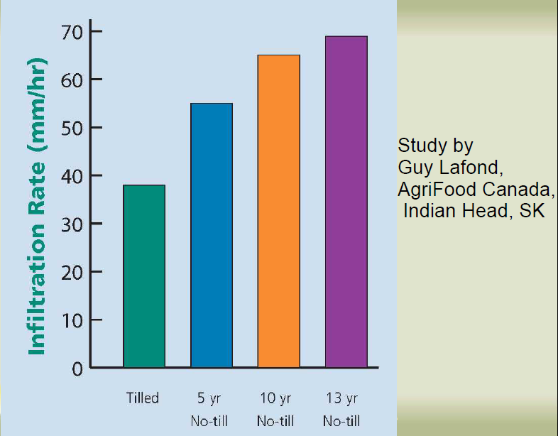
Water Infiltration and No-Till
2.7”/hr
2.6”/hr
2.2”/hr
1.5”/hr
Notes:
Many studies have concluded that No-till can improve aggregate stability and thus improve water infiltration.

Slide 24
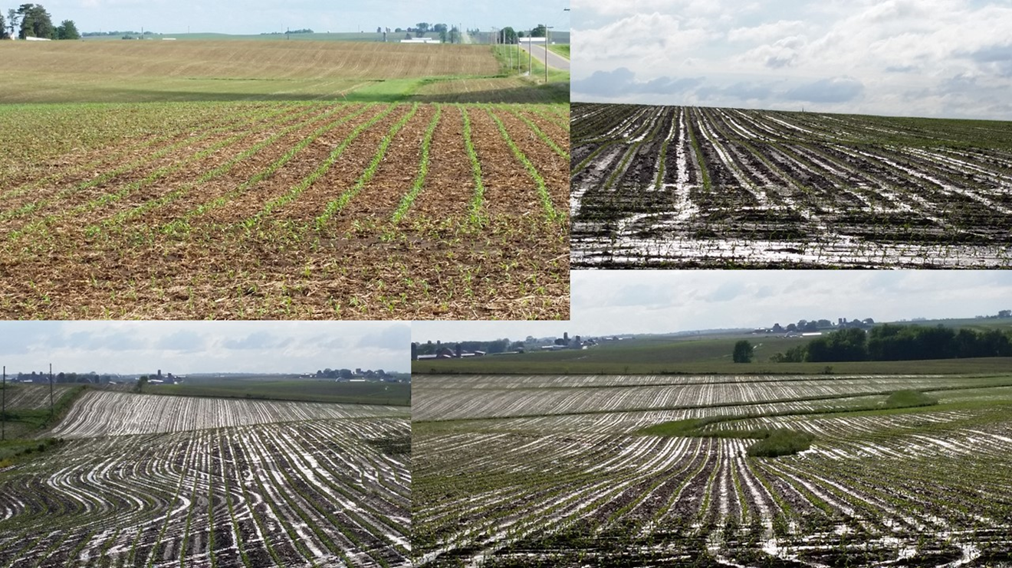
Notes:
The traffic involved in tillage can also create compaction, particularly under wet conditions. The slide shows ponding in these compacted areas.

Slide 25
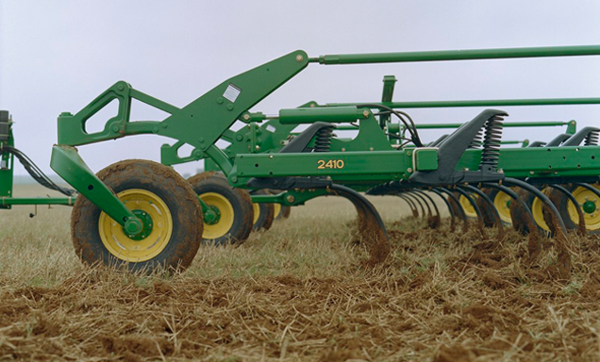
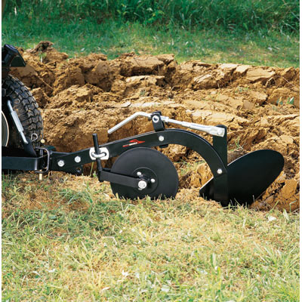
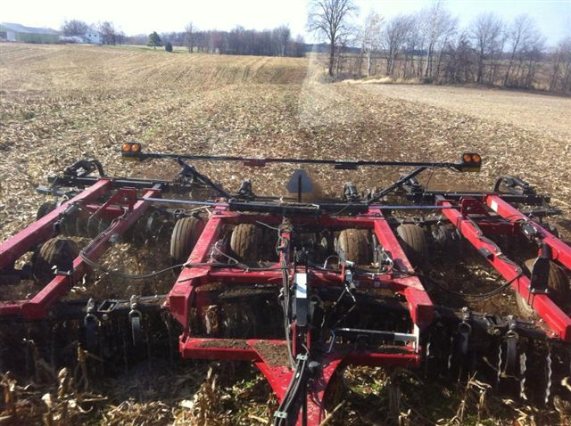
Reducing CO₂ Loss
loss is directly related to the volume of soil disturbed,
intensity of the disturbance,
soil moisture content,
soil temperature at the time the disturbance occurs.
Chisel Plow
Disk or VT?
Moldboard Plow
Notes:
Shallow soil disturbance (1-3 inches) releases less CO2 than deeper operations.
When deep soil disturbance is performed, such as by subsoiling or fertilizer injection, make sure the vertical slot created by these implements is closed at the surface.
Planting with a single disk opener no-till drill will release less CO2 than planting with a wide-point hoe/chisel opener air seeder drill
Soil disturbance that occurs when soil temperatures are below 50° F will release less CO2 than operations done when the soil is warmer.
There are many brands and types of tillage tools and all have varying degrees of soil engagement and residue “management”.

Slide 26
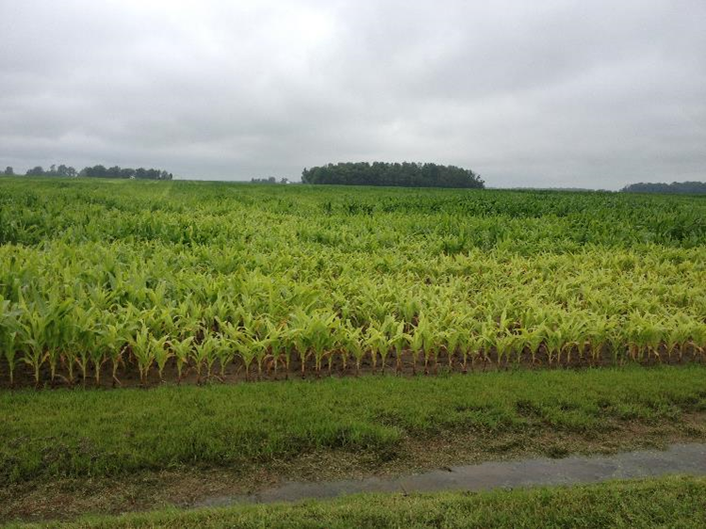
Ponding can be a result of soil disturbance.
Tillage and heavy equipment cause compaction.
July 7, 2015
Notes:
We can see that ponding and flooded crops were the norm for much of this region.

Slide 27
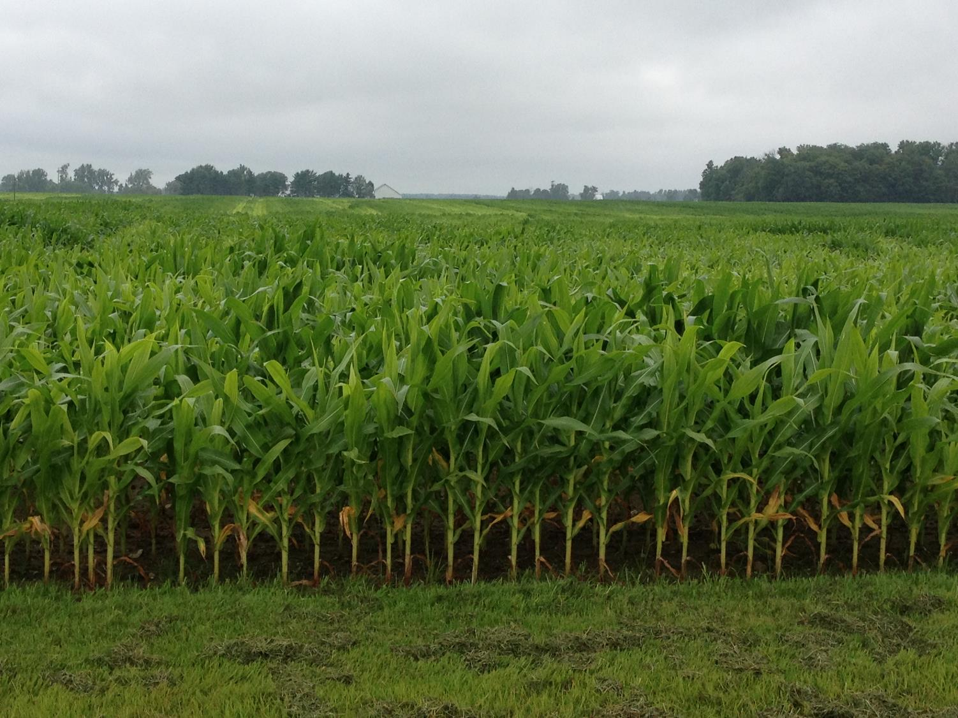
Remember the Fence Row
Notes:
We can blame a lot on the weather, however, certain parts of the field revealed significant differences in soil health. The area to the left seems to be far more resilient to the extreme saturation. In fact it was an old fence row that had been brought into production a few years ago. This area, by coincidence, had the 4 principles in place until recently. Our goal is to replicate the fence row across the landscape.

Slide 28
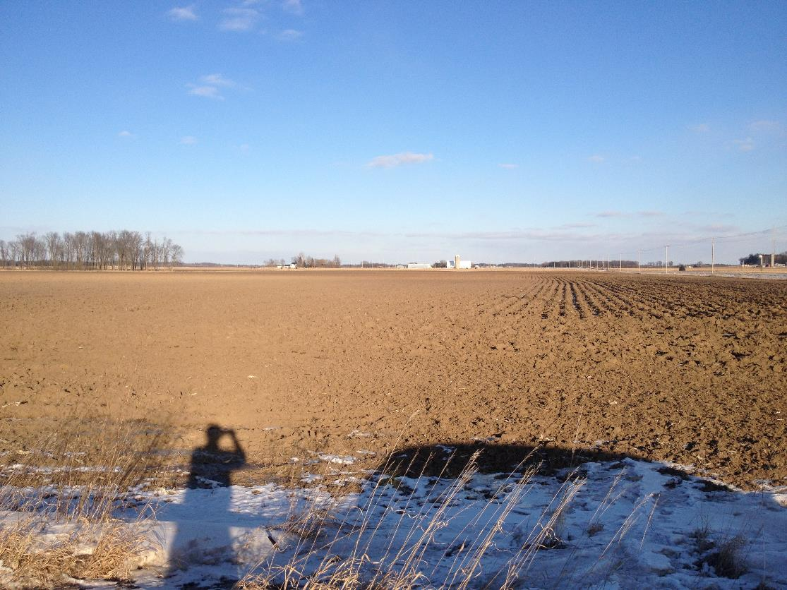
How can we rebound from a bad situation?
When in doubt…
Plow?
Notes:
Unfortunately, once the crop was determined failed or immediately after the crop was harvested, most fields received “Iron” therapy. This was probably good therapy for the frustrated farmers, but had little to no effect on improving the soil.
We have a tendency to go back to what we are comfortable with, generally tillage

Slide 29
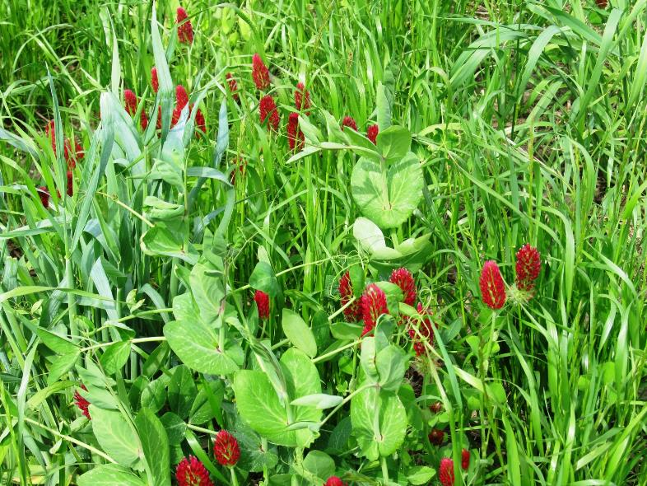
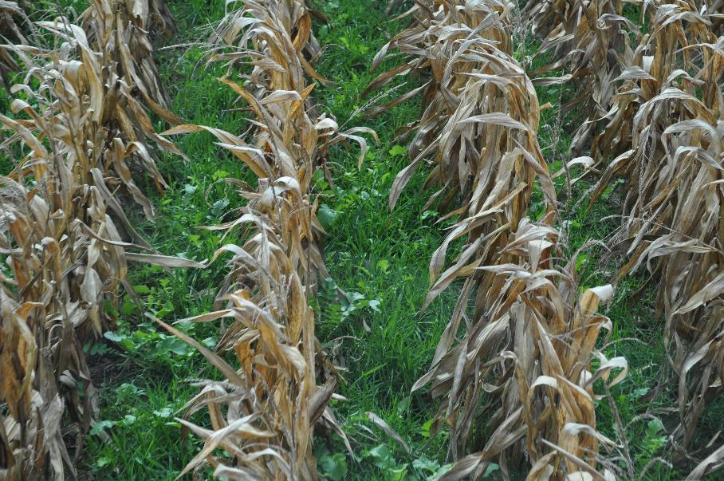
How can we rebound
from a bad situation?
When in doubt…
Plant!
Notes:
A few farmers took a different approach with a different mind set (when in doubt-plant).
Need to change our paradigm to look at soil health principles as the solution.

Slide 30
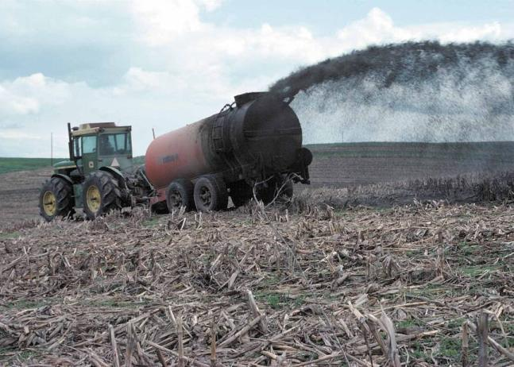
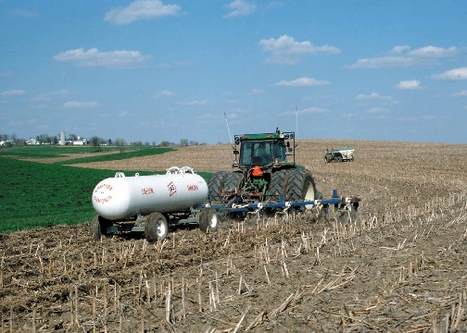
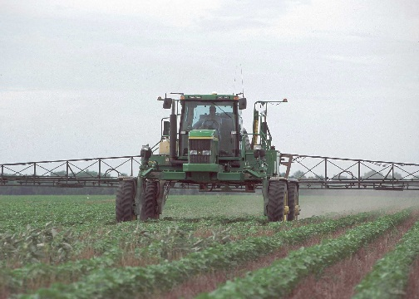
Chemical disturbances: over-application of pesticides, fertilizers and manures
Notes:
Other disturbances relate to chemicals where overapplication of pesticides, fertilizers, and manures can cause issues for the soil biology.

Slide 31
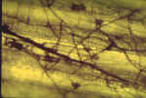
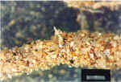

Fungi face problems….
In fallow fields,
Frequently tilled fields,
Over application of fungicides,
Over application of nitrogen and phosphorus
Notes:
This can also be a biological disturbance.

Slide 32
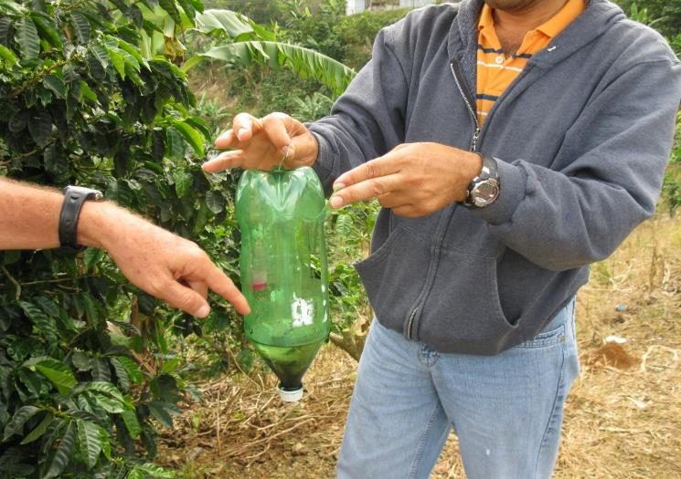
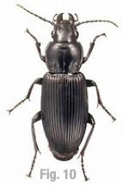
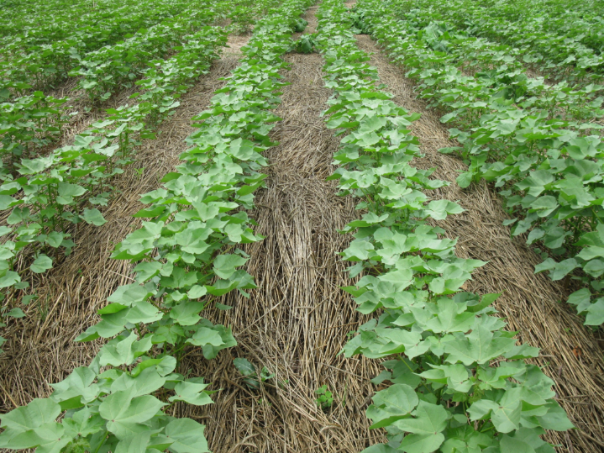
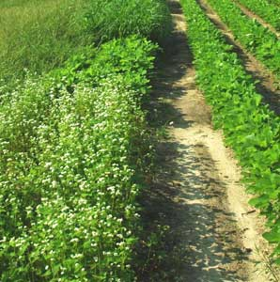
Integrated Pest Management
Prevention
Avoidance
Monitoring
Suppression
Notes:
Integrated pest management is similar to soil health management in that it focuses on sustainable management principles. IPM can aid in improving soil health by engaging in these sustainable practices and reducing pesticide use.

Slide 33
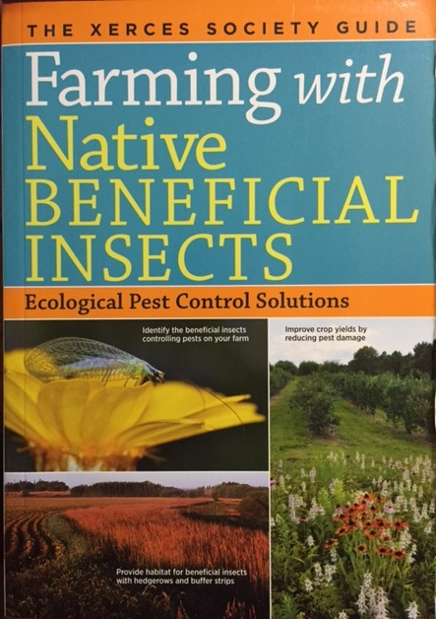
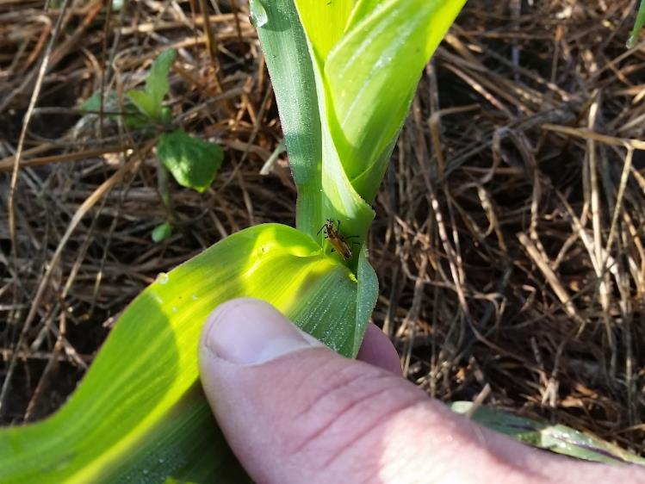
Living ecosystem
Notes:
Remember, you are creating and managing a living ecosystem! Widespread use of pesticides may be wiping out organisms critical for soil health.

Slide 34
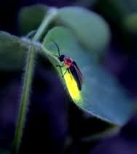
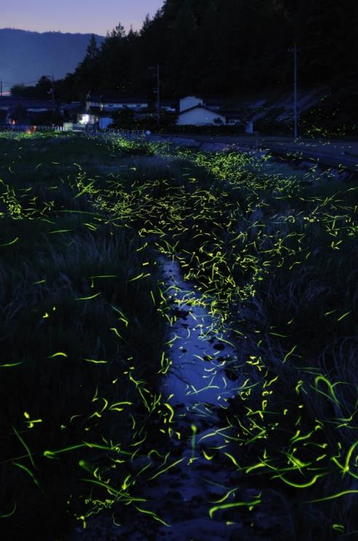
Notes:
As an example, fireflies feed on egg masses of caterpillars, slugs, etc. many of the pests that we fight in agriculture.

Slide 35

Biological Disturbance
Poor grazing practices
More than just embarrassing…
They degrade soil aggregates and reduce microbial habitat
Notes:
As we mentioned, biological disturbances can occur through the use of chemical applications but they can also be implemented through other management systems like grazing.

Slide 36


Monocultures and mono-management invites invasive species and biological imbalances.
Notes:
Ask the class to think of other biological disturbances.
Monoculture systems are a biological disturbance in that they don’t provide a diversity of food and cover for soil microbial communities

Slide 37
Minimize Disturbance
Maximize Soil Cover
Maximize Biodiversity
Provide Continuous Living Roots
Soil Health Principles
Notes:
Now we will focus on management systems that maximize soil cover.

Slide 38
Maximize Soil Cover
Many crops provide little biomass or cover
Prevents erosion
Further moderates soil temperatures
Reduces evaporation
Reduces compaction from machines and livestock
More food for microbes
Fuels the nutrient cycle
Identify practices & activities

Slide 39

More is Better!
Notes:
The more cover you can have over the soil, the better. Also, more species diversity in cover crops can enhance soil health properties. Cover crops can also provide additional cover for low biomass crops.

Slide 40
Notes:
For many farmers, the concept that more is better is difficult. We here often-”my soil is too cold and wet” . Billions if not trillions of $ have been spent on equipment and technology to mechanically warm and dry the soil.

Slide 41


66.57°F
68.90°F
Notes:
And yet, is tilled soil always warmer?...It depends on a number of factors including time of day, time of the season, moisture content, etc.

Slide 42


Carbon mat: feeds soil, keeps it cool, suppresses weeds, and protects it from raindrop impact
Notes:
If you mechanically warm your soil in the spring are you giving up moisture, air and habitat in the summer.

Slide 43
When soil temperature reaches…
140 F Soil bacteria die
130 F 100% moisture is lost through
evaporation and transpiration
113 F
Some bacteria species start dying
100 F 15% moisture is used for growth
85% moisture lost through
95 F evaporation and transpiration
70 F 100% moisture is used for growth
J.J. McEntire, WUC, USDA SCS, Kernville TX, 3-58 4-R-12198. 1956
Notes:
43
Soil temperatures are a way of determining the health of your cropland and pastures. By placing a temperature gauge on the surface can show you what kind of microclimate you have created. Soil temperatures can exceed ambient air temperatures by 10 to 20 degrees.
Plant use of moisture is directly linked to soil temperature. At 70 F soil temps 100% of the moisture is used for growth, none is loss. At 100 F you lose 85% of your moisture through evaporation-transpiration. At 113 F 100% of soil moisture is lost through evaporation-transportation, no plant growth is occurring. A plant’s natural reaction to hot temperatures is to evaporate soil moisture through their system to cool itself. Protein cooks at 120 F. Thus the plant will avoid being cooked by using all the moisture you have caught in the soil for air conditioning. At 130 F, soil organisms start to die.
So it is important to manage for cool soil conditions. This is the biggest loser of soil moisture. Hot ground means you have created a drought even during moist years.

Slide 44

Why all the buzz about
Cover Crops?
Less carbon loss here
It’s all about the carbon!
(Organic Matter)
We want more carbon here
Notes:
It’s really all about the carbon cycle. We can build it so much faster in the soil if we grow more biomass and stop losing carbon to the atmosphere through tillage.

Slide 45
Minimize Disturbance
Maximize Soil Cover
Maximize Biodiversity
Provide Continuous Living Roots
Soil Health Principles
Notes:
Now we will discuss some management practices that can help maximize biodiversity in the field which is our third soil health principle.

Slide 46
Soil Health Principles & Soil Function
Maximize Biodiversity &
Maximize Living Roots
Break disease/pest cycles
Stimulate/change belowground diversity
Increase soil organic matter
Increase nutrient cycling
Enhance plant growth
Increase predator & pollinator populations
Feed Biota
Image courtesy of Barry Fisher, NRCS-SHD
Notes:
The second two principles focus on feeding the organisms inhabiting soil. Maximizing the diversity of food (energy and carbon inputs) and aboveground biodiversity through increased plant, animal, or soil amendments increases the diversity of soil animals, microorganisms, and activities. Diversity not only refers to food sources, but also aboveground diversification of plants and animals, as well as microbial diversification underground. Diversification stimulates a host of additional benefits including breaking disease cycles, providing habitat for pollinators, wildlife, and beneficial predators, and stimulating plant growth.

Slide 47
Diversify with Crop Diversity
Plants interact with particular microbes
  Trade sugar from roots for nutrients and water
Microbes convert plant material to OM
Requires a diversity of plant carbohydrates to support the variety of microbes
Lack of plant diversity will drive system to favor some microbes more than others
Notes:
This slide focuses on how crop diversity can create diversity in soil biology.

Slide 48


Soil Biology
Aggregate stability will only regenerate biologically.
Balanced and diverse functional groups of biological populations are critical for restoring soil functions and building disease and pest defenses.
Colonizing mycorrhizal fungi and aerobic microbes (e.g.-rhizobium) build soil structure and cycle nutrients
Notes:
Maximizing diversity is really all about habitat for soil organisms… build it and they will come….feeding the soil biology. As we discussed before, without habitat, beneficial soil biology, such as mycorrhizal fungi and rhizobia bacteria that build structure and tilth, may also be lost. Without a balance of these organisms, the soils lose key functions and are subject to compaction, crusting, and high bulk density.
Observations in Tennessee…monoculture legumes will show poor to no defined aggregation. Speculation: Soil biology needs energy and will find and will digest it in and between aggregates causing them to collapse.
No cover or plant growth will cause no aggregation or poor aggregation, platy structure. Aggregates require active carbon.

Slide 49




Crop Rotations
Notes:
One of the most obvious ways to increase biodiversity is through crop rotations.

Slide 50


Notes:
Morrow Plots at the University of Illinois is the oldest agronomic experiment in the US (started in 1876).
They show a steady loss in soil organic matter but there is not as much loss in systems that have more diversity.

Slide 51
Rotating time periods
Lengthen the rotation
  2 years to 4 years, 4 years to 8 years
  consider perennials
Shorter season crop varieties
  90 day corn
  Add a winter crop
Multiple crops per year
  Double/triple cropping
  Poly cropping
  Multi-story cropping
Notes:
Rotation strategies for improving soil health

Slide 52




Increasing Peanut and Cotton Yields
with Sod Based Rotations
University of Florida
Benefits of Rotation
50 - 100% increase in peanut yields
40 fold increase in crop roots to 5 ft.
Increase in cotton yields
Reduction in parasitic nematodes
Reduced use of fungicides (25%), nematicides (100%) & herbicides (50%)
Increase in soil organic matter
Increase in water infiltration
Economic model – Increase net profit for a 200 ac. farm from < $10,000/yr. to > $40,000/yr.
Year 1
Bahia
Year 2
Cattle
Year 3
Peanuts
Year 4
Cotton
Notes:
Example that uses crop rotation to increase peanut and cotton yields.

Slide 53
Adding Diversity with Cover Crops
Supports other soil health principles (year round living roots, surface residue)
Adds diversity during non-cropping part of the year
Offers functions for specific objectives not provided by cash crops
Mixes mitigate any negative affects of single species
Increases and diversifies the soil food web
Mixes provide cover crop insurance
Notes:
Examples of how cover crops can increase diversity

Slide 54



“Passive protective blanket”
“Active protective blanket”
“Protects soil life”
“Protects and Feeds soil life”
Dr. Jerry Hatfield- ARS
Notes:
Cover is important as protection of soil life…a diverse and active cover not only protects but also feeds soil life. Like us, sooner or later they need to eat, and it can’t always be shredded wheat.

Slide 55

C:N Ratio for Various Crops
Rye
  High C:N
  Ties up N
  Compounds problem following another or ahead of high C:N crops
Hairy Vetch
  Low C:N
  Release lots of N
  Decomposes fast
Rye & Hairy Vetch Mix
  Balance C:N ratio
  Control decomposition
  Ideal cover crop mix
Notes:
Not all cover crops are created equal. We need to use covers that complement our crop rotation, provide desirable habitat and address resource concerns. Understanding differences in the Carbon:Nitrogen ratio between plants is critical for this selection.
Ask the class what drives C:N –is it the C or the N? Discuss that most plants contain 40-50% carbon so it is the N that is the driver (it is the limiting nutrient).
Ask the class how you can change the N in a plant. Vegetative vs mature, N fertilizer or N fixation by legumes.
Ask class what effects a high or low C:N ratio cover crop may have on the next crop; nutrient cycles; residue decomposition.

Slide 56


Crop Classification for Diversity
Plant morphology
  Broadleaf
  Grasses
Plant growth habits
  Cool season
  Warm season
Notes:
So if plant diversity is this important, maybe we should have a basic strategy that applies to most situations. For cropland, we try to at least get all crop types growing at some point in a rotation or together.
Why - ask the class for input. Basically, each crop type may provide a different function, food and outcome. We’ve known for years that certain crops of different crop types can be synergistic to each other (i.e. grasses and legumes). We know that different plants secrete different compounds that feed and attract different organisms.

Slide 57


Crop Classification - Warm Season
Broadleaf
Alfalfa
Soybean
Buckwheat
Chick pea
Cow pea
Sunflower
  Grasses
Corn
Millet
Sudan
Sudex
Sorghum
Notes:
These are some examples of warm-season grasses and broadleaf crops.

Slide 58


Crop Classification - Cool Season
Grasses
Barley
Rye
Triticale
Wheat
Broadleaf
Canola
Clovers
Mustards
Pea
Radish
Turnips
Notes:
These are some examples of cool-season grasses and broadleaf crops.

Slide 59


Mimic Native Range
Notes:
Mimicking native range can also mimic the positive soil health attributes found in these kinds of soils.

Slide 60


The Influence of Functional Diversity and Composition on Ecosystem Processes
David Tilman,* Johannes Knops, David Wedin, Peter Reich,
Mark Ritchie, Evan Siemann
Notes:
Aboveground biomass relates to site productivity. Therefore, up to a certain point, the greater the number of species present, the greater the productivity can be.

Slide 61


The Influence of Functional Diversity and Composition on Ecosystem Processes
David Tilman,* Johannes Knops, David Wedin, Peter Reich,
Mark Ritchie, Evan Siemann
Notes:
This is another way of showing the information, similar to the previous slide. In this case we are seeing that an increase in functional diversity (functional groups include legumes, cool-season grasses, warm-season grasses, woody plants, and forbs), up to a certain degree, also increases site productivity.

Slide 62

To Build Organic Matter We Need to Feed the Herd
An acre of healthy soil has the equivalent of 4 cows worth of microorganisms living in it. (Illustration by Eve Stika)
Notes:
You can no more starve your way to a healthy heart than you can starve your way to a healthy soil. Continuous, diverse living cover is the best food source.

Slide 63

Building Soil Diversity
How did nature make all that great prairie soil in the first place?
Notes:
The bison roamed around eating the grass. Primarily it was warm season grass and forbs but there was a tremendous amount of diversity. There is still discussion about exactly how the bison grazed. There were a lot of factors that came into play (i.e. time of year, growing or dormant grasses, available water, what areas burned, what didn’t burn). Some writings and accounts say they were in small groups grazing only in the burned areas for the entire year. These burned areas would have been grazed pretty hard while unburned areas were almost ungrazed and then the next year they moved to another burned area. There are also accounts of large herds numbering in the hundreds of thousands. As you can imagine when a large herd like this moved through an area everything probably got grazed and/or trampled pretty hard. In either of these scenarios the grasslands were severely grazed and then rested for a long period of time, severely grazed and then rested. It was this type of management that developed some of the most fertile soils in the world. I think we can use different forms of this type of management to repair our eroded and worn out soils.

Slide 64

Some Disturbance?
Chad Bitler, M.S. Agriculture Resource Coordinator (ARC)
Greenacres Foundation
Notes:
At first glance this may seem like too much disturbance, but in this system the rest period allows for rapid regeneration from the improved cycling of carbon and nutrients.

Slide 65
Soil Health Principles
Minimize Disturbance
Maximize Soil Cover
Maximize Biodiversity
Provide Continuous Living Roots
Soil Health Principles
Notes:
We’ll now move on to our last soil health principle, Provide Continuous Living Roots.

Slide 66

A. H. Heggenstaller, University of Alberta
Notes:
Without the winter cover crop, we can see the expected losses of resources in winter and spring when there is no crop being grown.

Slide 67

A. H. Heggenstaller, University of Alberta
Notes:
With cover crops, you can see the expected losses are smaller and dry matter production occurs. In some cases, sacrificing a whole crop system may be worth consideration to
maximize benefits to the soil ecosystem.

Slide 68
Root Mass in Top 4” of Soil
Notes:
In a very short window, extensive root mass is possible. This adds to the soil carbon pool and greater production/maintenance of stable aggregates.
Corn produces approx. 950 lbs. of root mass in the top 4”
Soybeans/cotton produce approx. 400 lbs.
The cover crop produces over 2500 lbs. of root biomass planted in September and terminated in mid-April

Slide 69

Grow Living Roots Throughout the Year
Increases soil microbe activity
Increases plant nutrient recoverability
Increases biodiversity and biomass of soil organisms
Improves physical, chemical and biological properties of soils
Sequesters nutrients
Increases OM
Notes:
In addition to cover we need to jumpstart the soil life and soil function.

Slide 70

Kladivko
Notes:
This slide shows response ratios of 12 soil health measures for 2016 sampling in NW Indiana. Values greater than 1 indicate a positive effect of the cover crop compared to either no cover (left) or the conventional neighbor (right) while values below 1 indicate a negative effect of cover crops relative to their comparison. Treatment pairs that were significantly different at 0.10 level are indicated by asterisks.

Slide 71



You are growing your soil livestock
Carbon for Energy
Nitrogen for Protein
Notes:
The growing roots also feed the biology in the soil that is responsible for forming stable aggregates.

Slide 72
Minimize Disturbance
Maximize Soil Cover
Maximize Biodiversity
Provide Continuous Living Roots
Soil Health Principles
Notes:
So, we’ve gone through the four soil health principles and discussed why they are important for soil health. Hopefully, once you leave this workshop, these principles will roll off of your tongue when discussing soil health. Next, we will identify the indicators in the field that will show us how well, or not so well, we are doing at adhering to these principles.

Slide 73
The following slides are optional
Notes:
The following slides are optional and may be incorporated into specific sections of the presentation depending on the trainer and audience.

Slide 74

Reicosky, 1997
Notes:
MP = moldboard plow
MP + DH2 = moldboard plow plus disk harrow twice
DH = disk harrow
CP = chisel plow
NT = no-till
How long we leave the soil open is a factor as well.

Slide 75


Slide 76

Ecological Architecture:
Source: Conservation Research Institute
©2008 Rodale institute
Notes:
Plants have a diversity of rooting systems and rooting architecture.

Slide 77





1926 Root Studies-Weaver
Notes:
We’ve been studying diversity of plants for awhile.

Slide 78


1926 Root Studies-Weaver
Alfalfa- dryland A, irrigated B
Sunflower- 2” spacing A, 8”spacing B
Notes:
Nature responds and adapts to environment

Slide 79



Slide 80
0 5 10 15 20
# of species
Diversity and Microbial Communities
Notes:
This slide indicates that as plant diversity increase so does the amount of microbial biomass in the soil as measured using the PLFA assessment.

Slide 81
Diversity and Microbial Communities
0 5 10 15 20
# of species
Notes:
This slide look at the amount for microbial respiration, it increases as the number of plant species increases.
Respiration is an indicator of activity, the more respiration the more biological activity taking place, e.g. increase nutrient cycling

Slide 82
In a study of the effects of drought on plant abundances in 207 plots of his long-term, nitrogen-addition experiment, Tilman and his collaborator, John Downing, saw that individual species’ dynamics became less stable at higher diversity. However, just the opposite happened for the system as a whole. Drought caused the productivity of the most diverse plots to fall by a factor of 2 but caused productivity to fall by a factor of 12 in the least diverse plots.
“Diversity is now recognized as one of the three or four major factors controlling the functioning of ecosystems.”

Slide 83
Mimic Nature: Biomimicry/Ecomimicry
Notes:
The great prairie soils of the world were developed with herd/livestock interaction. The animals moved in dense herds for protection from predators. They left behind dung and urine and kept moving. This will be discussed further in a later session.

Slide 84
Increase Nutrient Cycling: Herd Impact
Allan Savory
Notes:
Depending on the agenda and location it may be good to show Allan Savory’s Ted Talk video.

Slide 85
Nutrient Cycling Through Density
Notes:
The animal rumen provides additional biodiversity with organisms designed to process the fiber.

Slide 86

Nurtures Ecological Memory
Notes:
It should be noted that management is key. Merely putting some livestock on the land doesn’t assure success. We will discuss this in greater detail in later sessions.

