Slide 1
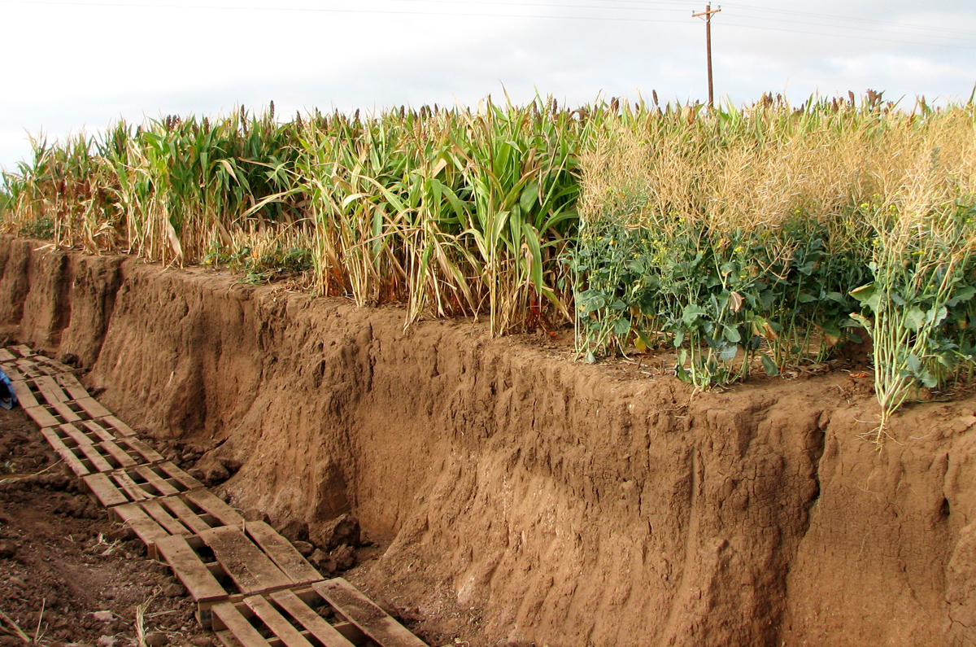

Module 2: Soil Biology
Developed by Jennifer Moore-Kucera, Ph.D.
USDA-NRCS-Soil Health Division
"In the end, we conserve only what we love.
We will love only what we understand.
We will understand only what we are taught."
~ Baba Dioum, Senegalese poet
NEXT SLIDE - Video – Birth of an Earthworm
Video courtesy of Barry Fisher, NRCS-SHD
Notes:
This module will focus on soil biology and its importance in achieving good soil health.

Slide 2

Birth of an Earthworm
Notes:
This slide is a video that shows the birth of an earthworm.

Slide 3
Goals
By the end of this lesson, you will be able to:
List at least six functions that soil microbes perform
Define and describe the three broad functional groups used to categorize soil organisms and list a few key organisms for each group
Identify and define biological hot spots in soil and key organisms living in each zone/sphere.
Describe how the soil health principles influence soil biology and soil function
Notes:
Follow material on presentation slide.

Slide 4
What are Important Soil Functions?
Notes:
Time required: ~10 min….write these on a whiteboard or flipchart
Ask participants to make a list of soil functions important for agriculture/range/forest production. Given that this module follows the Soil Health Basics presentation, they should come up with something in line with the following functions of healthy soils (**this is a good review/recap of important soil functions):
Produce food, feed, fiber, biofuel feedstocks, and medicinal products
Capture, filter, drain well, and store water
Maximizes internal nutrient cycling
Resilient to drought, temperature extremes, fire and floods
Protects plants from pathogens and stress
Detoxifies pollutants
Stores C and modifies release of gases (e.g., CO2, CH4, N20)
Stable, resisting the erosive forces of wind and water
After the list is created, ask them to put a star next to the functions that are driven by the actions and interactions of soil organisms. All of them should have a star next to them!

Slide 5
What are Important Soil Functions?
Produce food, feed, fiber, biofuel feedstocks, and medicinal products
Capture, filter, drain well, and store water
Cycle and recycle nutrients
Resilient to drought, temperature extremes, fire & floods
Protect plants from pathogens and stress
Detoxify pollutants
Store C and modify release of gases (e.g., CO₂, CH₄, N₂0)
Stability, resist the erosive forces of wind and water

Slide 6
Which soil functions are strongly influenced by the actions of soil organisms?
Produce food, feed, fiber, biofuel feedstocks, and medicinal products
Capture, filter, drain well, and store water
Cycle and recycle nutrients
Resilient to drought, temperature extremes, fire & floods
Protect plants from pathogens and stress
Detoxify pollutants
Store C and modify release of gases (e.g., CO₂, CH₄, N₂0)
Stable, resist the erosive forces of wind and water
Notes:
After the list is created, ask them to put a star next to the functions that are driven by the actions and interactions of soil organisms. All of them should have a star next to them!

Slide 7
Which soil functions are strongly influenced by the actions of soil organisms?
Produce food, feed, fiber, biofuel feedstocks, and medicinal products
Capture, filter, drain well, and store water
Cycle and recycle nutrients
Resilient to drought, temperature extremes, fire & floods
Protect plants from pathogens and stress
Detoxify pollutants
Store C and modify release of gases (e.g., CO₂, CH₄, N₂0)
Stable, resist the erosive forces of wind and water
ALL OF THEM!

Slide 8
How Many Different Types of Soil Organisms Can you Name?
Notes:
Regardless of how we define diversity and measure it, soils are home to vast abundance and types of organisms. Likely you already are familiar with many of them.
Ask participants to name soil organisms they know and write on board/flipchart or simply take notes and then read the combined list at the end. This should take only 1-3 minutes.
Answers may include: bacteria, fungi, algae, ants, beetles, mites, spiders, nematodes, earthworms

Slide 9
Soil Food Web
Global Soil Biodiversity Atlas. 2016. Orgiazzi, Bardgett, Barrios et al. Luxembourg, European Commission, Publications Office of the European Union: 176p.
Notes:
Historically, soil biodiversity was studied by mapping the soil food webs. This approach details the chain of energy transfer in soil and is based on grouping organisms according to their trophic role and food preferences. In a very simplistic manner, the food web is fueled by plants and photosynthetic bacteria that fix C from the atmosphere through photosynthesis. Other organisms then obtain their energy by breaking down plant residues and organic compounds or by consuming other organisms. During decomposition and consumption, nutrients are converted from organic to inorganic forms and made available to plants and other soil organisms (Paraphrased from Turbe et al., 2010).
Pros of the food web approach: Very useful for understanding nutrient cycling and energy flows and provided the foundation to study functional soil biodiversity.
Limitations: overlooks other important processes not based on feeding relationships, such as soil structure development, parasitism and pathogenesis. Relies on biomass and species composition, whereas activity provides a better understanding of soil biological function.

Slide 10
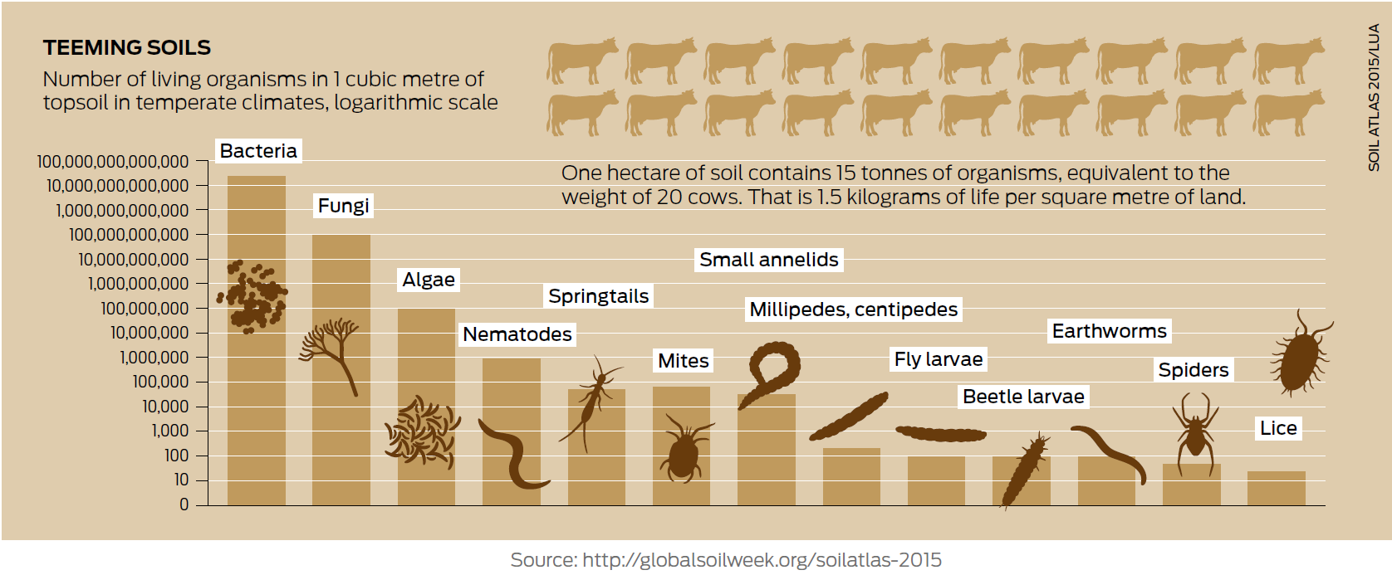
Soils Host Vast Numbers & Mass of Organisms
1.3 yd³
2.5 acres
Notes:
2.5 acres contains the weight of 20 cows of microbes in the soil. This is equivalent to about 3 lbs per square yard of soil.
Source: Global soil biodiversity Atlas.

Slide 11
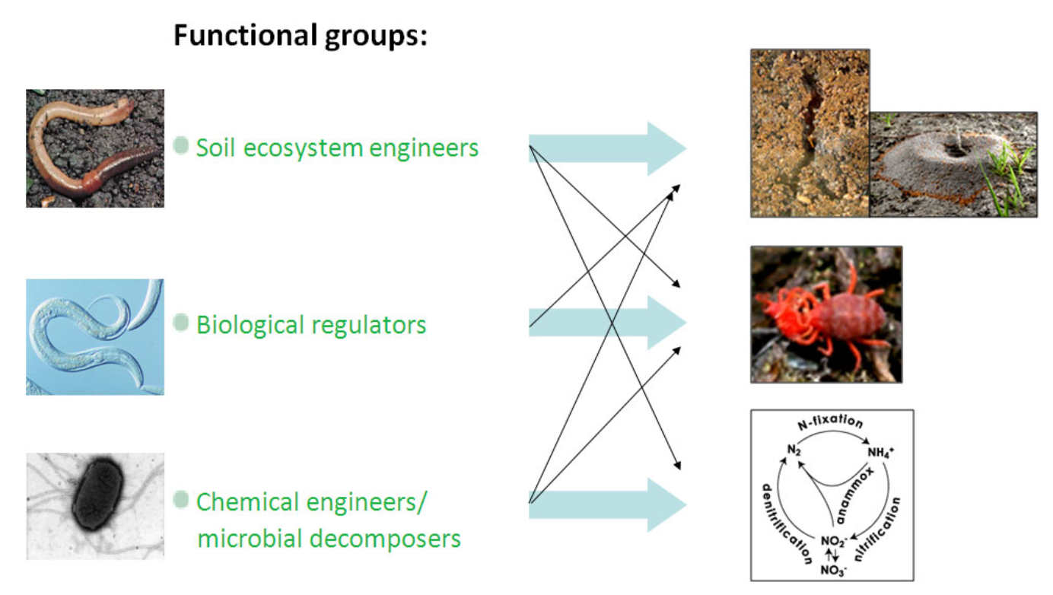
Three Broad Functional Groups
Turbe et al., 2010
Notes:
Soil organisms have coevolved for hundreds of millions of years and interact in positive (mutualistic) and negative (e.g. predator versus prey) ways. Conserving biodiversity also translates to conservation of important functions or services that the biological community provides. Keeping in mind that soil, soil biodiversity, and soil functions are complex interactions between inherent soil properties, climate, management, and the life within the soil, a simplistic view is to categorize soil organisms into the following broad functional groups. These include the soil ecosystem engineers, the biological regulators, and the chemical engineers (aka microbial decomposers).
The following slides will explain:
what these groups are primarily responsible for,
key representatives will be identified and a brief overview of specific functions,
where they are found in soils, and their abundance
The arrows crossing among and between the different groups are an indication that the groups are not exclusive to certain members and multiple members can be influential on other functions but in order to follow some structure and help us understand key groups, we will go through them by identifying the dominant players.

Slide 12
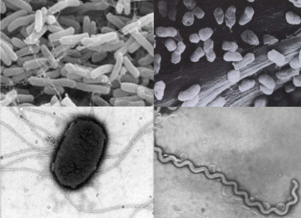
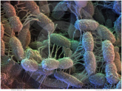
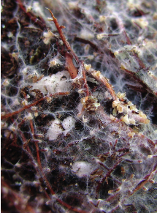
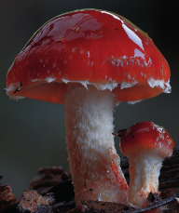
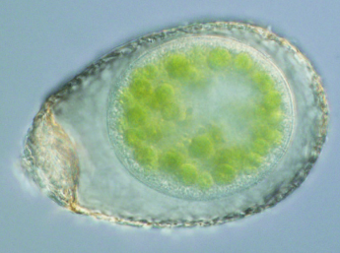
Chemical Engineers
Functional group | Function | Representative members
Chemical Engineers | Regulate 90% of energy flow in soil; Build soil organic matter and aggregates | Soil microbes (bacteria, archaea, fungi, protozoa)
Turbe et al., 2010
Notes:
Chemical engineers involve soil microbes, regulate 90% of energy flow in soil and are responsible for decomposition of plant organic matter into nutrients that are available for plants. Soil microbes are also responsible for stimulating plant growth, plant protection and the production of multiple antibiotics used for human and animal health.
Source: Turbe et al., 2010

Slide 13
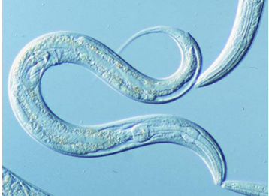
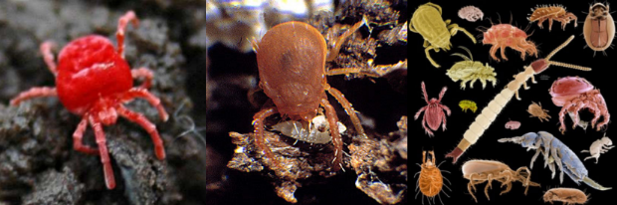
Biological Regulators
Functional group | Function | Representative members
Biological Regulators | Regulate populations of other soil organisms | Protozoa and small invertebrates (e.g., nematodes, pot worms, springtails, mites)
Turbe et al., 2010
Notes:
Source: Turbe et al., 2010
Biological regulators include small invertebrates such as protozoa, nematodes, pot worms, springtails, and mites. Through grazing, predation or parasitism, these organisms regulate populations of other invertebrates and microbes.

Slide 14
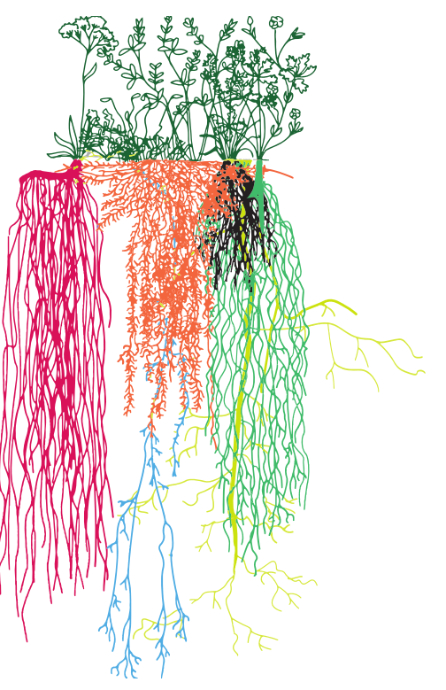
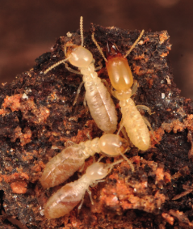
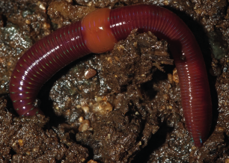
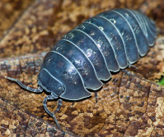
Ecosystem Engineers
Functional group | Function | Representative members
Ecosystem Engineers | Build pore networks and aggregates Redistribute soil particles, microbes, & organic matter | Plant roots, earthworms, and other larger invertebrates (e.g., millipedes, centipedes, beetles, caterpillars, scorpions)
Turbe et al., 2010
Notes:
Source: Turbe et al., 2010
Ecosystem engineers are the larger organisms such as earthworms, ants, termites, etc. as well as plant roots that modify or create their own habitat and, in doing so, create biopores that channel air and water, mix organic materials during burrowing, and help build resistant soil aggregates. By regulating resources and redistributing and regulating access to resources, these organisms create ‘hotspots’ that support high numbers of microorganisms.
A large source that fuels the entire soil system relate to the impacts of plant roots, which is the first group of ecosystem engineers to discuss.
Plant roots can cause physical weathering as they grow and expand inside cracks in the rocks. Roots and decaying vegetation also produce organic compounds such as solvents, acids and alkalinity that enhance the actions of percolating rainwater.
The two main types of root systems are fibrous and taproot. Fibrous roots are the traditional structures formed by primary and secondary roots branching in all directions in the soil. By contrast, taproots are characterized by a single firm root growing straight down, with minor roots developing on either side. Other specialized roots do exist; for example, the tuberous roots of sweet potato are modified for the storage of nutrients and water.
The number of known plant species has been estimated to be around 400,000.

Slide 15
What are the requirements of life and what makes soil living?
Notes:
Reiterate the definition of soil health…“The continued capacity of the soil to function as a vital living ecosystem that sustains plants, animals, and humans”. Then ask participants to compile a list of what it takes to be considered alive on a chart or white board (ALL PROCESSES BELOW CAN BE DIRECTLY RELATED TO THE BIOLOGICAL HOT SPOTS)
Should include:
Breathing—respiration/gas exchange
Shelter—aggregates/pores
Food source—detritus layer
Reproduction—pores/water films
Elimination—nutrient cycling
Death

Slide 16

In agricultural soils, soil organisms are optimal under the following conditions:
  Near-neutral pH (6-7.5)
  Warm soil temps (60-90°F)
  Soil water at field capacity
  Good aeration (low bulk density)
  Abundant and diverse food sources
  Diverse soil pore sizes
  Minimal contaminants, salts
C (food) is most limiting
Optimum pH, temp, H₂O, O₂, etc.
  O
http://googoogallerykids.blogspot.com/2011/02/obscure-scan-sunday-three-bears.html
Notes:
There are numerous factors that influence biodiversity and activity of soil organisms. Although microbes can exist in the most extreme environments possible, most agricultural soils benefit from the following conditions:
Near-neutral pH (6-7.5)
Warm soil temps (60-90°F)
Soil water at field capacity (moist with no excess water draining out)
Good aeration (low bulk density)
Abundant and diverse food sources
Diverse soil pore sizes
Minimal contaminants, salts
Equate these conditions to Goldilocks, needs to be “just right”.

Slide 17
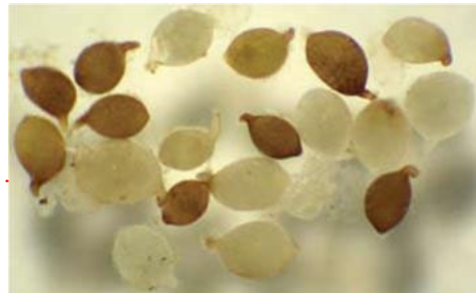
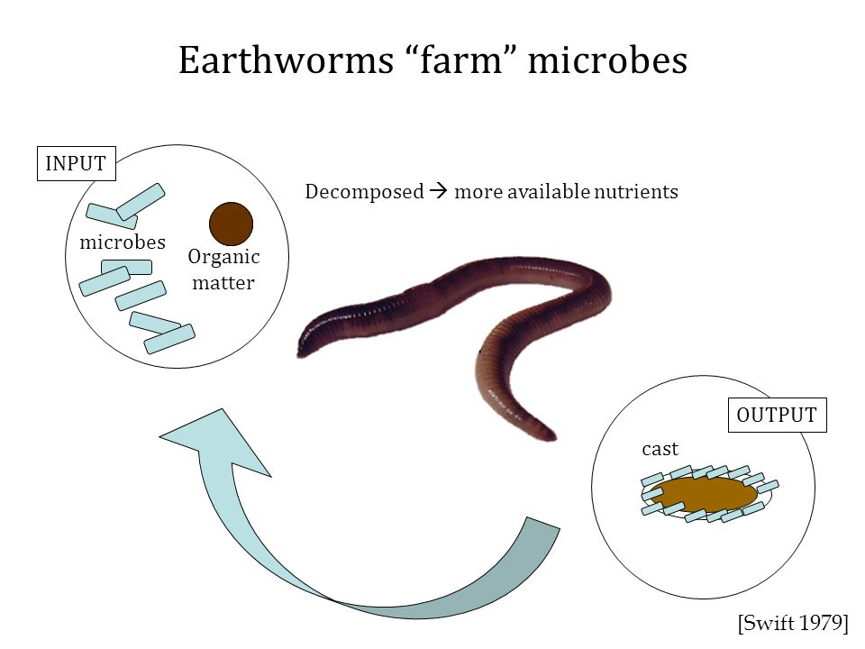
Survival Strategies, Sleeping
Beauty & Prince Charming
Cysts of nematodes; Turbe et al. 2010
https://www.youtube.com/watch?v=AnsYh6511Ic
Enter long, resistant resting stages
Majority of soil life are inactive
Fungi, earthworms, nematodes, & other fauna act as ‘Prince Charming’
Bacteria move on fungal hyphal highways
Notes:
Paraphrased from Turbe et al., 2010
The majority of life in soil is not in an active state but often remain in a resting stage that allows them to stay alive when conditions are not conducive but rebound quickly when conditions improve.
For example, over 90% bacteria in soil are inactive because they have not been able to move towards an organic substrate to use but spring to life quickly upon rewetting of soil to redistribute soluble organic C and nutrients.
If we want to encourage a diverse and healthy habitat for microorganisms we must provide food, nutrients, proper aeration, pH, water, etc.
Protists and nematodes form cysts
Bacteria form endospores
Fungi form spores
Bacteria and fungi change cell chemistry
Microarthropods can enter a state of ‘crytobiosis’ (suspended metabolism to survive extreme temperatures or dryness)

Slide 18
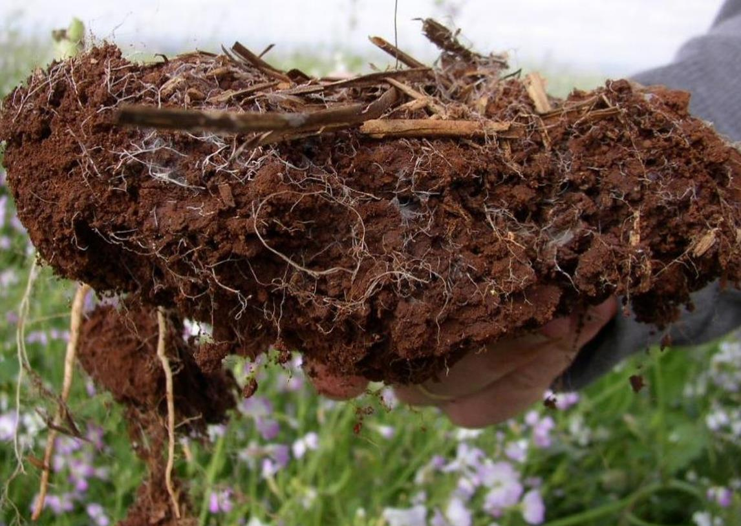
Biological Hot Spots of Soil Function
Litter layer
(detritusphere)
Earthworm & Root channels
(drilosphere)
Pore spaces
(porosphere)
Aggregate surfaces
(aggregatusphere)
Root zone (rhizosphere)
Beare et al. 1995. Plant & Soil 170:5-22 .
Kuzyakov et al. 2015. Soil Biol Biochem 83:184-199
Photo: Dr. Joao Carlos De Moraes Sa
Notes:
A hierarchical view of biodiversity as it influences the diversity in structure and function of ecosystems.
Activity idea: COLLECT SOIL FROM DIFFERENT MANAGEMENT PRACTICES AND GIVE TO DIFFERENT GROUPS TO IDENTIFY THE ZONES OF BIOLOGY WITHIN THE MANAGEMENT
The slide illustrates the places where microbes live—if any are missing then soil health is degraded. To begin to understand how to evaluate the health of a soil from a biological perspective, we need to change our view of how soil functions. Instead of looking at profiles and texture, we need to look at the biological processes or spheres of influence that are taking place working in concert together. The following slides will run through each of these independently.
This information is taken for a paper entitled A hierarchical approach to evaluating the significance of soil biodiversity to biogeochemical cycling by M.H. Beare and others, below are some direct quotations:
Soils can be viewed as being composed of a number of biologically relevant spheres of influence that define much of their spatial and temporal heterogeneity.
They are formed and maintained by biological influences that operate at different spatial and temporal scales. Although not mutually exclusive, each sphere has fairly distinct properties that regulate the interactions among organisms and the biogeochemical processes that they mediate.
Probably more than any other biological factor, the composition and structure of plant communities determine, directly or indirectly, the physical, chemical and biological properties of soils. Individual plants can have markedly different zones of influence in soils.

Slide 19
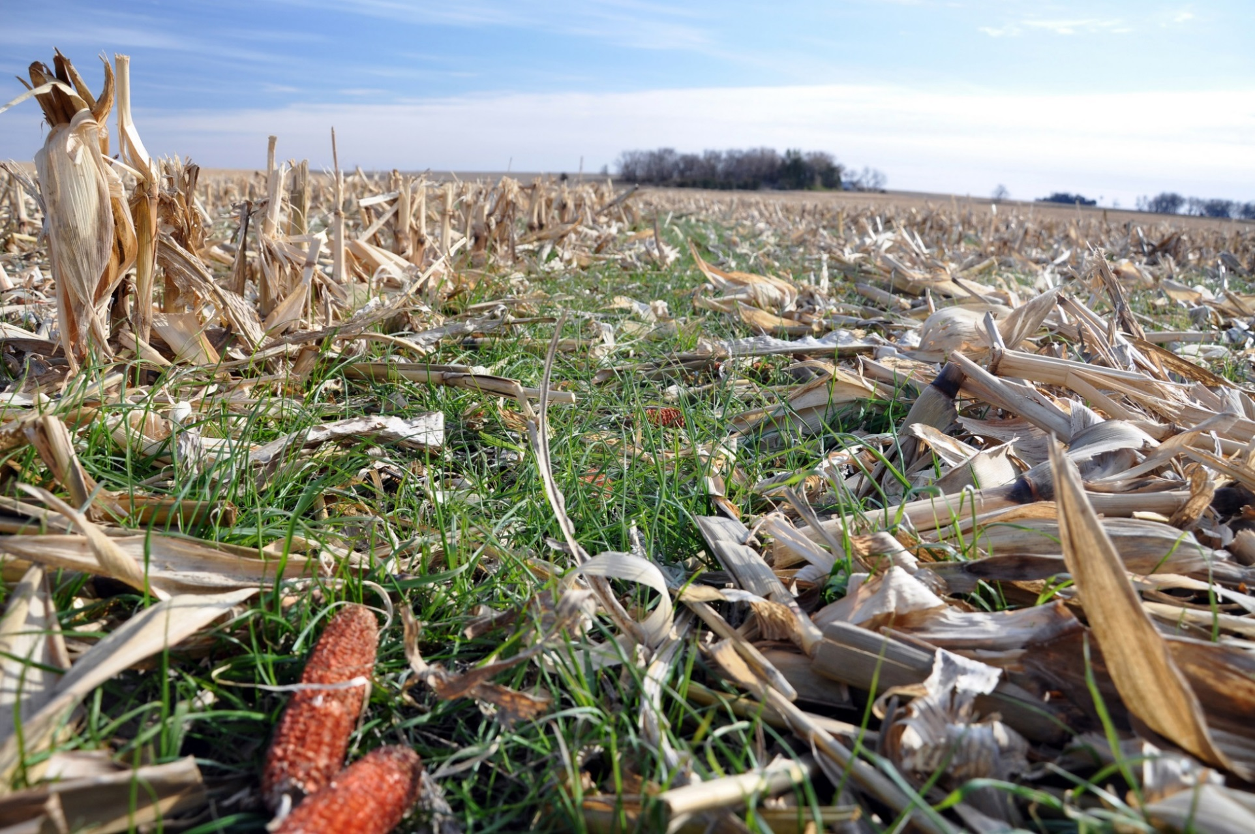
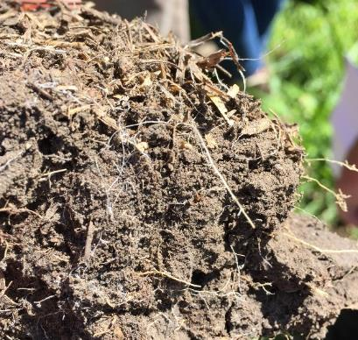
Litter Layer (Detritusphere)
Protects soil
Conserves soil temp & moisture
Carbon source for soil organisms
Photo source: NRCS
Photo: J Moore Kucera NRCS
Notes:
This is the zone above the mineral soil surface
It contains recognizable plant and animal detritus undergoing decay
It contains high concentrations of saprophytic fungi, mites, nematodes and some macrofauna (e.g., beetles, centipedes, etc.)

Slide 20
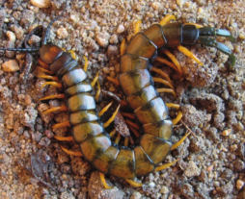
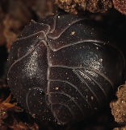
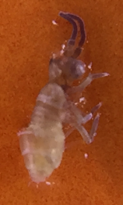
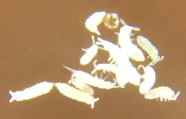
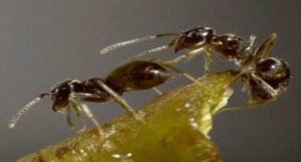
Detritusphere: Key Soil Organisms
Mesofauna (Biological regulators)
Springtails (Collembola)
Mites
Macrofauna (ecosystem engineers)
Earthworms, beetles, centipedes, ants, isopods
Notes:
Springtails and mites are tiny arthropods that eat bacteria and fungi associated with decaying vegetation.
The macrofauna help to shred, mix, and fragment residues at the surface. This increases surface area for saprophytic fungi and bacteria to release specialized enzymes that breakdown residues. They also disperse microbial spores and influence microbial activity and nutrient cycles.

Slide 21
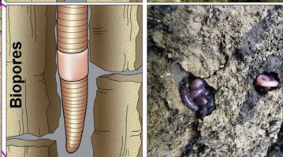
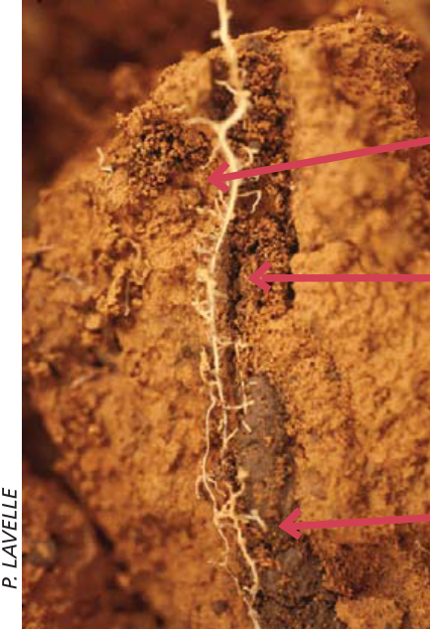
Earthworm & Root Channels (Drilosphere)
Mixes and moves residues
Large pores
Nutrient rich
Microbial enriched
Air and water flow
Roots grow & take advantage
Beare et al. 1995. Plant & Soil 170:5-22; Kuzyakov et al. 2015. Soil Biol Biochem 83:184-199
Notes:
Earthworms ingest labile (easily moved/broken down) and recalcitrant (not easily moved/broken down) organics and processes them within the hindgut of earthworms and other soil organisms (mainly invertebrates) at various depths
Redistribute plant litter “Carbon” throughout the soil the profile
Enrich soils with N, P, and humified organic matter
Increase water infiltration
Provide a biopore for plant roots
Homogenize the soil surface
Increase biodiversity in soils

Slide 22
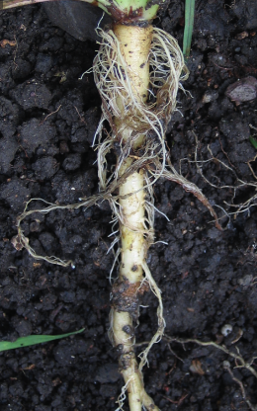
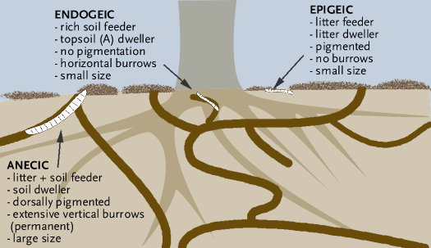
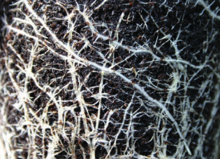
Drilosphere: Key Soil Organisms
Earthworms, millipedes, etc.
Plant roots
  Turbe et al 2010; Orgiazzi, Bardgett,
  Barrios et al. 2016. Global Soil Biodiversity Atlas.
Notes:
Zone of influence by earthworms and other microarthropods & millipedes
Function: shred and redistribute plant litter from the detritusphere throughout the soil profile
Earthworm Functions:
Decompose & relocate organic matter
Stimulate & move microbial community
Increase available N and P
Create stable aggregates
Consume and redistribute seeds
Invasive in northern forests
Creates large pores important for water infiltration and air exchange
Transport of soil microbes and labile and recalcitrant materials
Epigeic earthworms are those that live in the superficial soil layers and feed on undecomposed plant litter.
Endogeic earthworms forage below the soil surface in horizontal, branching burrows. They ingest large amounts of soil, showing a preference for soil that is rich in organic matter. Endogeics may have a major impact on the decomposition of dead plant roots, but are not important in the incorporation of surface litter.
Anecic earthworms build permanent, vertical burrows that extend deep into the soil. This type of worm comes to the surface to feed on manure, leaf litter, and other organic matter. This class of earthworms, such as the night-crawlers, have profound effects on organic matter decomposition and soil structure. Most common are members of the family Lubricidae (220 species)
May account for 50% of total soil faunal biomass in grasslands and up to 60% in some forests
10-50/ft² to 200/ft² in pastures with several thousand species
Most common are members of the family Lubricidae

Slide 23
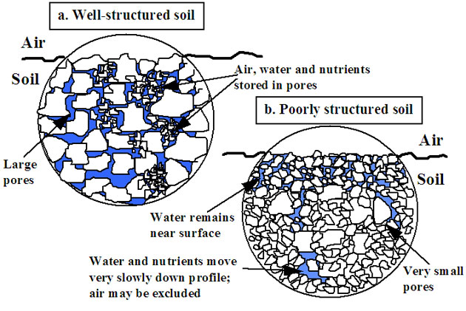
Pore Space (Porosphere)
“Lungs & circulatory system”
Air flow
Water flow, storage, & availability
Biological highways
Notes:
The lungs and circulatory system of the soil:
Regulates water and air flow
Impacts N, P mineralization
Impacts soil organism biomass and diversity
Site of nutrient exchange
Site of mycorrhizal entanglement and sequestration of water and nutrients
Root interface
Part of the water cycle
Plant roots, earthworms and other arthropods can rearrange soil particles to create smooth, cylindrically shaped macropores (biopores)
Biopores can extend a considerable distance in the soil, forming channels for preferential flow of water and nutrients
Good air exchange in the soil creates habitat in which aerobic organisms can thrive
Poor air exchange leads to anaerobic conditions, organisms that can tolerate this habitat tend to be those that cause disease and produce byproducts that inhibit root growth, e.g. alcohols
A mix of different sized pores is important
Collapse of space and large pores disrupts air, water, nutrient flows, and biological highways

Slide 24
Pore Space (Porosphere)
Organisms that colonize depend on size and resources
Many move through soil via connected pores
Nematodes and protozoa are common if prey is present (e.g., bacteria, fungi, etc.)
Notes:
Related to biopores but includes medium, small, and micropores
Regulates H₂O & air flow
Pore networks help redistribute microorganisms, nutrients, etc.
Different sizes house and protect organisms and promote a diverse habitat
Bacteria, protozoa, fungal hyphae, nematodes, etc.
Most sensitive to disturbances
Protects microbes from larger predators

Slide 25
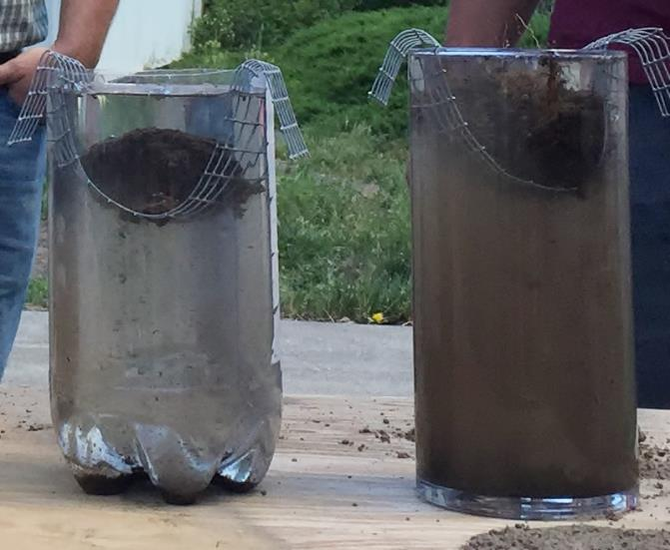
Aggregate Surfaces (Aggregatusphere)
Creates stability and
resists erosion
Protects organic matter
and microbes
Supports porosphere
Created by microbial glues, fungal hyphae, dead cells, plant roots
Photo: J Moore Kucera, NRCS-SHD
Notes:
Lack of good soil aggregation results in compacted soils that:
Restrict root growth
Provide poor root zone aeration
Have poor drainage
Soil compaction has always been thought of as a physical soil problem caused by excessive tillage and heavy equipment squeezing the soil pore space.
Compaction is actually due to a loss of soil organic matter and destruction of soil aggregates. These need to be replaced in the soil in order to provide a stable soil base in which to produce food & fiber
Soil compaction is a biological problem related to decreased production of polysaccharides and glomalin in the soil and a lack of living roots and mycorrhizal fungus in the soil.

Slide 26
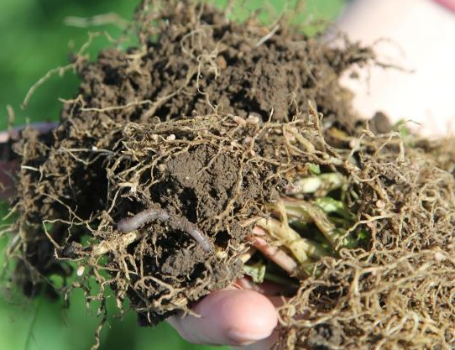
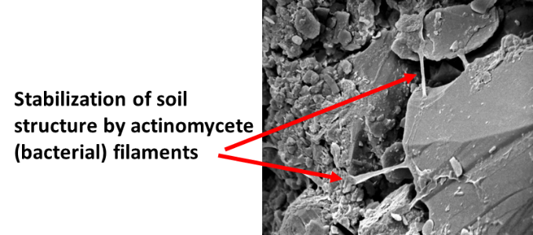
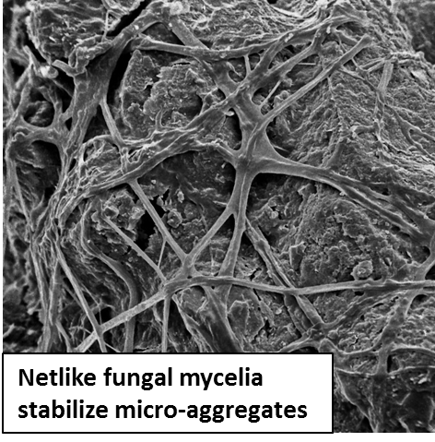
Soil Organisms Physically Stabilize Soil Aggregates
Plant roots enmesh soil particles
Earthworm casts & termite mounds
Fungal and bacterial filaments physically enmesh soil particles
Image source: Aaron Roth, NRCS-OR
SEM photo source (accessed on 6/2/2016): Eickhorst, Thilo & Tippkoetter, Rolf. Micropedology – The hidden world of soils. University of Bremen, Germany. http://www.microped.uni-bremen.de
Notes:
Follow material on presentation slide.

Slide 27
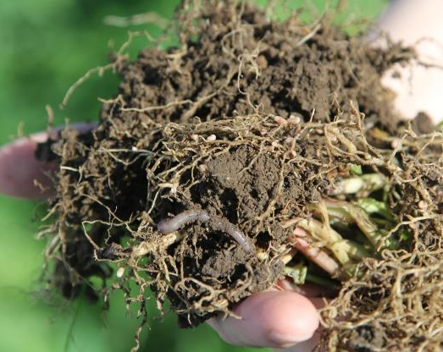
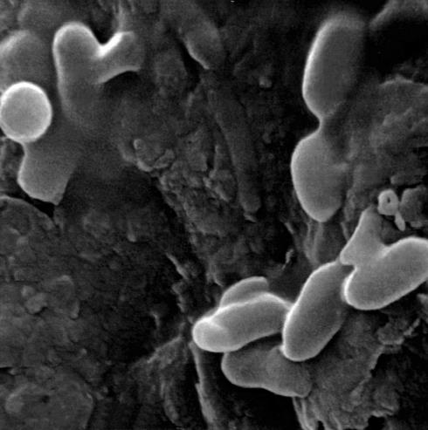
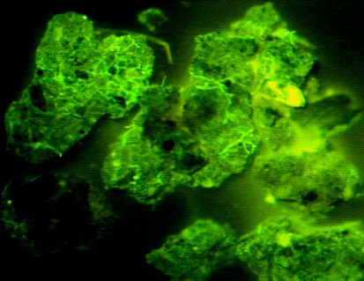
Soil Organisms Chemically Stabilize Soil Aggregates
Polysaccharides released by bacteria bind particles
Soil proteins and other biochemicals bind soil particles
Image source: Aaron Roth, NRCS-OR
Bacteria (ovals) with ‘sticky’ polysaccharides (red arrows)
Glycoproteins on soil aggregates
Dr. Nichols, USDA-ARS
SEM photo source: Eickhorst, Thilo & Tippkoetter, Rolf. Micropedology – The hidden world of soils. University of Bremen, Germany. http://www.microped.uni-bremen.de
Notes:
Tillage tends to reduce overall numbers of soil organisms, especially fungi that form hyphae and earthworms, important for soil aggregation and other soil functions. It also tends to favor increased bacterial populations and their predators (Protists and nematodes shift to bacterial-feeders). In contrast, no-till or reduced till favors higher overall populations, especially fungi and earthworms and nematodes shift to fungal-feeders.
Forming soil aggregates requires both biological and physical actions:
Need conditions that will allow for Arbuscular Mycorrhizal Fungi (AMF) colonies to be established
AMF release glues as hyphae work their way out through the soil
Hyphae entangle soil particles, realign them
Create alternating wetting/drying cycles helping to bind particles together

Slide 28
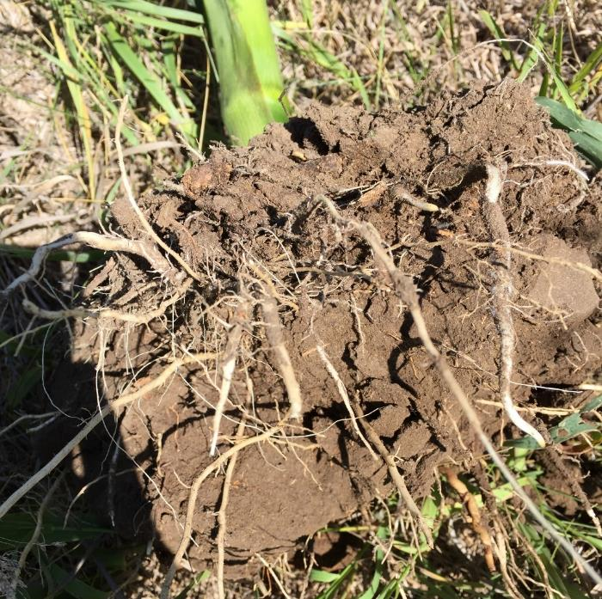
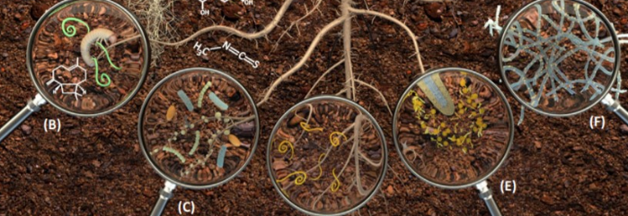
Root Zone
(Rhizosphere)
Root exudates & chemical signals stimulate microbes & predators
  Symbiosis
  Protection
  Nutrients
  Resilience
Photo: J Moore Kucera, NRCS-SHD
Trends in Plant Science 2016 21, 256-265DOI: (10.1016/j.tplants.2016.01.008)
Notes:
Highest density of roots is in the A horizon but can occur throughout profile.
Roots are important for a number of reasons: Anchor (keeps plant in soil, prevents soil erosion, holds stem upright), Absorption (water and dissolved minerals), Storage (starch and other nutrients), Habitat (provides nutrients to microbes, helps with aggregation)

Slide 29
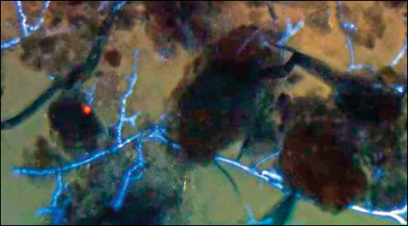
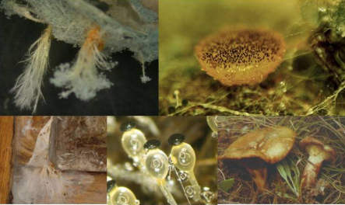
Root Zone (Rhizosphere):
Key Organisms
Plant roots stimulate microbes
Microbes: fungi, bacteria, protozoa, nematodes
Symbiosis
Chemical signaling
Nutrient cycling
http://www.soilquality.org.au/factsheets/soil-biological-fertility
  Turbe et al 2010; Coleman & Crossley 1996; Nannipieri & Badalucco 2003; Global Soil Biodiversity Atlas. 2016. Orgiazzi, Bardgett, Barrios et al.
Notes:
Different plants attract and support a different microbial community. Additional factors influencing biodiversity composition include composition of plant components, nutrient content in tissues, tissue senescence and temperature, moisture, and inherent soil properties.

Slide 30
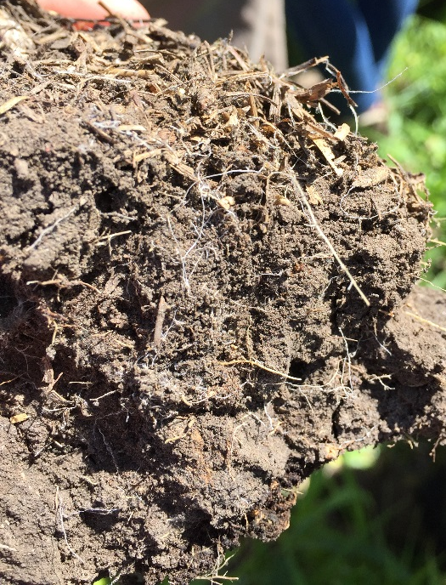
Rhizosphere: Key Organisms
Bacteria
Most numerous
2-5% of SOM but responsible for 90% of energy flow
  1 g can contain 10 million with 100s to 1000s of different species
  0.5-3 tons per acre
  (Killham 1994)
Fungi
Saprophytic
Mycorrhizal
Pathogenic
Up to 5 tons per acre
  Turbe et al 2010; Coleman & Crossley 1996; Nannipieri & Badalucco 2003; Global Soil Biodiversity Atlas. 2016. Orgiazzi, Bardgett, Barrios et al.
Notes:
Follow material on presentation slide

Slide 31
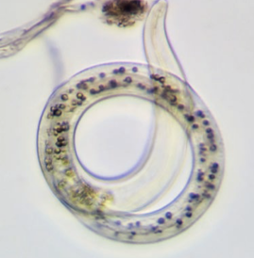
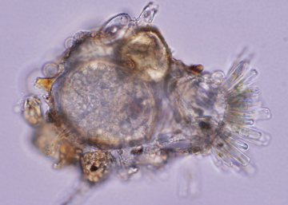
Rhizosphere: Key Organisms
Nematodes and Protozoa
Feed on a wide diversity of organisms
Key in N and P cycling
Some are pathogenic
Also common in porosphere
  Turbe et al 2010; Coleman & Crossley 1996; Nannipieri & Badalucco 2003; Global Soil Biodiversity Atlas. 2016. Orgiazzi, Bardgett, Barrios et al.
Notes:
1 gram can contain 10 or more nematodes!
One acre may contain 200 pounds of nematodes!
1 gram can contain 10,000+ protists!
One acre may contain the weight equivalent of 2 sheep of protists!

Slide 32
Key Functions of Soil Organisms
Function | Description
Decomposition | Recycle wastes, create organic matter,
Modifies soil structure | Increase amount and rate of air and water exchange; increase infiltration, drainage, and storage capacity; resist erosion
Nutrient cycling | Decomposition retains, cycles, and releases nutrients
Soil detoxification | Degrade agrichemicals, pollutants, toxins
Symbiotic/ asymbiotic assoc. | N-fixation (converts atmospheric N₂ ⬄ organic forms), mycorrhizae (increase root adsorptive surface for H₂O, nutrients
Biological population regulation | Suppress and/or feed on soil-borne plant pathogens and plant-parasitic nematodes
Weed suppression | Eat and/or decompose weed seeds
Plant protection | Enhance plant growth by protecting plants from pathogens. Example, can form biofilms around roots and sends chemical signals that influence plant response to pathogens
Notes:
Follow material on presentation slide.

Slide 33

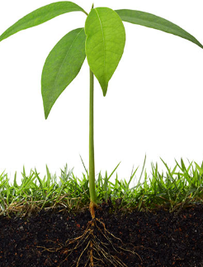
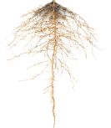




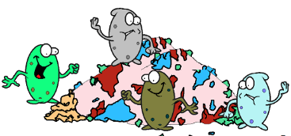


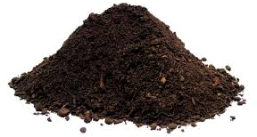
Continuous Flow of C Drives the System
Atmospheric CO₂
Respiration CO₂
“Active” organic matter C
Plant C
Microbial Biomass C
Dead microbes
SOM–C
Image courtesy of Dr. Chenhui Li
Notes:
This diagram shows how the flow of active organic matter (organic C) is the driving force of the microbial biomass and their activities.

Slide 34
Soil Biology and Nutrient Cycling
The majority of fertilizers, no matter what initial form, go through microbes before plants get it
Soil microbial biomass accounts for:
  1-5% of total organic C
  2-6% of total organic N
  ~3% of total organic P in arable soils
  5-24% of total organic P in grassland soils
Paul, 1984, Plant and Soil 76:275-285;
Brookes et al., 1984. Soil Biol Biochem, 16:169-175
Notes:
Fertilizer Use Efficiency (Annual Crops)
N: 30-70%
P: 5-40%
K: 50-80%
NUE cereal: 30-35%

Slide 35
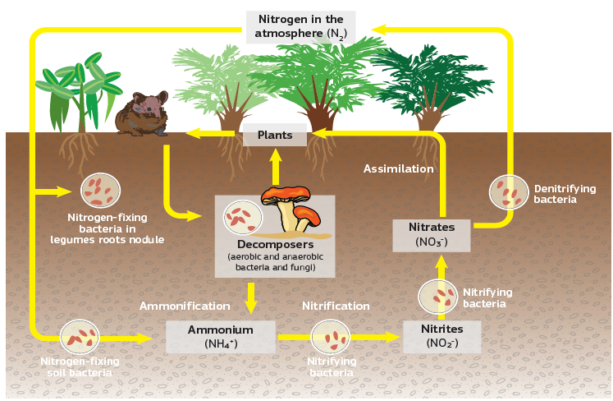
Microbes are involved in all steps of soil N cycle
N-fixation: N₂ → Organic N
Ammonification: Organic N → NH₄⁺
Nitrification: NH₄⁺ → NO₂⁻ → NO₃⁻
Denitrification: NO₃⁻ → → N₂O → N₂
Schematic representation of the main flows of nitrogen (N) through the terrestrial environment. The importance of soil bacteria and fungi in the cycle is immediately recognized as being a key element, providing different forms of N compounds assimilable by higher organisms, such as plants. (JJB, FVI, NLA, NRCS)
Notes:
Oftentimes <50% of N added is taken up into plants immediately (referenced source showed 30-70% for N; source is Agron Journal 91:357-363)
Uptake is regulated by relationships between soil microorganisms and plants

Slide 36
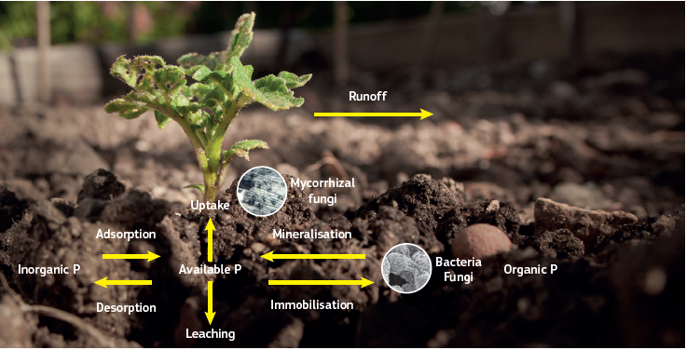
Microbes help release P from organics and minerals
Source: Global Soil Biodiversity Atlas: Simplified phosphorus (P) cycle in the soil. (DG, JRC)
P fertilizer use efficiency 5-40%
P sources mainly from ancient rocks and deposits
P binds to Al, Fe at low pH
P binds to Ca, Mg at high pH
P most available at pH 6-7
P-solubilizing bacteria and specialized fungi release enzymes and acids that release stored org-P and mineral-P
Notes:
Follow material on presentation slide.
Reference for fertilizer use efficiency for annual crops is from Agron Journal 91:357-363

Slide 37
Examples of Biological Regulators
Fungi: parasitize soybean cyst nematodes
Mites: regulate springtail (L) and
nematode (R) populations
Fungi: regulate nematode populations
Protozoa: prey on bacteria
(can consume 10⁶ to 10⁹ bacteria per day)!
http://www.extension.umn.edu/agriculture/soybean/soybean-cyst-nematode/chemical-biological-potential.html
Notes:
Examples of population control through predation, grazing, and parasitism

Slide 38
Symbiosis Example: Mycorrhizae
Mykós (fungus)- riza (root)
Plants use 5-20% of C from photosynthesis to ‘feed’ fungi
Fungi increase adsorptive root surface area at least 10x
Fungi increase nutrient uptake especially P and Zn
Fungi suppress pests and diseases
Fungal networks build soil aggregates
Notes:
Greek word meaning fungus root
Most crops are mycorrhizal including onions, corn, cotton, wheat, soybeans, potatoes, alfalfa, sugarcane, cassava, rice, most vegetables, beets, apples, grapes, citrus fruit, trees (lumber and fiber), cacao, coffee, rubber.
Some non-mycorrhizal crops have been shown to inhibit mycorrhizae in the next crops according to researchers at Penn State. These include canola, buckwheat, forage radish, camelina, and mustards.
http://extension.psu.edu/plants/crops/cropping-systems/documents/mycorrhizal-fungi-and-field-crops.pdf
(see David Sylvia’s webpage for C fluxes https://sites.psu.edu/dmsylviaweb/mycorrhiza-overview/)

Slide 39




Soil Food Web Benefits: Plant Protection Examples
Antibiotic Production
Fungi
Bacteria
Protection
Biofilm of beneficial bacteria protecting against P. syringae
http://www.udel.edu/udaily/2009/oct/bais101708.html
Chemical signals
Bacteria released abscisic acid (close plants stomata)
Predation
Soybean cyst nematode parasitized by a fungus
Protection
Roots protected from Rhizoctonia solania by springtails (left) and without (right)
http://www.the-scientist.com/?articles.view/articleNo/
34209/title/The-Soil-Microbiome/
http://www.extension.umn.edu/agriculture/soybean/soybean-cyst-nematode/chemical-biological-potential.html
Notes:
Follow material on presentation slide.

Slide 40

Aphid-hunting wasps receive signal
Aphids attack leaf
Plants under attack send chemical signal in air
Blight & other pathogens cause plant tissue death
Belowground signals bacteria to the rescue
Drought induces plant stress
Fungal mycelial networks transmit warning to neighbors
Notes:
An example of the interconnected nature of the soil/plant system…Aphids and other organisms may attack the plant because it is under stress from drought. The plant can send chemical signals through the air and soil to engage other organisms (i.e. wasps and bacteria) to attack these pests which provides food for these organisms.

Slide 41



Extract organisms using a Tullgren (aka Berlese) Funnel
NEXT SLIDE - Video - Fauna Captured from Berlese Funnel Trial
Video & photo courtesy of Jen Moore Kucera, NRCS-SHD
Notes:
This is a method that allows you to capture soil organisms and microorganisms from a sample of soil.

Slide 42

Video - Fauna Captured from Berlese Funnel
Notes:
This slide includes a video of some captured soil organisms and microorganisms using the technique.

Slide 43
How do we support biodiversity to support healthy soils?
Notes:
Not surprisingly, many biologically friendly practices are similar or same as those recommended by NRCS.

Slide 44
Soil health Principles To Support High Functioning Soils
Maximize living roots
Feed diverse, continuous inputs (C sources, energy)
Protect habitat (aggregates and organic matter)
Maximize cover
Maximize diversity
Minimize disturbance
Notes:
This is the answer to the question on the previous slide.

Slide 45

Soil Health Principles & Soil Function
Minimize Disturbance &
Maximize Soil Cover
Maintain stable aggregates
Reduce erosion and runoff risk
Buffer temperature
Reduce evaporation
Maintain soil organic matter
Protect Soil Habitat & SOM
Image courtesy of Barry Fisher, NRCS-SHD
Notes:
The first two principles focus on protection of the soil habitat: minimizing disturbance and maximizing soil cover maintains or increases stable soil aggregates and soil organic matter (SOM), and protects the fragile surface of the soil that is most susceptible to the degrading forces of wind and water. Covering the soil also buffers against extreme swings in temperature that stress plants and soil organisms, reduces evaporation rates, and increases water-use efficiency. SOM is highest at the soil surface and is critical for stabilizing soil aggregates. Maintaining SOM helps support additional soil functions including water infiltration and storage, nutrient-holding capacity and release, and habitat for soil biota.

Slide 46
Soil Health Principles & Soil Function
Maximize Biodiversity &
Maximize Living Roots
Break disease/pest cycles
Stimulate/change belowground diversity
Increase soil organic matter
Increase nutrient cycling
Enhance plant growth
Increase predator & pollinator populations
Feed Biota
Image courtesy of Barry Fisher, NRCS-SHD
Notes:
The second two principles focus on feeding the organisms inhabiting soil. Maximizing the diversity of food (energy and carbon inputs) and aboveground biodiversity through increased plant, animal, or soil amendments increases the diversity of soil organisms, microorganisms, and activities. Diversity not only refers to food sources, but also aboveground diversification of plants and animals, and microbial diversification underground. Diversification stimulates a host of additional benefits including breaking disease cycles, providing habitat for pollinators, wildlife, and beneficial predators, and stimulating plant growth.

Slide 47


Agricultural Management
Practices and Soil Health
Choose practices that feed soil organisms and protect their habitat (soil aggregates)
Lehman, R. M., et al. (2015). J. Soil Water Conserv. 70(1): 12a-18a.
Notes:
Follow material on presentation slide.

Slide 48
Managing for Biology
Manage for hot spots
Support biology to build aggregates and create pore space
Protect the habitat
Feed the soil so it can feed us
Optimize biological nutrient cycling
Optimize plant-microbe interactions for plant defense optimization
Most ag soils are carbon depleted
Disturbances destroy habitat and hyphal networks
Bare, fallow fields provide little protection, no C
Agrichemicals have mixed effects
Many fertilizer concentrations are too high for symbiosis
Notes:
Follow material on presentation slide.

Slide 49
What do living organisms need?
How can we feed soil organisms?
  Choose practices that provide diverse, near continuous inputs and build reserves (soil organic matter)
How can we provide and protect habitat?
  Choose practices that minimize disturbance of habitat (aggregates) and food sources (soil organic matter including residues)
  Choose practices that support a stable habitat from major swings in temperature, water, and chemistry
The next module will go into greater detail about these principles and identify specific practices to support, maintain, and enhance soil biology and the critical functions they perform.
Notes:
Follow material on presentation slide.

