Slide 1
The Art of Growing Gimungus Pumpkins
Adam Blalock
TSU Nursery Extension
Otis L. Floyd Nursery Research Center
McMinnville, TN

Slide 2
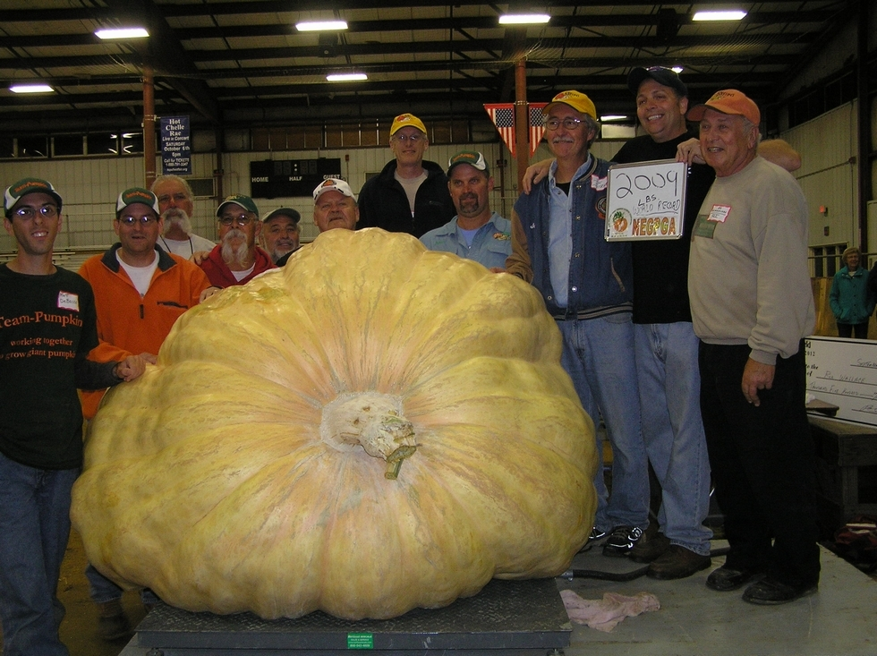
Notes:
… so if you’re a pumpkin grower, this is an extremely exciting time to be growing.

Slide 3
Some Giant Pumpkin History
1903 – World record set at 403lbs.
Howard Dill – The Godfather of pumpkins
  1978 – made a chance cross of the ‘Goodrich Giant’ and ‘Genuine Mammoth’
  1979 – broke the 76 year old world record using seeds from that cross!
2012 – the world record now stands at 2,009 pounds!!!

Slide 4
Weight (lbs.)
Year

Slide 5
The 3 most common questions a giant pumpkin grower will hear.
Notes:
What’s the number one question a giant pumpkin grower hears?

Slide 6
The 3 most common questions a giant pumpkin grower will hear.
How many pumpkin pies will that make?

Slide 7
The 3 most common questions a giant pumpkin grower will hear.
How many pumpkin pies will that make?
Did you feed it milk?

Slide 8
The 3 most common questions a giant pumpkin grower will hear.
How many pumpkin pies will that make?
Did you feed it milk?
How did you grow it?

Slide 9
How do you Grow a Giant Pumpkin?

Slide 10
How do you Grow a Giant Pumpkin?
Get the best seeds you can

Slide 11
How do you Grow a Giant Pumpkin?
Get the best seeds you can
Get your soil into the best condition you can

Slide 12
How do you Grow a Giant Pumpkin?
Get the best seeds you can
Get your soil into the best condition you can
Use the best cultural practices you can

Slide 13
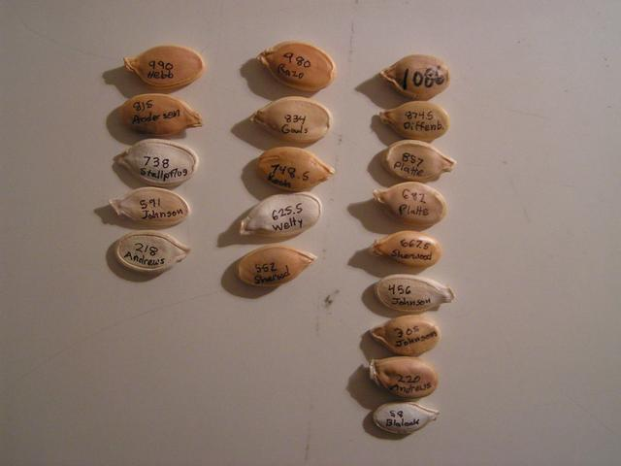
1. Get the Best Seeds You Can

Slide 14
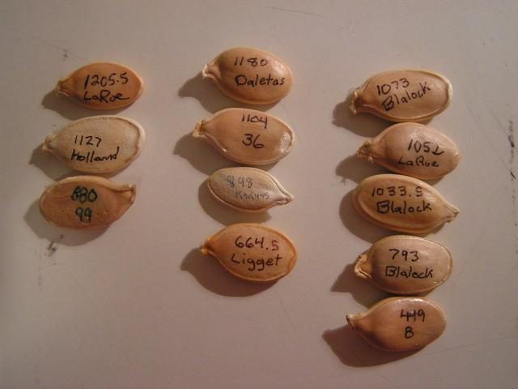
Never Underestimate the Power of Genetics
Pumpkins weight
Year grown
1046.5 Blalock, 2007
Growers last name

Slide 15
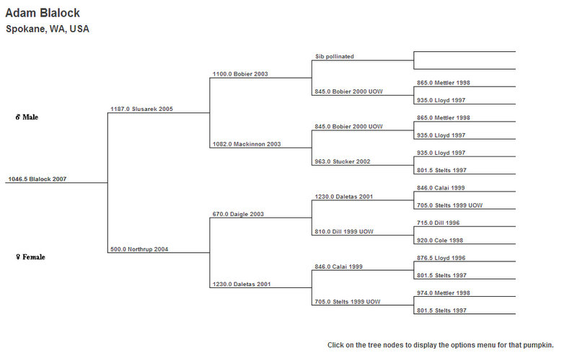
Genetics
Each Seed Will Have a Family Tree

Slide 16
Seeds
New Seeds
  Seeds with no known progeny
  High risk but…
  Potential for high reward
Proven Seeds
  Seeds at least 2 years old
  Seeds with known progeny
  Hard to get

Slide 17
2. Get your soil into the best condition you can
Soil is critical!
Well drained and high in organic matter
Old manure, leaves, and compost added annually
  5+ cu. yd. per 1,000 sq. ft.!
pH between 6.5 and 6.8
Calcium and Magnesium must not be lacking
Limit competition from neighboring trees or plants

Slide 18
My Soil Amendments Before the Plants go in
16-16-16 or 10-20-20
Gypsum – Calcium Sulfate
Calcium Nitrate
Ironite® – trace minerals
Kelp meal – seaweed

Slide 19
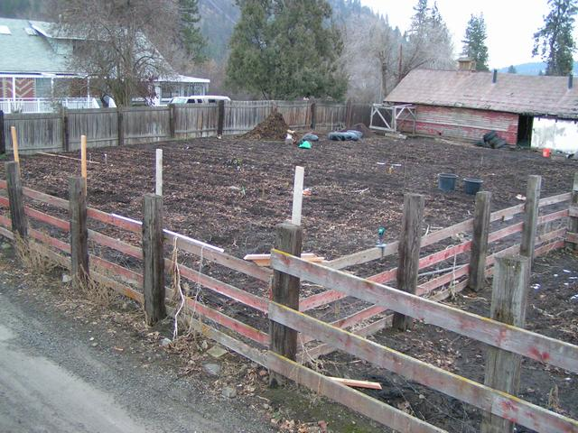
Notes:
Mid winter: Leaves were tilled in during the fall. Aged manure hasn’t been added.

Slide 20
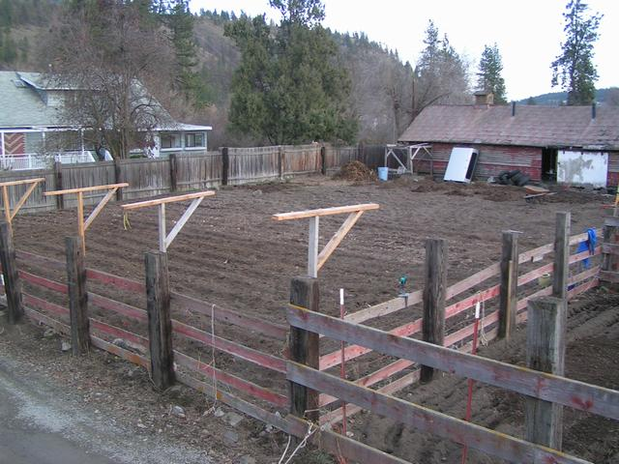
Notes:
Late winter: aged manure is added, one wheel barrow load every 4-5 feet, its spread out, and tilled in with ammendments.

Slide 21
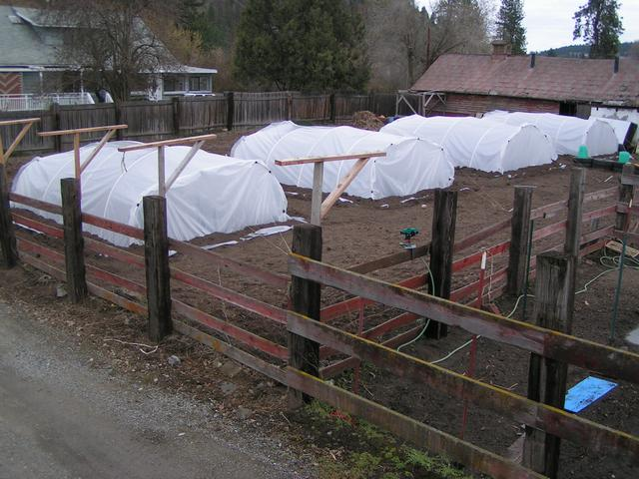
Notes:
Soil is tilled only where the greenhouses will go. The rest of the soil is tilled after the greenhouses are up. Try to have houses up for a week to warm the soil.

Slide 22
Germinating the Seeds
85 degrees consistent
Use high quality sterile seed starting mix
Media should be moist, not wet
Planted pointy end down about ½ to ¾ inch
Filing on the rounded side of the seed can help with shedding the seed coat once germinated
Don’t forget to label and record.

Slide 23
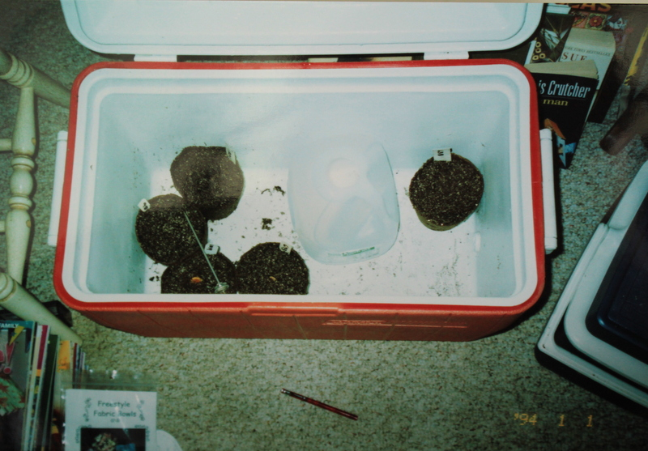
Notes:
Water heated to around 120-130 degrees every 8-10 hours. Seeds are in 4 inch peat pots with extra holes punched in them.

Slide 24
3. Cultural Practices
Avoid soil compaction at all costs
Maintain a WEED FREE garden
Train the vines correctly – Christmas tree pattern
Bury vines – they will root at each leaf axil
Maximize drainage under fruit – Sand
Erect a shade structure over the fruit
Place white towels over fruit, soak with calcium
Mist when temperatures are above 90 deg.
Fertigate 2x per week
  Once with an organic fish and/or seaweed fertilizer
  Once with a balanced waters soluble fertilizer like 15-30-15, 20-20-20

Slide 25
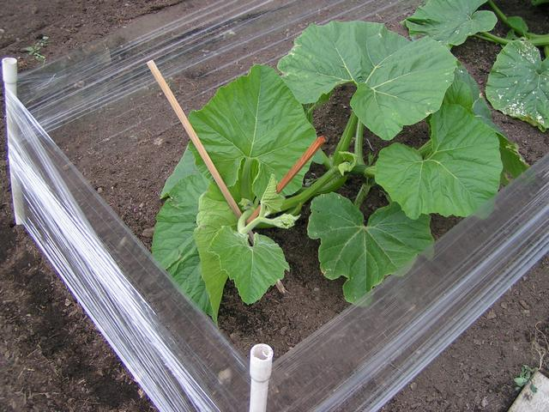
Notes:
Cling wrap makes a good wind break when plants are young before the vines can be buried. The main vine is let down slowly to avoid kinks. Always let down at the end of the day when the vine is warmest and more flexible.

Slide 26
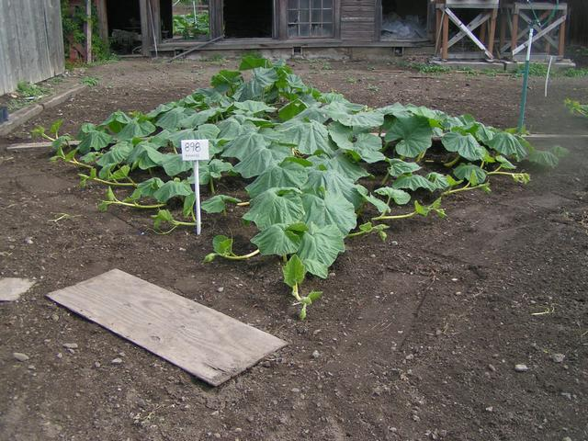
Notes:
The Christmas tree pruning method. Avoiding soil compaction. Keep weeds OUT. Vines buried. PERFECT!

Slide 27
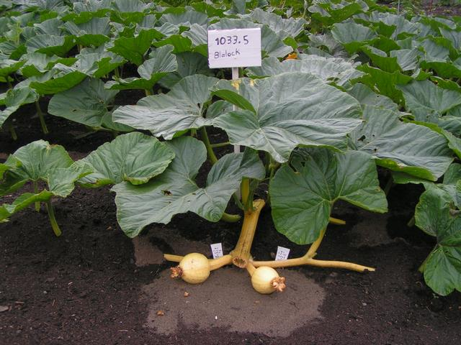
Notes:
Vine pruning technique. Flat vine. Sand for good drainage. Fruit selection.

Slide 28
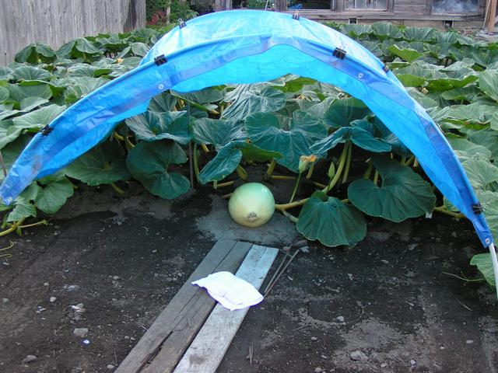
Notes:
Shade structure. Covering the fruit with white towel soaked in calcium. Avoiding soil compaction. Training vines. Burying vines.

Slide 29
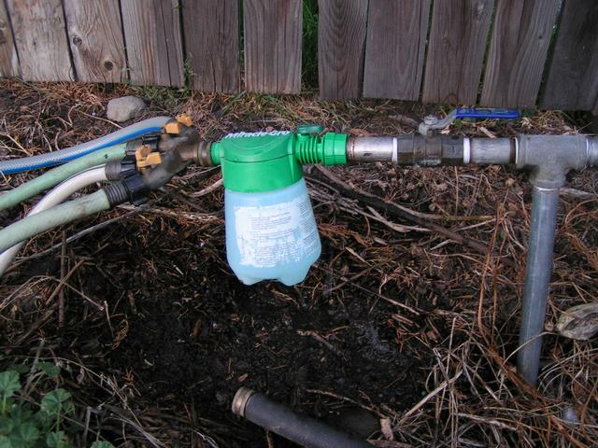
Notes:
Fertication.

Slide 30
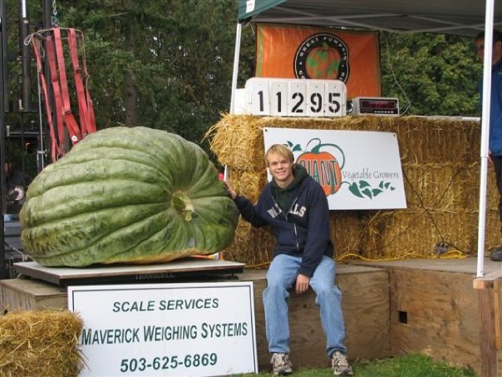
The Story of my Northwest Record Squash in 2007
Story ends in 2007
Began in 2005

Slide 31
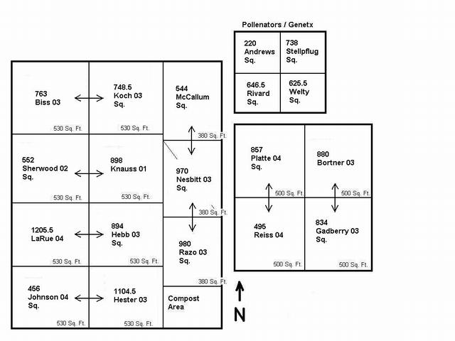
2005
Grew 20 plants including
  The 748.5 Koch
  The 625.5 Welty

Slide 32
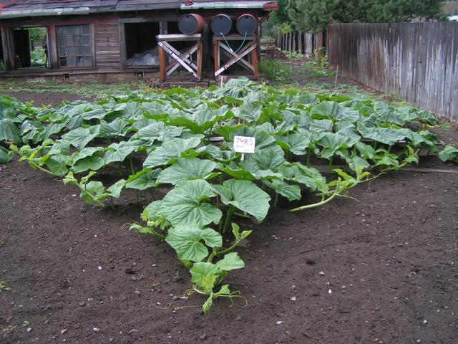
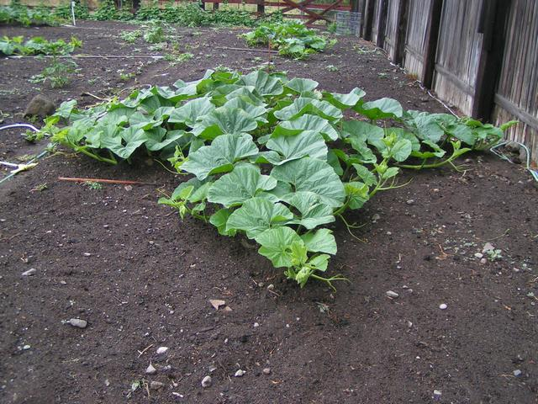
July 09, 2005
625.5 Welty
748.5 Koch

Slide 33
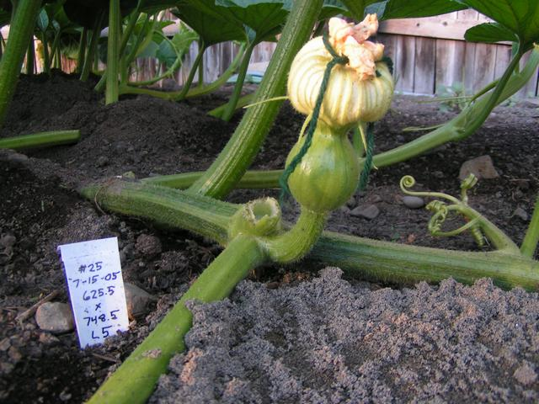
625.5 Welty
July 17, 2005

Slide 34
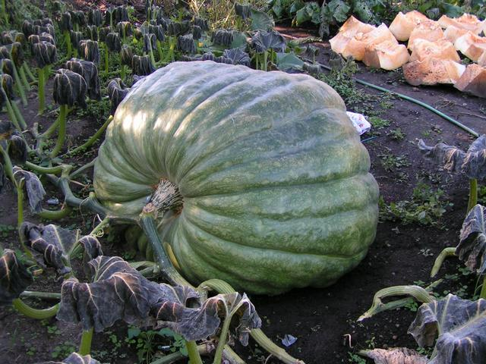
625.5 Welty
September 25, 2005
633 pounds

Slide 35
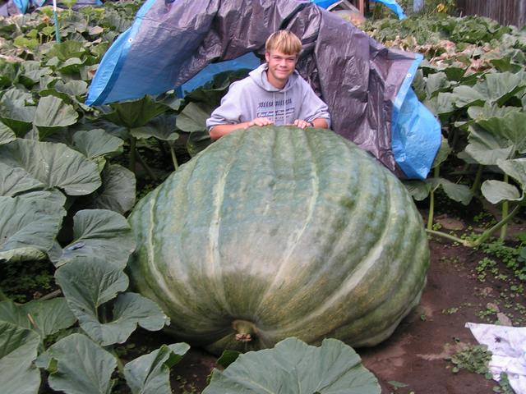
748.5 Koch
September 17, 2005
961 pounds

Slide 36
The 633 Blalock, 2005
633 Blalock, 2005 (625.5 Welty x 748.5 Koch)
?
=
X
633 lbs.
~20% +
961.5 lbs.
~10% -

Slide 37
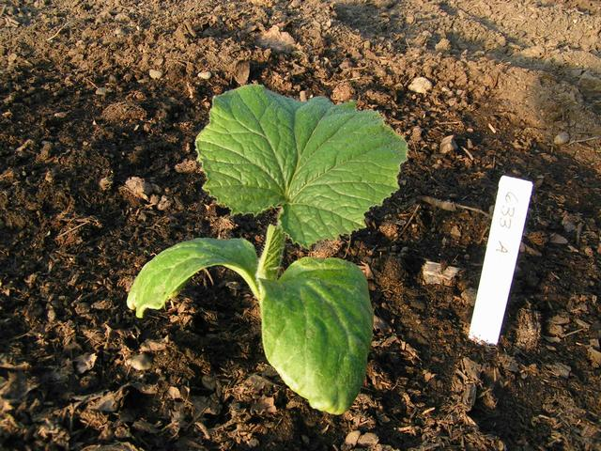
May 05, 2007
Notes:
Now the story is current. These are pictures of the actual plant that grew 1129.5.

Slide 38
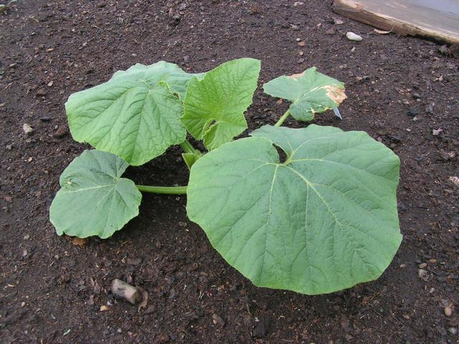
May 21, 2007

Slide 39
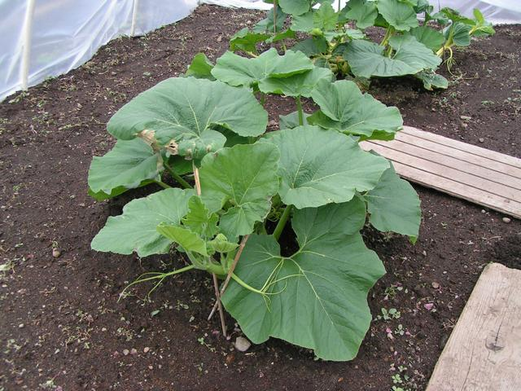
June 04, 2007

Slide 40
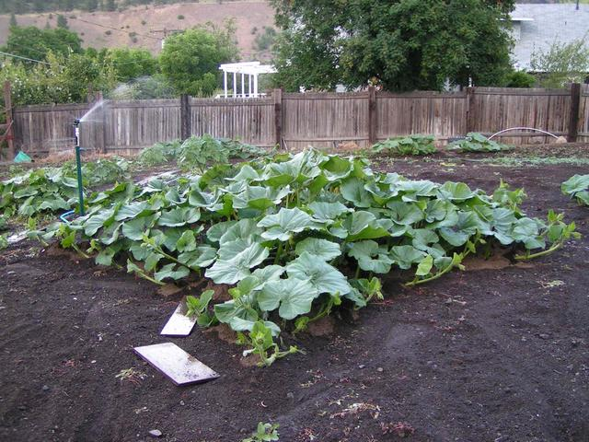
June 29, 2007

Slide 41
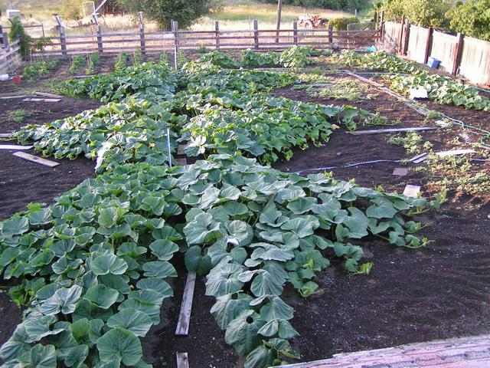
July 07, 2007

Slide 42
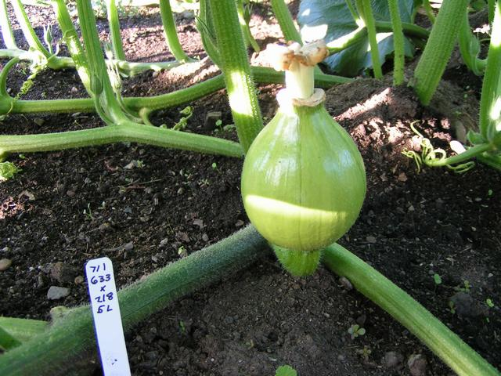
July 07, 2007

Slide 43
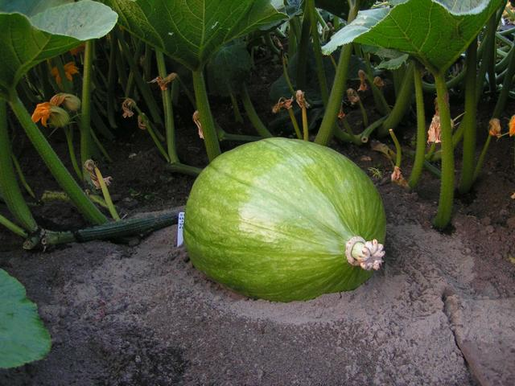
July 18, 2007

Slide 44
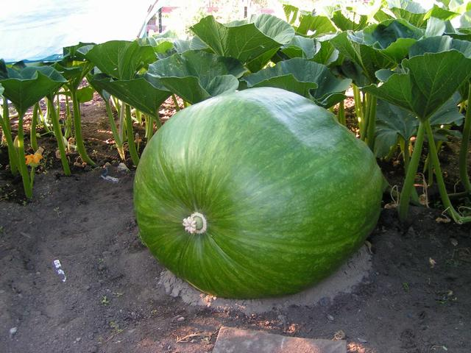
July 30, 2007
Est. 140 lbs.

Slide 45
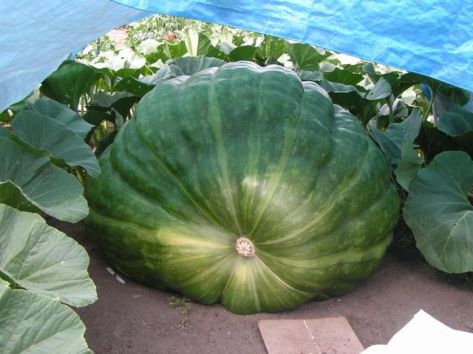
August 26, 2007

Slide 46
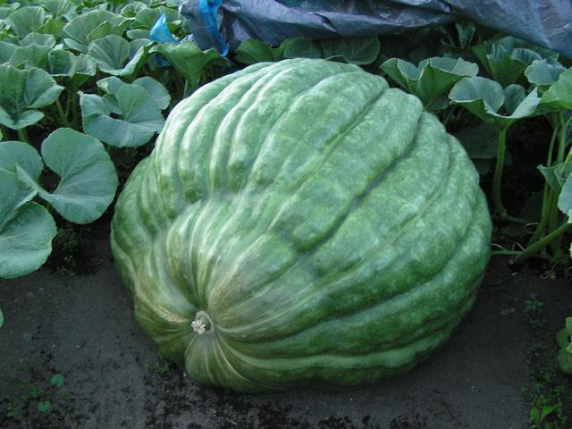
September 8, 2007
Est. 970 lbs.

Slide 47
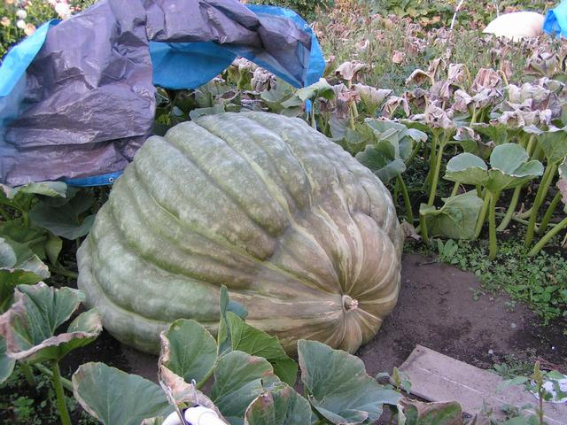
September 29, 2007
Est. 1,121 lbs.

Slide 48
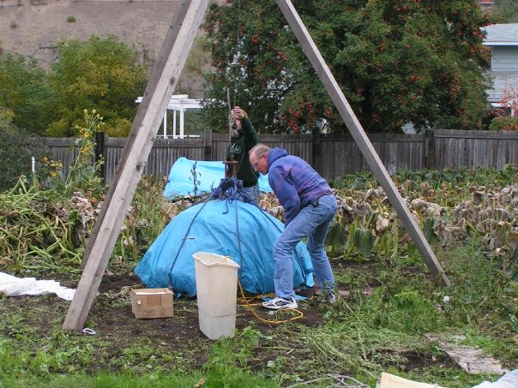
October 7, 2007
Loading the Monster

Slide 49
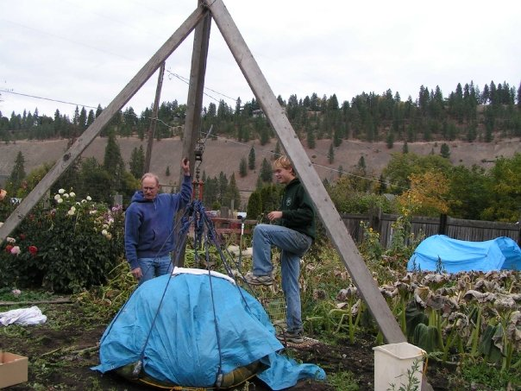
October 07, 2007
It’s kind of heavy or something…

Slide 50
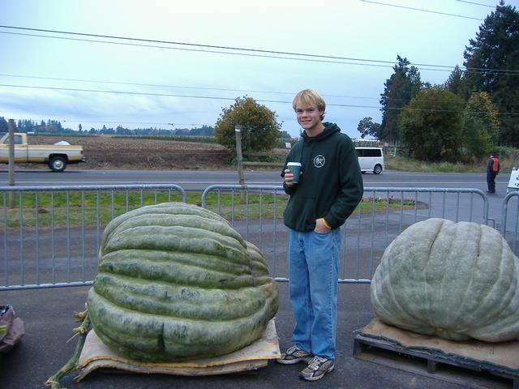
October 8, 2007

Slide 52
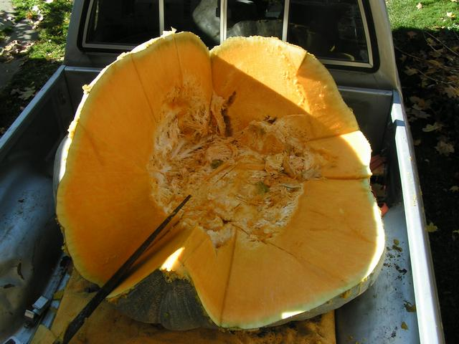

Slide 53
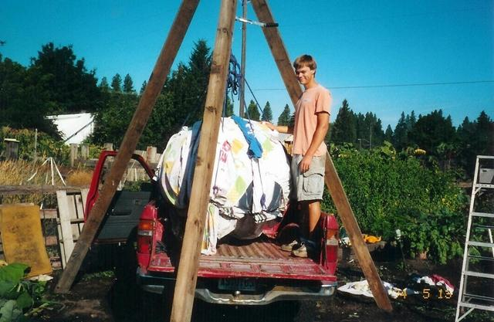
The End

Slide 54

Questions
Adam Blalock
TSU Nursery Extension Specialist
Otis L. Floyd Nursery Research Center
472 Cadillac Lane
McMinnville, TN 37110
ablaloc1@tnstate.edu
(931) 815-5169
TSU Nursery Research Center

Slide 55
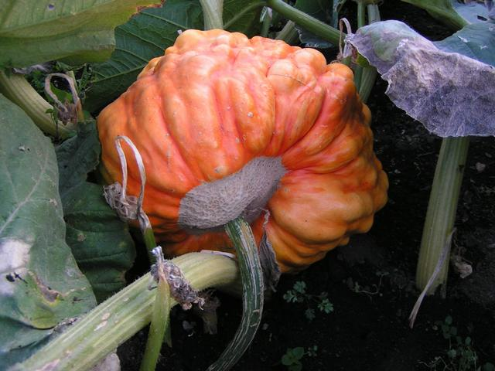

Slide 56
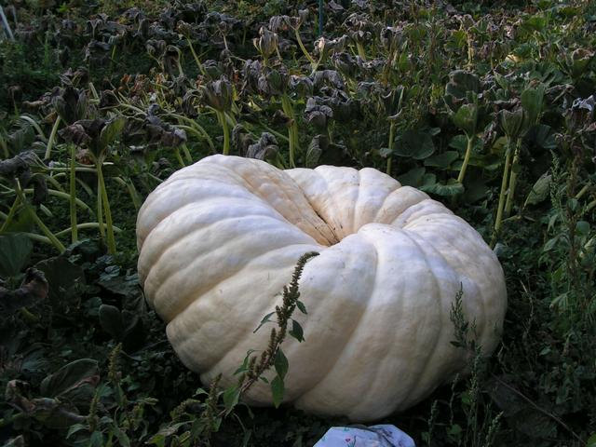

Slide 57
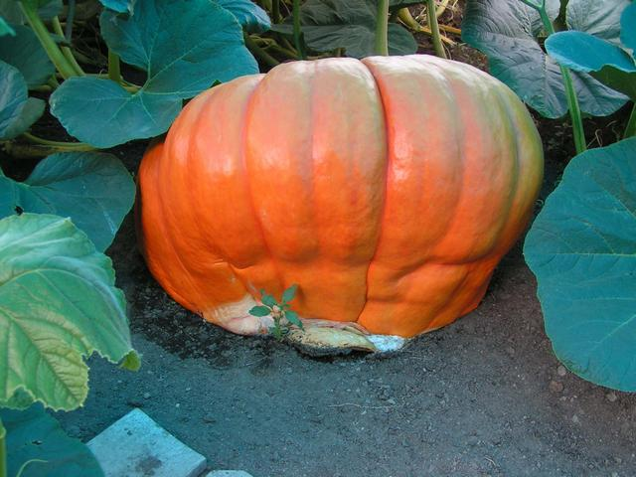

Slide 58
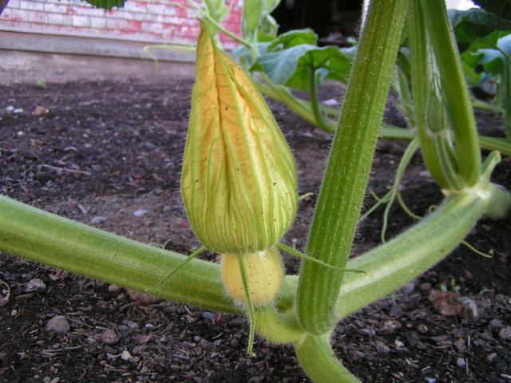

Slide 59
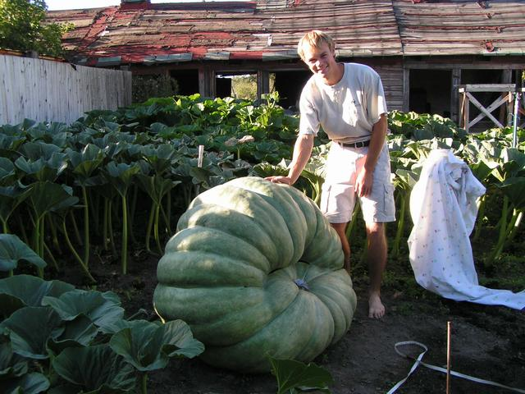
August 7, 2007
Casualties!

