Slide 1
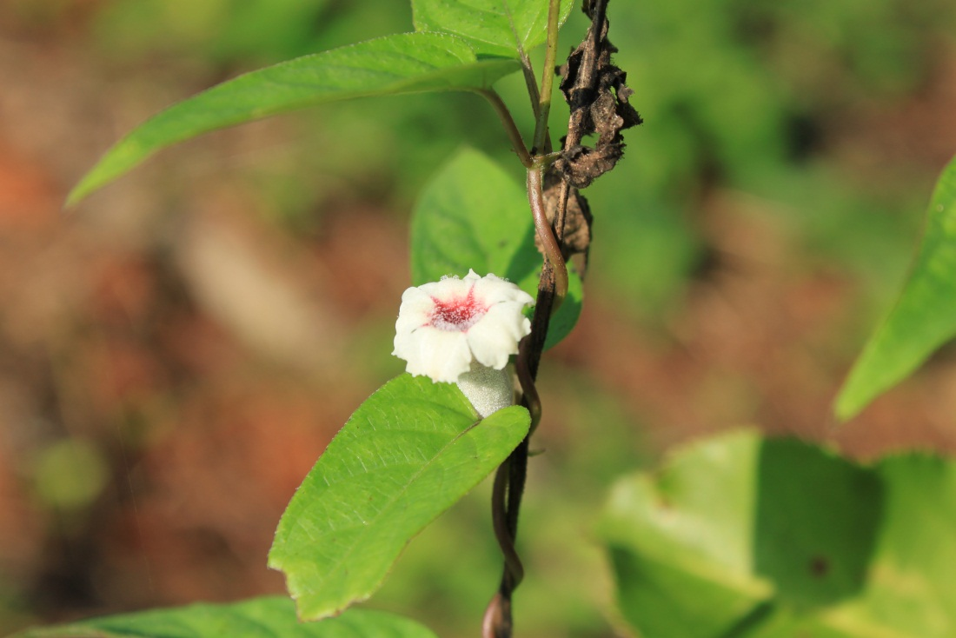
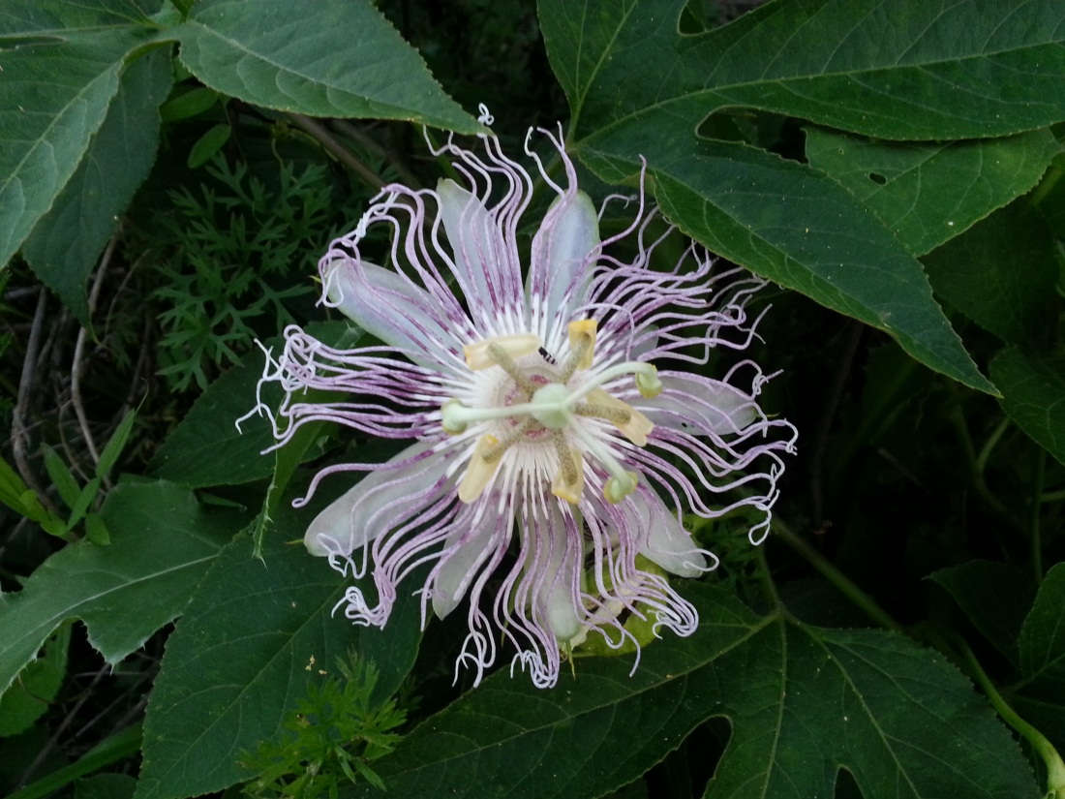
Skunk Vine and Other Weedy Vines of Tennessee
Adam Blalock
TSU Nursery Extension Specialist
McMinnville, TN

Slide 2
What is a Vine?
Vine:
  An herbaceous long stemmed annual or perennial plant requiring a support.
    Morning Glory (Ipomoea purpurea)
    Squash/pumpkins
Liana:
  A woody long stemmed perennial plant requiring a support.
    Grapes (Vitis spp.)
    Wisteria (Wisteria spp.)

Slide 3
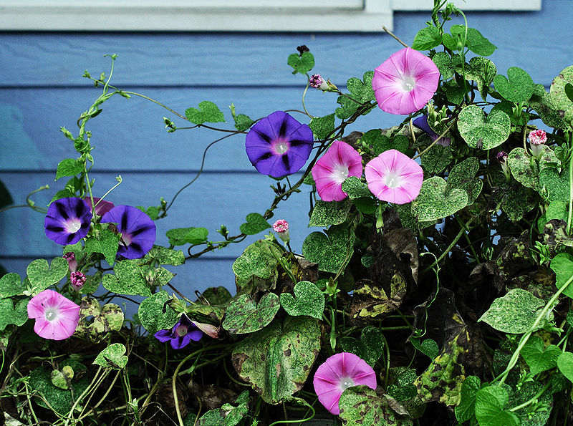
VINE:
Morning Glory (Ipomoea purpurea)
http://en.wikipedia.org/wiki/File:MorningGlories-Tonsofem.jpg

Slide 4
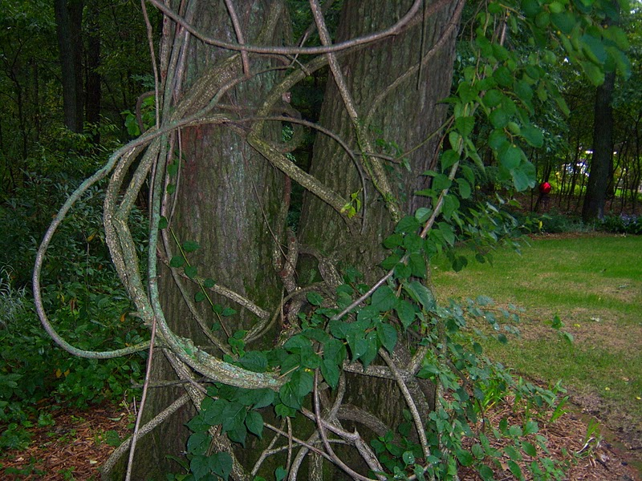
LIANA:
Bittersweet
(Celastrus orbiculatus)
http://irishgardenhouse.blogspot.com/2011/09/bitter-sweet-vine.html

Slide 5
Weedy Vines
Cupseed (Calycocarpum lyonii) – Native
Field Bindweed (Convolvulus arvensis) – Exotic
Dodder (Cuscuta spp.) – Exotic/Native
Chinese Yam (Dioscorea oppositifolia) – Exotic
Black Bindweed (Fallopia convolvulus) – Exotic
Japanese Hop (Humulus japonicus) – Exotic
Morning Glory (Ipomoea spp.) – Native/Exotic
Passion Flower (Passiflora incarnata) – Native
Goat Head Vine (Tribulus terrestris) – Exotic
Periwinkle (Vinca minor, Vinca major) – Exotic

Slide 6
Weedy Lianas
Hardy Kiwi (Actinidia arguta) – Exotic
Chocolate Vine (Akebia quinata) – Exotic
Amur Peppervine (Ampelopsis brevipedunculata) – Exotic
Wooly Dutchman‘s Pipe (Aristolochia tomentosa) – Native
Cross Vine (Bignonia capreolata) – Native
Trumpet Vine (Campsis radicans) – Native
Bittersweet (Celastrus orbiculatus) – Exotic
Sweet Autumn Clematis (Clematis terniflora) – Exotic

Slide 7
Weedy Lianas
Creeping Euonymus (Euonymus fortunei) – Exotic
English Ivy (Hedera helix) – Exotic
Japanese Honeysuckle (Lonicera japonica) – Exotic
Skunk Vine (Paederia foetida) – Exotic
Virginia Creeper (Parthenocissus quinquefolia) – Native
Kudzu (Pueraria lobata) – Exotic
Green Briar (Smilax rotundifolia) – Native
Poison Ivy (Toxicodendron radicans) – Native
Grape (Vitis spp.) – Native
Wisteria (Westeria spp.) – Exotic/Native

Slide 8
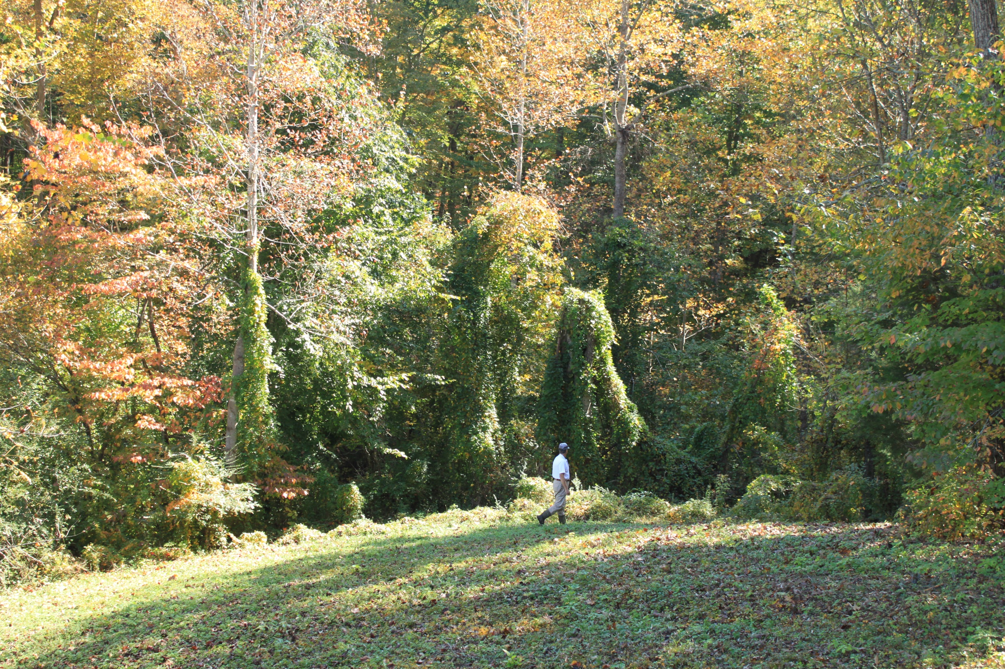
Skunk Vine
(Paederia foetida)

Slide 9
Skunk Vine
Twining woody vine native to Southeast Asia, Japan, and India
Introduced to central Florida prior to 1867 as a fiber crop
Became “problematic” in 1916
Category 1 (of 2) Florida Exotic Pest
Ability to grow in a wide range of conditions (including standing water!)

Slide 10
Skunk Vine
Family: Rubiaceae (20 genera native to FL.)
  Genus: Paederia (0 species native to FL.)
    Species: foetida and cruddasina (exotic weeds)
Few (if any) predators in N. America
Hardiness: Zone 6 (in Japan)
Deciduous from central Florida north
Dispersed via (birds), vegetative rooting, and humans
Key identifying feature: Smells like sour broccoli

Slide 11
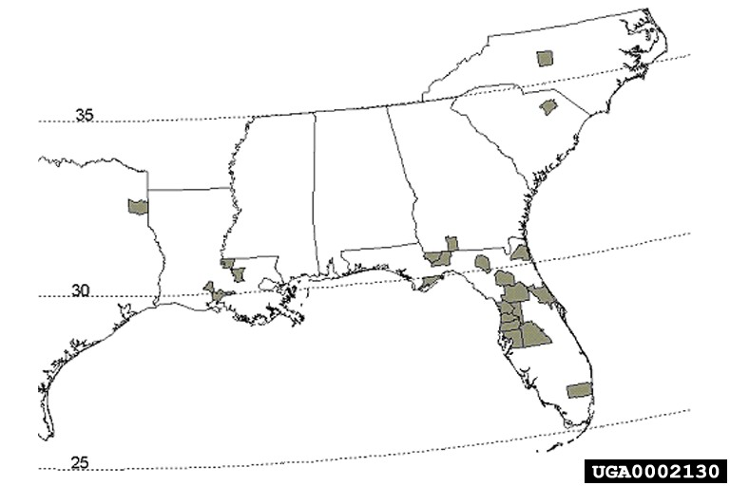
Skunk Vine
Distribution Map
1999
http://dnr.state.il.us/stewardship/cd/biocontrol/27skunkvine.html

Slide 12
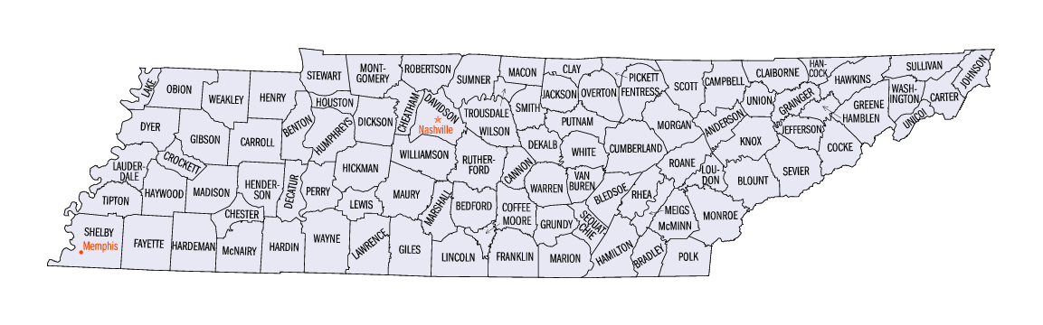
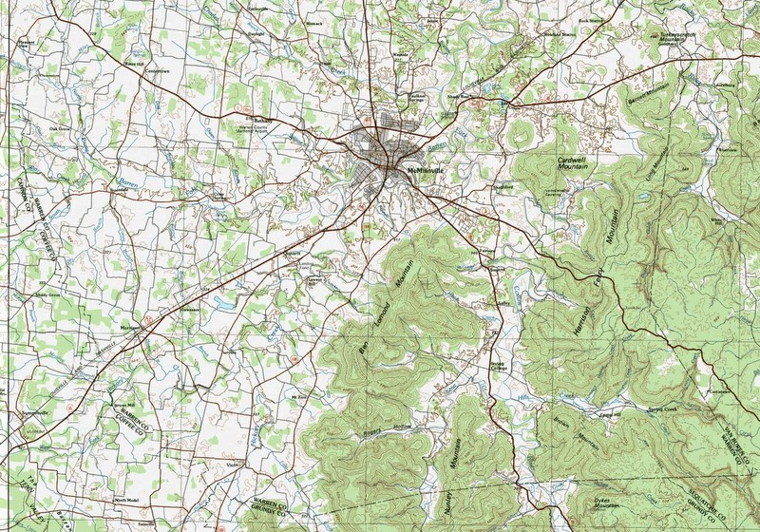
Skunk Vine
In Tennessee
McMinnville

Slide 13
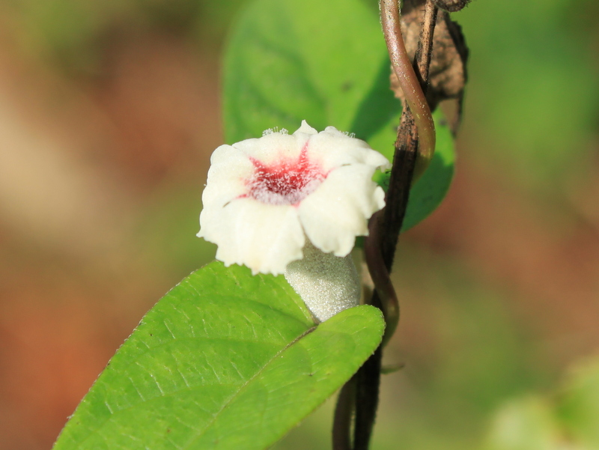
Skunk Vine Flower

Slide 14
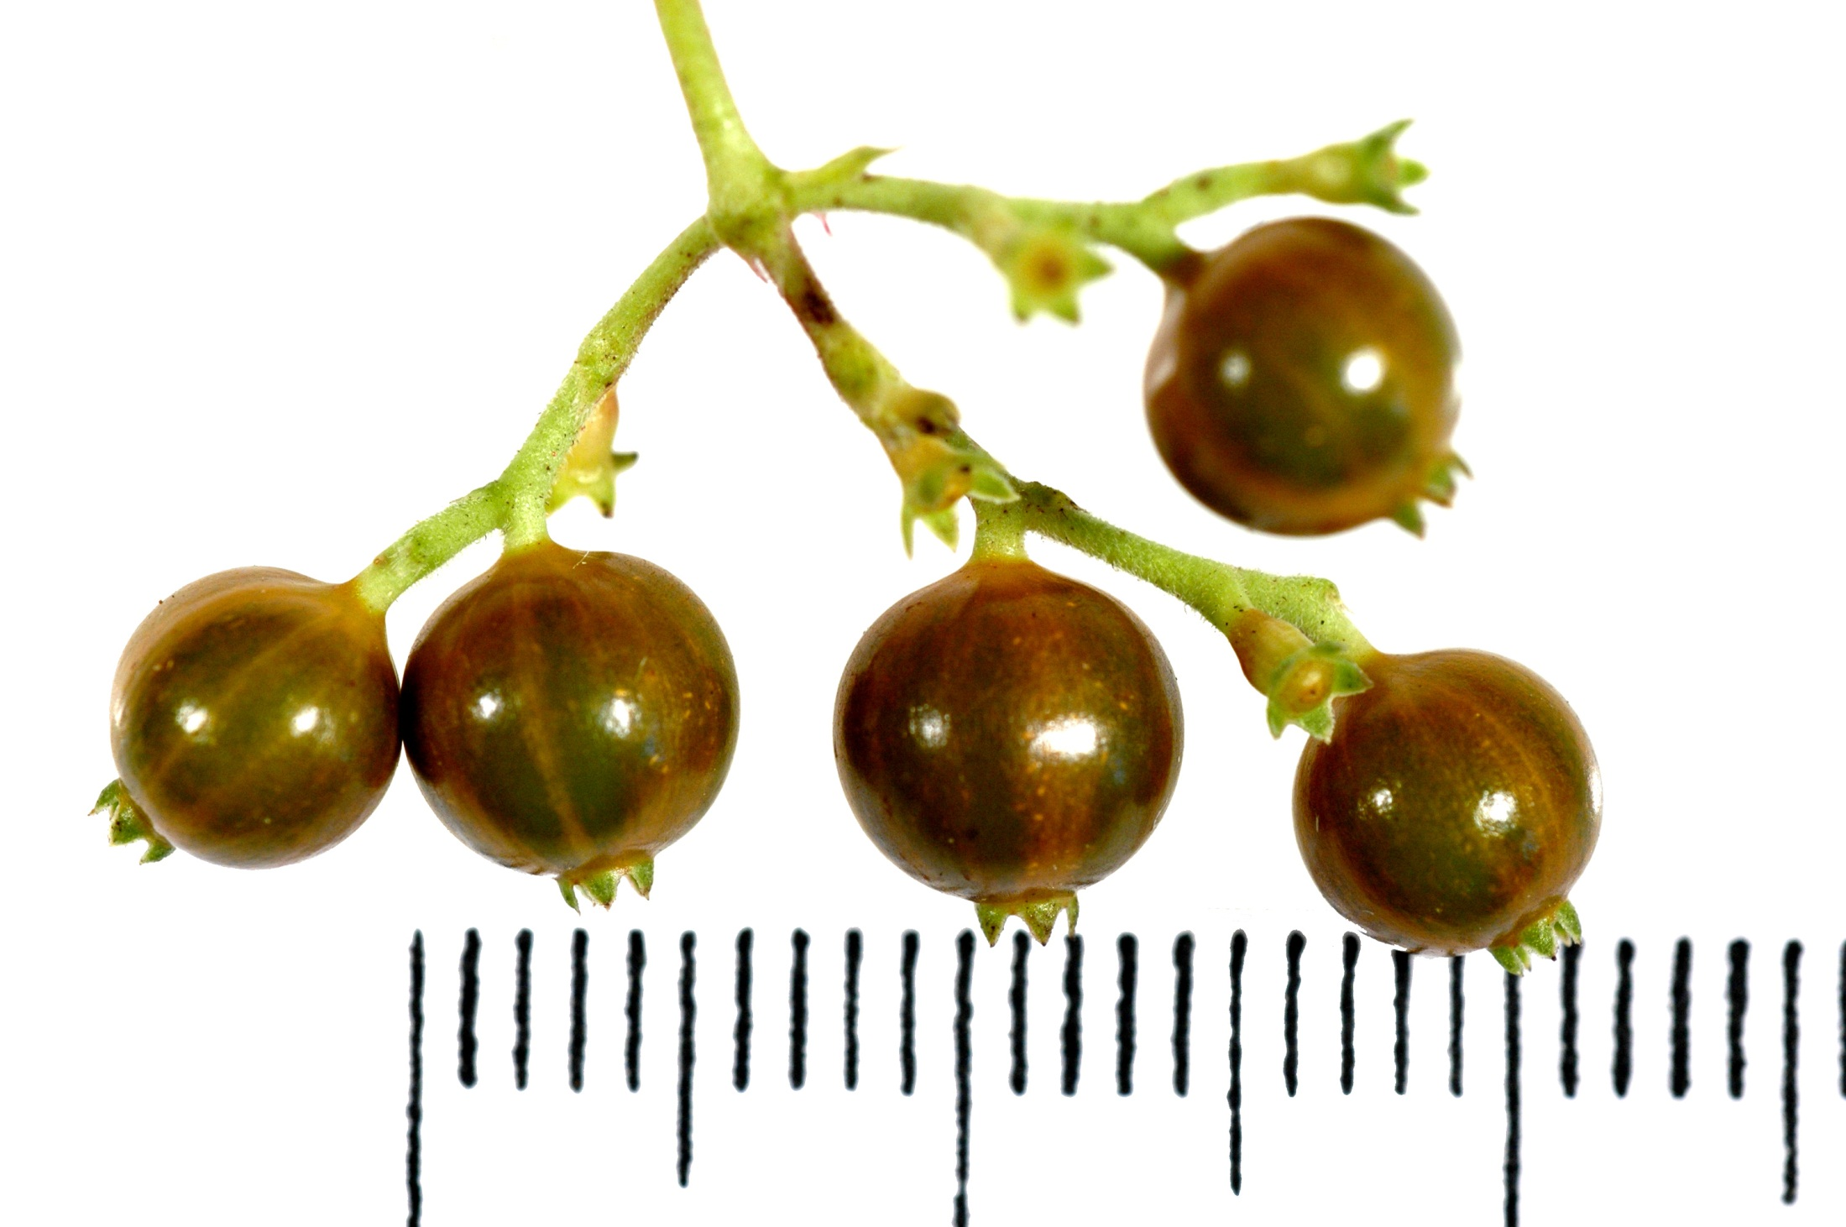
Skunk Vine Berries

Slide 15
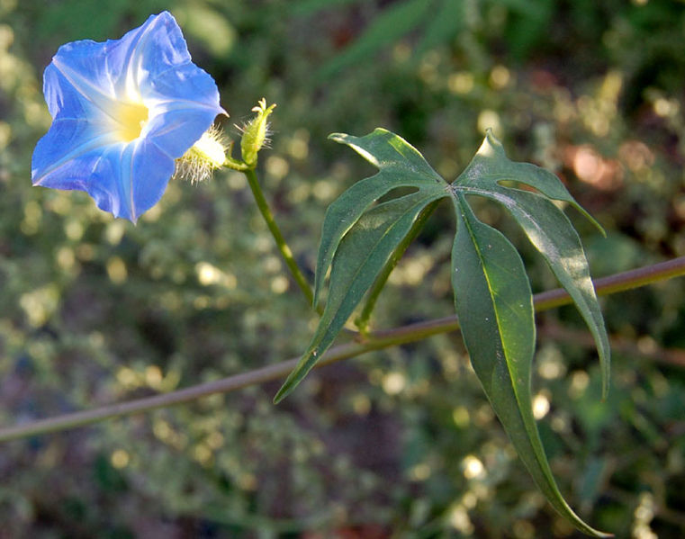
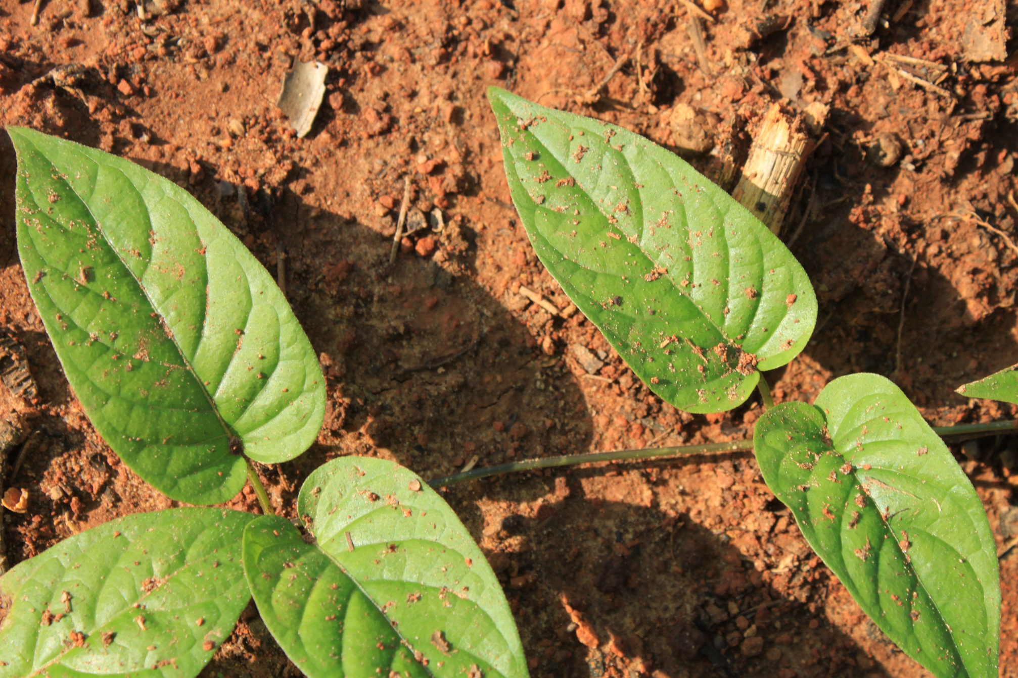
Morning Glory
(Ipomoea sp.)
Skunk Vine
(Paederia foetida)

Slide 16
Skunk Vine
(Paederia foetida)
Habitats:
  Grassy hillsides
  Primary forests
  Secondary forests
  Open places
  Forest shade
  Riverbanks
  Canal banks
  Waste grounds
  Hedges and thickets
  Roadsides
  Fences
  Large cities
  Where doesn’t it grow?

Slide 17
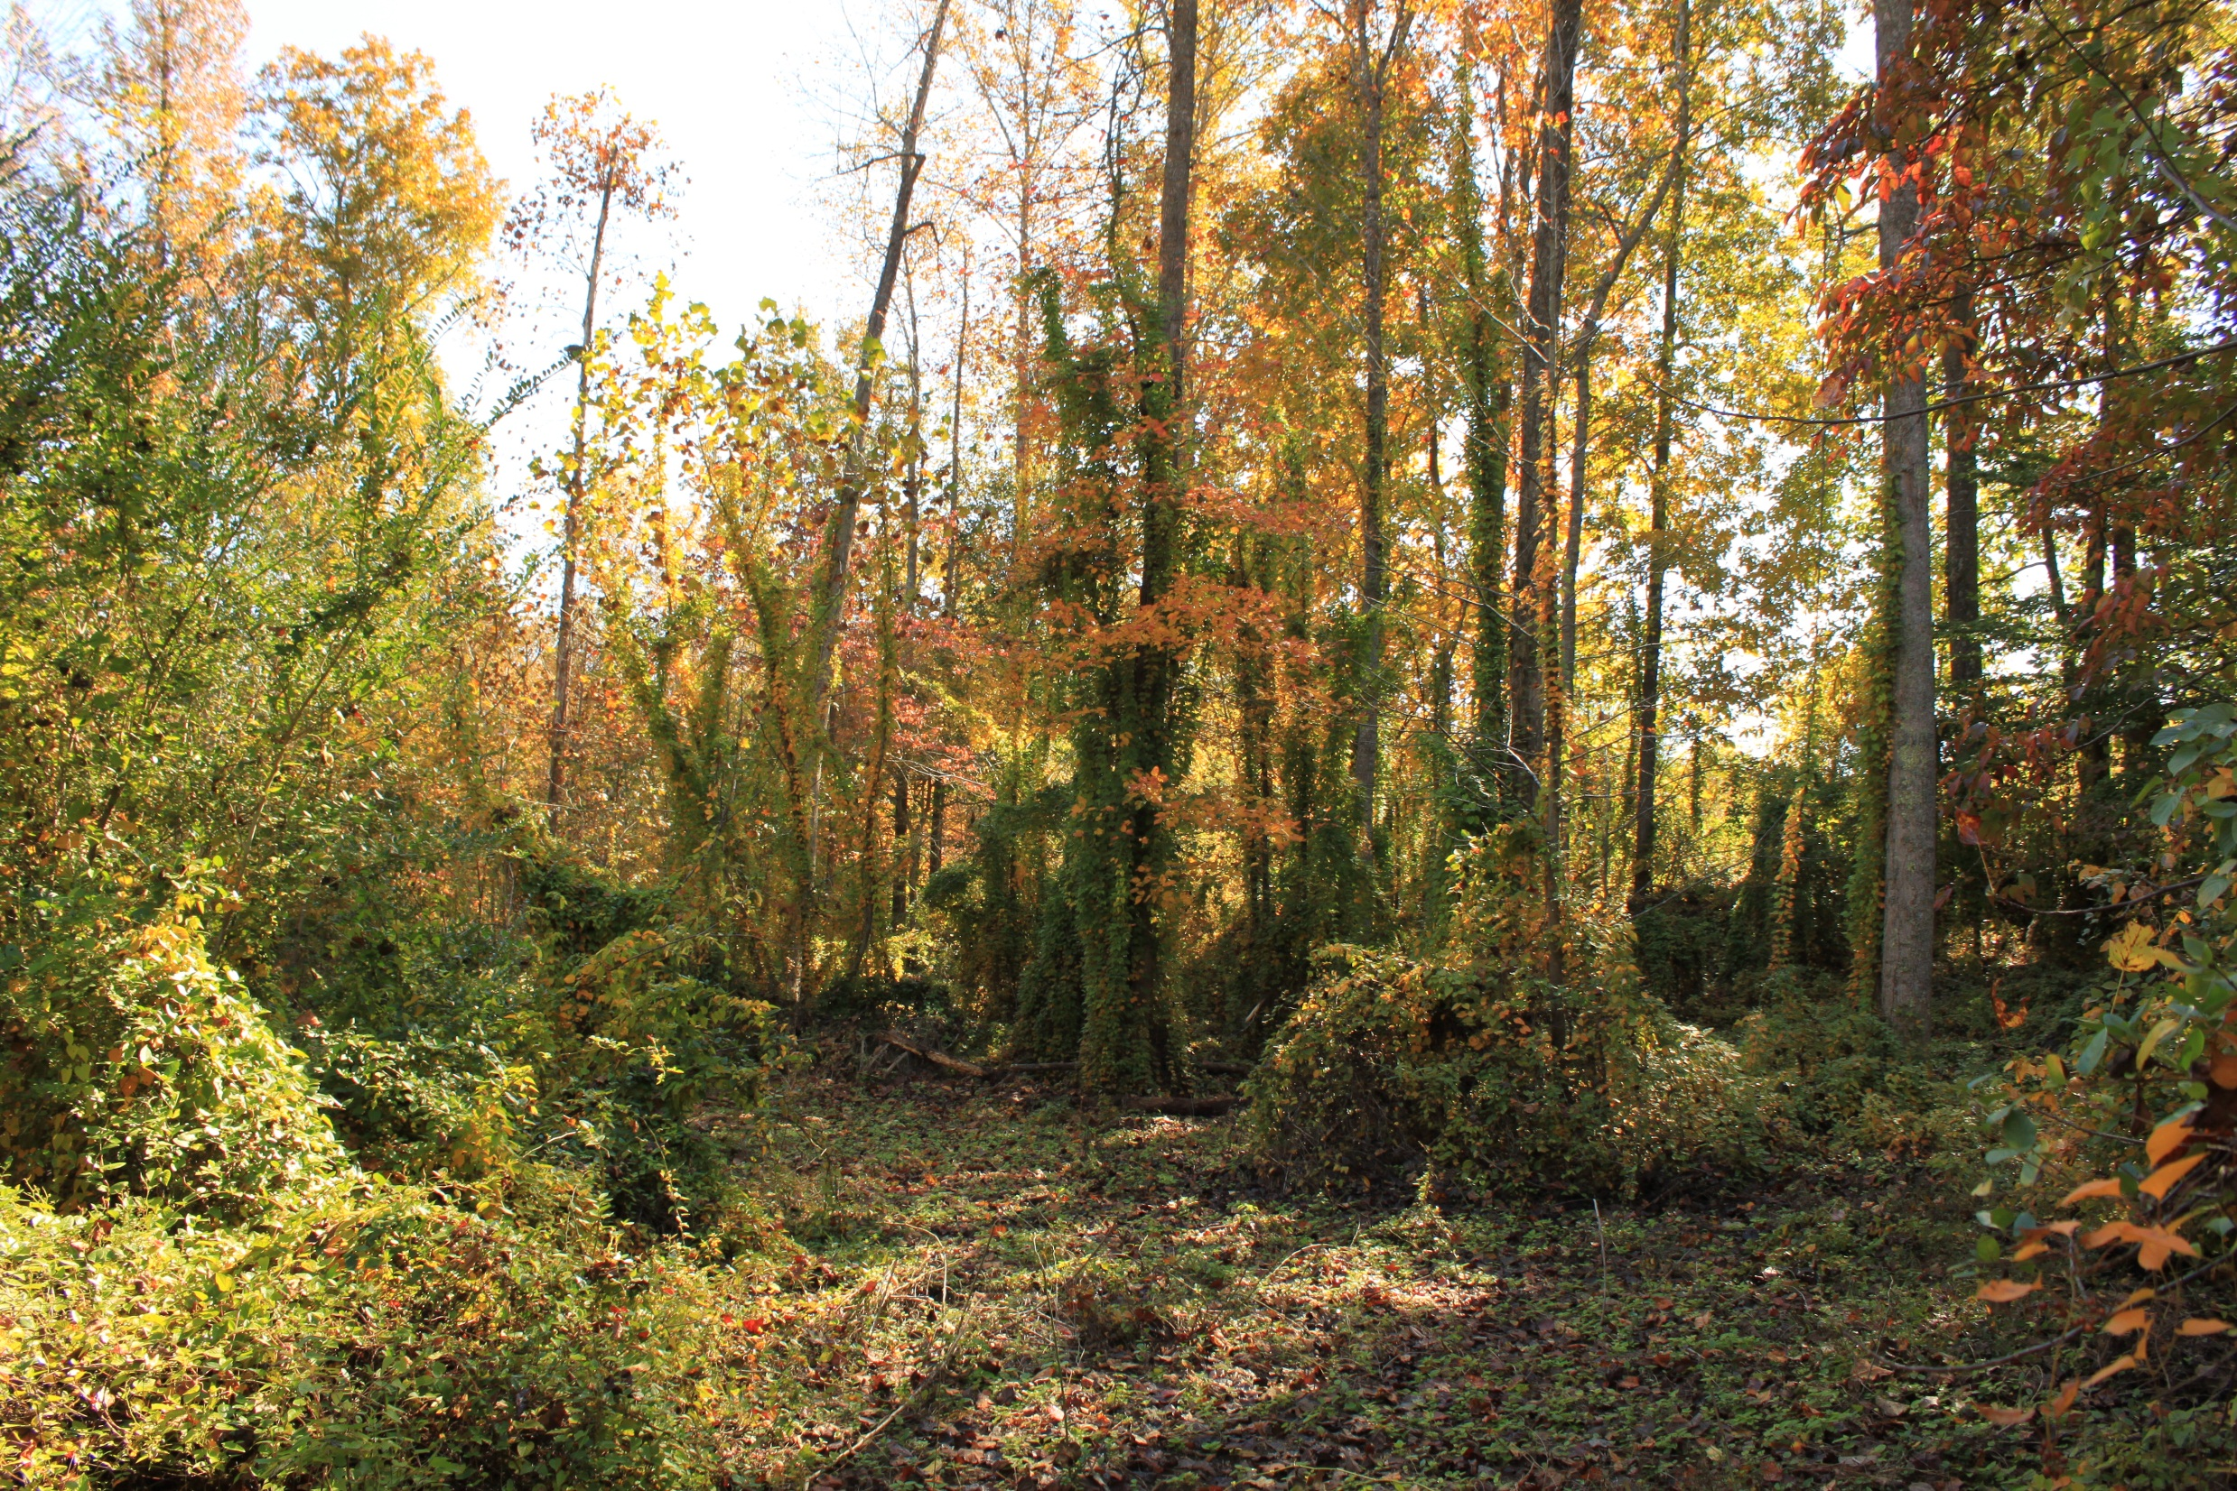

Slide 18
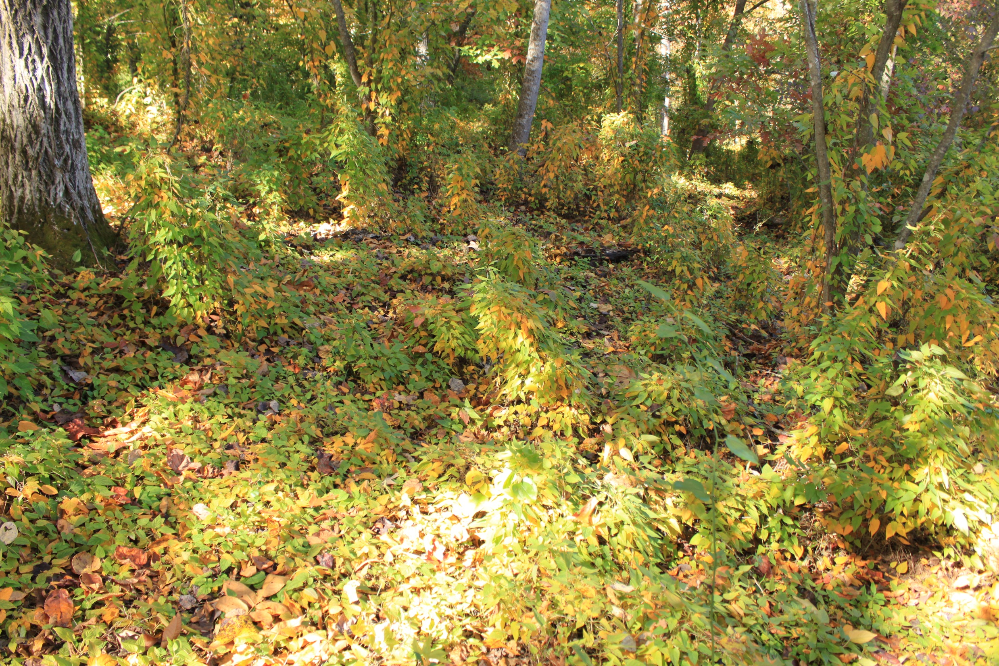

Slide 19
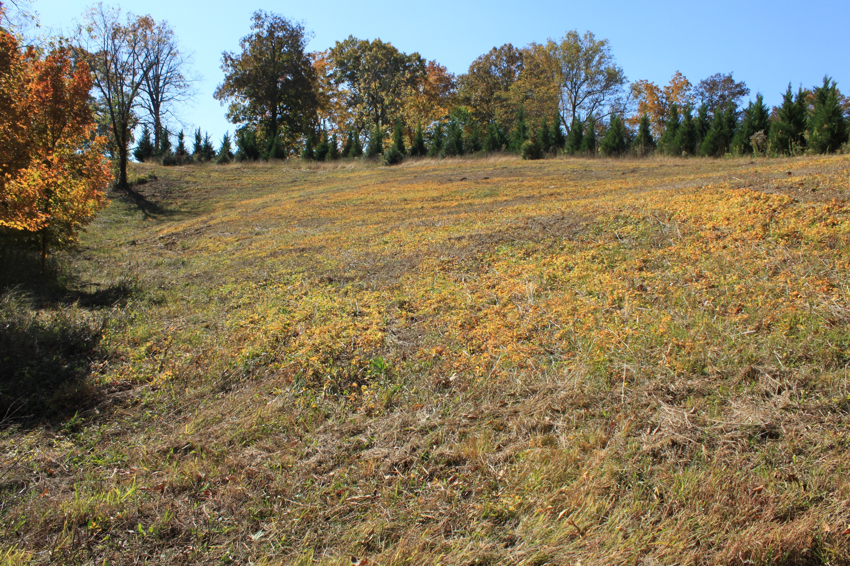

Slide 20
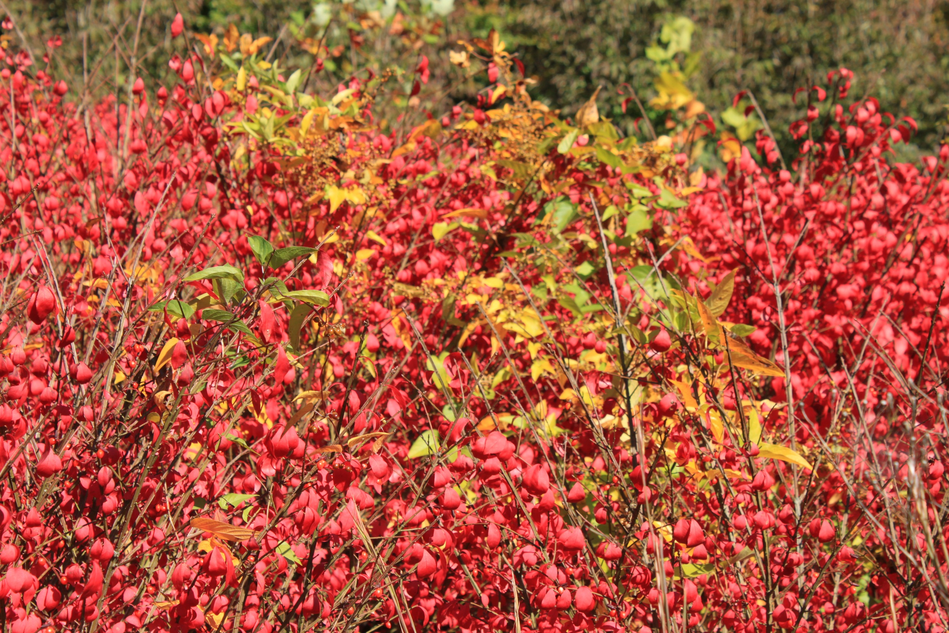

Slide 21
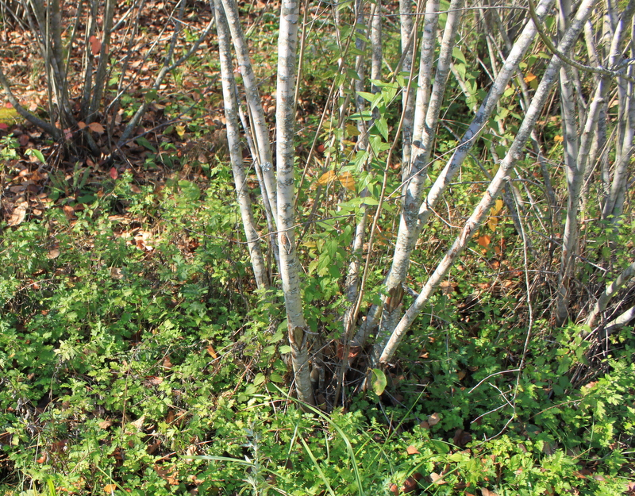

Slide 22
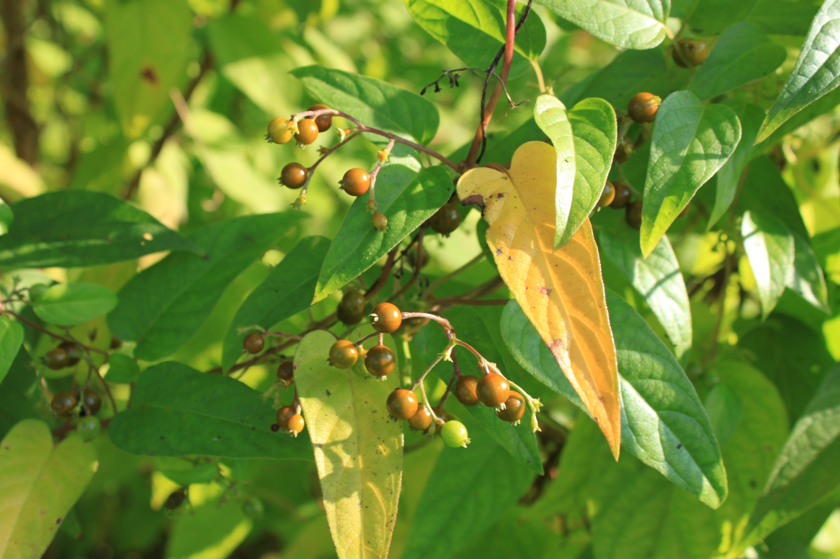

Slide 23
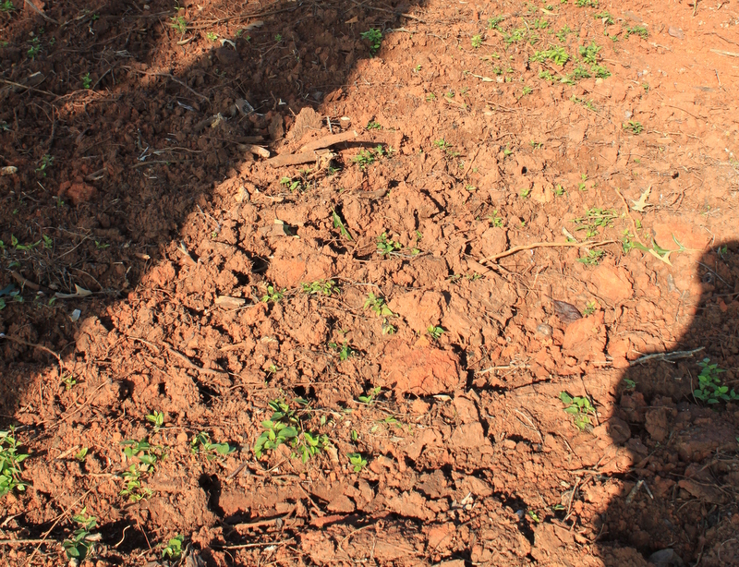

Slide 24
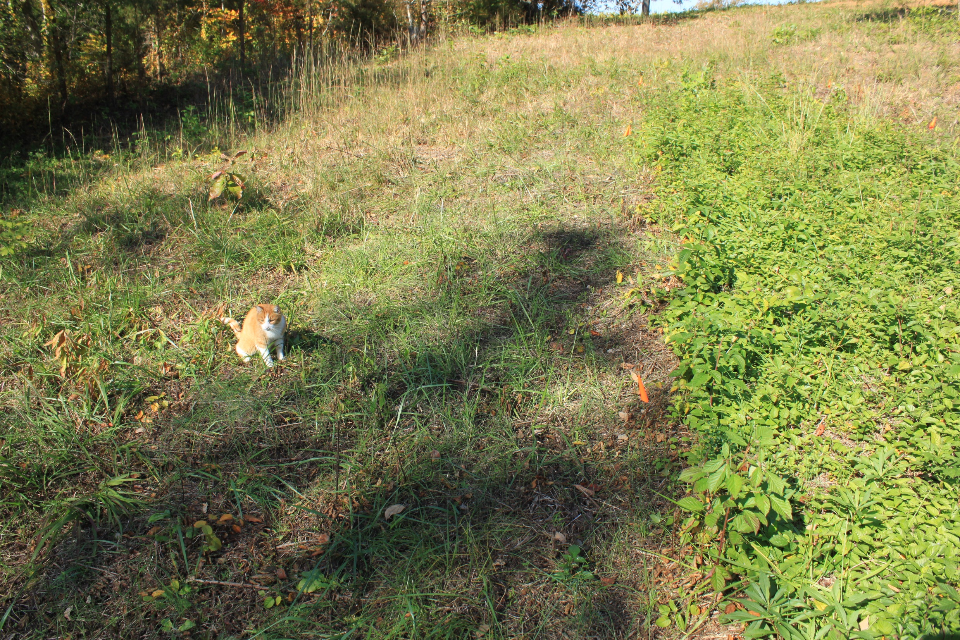
Skunk Vine Test Spray
A small area of Skunk Vine was sprayed for observations.
Chemical: Remedy (triclopyr)
Rate: 0.5% Remedy + 0.5% nonionic surfactant

Slide 25
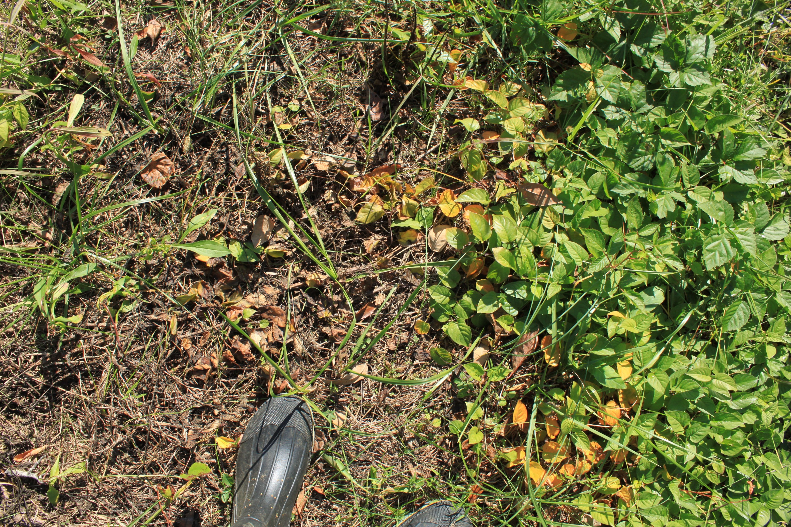
Skunk Vine Test Spray

Slide 26
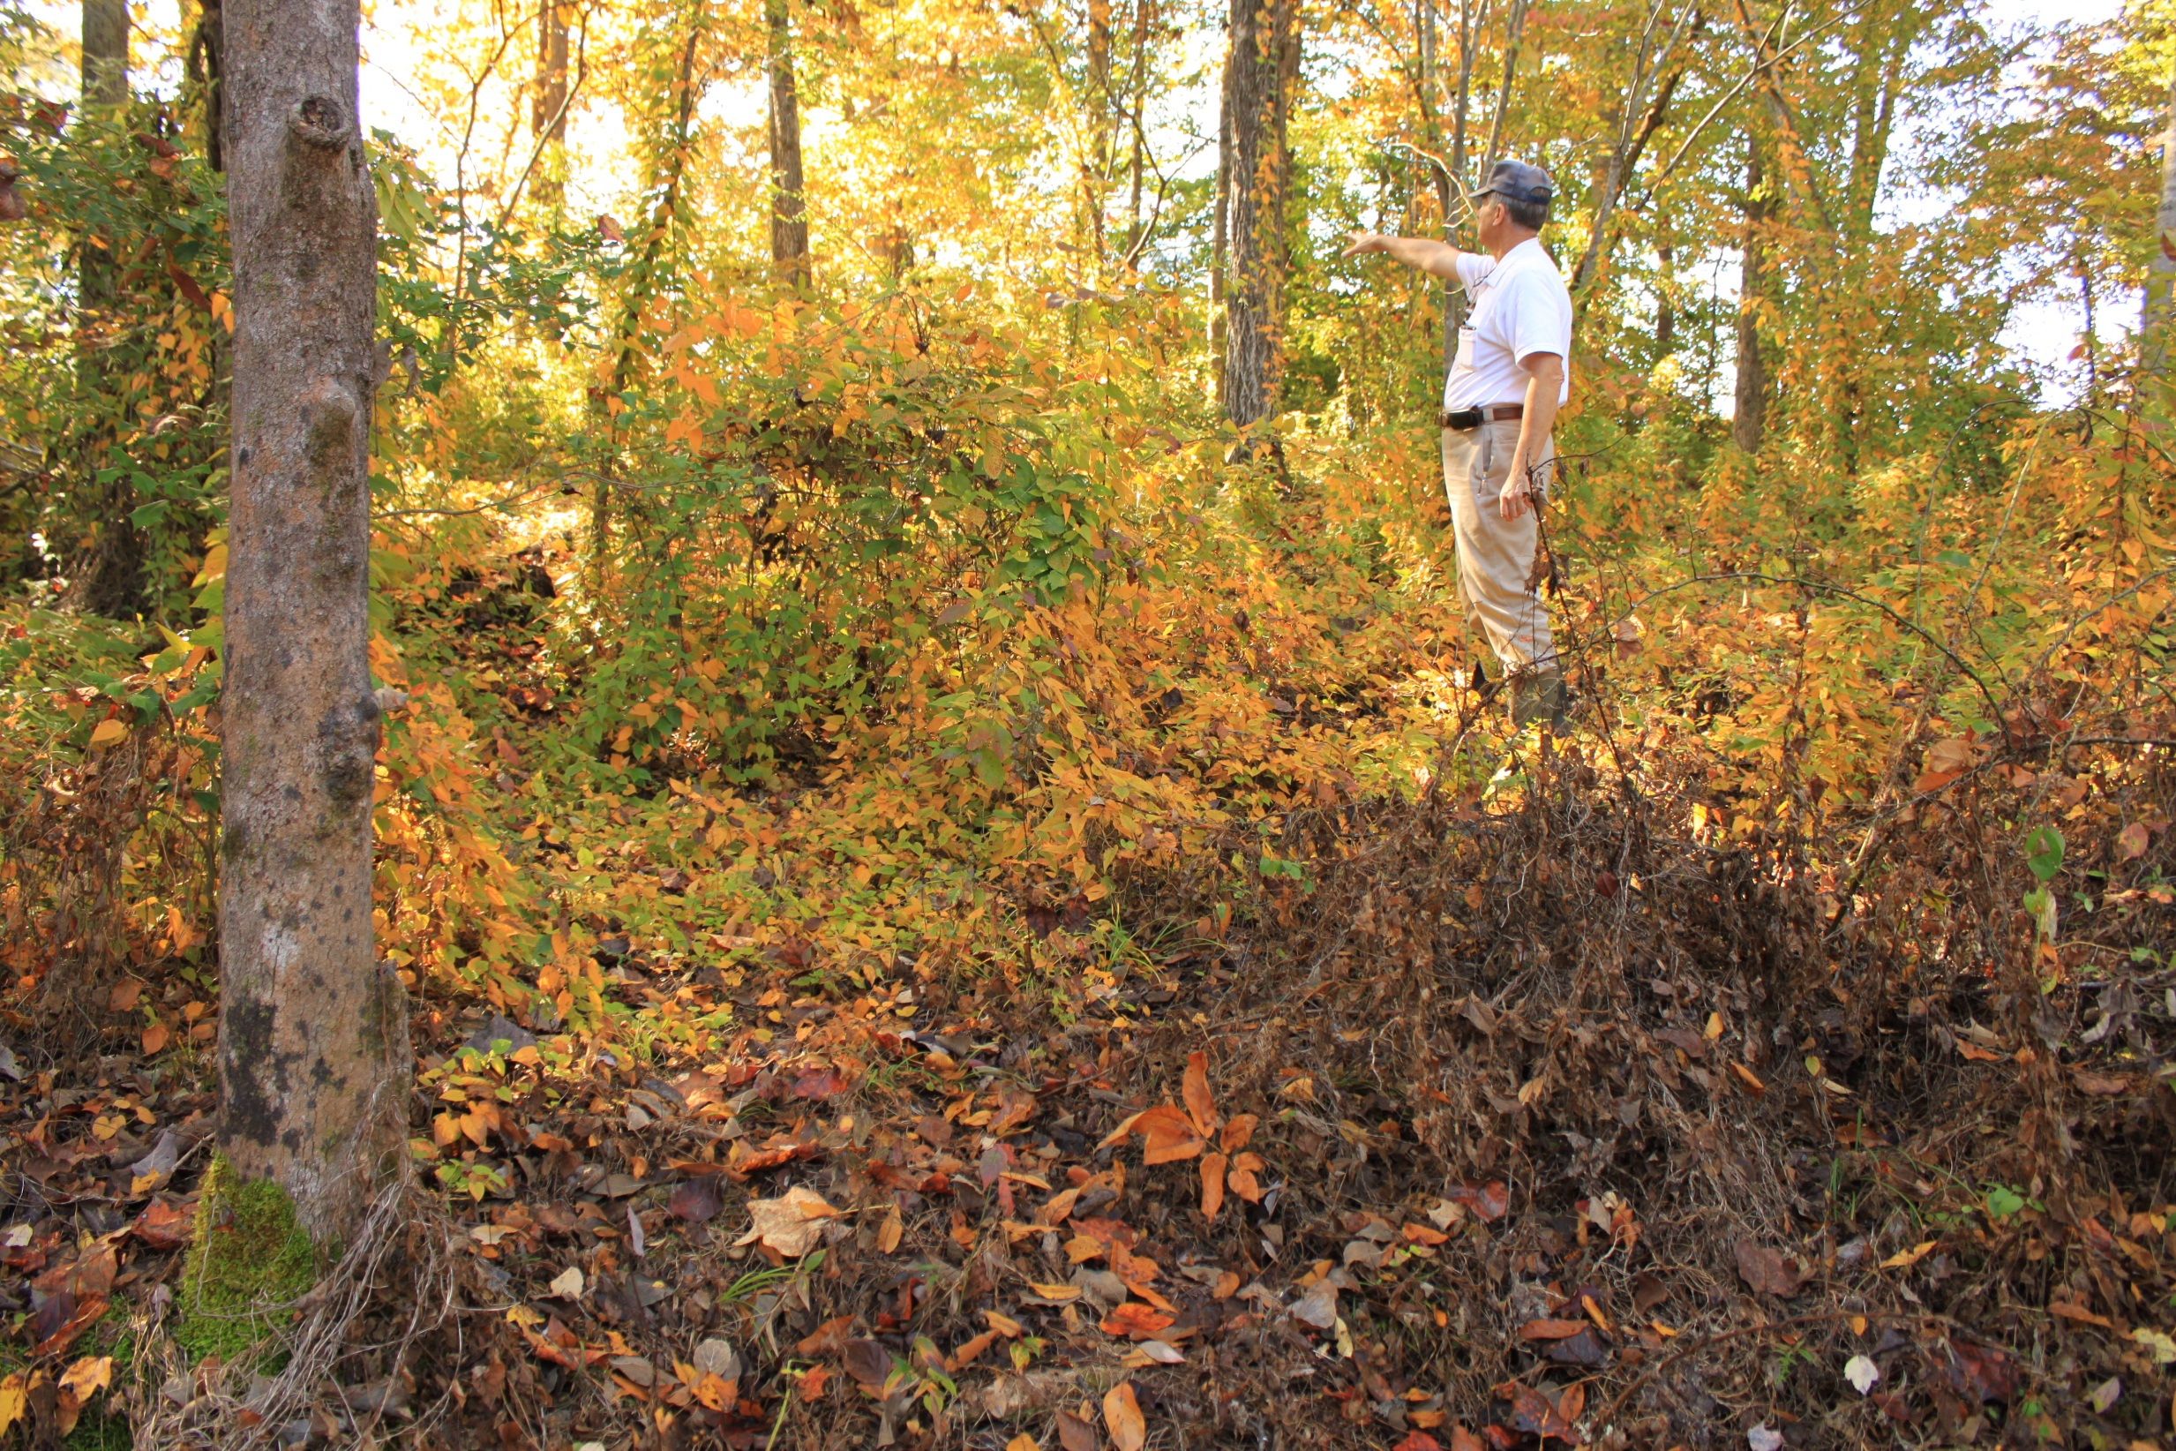
Skunk Vine Test Spray

Slide 27
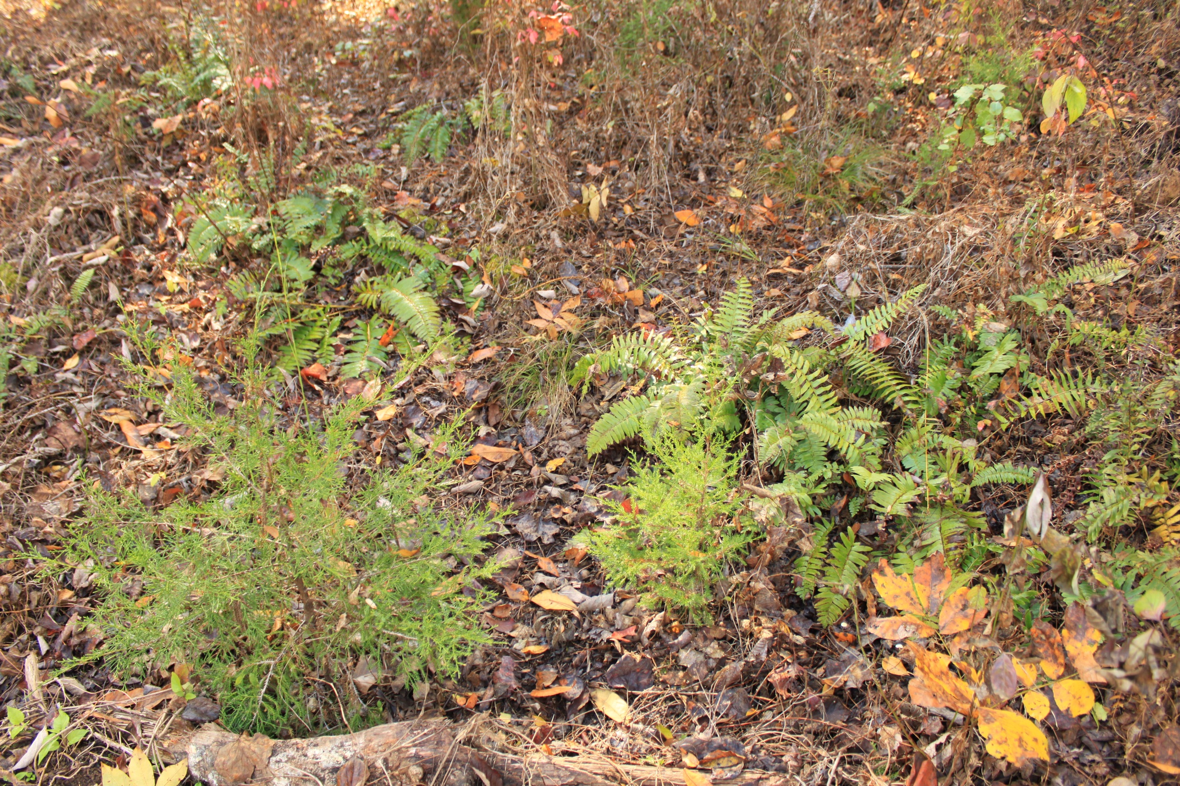
Skunk Vine Test Spray

Slide 28
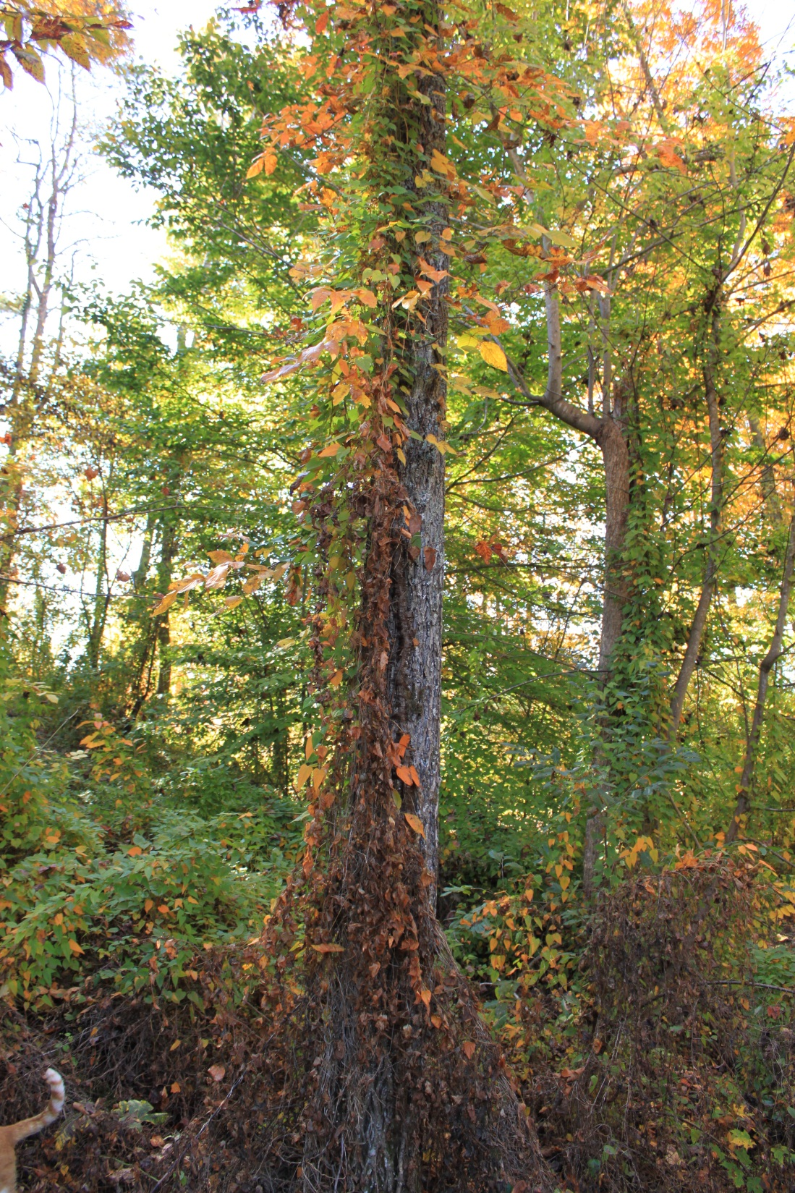
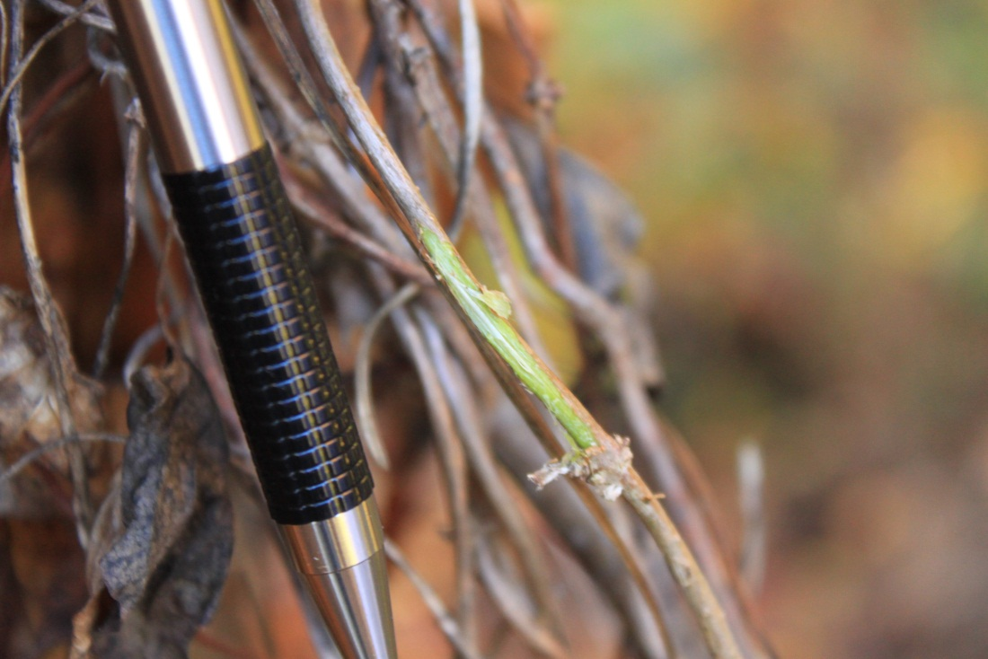
Skunk Vine Test Spray

Slide 29
Skunk Vine Conclusion
Potential to impact nursery production
  And change the ecosystems!
Cost of removal $430 - $1,622/ha.
  (Stocker and Brazis, 1999)
  “Complete control was not achieved…”
A good candidate for Biological control…
Care and be aware!

Slide 30
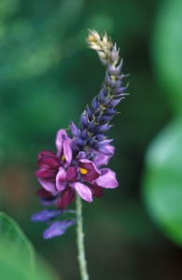
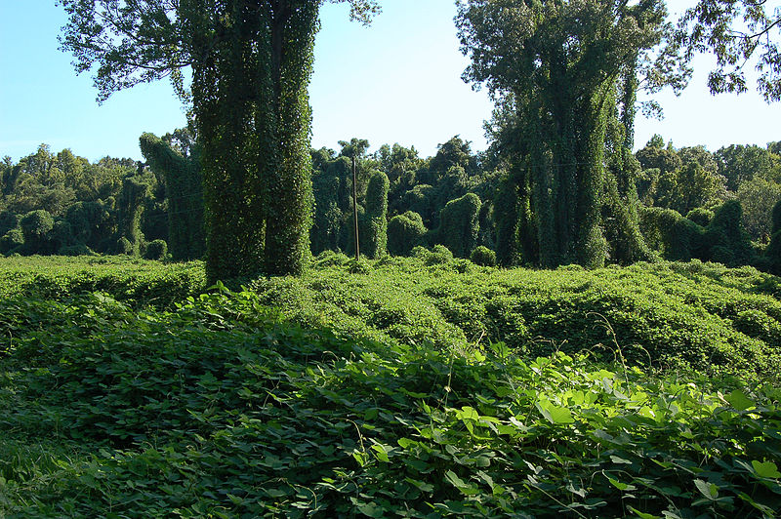
Kudzu
(Pueraria lobata)
http://www.in.gov/dnr/entomolo/4538.htm
http://eattheinvaders.org/kudzu/

Slide 31
Kudzu
Native to Southeast Asia
Spreading at the rate of 150,000 acres/year
Up to 1 foot of growth per day
Up to 60 feet of growth per year
Introduced in 1876
USDA encouraged planting from 1935-50!
USDA declared Kudzu a weed in 1972!!!
Edible and apparently delicious!

Slide 32

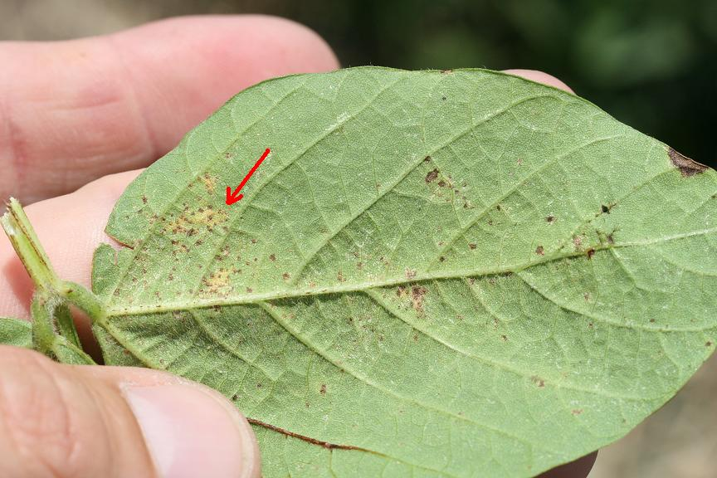
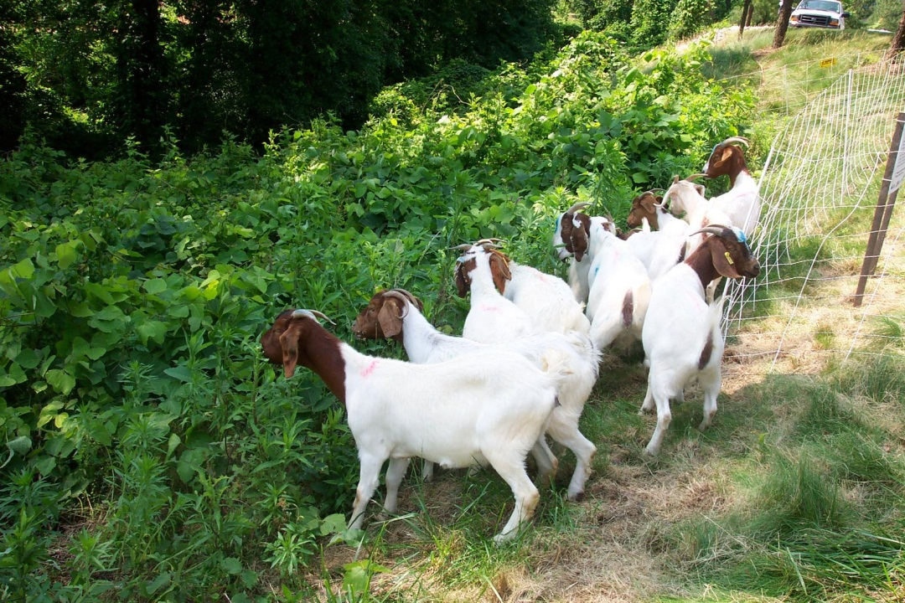
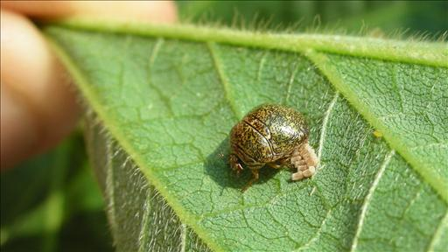
Kudzu Pests
Asian Soybean Rust
http://www.maxshores.com/kudzu/
Goats
http://soybeanrust.tamu.edu/photoarchives.htm
Kudzu Bug
http://www.dawnvertrees.com/2010/09/got-kudzu.html
http://online.wsj.com/article/SB10001424052970203791904576611721227144948.html

Slide 33
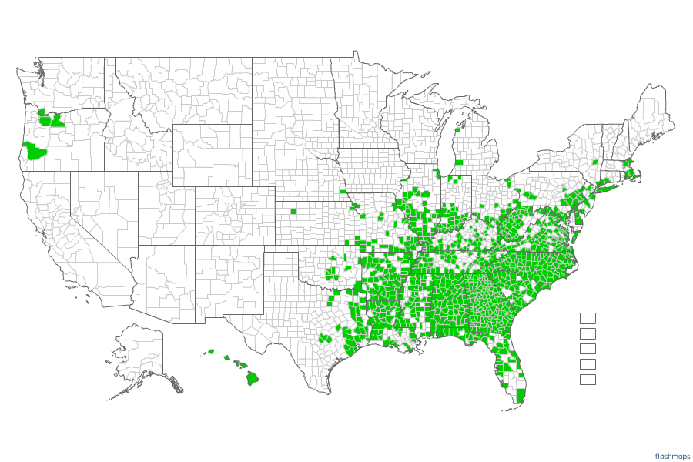
Kudzu Distribution
2009
December 08, 2011.
http://invasivore.org/2011/12/species-profile-kudzu/

Slide 34
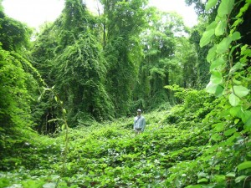
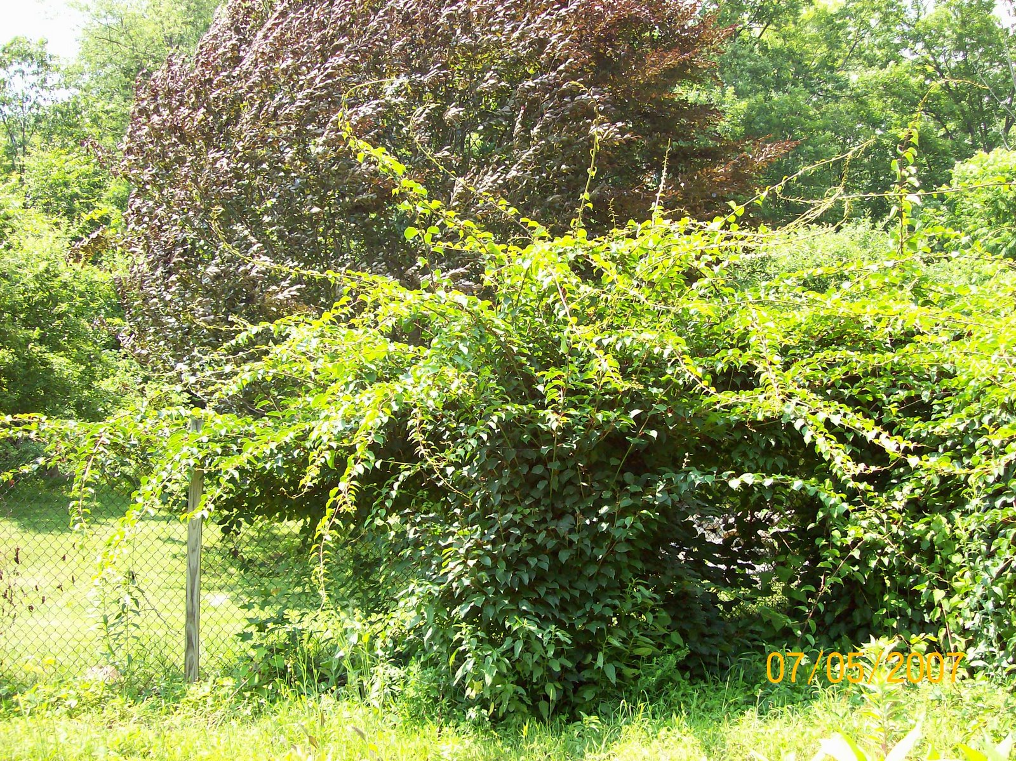
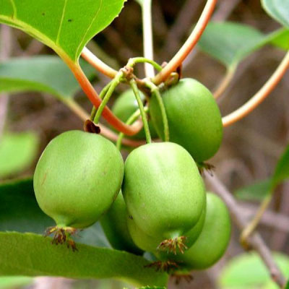
Hardy Kiwi
(Actinidia arguta)
http://nativeplantwildlifegarden.com
http://www.waldeneffect.org/blog/Hardy_Kiwi:_Actinidia_arguta/
http://www.clwebber.com/2007/07/out-of-control/

Slide 35
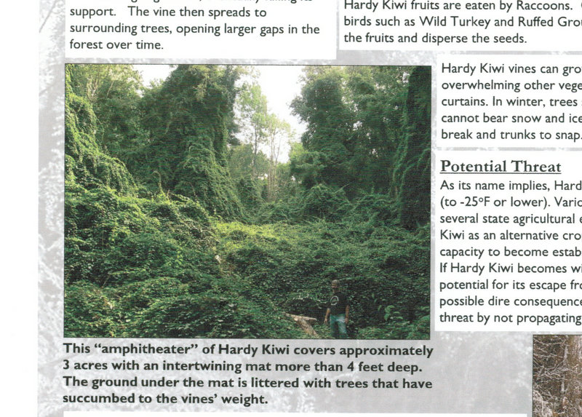
Hardy Kiwi
(Actinidia arguta)
http://www.massaudubon.org/PDF/invasive_species/hardykiwipestalert.pdf

Slide 36
Hardy Kiwi
(Actinidia arguta)
Edible and delicious
Fruit are sweeter than Kiwifruit!
No peeling necessary
A newly identified invasive vine (in New England)
Native to Japan, Korea, Northern China and Siberia
Extremely vigorous easily growing 30 feet/yr.
Dioecious plants (males appear more vigorous)
Hardy to -30 deg. F.

Slide 37
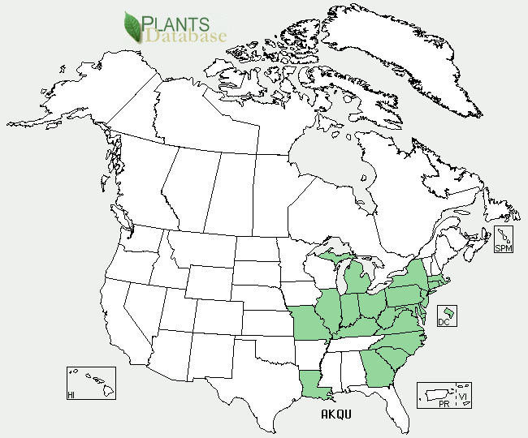
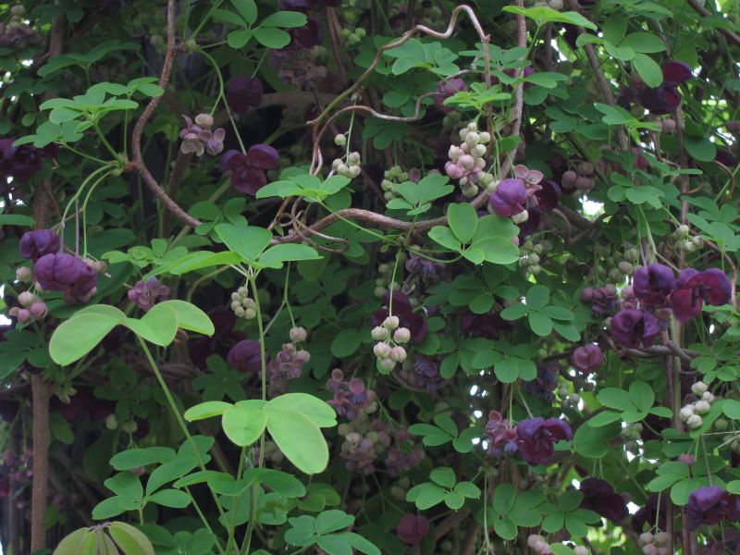
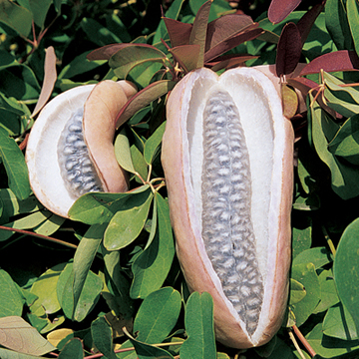
Chocolate Vine
(Akebia quinata)
http://threatsummary.forestthreats.org
http://www.portlandnursery.com/plants/shrubs-vines/akebia.shtml
http://pearledearth.blogspot.com/2012/04/chocolate-vine.html

Slide 38
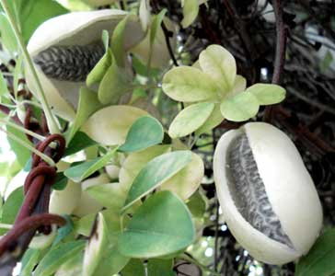
Chocolate Vine
(Akebia quinata)
Native to Japan, Korea, and China
Can grow 20 feet or more per year
Edible pods said to taste “tropical”
Flowers said to smell like chocolate
Hardy to Zone -20 deg. F
http://www.paghat.com/akebiafruit.html

Slide 39
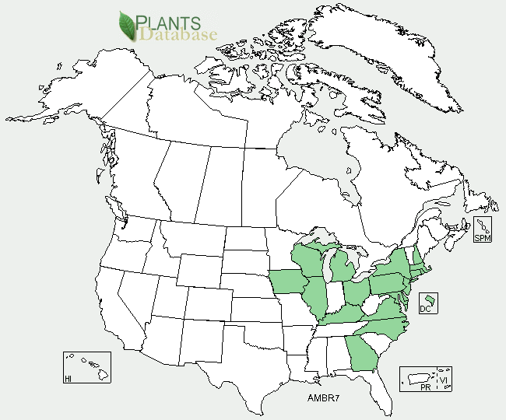
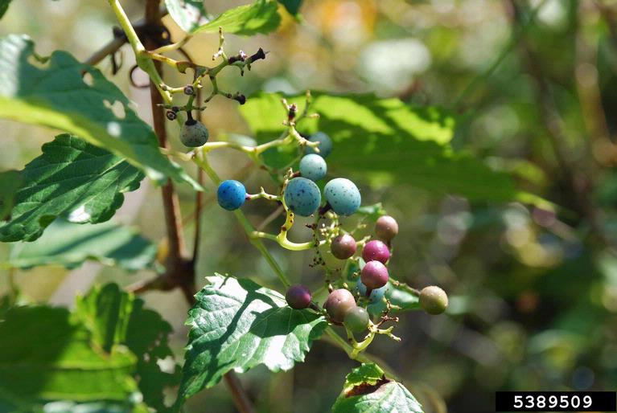
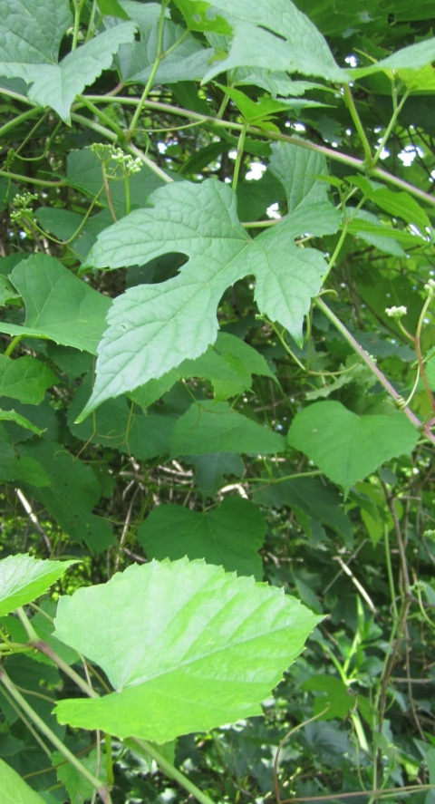
Amur Peppervine/Porcelain Vine
(Ampelopsis brevipedunculata)
http://plants.usda.gov/java/profile?symbol=AMBR7
http://princetonnaturenotes.blogspot.com/2012/07/distinguishing-porcelain-berry-and.html
http://www.invasive.org/browse/subinfo.cfm?sub=3007

Slide 40
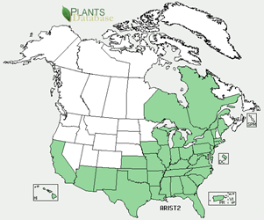
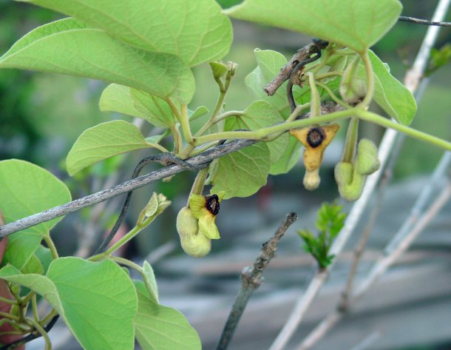
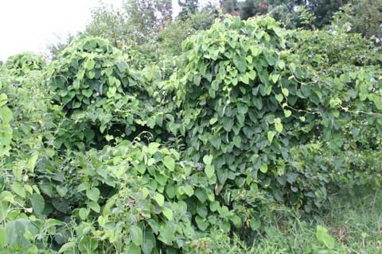
Wooly Dutchman's Pipe
(Aristolochia tomentosa)
http://plants.usda.gov/java/profile?symbol=ARIST2
Aristolocia spp.
http://www.btny.purdue.edu/weedscience/2009/WoollyDutchmansPipe09.html
http://www.discoverlife.org/mp/20q?search=Aristolochia+tomentosa&mobile=close&flags=glean:

Slide 41
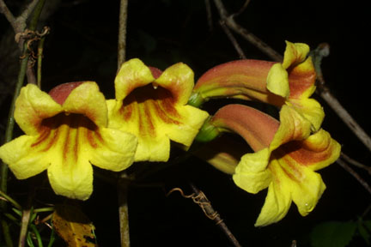
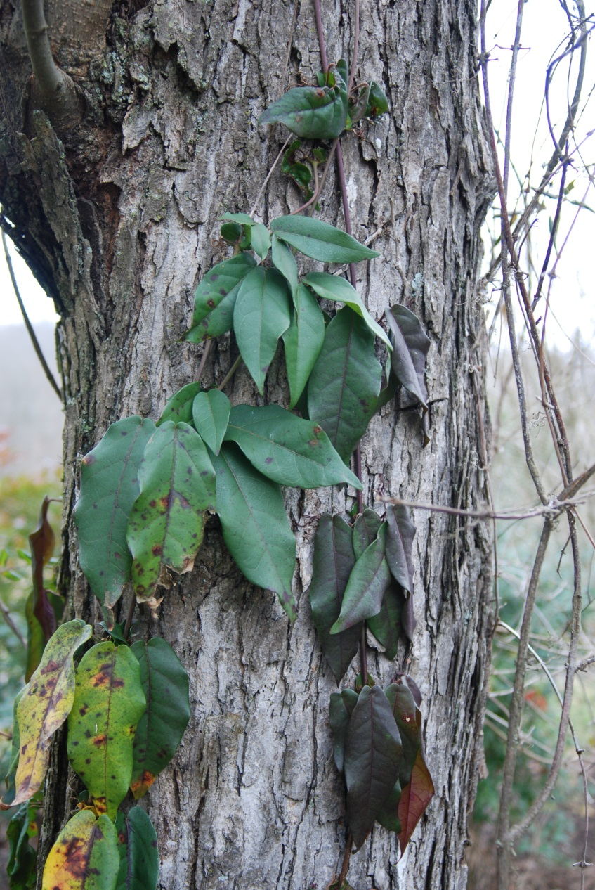
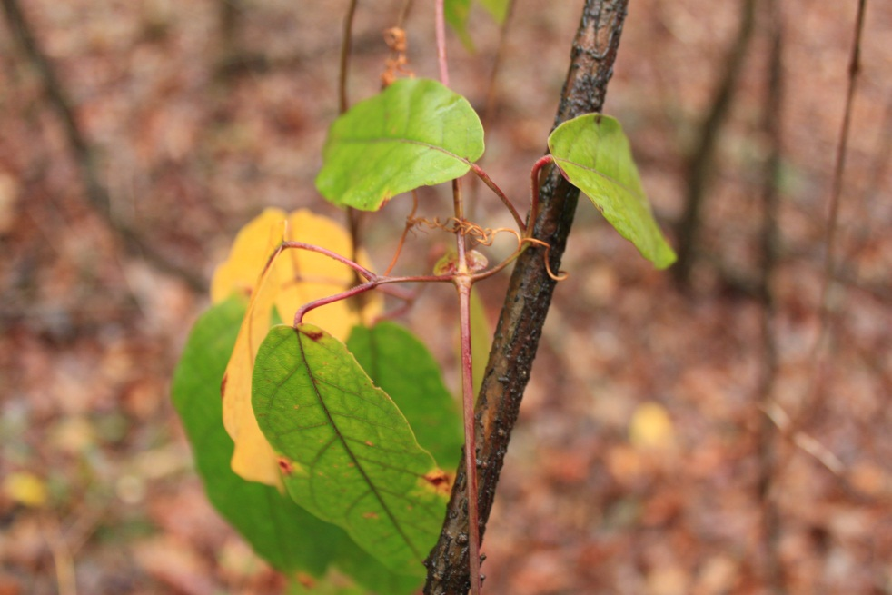
Cross Vine
(Bignonia capreolata)
http://www.cas.vanderbilt.edu/bioimages/species/bica.htm

Slide 42
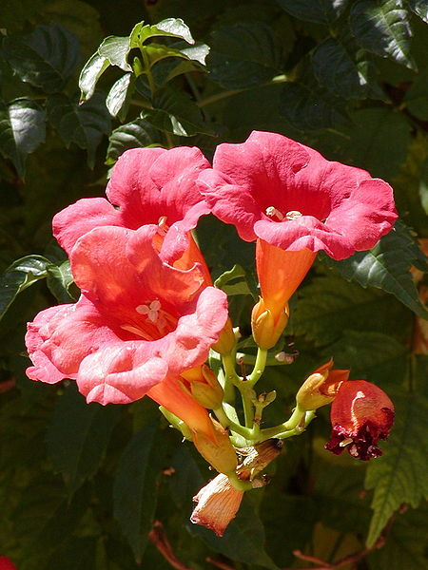
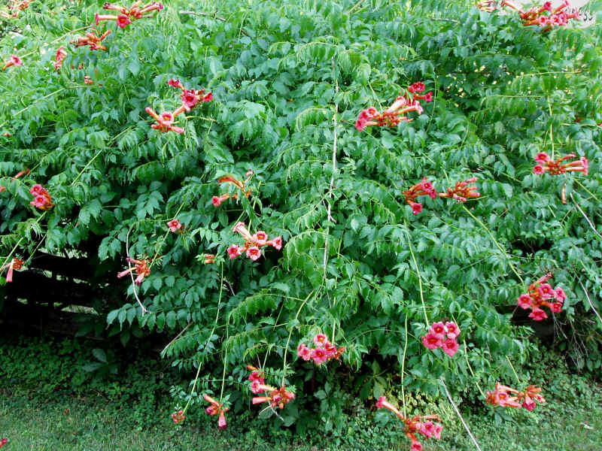
Trumpet Vine
(Campsis radicans)
http://en.wikipedia.org/wiki/File:Campsis_radicans-leaf.jpg
http://en.wikipedia.org/wiki/File:Campsis_radicans-600px.jpg
http://www.easywildflowers.com/quality/cam.rad.htm

Slide 43




Bittersweet
(Celastrus orbiculatus)
http://snr.unl.edu/invasives/invasiveplants.htm
http://www.loe.org/shows/segments.html?programID=12-P13-00023&segmentID=7
http://botit.botany.wisc.edu/Resources/Botany/Morphology/Illustrations%20for%20Terms/Habit/Vine/bittersweet%20vine%20MC%20.jpg.html

Slide 44



Sweet Autumn Clematis
(Clematis terniflora)
http://bbe-tech.com/bees/2011/09/01/feed-your-bees-in-the-fall-with-sweet-autumn-clematis/
http://www.invasive.org/browse/detail.cfm?imgnum=2120053

Slide 45
What is Wrong Here?
(Hint: both statements are correct)
“Sweet autumn clematis is a wonderful vine native to Virginia. You see it bloom along roadways, up into trees, along streambanks and ditches and along fences in people's yards. It's pretty and smells oh so good.”
  Kathy Van Mullekom, Garden Writer
“Sweet Autumn Clematis is highly invasive vine from Japan that is quite showy in bloom. The 5-parted leaves are semi-evergreen; the flowers are very sweetly fragrant.”
  Will Cook, Ass. Prof., Duke U.

Slide 46
What is Wrong Here?
(Hint: both statements are correct)
“Sweet autumn clematis is a wonderful vine native to Virginia. You see it bloom along roadways, up into trees, along streambanks and ditches and along fences in people's yards. It's pretty and smells oh so good.”
  Kathy Van Mullekom, Garden Writer
“Sweet Autumn Clematis is highly invasive vine from Japan that is quite showy in bloom. The 5-parted leaves are semi-evergreen; the flowers are very sweetly fragrant.”
  Will Cook, Ass. Prof., Duke U.
Clematis virginiana
Clematis terniflora

Slide 47




Creeping Euonymus
(Euonymus fortunei)
http://informedfarmers.com/climbing-euonymus/
http://commons.wikimedia.org/wiki/File:Euonymus_fortunei_Minimus_kz1.jpg
http://www.cas.vanderbilt.edu/bioimages/image/e/eufo5-wpon-tree21056.htm

Slide 48



English Ivy
(Hedera helix)
http://bioweb.uwlax.edu/bio203/s2009/hitchins_abby/habitat.htm
http://www.invasive.org/search/action.cfm?q=hedera%20helix

Slide 49



Japanese Honeysuckle
(Lonicera japonica)
http://dnr.state.il.us/stewardship/cd/species/3039.html
http://blog.emergencyoutdoors.com/edible-wild-plants-japanese-honeysuckle-lonicera-japonica/

Slide 50



Virginia Creeper
(Parthenocissus quinquefolia)
http://www.unionagway.com/Plants/Vines-Detail.htm
http://en.wikipedia.org/wiki/File:Parthenocissus_quinquefolia_fructis.jpg

Slide 51



Poison Ivy
(Toxicodendron radicans)
http://www.eattheweeds.com/poison-ivy-ponderings/

Slide 52



Grape
(Vitis spp.)
http://www.all-creatures.org/pica/ftshl-grape-22.html
http://forums.gardenweb.com/forums/load/woodland/msg1222154814969.html
http://etc.usf.edu/clippix/picture/wild-grape-vines.html

Slide 53



Wisteria
(Wisteria spp.)
http://plants.usda.gov/java/profile?symbol=wifl
Wisteria species:
W. brachybotrys
W. floribunda
W. frutescens
W. sinensis
http://www.duncannurseries.com/vines.htm
http://bonsaibeginnings.blogspot.com/2012/03/romantic-and-nostalgic.html

Slide 54


Cupseed
(Calycocarpum lyonii)

Slide 55




Field Bindweed
(Convolvulus arvensis)
http://plants.usda.gov/java/profile?symbol=coar4
http://www.co.clay.mn.us/Depts/SoilWatr/CCWMA/IDPrRest.htm
http://sacramentogardening.blogspot.com/2010/09/little-off-top-barber.html
http://www.invasive.org/weedcd/species/4338.htm

Slide 56



Dodder
(Cuscuta spp.)
http://plants.usda.gov/java/profile?symbol=CUPE3
https://dnr.state.il.us/Stewardship/cd/species/5446.html

Slide 57




Chinese Yam
(Dioscorea oppositifolia)
http://plants.usda.gov/java/profile?symbol=diop
http://www.123rf.com/photo_4734082_chinese-yam.html
http://dnr.state.il.us/stewardship/cd/species/4527.html
http://extension.entm.purdue.edu/CAPS/pestInfo/chineseYam.htm

Slide 58




Black Bindweed
(Fallopia convolvulus)
http://plants.usda.gov/java/profile?symbol=POCO10
http://www.sweetbeet.com/growernet/Resources/pests/weeds/wldbkwht.htm
http://www.aphotoflora.com/d_fallopia_convolvulus_black_bindweed.html

Slide 59




Japanese Hop
(Humulus japonicus)
http://plants.usda.gov/java/profile?symbol=HUJA
Humulus lupulus
http://coloradobeerweek.wordpress.com/2010/10/15/fresh-hop-festival-tomorrow/
http://www.invasive.org/browse/subinfo.cfm?sub=10091#maps
http://www.invasive.org/browse/subinfo.cfm?sub=10091#maps

Slide 60




Morning Glory
(Ipomoea purpurea)
http://plants.usda.gov/java/profile?symbol=IPPU2
http://www.missouriplants.com/Bluealt/Ipomoea_purpurea_page.html
http://en.wikipedia.org/wiki/File:Pink_Morning_Glory_2500px.jpg
http://en.wikipedia.org/wiki/File:Glorious_Morning_Glories.JPG

Slide 61



Passion Flower
(Passiflora incarnata)

Slide 62



Green Briar
(Smilax rotundifolia)
http://www.bio.brandeis.edu/fieldbio/Vines/NewFiles/Species%20Pages/Greenbriar.html

Slide 63




Goat Head Vine
(Tribulus terrestris)
http://plants.usda.gov/java/profile?symbol=TRTE
http://plantali.blogspot.com/2010_04_01_archive.html
http://plants.usda.gov/java/profile?symbol=TRTE
http://hollerit.blogspot.com/2010/02/beware-tribulus-terrestris-ahead.html

Slide 64




Common and Bigleaf Periwinkle
(Vinca minor), (Vinca major)
http://plants.usda.gov/java/profile?symbol=VIMI2
http://www.nps.gov/plants/alien/pubs/midatlantic/vimi.htm

Slide 65

Questions
Adam Blalock
TSU Nursery Extension Specialist
Otis L. Floyd Nursery Research Center
472 Cadillac Lane
McMinnville, TN 37110
ablaloc1@tnstate.edu
(931) 815-5169
TSU Nursery Research Center

