Slide 1
HALE STADIUM
GAME DAY
OPERATIONS

Slide 2
HALE STADIUM
RENOVATIONS

Slide 3
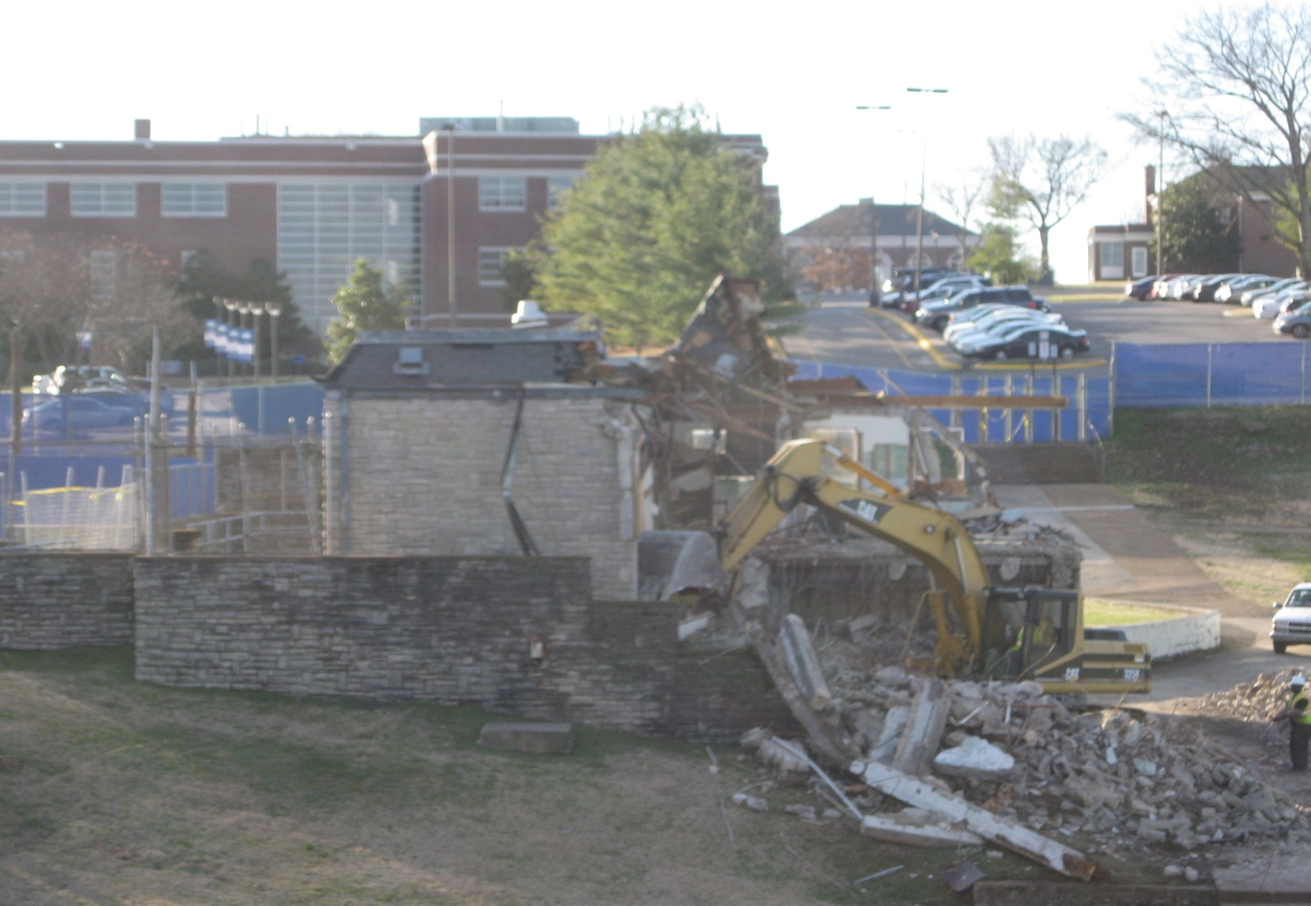

Slide 4
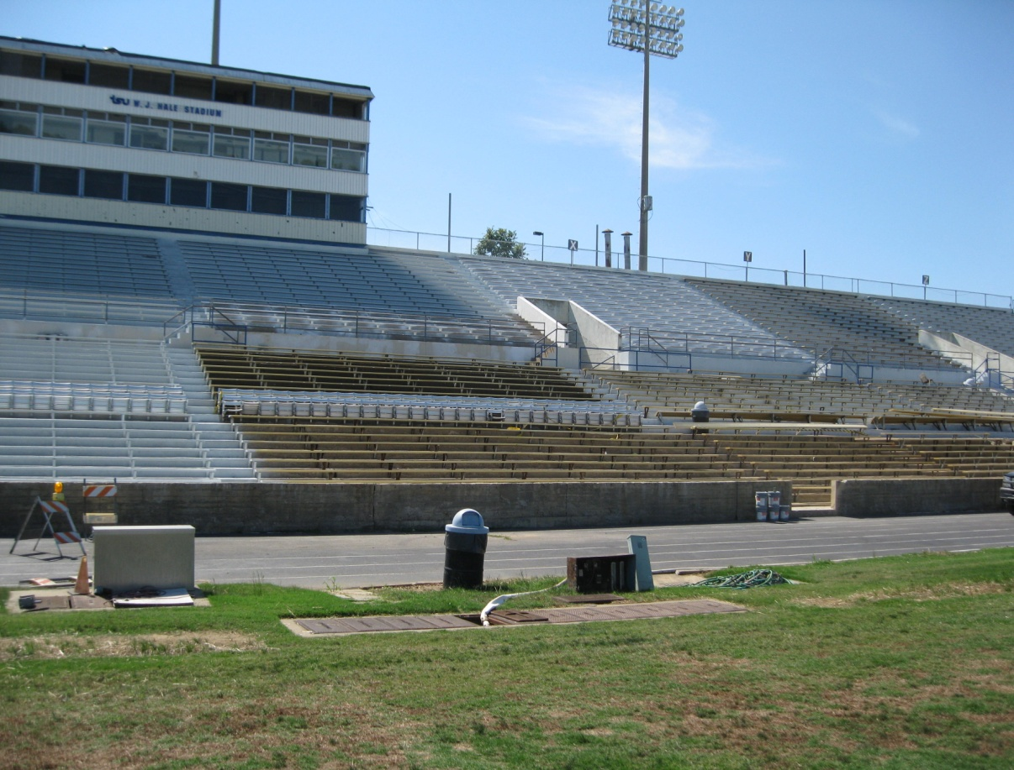

Slide 5
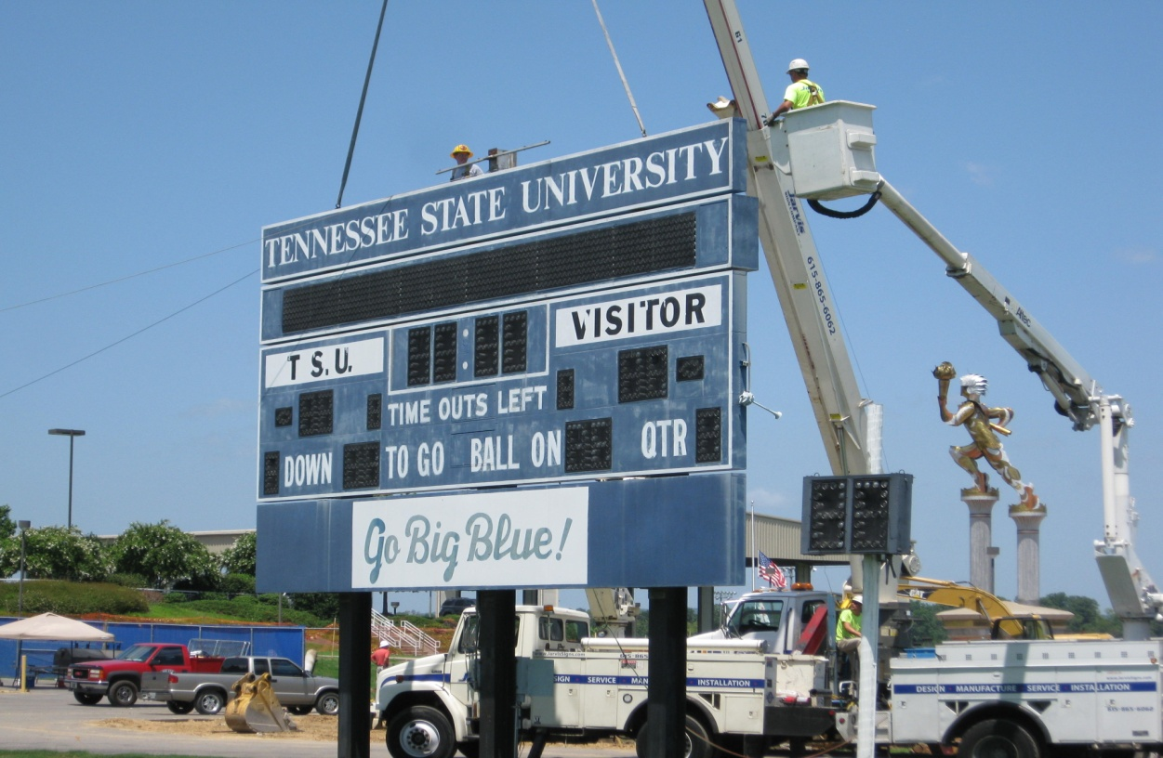

Slide 6
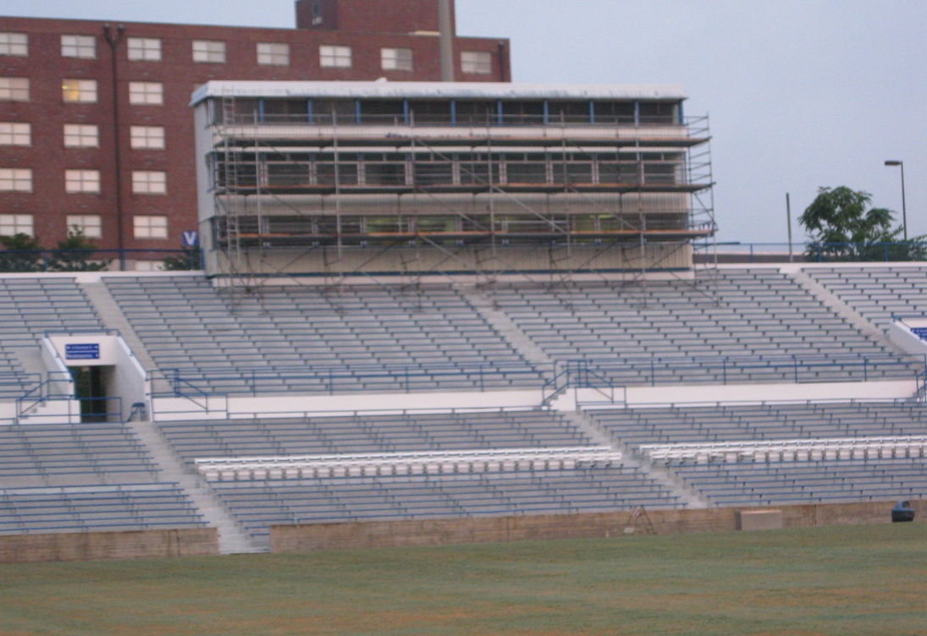

Slide 7
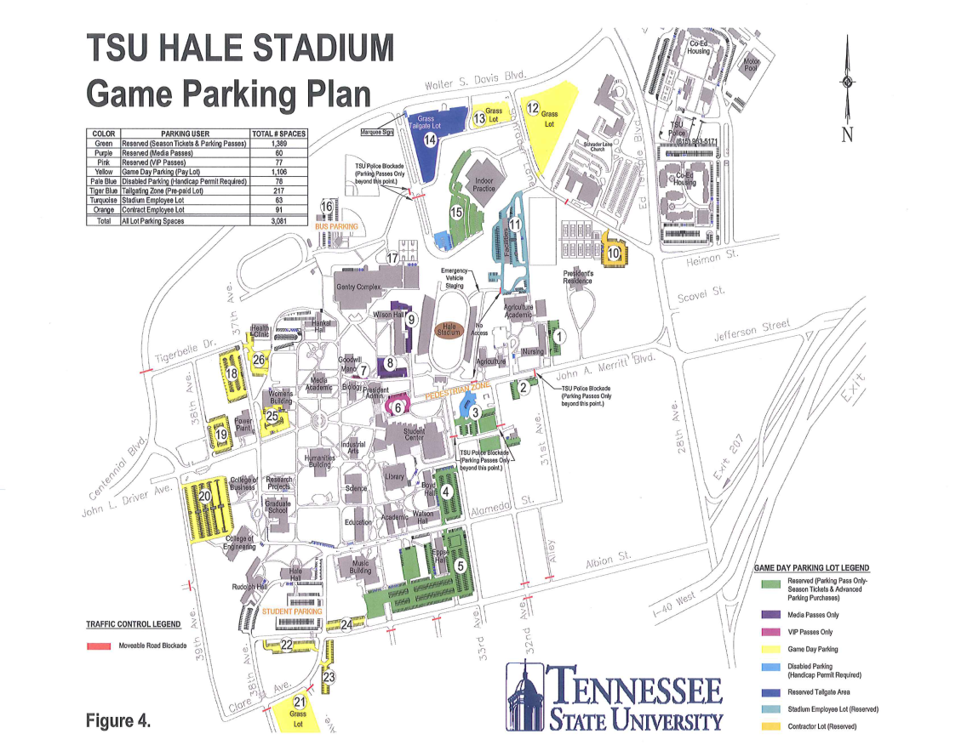

Slide 8
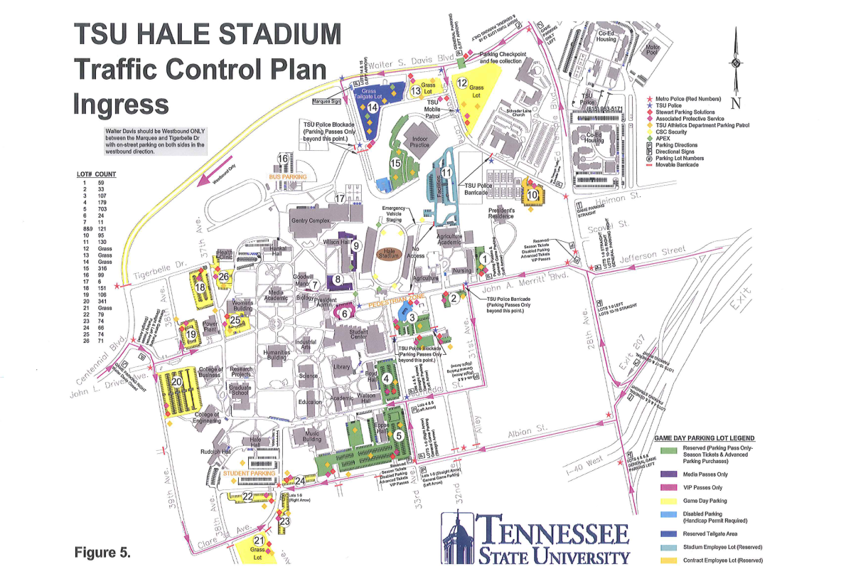

Slide 9
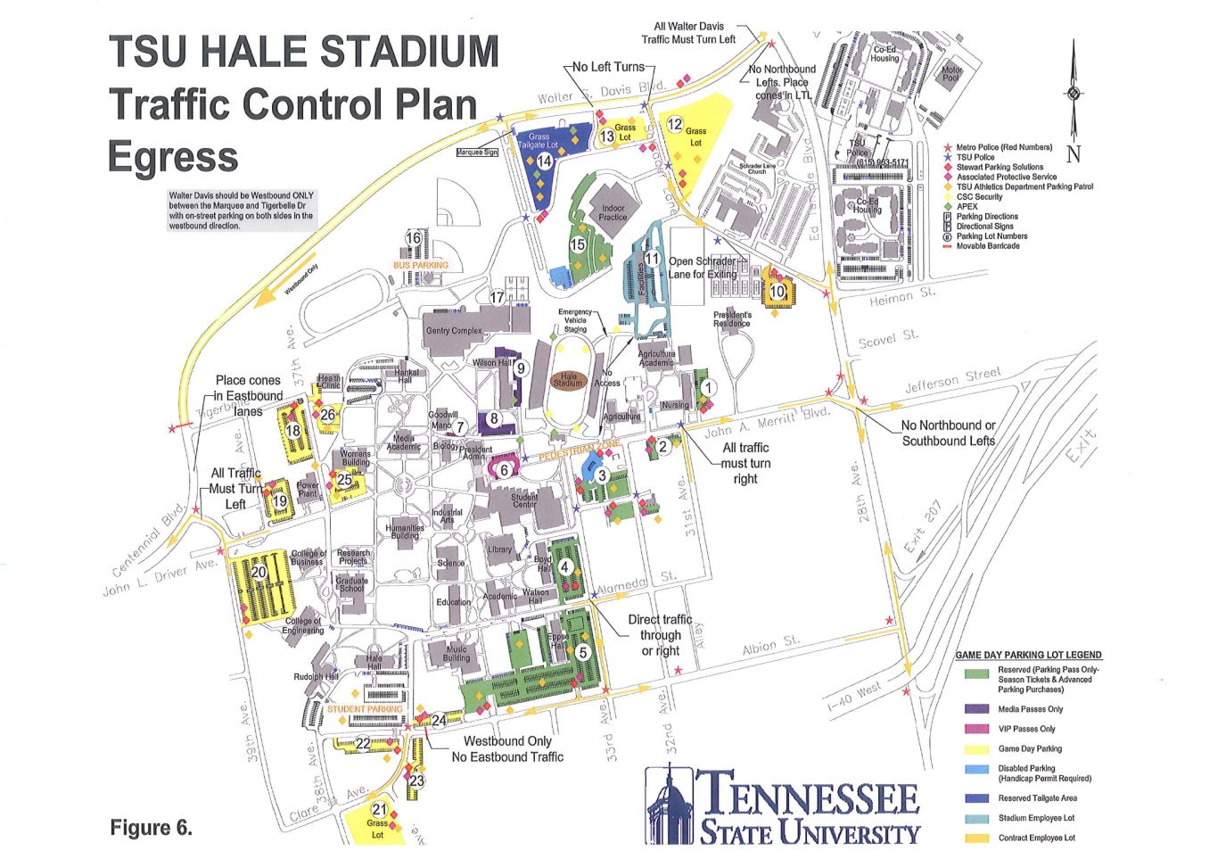

Slide 10
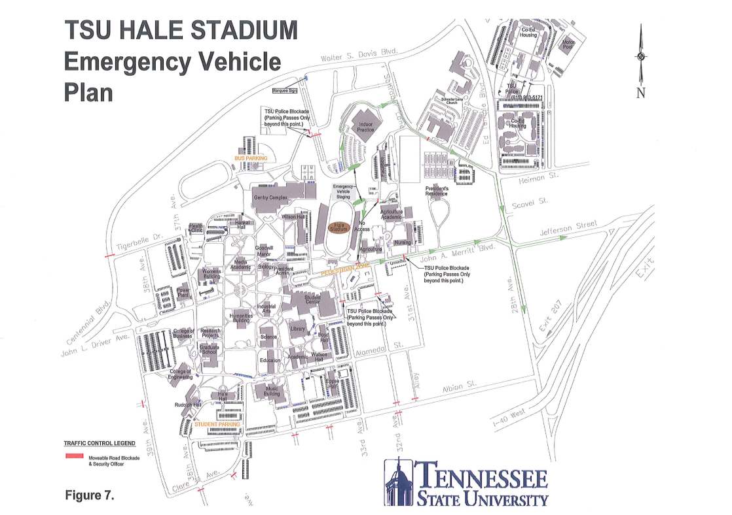

Slide 11
Game Dates
09/15/2012
10/06/2012
10/27/2012

Slide 12
STADIUM SEATING CAPACITY
18,000
PARKING SPACES
5,756

