Slide 1
Demystifying the Dissertation Proposal
Choosing a Topic, Finding the Literature and Writing it Up, the Conceptual Framework and Question, the Research Design, and Research Methodologies
Kimberly L. King-Jupiter, Ph.D.
Dean and Professor
Alethea Fletcher Hampton, Ed.D.
Assistant Dean and Assistant Professor

Slide 2
Workshop Agenda
Brief introductions
Goal of Research – C. Wright Mills (1959)
Choosing a Topic
Jumping into the Literature Review
The Question
The Conceptual Framework
Four Elements of Research – Michael Crotty
Overview of Research Methodologies/Methods
Research Designs
Practice Scenarios

Slide 3
C. Wright Mills (1959)
. . . [T]he most fruitful distinction with which the sociological imagination works is between “the personal troubles of milieu” and “the public issues of social structure” (p. 350)

Slide 4
Choosing a Topic
Topics are broad, but will allow you to examine and select a sub-topic for your research.

Slide 5
Beginning your Literature Review
Helpful Internet-based Tools for Research
Academic Search Premier
Dissertations and Thesis
EbscoHost
Education Source
ERIC
Google Scholar
Lexis Nexis Academic
NIH.gov
Psych Info
West Law

Slide 6
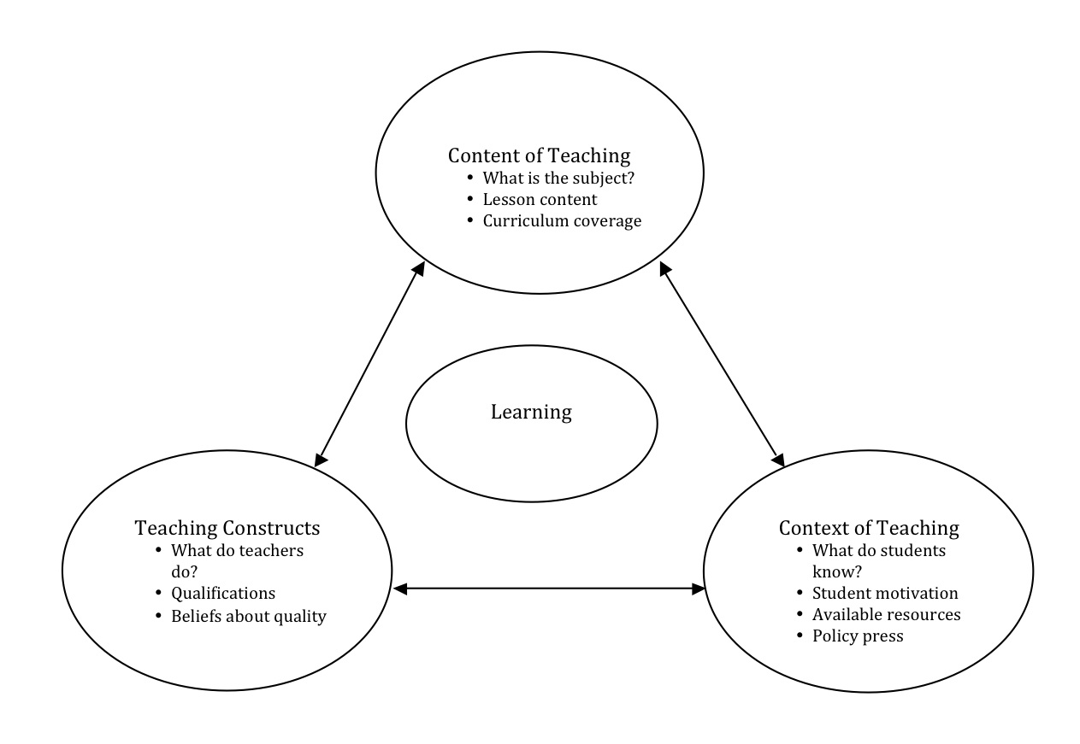
Conceptual Framework

Slide 7
Structuring a Question
Do allow your research question to emerge from the literature.
Do not create a question that you can answer with ‘yes’ or ‘no’
Do not select a research methodology before you have a research question.
Do select a question that you can answer during the time you have and the resources at your disposal.

Slide 8
Four Elements of Research
epistemology
theoretical perspective
methodology
methods

Slide 9
What is the Research Design?
What data do you need
Where or who will you get your data from
How will you collect your data
What statistical processes or methods can you use on the data
Decide how to present raw and processed data
Check that the collected data makes sense with what you intend to do

Slide 10
Qualitative Research
Quantitative Research
Mixed-Methods Research
Characteristics of the 3 Research Paradigms

Slide 11
Qualitative Research Methods
Inductive or bottom up (uses more words, images, categories)
Phenomenology
Ethnography
Case study research
Grounded theory
Historical research

Slide 12
Quantitative Research Methods
Relies primarily on the collection of numerical data (basic building block are variables)
Experimental
Quasi-experimental
Causal comparative
Survey
Descriptive
Correlational

Slide 13
Mixed Methods Research
Quantitative and Qualitative Methods are mixed in one overall study
Triangulation
Embedded
Explanatory
Exploratory

Slide 14
Variables—independent, dependent, controls, and constants
Two groups of students were tested to compare their speed working math problems. Each group was given the same problems. One group used calculators and the other group computed without calculators.
Independent Variable __________________________
Dependent Variable __________________________
Control __________________________
Constant __________________________

Slide 15
Scientific Method
Sponge Bob notices that his pal Gary is suffering from slimotosis, which occurs when the shell develops a nasty slime and gives off a horrible odor. His friend Patrick tells him that rubbing seaweed on the shell is the perfect cure, while Sandy says that drinking Dr. Kelp will be a better cure. Sponge Bob decides to test this cure by rubbing Gary with seaweed for 1 week and having him drink Dr. Kelp. After a week of treatment, the slime is gone and Gary’s shell smells better.
What was the initial observation?
What is the independent variable?
What is the dependent variable?
What should Sponge Bob’s conclusion be?
What should Sponge Bob have done differently?

Slide 16
Identify the Controls and Variables
Smithers thinks that a special juice will increase the productivity of workers. He creates two groups of 50 workers each and assigns each group the same task (in this case, they’re supposed to staple a set of papers). Group A is given the special juice to drink while they work. Group B is not given the special juice. After an hour, Smithers counts how many stacks of papers each group has made. Group A made 1, 587 stacks, and Group B made 2, 13 stacks.
Identify the:
Control Group
Independent Variable
Dependent Variable
What should Smithers’ conclusion be?
How could this experiment be improved?

Slide 17
Lisa is working on a science project. Her task is to answer the question: “Does Rogooti (which is a commercial hair product) affect the speed of hair growth?” Her family is willing to volunteer for the experiment.
Describe how Lisa would perform this experiment. Identify the control group, and the independent and dependent variables in your description.

