Slide 1
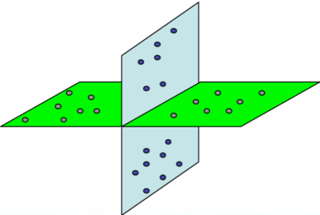
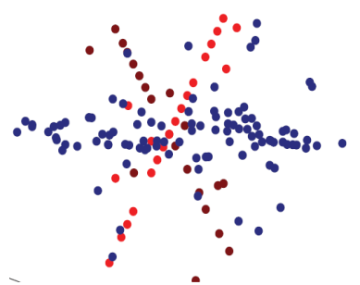
1st Annual Workshop on Data Science @
Tennessee State University
Robust Subspace Clustering in High Dimension:
A Deterministic Result
Guangcan Liu

Slide 2
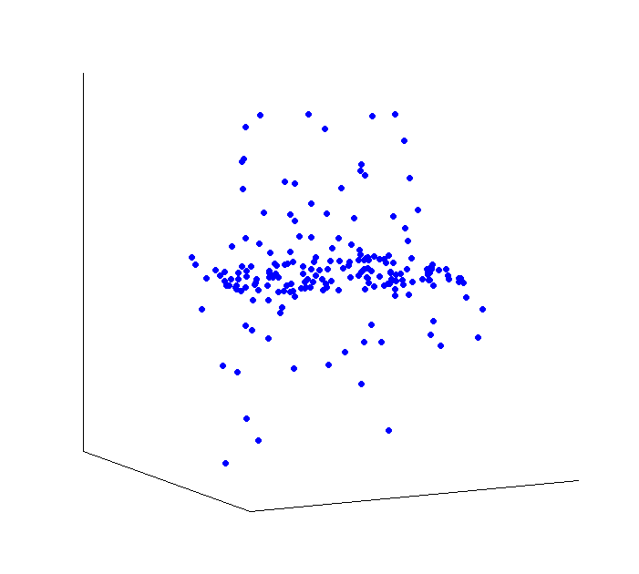
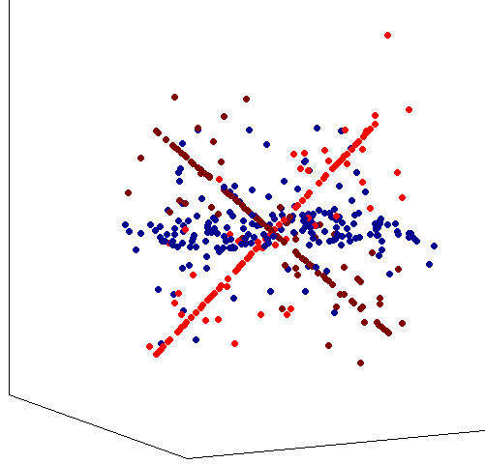
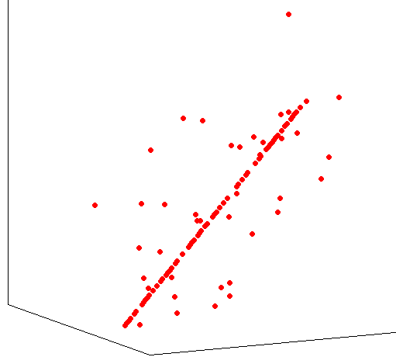
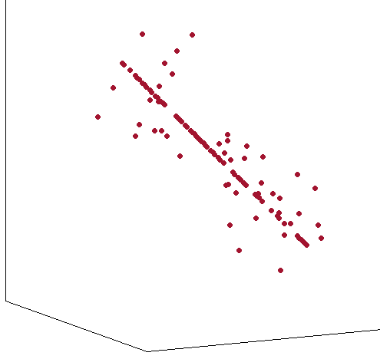
Problem Definition (Robust Subspace Clustering)
Survey
Applications
input
People
Computer Vision
Image Processing
Biometric
Physics
System theory
… …
Rene Vidal
Takeo Kanade
Ali Skemen
Gilad Lerman
David Donoho
Emmaunuel Candes
Anna Little
Laura Balzano
Jerome Baudry
Robert Nowark
Alexander Powell
Elad Admir
Ehsan Elhamifar
Don Hong
Yi Ma
Teng Zhang
Shuicheng Yan
Huan Xu
Zhouchen Lin
Guangcan Liu
… …
$$R^{m}$$
output
Methods
RANSAC (1981) -- LD
SIM (1998) -- HD
MSL (2004) -- HD
LSA (2006) -- HD
LLMC (2007) -- HD
ALC (2007) -- HD
GPCA (2008) -- LD
SC (2009) -- HD
SSC (2009) -- HD
SCC (2009) -- HD
LRR (2010) -- HD
LBF (2011) -- HD
SLBF (2011) – HD
… …
Errors
white noise
outliers
missing entries
corruptions
… …

Slide 3
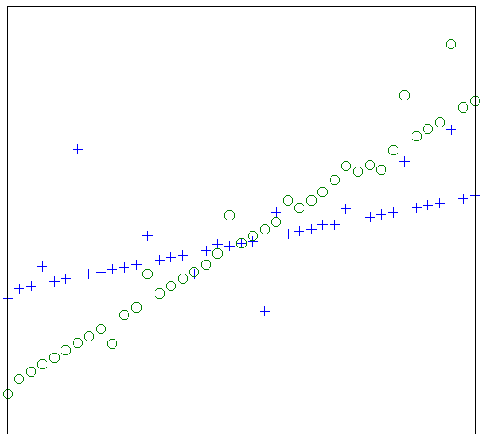
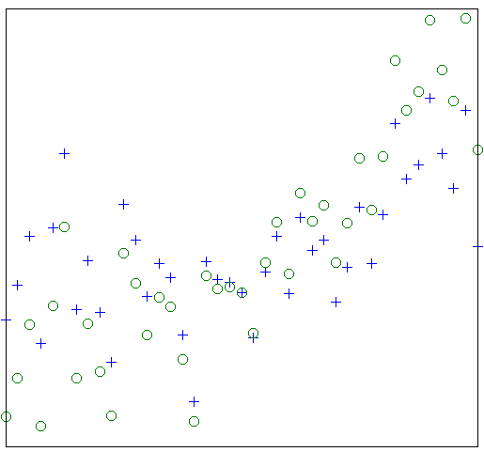
In general case, the problem is ill-posed
Unidentifiability
Example 1
Example 2
2D
Question: Under which conditions, it is possible to EXACTLY solve the robust subspace clustering problem

Slide 4
A Special Case
Let $S=S_{1}+S_{2}…+S_{k}$ be the sum of all $k$ subspaces.
High Dimension Assumption:
The ambient data dimension m is so high such that
$$m≫Dim\left(S\right)$$
This special case is indeed significant !
Hopkins155 (widely used in research):
Ambient data dimension, m$=100±20$
Number of subspaces, $k=2 or 3$
Dimension of each subspace $≤4$
$$\left[\begin{matrix}p_{11} \\ q_{11} \\ \begin{aligned}⋮ \\ p_{F1} \\ q_{F1}\end{aligned}\end{matrix} \begin{matrix}p_{12} \\ q_{12} \\ \begin{aligned}⋮ \\ p_{F2} \\ q_{F2}\end{aligned}\end{matrix} \begin{matrix}⋯ \\ ⋯ \\ \begin{aligned}⋱ \\ ⋯ \\ ⋯\end{aligned}\end{matrix} \begin{matrix}p_{1n} \\ q_{1n} \\ \begin{aligned}⋮ \\ p_{Fn} \\ q_{Fn}\end{aligned}\end{matrix}\right]=\left[\begin{matrix}A_{1} \\ ⋮ \\ A_{F}\end{matrix}\right]\left[\begin{matrix}h_{11} & ⋯ & h_{1n} \\ h_{21} & ⋯ & h_{2n} \\ \begin{aligned}h_{31} \\ 1\end{aligned} & \begin{aligned}⋯ \\ ⋯\end{aligned} & \begin{aligned}h_{3n} \\ 1\end{aligned}\end{matrix}\right]$$
$R^{2F×n}$ $R^{2F×4}$ $R^{4×n}$
$$Dim\left(S\right)≤\sum_{i}^{k}{Dim\left(S_{i}\right)}≤3×4=12≪m$$

Slide 5
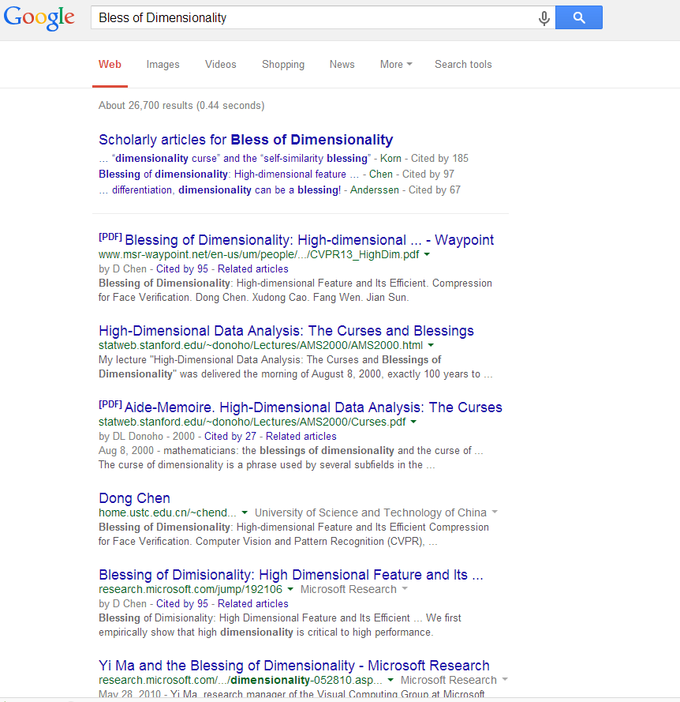
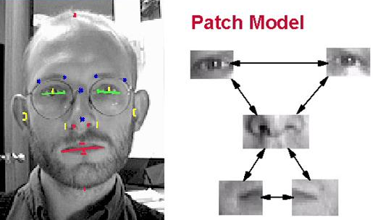
A Special Case
Let $S=S_{1}+S_{2}…+S_{k}$ be the sum of all $k$ subspaces.
High Dimension Assumption:
The ambient data dimension m is so high such that
$$m≫Dim\left(S\right)$$
This special case is indeed significant !
Face Images:
Consider $k=10,000$
The dimension of each (front) face subspace is about 5
$10×10$ face images ($m=100)$
$Dim\left(S\right)≤5k=50,000>m$
$100×100$ face images ( $m=10,000$)
$Dim\left(S\right)≤5k=50,000>m$
$1000×1000$ face images ($m=1,000$,000)
$Dim\left(S\right)≤5k=50,000≪m$
Blessing of Dimensionality

Slide 6
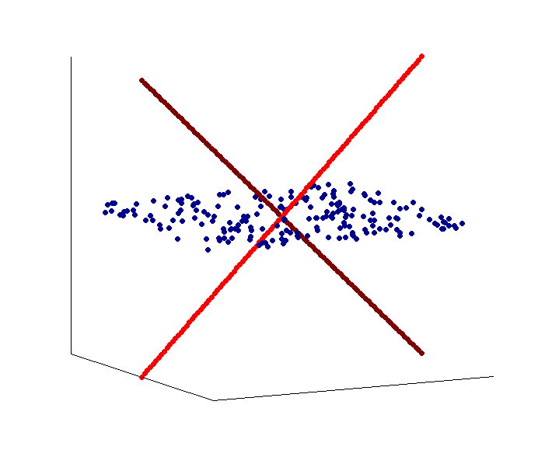
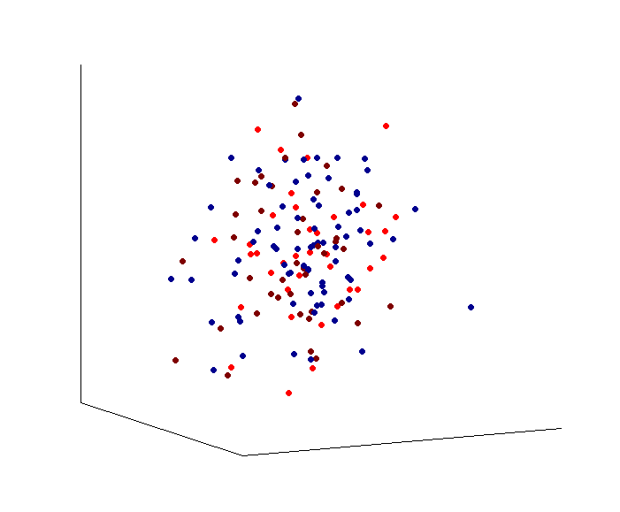
Problem Formulation (Robust Subspace Clustering)
What is the difference with PCA ?
Input: $X=[x_{1},x_{2},…,x_{n}]$, a given data matrix each column in which is an m-dimensional data point approximately drawn from some subspace.
$X=L_{0}+E_{0}$
Output:
Correct subspace membership
Low-Rankness Assumption:
$S=S_{1}+S_{2}…+S_{k}$.
$$r_{0}≜rank\left(L_{0}\right)=Dim\left(S\right)≤\frac{min⁡(m,n)}{\log{max⁡(m,n)}}$$
i.e., High Dimension Assumption + $n$ is also sufficiently large
i.e., the sum of multiple subspaces together is a subspace
$X$ (observed)
$L_{0}$ (authentic)
$E_{0}$ (errors)
PCA
Robust subspace clustering (High Dimension)
$$R^{m}$$
linear
$$=$$
$$+$$
nonlinear in linear

Slide 7
A Baseline Idea
Comments
white noise:
PCA (principal component analysis)
$${\hat{L}}_{0}=arg min_{L}{{\left|L\right|}_{∗}+λ{\left|X−L\right|}_{F}^{2}}$$
spare corruptions:
PCP (principal component pursuit)
[Wright et al., NIPS’09; Candes et al., JACM’11]
$${\hat{L}}_{0}=arg min_{L}{{\left|L\right|}_{∗}+λ{\left|X−L\right|}_{1}}$$
OP (outlier pursuit) [Xu et al., NIPS’10]
$${\hat{L}}_{0}=arg min_{L}{{\left|L\right|}_{∗}+λ{\left|X−L\right|}_{2,1}}$$
missing entries:
matrix completion[Candes et al., Fund. Math. Comp.’09]
$${\hat{L}}_{0}=arg min_{L}{{\left|L\right|}_{∗}+λ{\left|P_{Ω}\left(X−L\right)\right|}_{F}^{2}}$$
1
Error Correction
Positive
Provided that $L_{0}$ is low-rank, it is possible for (robust) PCA methods to recover $L_{0}$ from $X$ without considering multiple subspaces.
Candes et al. Robust Principal Component Analysis ? JACM’11.
Candes and Recht. Exact Matrix Completion via Convex Optimization. FMC’09.
Negative
In the case of multiple subspaces, the success condition for recovering $L_{0}$ is actually very restrictive:
The incoherent condition requried by (robust) PCA methods is inconsistent with multiple subspaces.
Guangcan Liu and Ping Li. Recovery of coherent data via low-rank dictionary pursuit, NIPS’14
The style of two steps is not easy to use in practice.
X
$${\hat{L}}_{0}$$
2
Standard Subspace Clustering
Step 1: compute an affinity matrix
SIM(shape interaction matrix)[Costeira et al., IJCV’98]
Perform SVD: ${\hat{L}}_{0}=\hat{U}\hat{Σ}{\hat{V}}^{T}$
Form an affinity matrix by $\hat{Z}=|\hat{V}{\hat{V}}^{T}|$
SSC (sparse subspace clustering)[Rene et al., CVPR’09]
$$\hat{Z}=arg min_{Z}{{\left|Z\right|}_{1} s.t.{\hat{L}}_{0}={\hat{L}}_{0}Z}$$
… …
Step 2: spectral clustering
$${\hat{L}}_{0}$$
Overall Grade: D (grading system A-F)

Slide 8
Preliminary : Shape Interaction Matrix (SIM)
Definition
For a data matrix $M$ each column in which is a data point, its shape interaction matrix (SIM) is
$VV^{T},$ (row projector)
where $UΣV^{T}$ is the skinny SVD of $M$.
The SIM of $L_{0}$, $V_{0}V_{0}^{T}∈R^{n×n}$ , identifies the true subspace membership
However, …
The following had been proved (Kanatani, ECCV’11; Vidal et al., IJCV’08; Liu et al., TPMAI’13; Xu et al., ICML’13):
for $x_{i}$ and $x_{j}$ from different subspaces, ${[V_{0}V_{0}^{T}]}_{ij}=0$
for $x_{i}$ and $x_{j}$ from the same subspace, ${[V_{0}V_{0}^{T}]}_{ij}≠0$ with high probability
$$V_{0}V_{0}^{T}$$
$$V_{0}V_{0}^{T}$$
$$X=U_{X}Σ_{X}V_{X}^{T}$$
$$V_{X}V_{X}^{T}$$
independent
intersection
SNRdB = 23

Slide 9
Our Method
Given $X$,$X=L_{0}+E_{0}$, recover $V_{0}V_{0}^{T}$ (the SIM of $L_{0}$) using a single convex procedure.
A Basic Theory[Liu et al., TPAMI’13]:
$$V_{0}V_{0}^{T}=\arg{min_{Z}{\left|Z\right|}_{∗} s.t. L_{0}=L_{0}Z}$$
About the nuclear norm, $|⋅{\left.​\right|}_{∗}$:
Let $\{σ_{1},σ_{2},…\}$ be the singular values of a matrix $M.$ Then ${\left|M\right|}_{∗}=\sum_{i}{σ_{i}}$
Nuclear norm is the closest convex approximation to the rank function
$$π=\left[\begin{aligned}σ_{1} \\ σ_{2} \\ . \\ . \\ . \\ . \\ . \\ .\end{aligned}\right], rank\left(M\right)={\left|π\right|}_{0}, {\left|M\right|}_{∗}={\left|π\right|}_{1}$$

Slide 10
Our Method
Given $X$,$X=L_{0}+E_{0}$, recover $V_{0}V_{0}^{T}$ (the SIM of $L_{0}$) using a single convex procedure.
A Basic Theory[Liu et al., TPAMI’13]:
$$V_{0}V_{0}^{T}=\arg{min_{Z}{\left|Z\right|}_{∗} s.t. L_{0}=L_{0}Z}$$
$$X−E_{0}=\left(X−E_{0}\right)Z$$
To recover $V_{0}V_{0}^{T}$, one may try:
$$\min_{Z,S}{{\left|Z\right|}_{∗}+λ{\left|E\right|}_{ℓ}} s.t., \left(X−E\right)=\left(X−E\right)Z$$
not convex !
Paolo, Rene, and Avinash, “A Closed Form Solution to Robust Subspace Estimation and Clustering”, CVPR’11:
$$\min_{Z,S}{{\left|Z\right|}_{∗}+λ{\left|E\right|}_{1}} s.t., \left(X−E\right)=\left(X−E\right)Z$$
${\left|E\right|}_{F}^{2}$: white noise
${\left|E\right|}_{1}$: randomly sparse errors
${\left|E\right|}_{2,1}$: column-wisely sparse errors
$${ E}_{0}$$
randomly
sparse

Slide 11
Our Method
Given $X$,$X=L_{0}+E_{0}$, recover $V_{0}V_{0}^{T}$ (the SIM of $L_{0}$) using a single convex procedure.
A Basic Theory[Liu et al., TPAMI’13]:
$$V_{0}V_{0}^{T}=\arg{min_{Z}{\left|Z\right|}_{∗} s.t. L_{0}=L_{0}Z}$$
A Convex Approximation Scheme:
An observation: $E_{0}V_{0}V_{0}^{T}≈0$
We remove $EZ$ in $X−E=\left(X−E\right)Z$:
$$X=XZ+E−EZ$$
Convex formulation:
$\min_{Z,S}{{\left|Z\right|}_{∗}+λ{\left|E\right|}_{ℓ}} s.t., X=XZ+E$
$$E_{0}$$
$$E_{0}V_{0}V_{0}^{T}$$
Question: What is lost ?

Slide 12
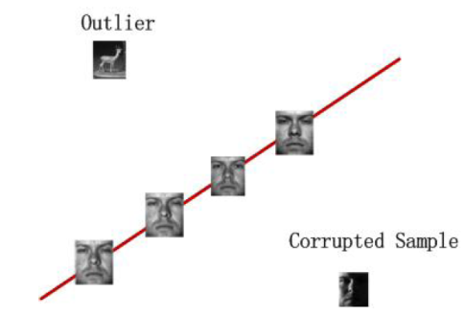
Our Method
Given $X$,$X=L_{0}+E_{0}$, recover $V_{0}V_{0}^{T}$ (the SIM of $L_{0}$) using a single convex procedure.
A Basic Theory[Liu et al., TPAMI’13]:
$$V_{0}V_{0}^{T}=\arg{min_{Z}{\left|Z\right|}_{∗} s.t. L_{0}=L_{0}Z}$$
under certain conditions, the convex procedure below can EXACTLY recover $V_{0}V_{0}^{T}$
$\min_{Z,S}{{\left|Z\right|}_{∗}+λ{\left|E\right|}_{ℓ}} s.t., X=XZ+E$
Setting: sample-specific errors
Low-Rank Representation (LRR) [Liu et al., ICML’10, TPAMI’13]
Rather surprisingly, in some cases, nothing is lost!
$${ E}_{0}$$
column-wisely
Sparse
(group sparsity)
(LRR) $\min_{Z,S}{{\left|Z\right|}_{∗}+λ{\left|E\right|}_{2,1}} s.t. X=XZ+E$

Slide 13
Our Method
Given $X$,$X=L_{0}+E_{0}$, recover $V_{0}V_{0}^{T}$ (the SIM of $L_{0}$) using a single convex procedure.
LRR:
$$\left(Z^{∗},E^{∗}\right)=arg \min_{Z,S}{{\left|Z\right|}_{∗}+λ{\left|E\right|}_{2,1}} s.t. X=XZ+E$$
A Deterministic Result
Assumption:
$span\left(L_{0}\right)∩span\left(E_{0}\right)=\left\{0\right\}$ (avoid unidentifiability)
$$m≫Dim\left(S\right)⇒$$
Notes
Theorem
There exists $γ^{∗}>0$, such that LRR with parameter $λ=\frac{3}{7\left|X\right|\sqrt{γ^{∗}n}}$ strictly succeeds as long as $γ≤γ^{∗}$ ($γ$ is the fraction of nonzero columns of $E_{0}$):
$U^{∗}{\left(U^{∗}\right)}^{T}=V_{0}V_{0}^{T}$ and $ℐ^{∗}=ℐ_{0},$
where $U^{∗}$ is the left singular vectors of $Z^{∗}$, and $ℐ^{∗}$ is the column support of $E^{∗}$.
$V_{0}$ --- right singular vectors of $L_{0}$
$ℐ_{0}$ --- column support of $E_{0}$
LRR also depends on the incoherent condition
$Z^{∗}≠V_{0}V_{0}^{T}$ ($Z^{∗}$ is asymmetric)
$ℓ_{1}$ regularization:
$$\min{{\left|Z\right|}_{∗}+λ{\left|E\right|}_{1}, s.t. X=XZ+E}$$
near recovery to $V_{0}V_{0}^{T}$, but not exact.
Provided that ${\left|\left[X_{:,i}\right]\right|}_{2}=1, ∀i=1,⋯n$,
$$λ=\frac{1}{\sqrt{\log{n} }}$$

Slide 14
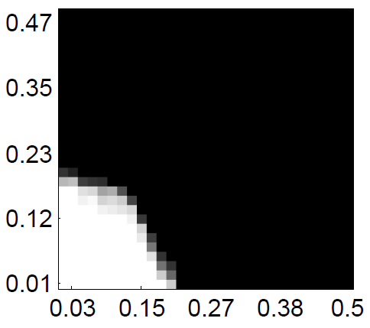
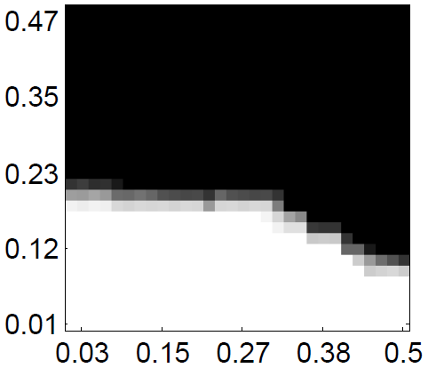
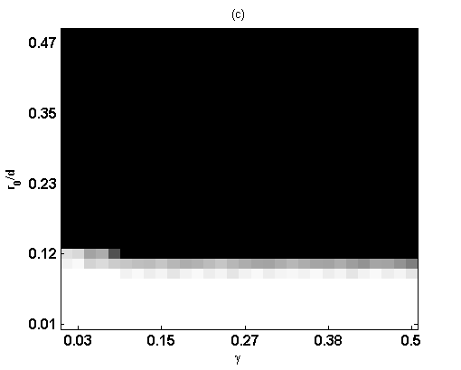
Results on Randomly Generated Data
Experimental Settings
ambient dimension $m=300$ #subspace $k=5$ #data points $n=300$
$r_{0}≜rank\left(L_{0}\right)=5,10,…,150$ $γ=1.7\%,3.4\%,…,50\%$ #trials = 100
$λ=1/\sqrt{\log{n}}$
Comparison
LRR
$$\min_{Z,S}{{\left|Z\right|}_{∗}+λ{\left|E\right|}_{2,1}} s.t. X=XZ+E$$
Outlier Pursuit (OP):
$\min_{L,S}{{\left|L\right|}_{∗}+λ{\left|E\right|}_{2,1}} s.t. X=L+E$
Recovering $V_{0}V_{0}^{T}$
Recovering colu_supp($E_{0}$)
$$r_{0}/m$$
$$r_{0}/m$$
$$r_{0}/m$$
$$r_{0}/m$$
corruption percentage $γ$
corruption percentage $γ$
corruption percentage $γ$
corruption percentage $γ$

Slide 15
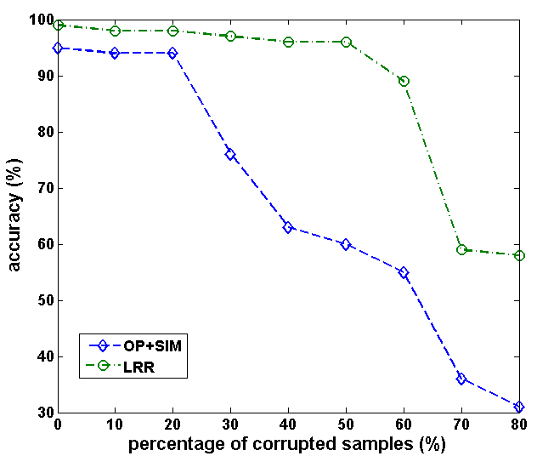
Results on Motion Sequences
Experimental Settings
Dataset: Hopkins155 (+ synthetic corruptions)
Baseline: Outlier Pursuit (OP) + SIM

Slide 16
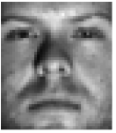
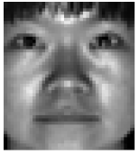
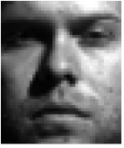
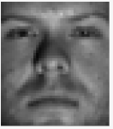
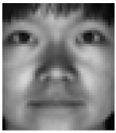
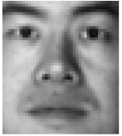
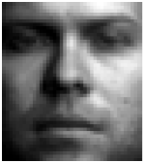
Results on Face Images
input
$X$=
······
$$\left(Z^{∗},E^{∗}\right)=arg \min_{Z,S}{{\left|Z\right|}_{∗}+λ{\left|E\right|}_{2,1}} s.t. X=XZ+E$$
output
$XZ^{∗}$=
······

Slide 17
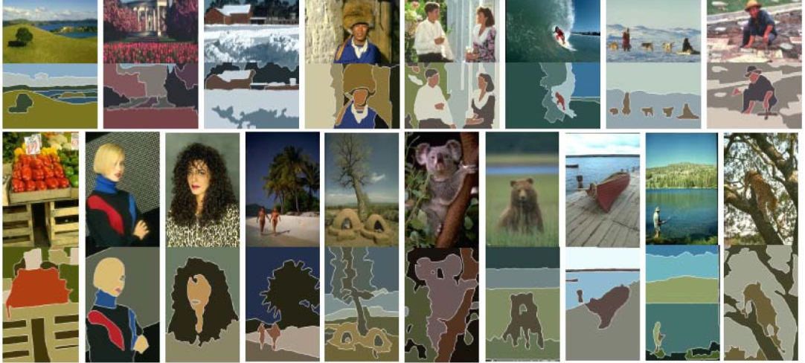
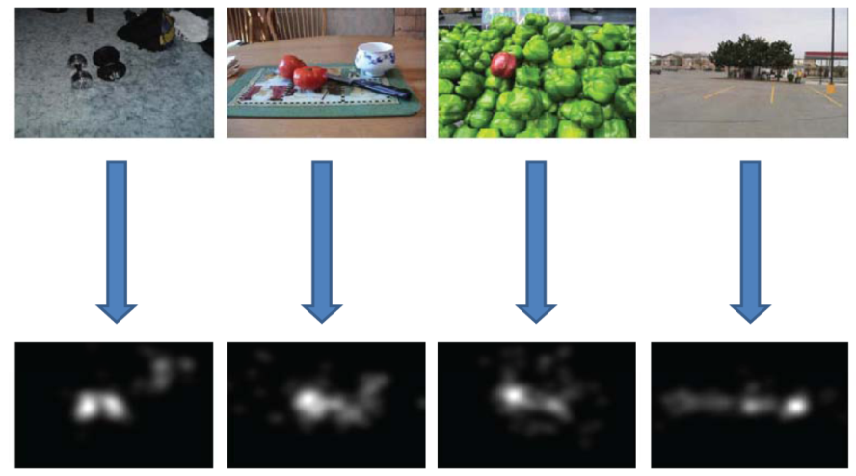
Some Comments for LRR
Positive:
Subspace clustering + error correction
Computationally stable (convex)
The model is flexible and can easily adapt to various problems:
Negative:
LRR still partially depends on the incoherent condition !
LRR has NOT fully captured the structure of multiple subspaces
Image segmentation, ICCV’11
Saliency Detection, TIP’11
Overall Grade: D+ (grading system A-F)

Slide 18
Conclusion & Future Work
Conclusion
Figuring out a significant and “easy” case for the robust subspace clustering problem (blessing of dimensionality)
Suggesting a convex formula termed LRR to resolve the problem under certain conditions
Future Work
Fast algorithms (curse of dimensionality)
Completely removing the dependence on the incoherent condition
References
[1] Liu et al. Robust Subspace Segmentation by Low-Rank Representation , ICML’10.
[2] Liu et al. Robust Recovery of Subspaces Structures by Low-Rank Representation, TPAMI’13
[3] Liu et al. Recovery of Coherent Data via Low-Rank Dictionary Pursuit, NIPS’14
[4] Liu et al. A Deterministic Analysis for LRR, TPAMI (under revision)

Slide 19
Questions ?
Welcome to email me:
gcliu@nuist.edu.cn

