Slide 1
The Office of Student Activities
Dr. Jame’l Hodges, Director
Ms. Sonja Revell, Assistant Director

Slide 2
Who We Are
Mission Statement
The mission of the Office of Student Activities is to provide programs and services that enrich students’ intellectual, ethical, and social development. The office supports programs that promote learning opportunities in personal growth, self-governance, social responsibility, and leadership development while assisting in the retention and graduation of students.

Slide 3
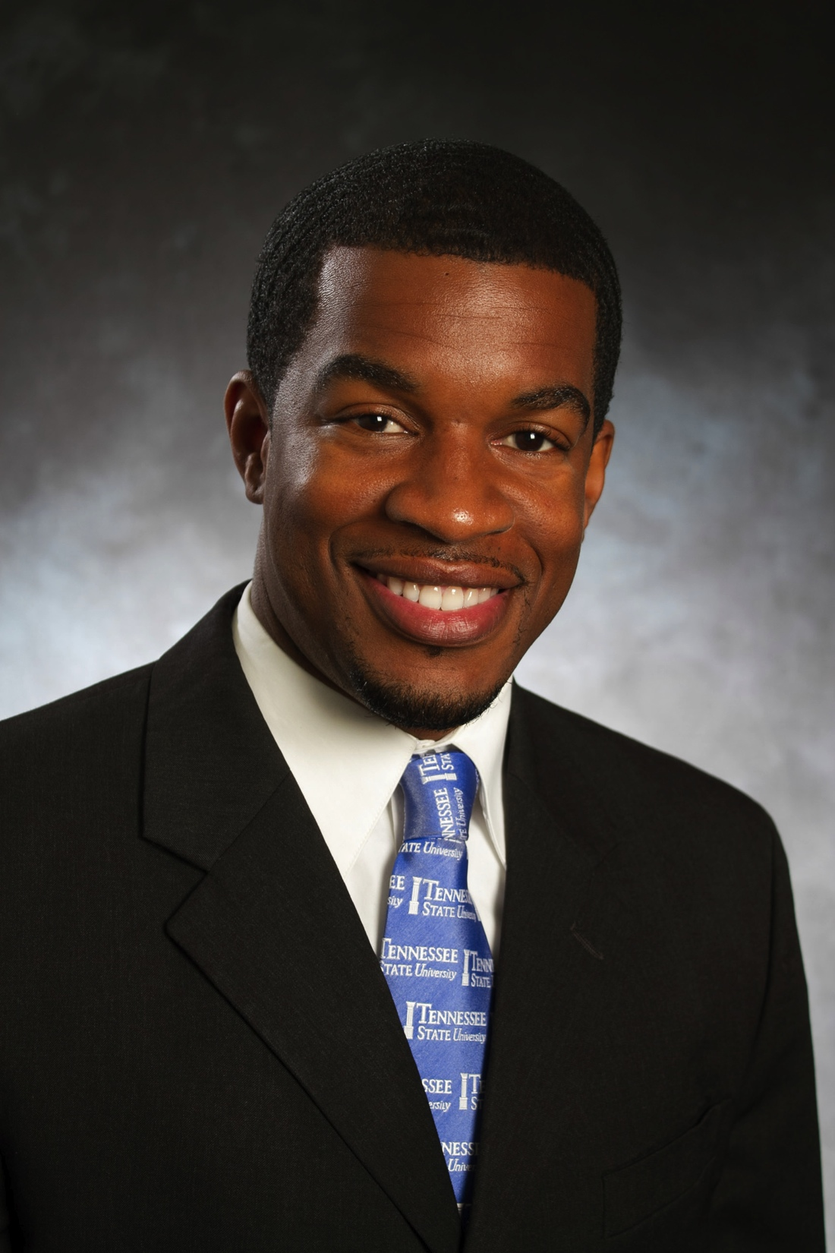
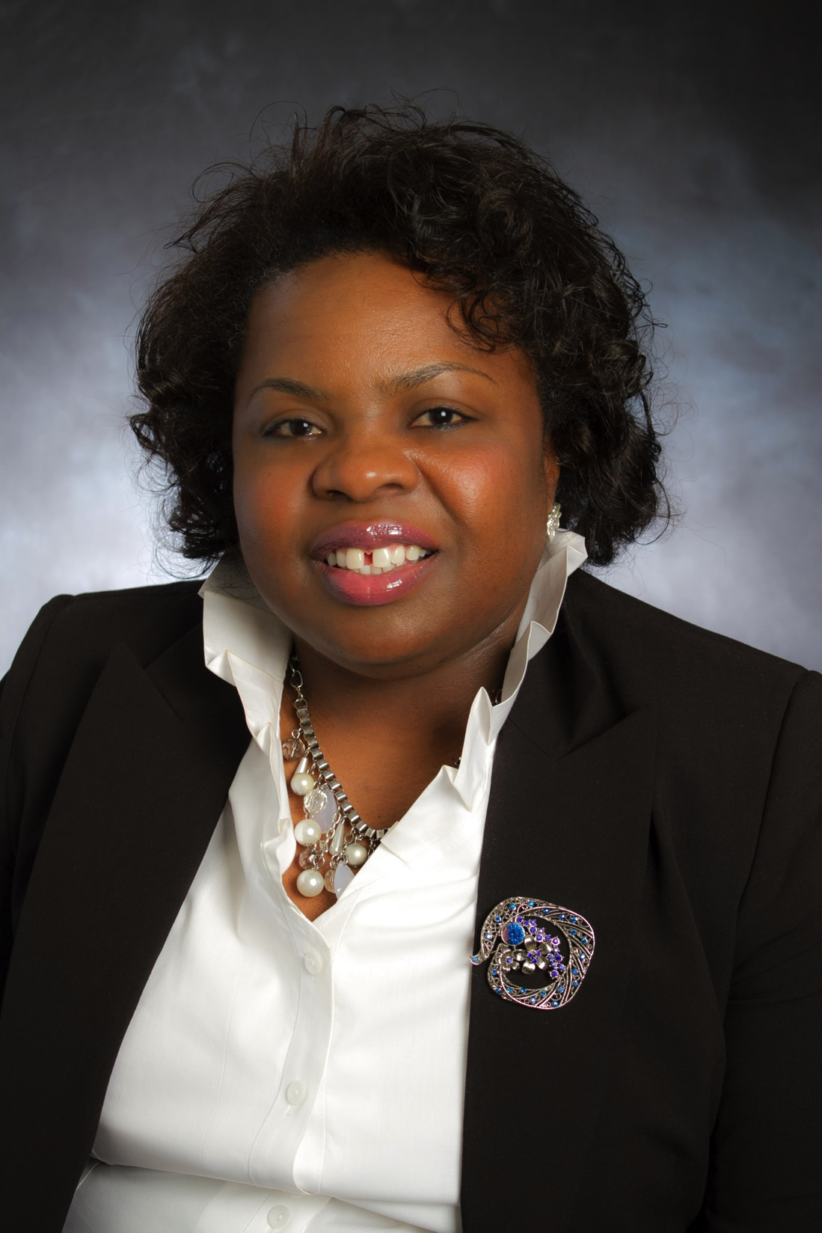
Student Activities Staff
Dr. Jame’l Hodges, Director
Sonja Revell, Assistant Director

Slide 4
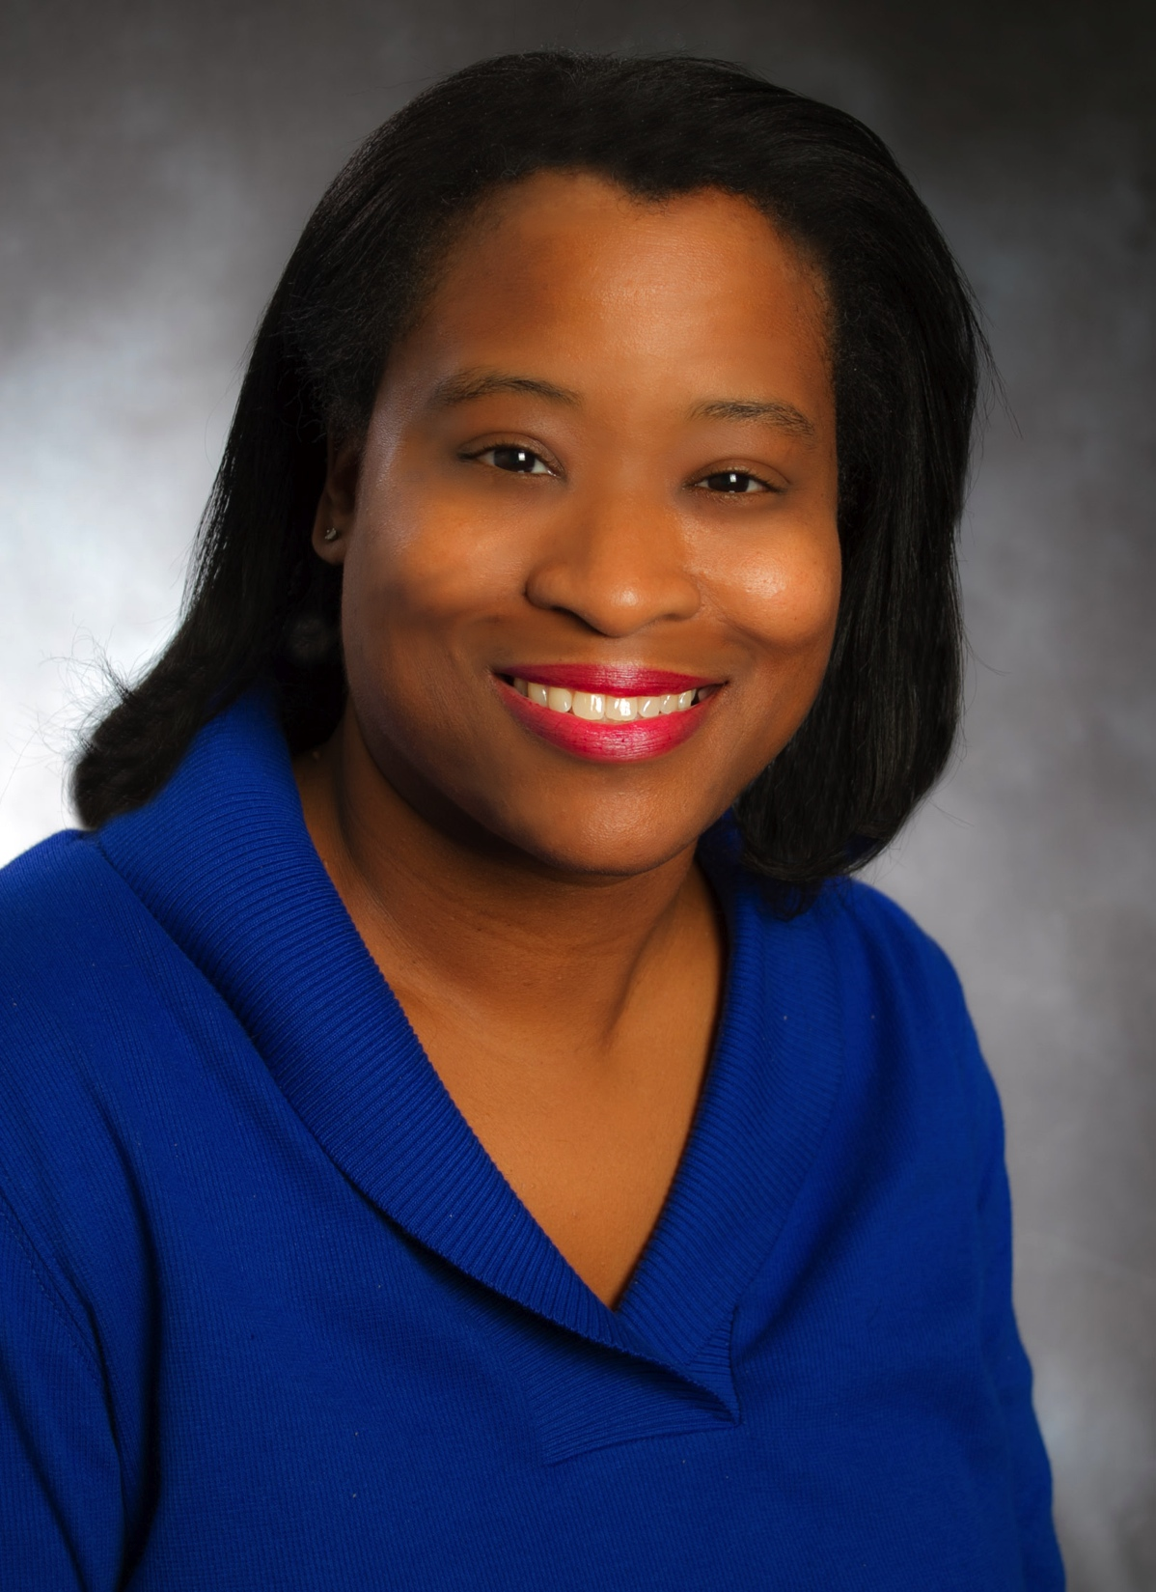
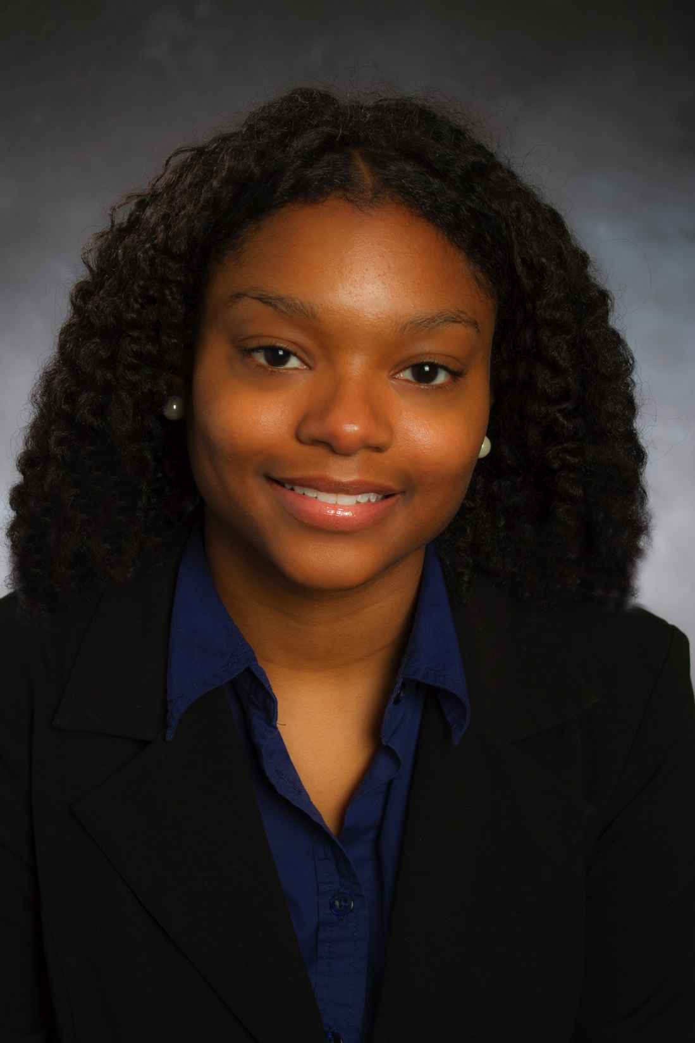
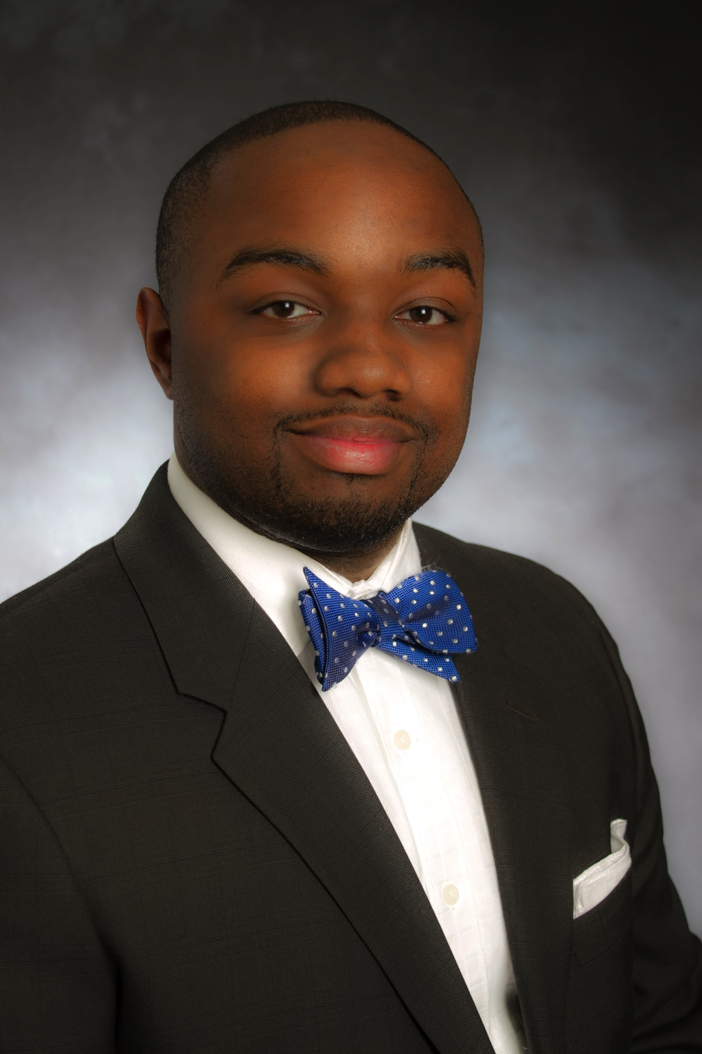
Student Activities Staff
Angie Jefferson
Coordinator of Registered Student Organizations
Ashley Floyd
Coordinator of Leadership Development
Stephen Smith
Coordinator of Greek Life

Slide 5
Registered Organizations
52 Registered Student Organizations
Academic, Ethnic, Religious, Fitness & Fashion, Greek, Professional, Military, Performing Arts, Student Life, and Cause-Oriented Groups
Registered Student Organizations can reserve campus facilities for meetings and programs, hold membership drives and membership intake processes, and be officially recognized by Tennessee State University.

Slide 6
Student Government Association
The Student Government Association is made up of:
House of Delegates (“The House”)
Student Union Board of Governors (SUBG)
Student Election Commission (SEC)
Liaison between Administration and Student Body
Located in the Office of Student Activities

Slide 7
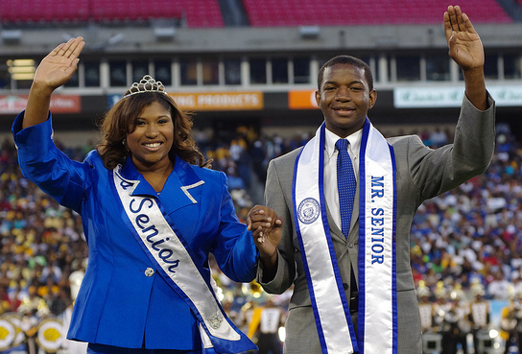
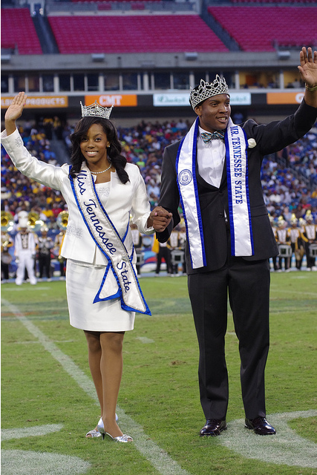
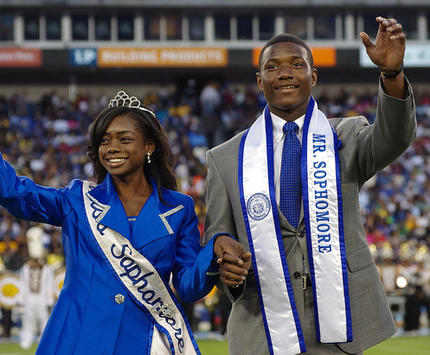
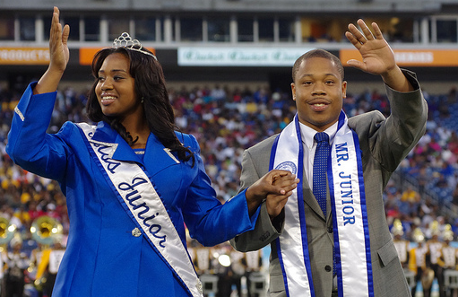
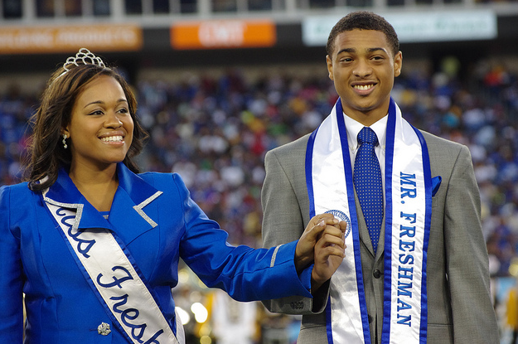
Royal Court

Slide 8
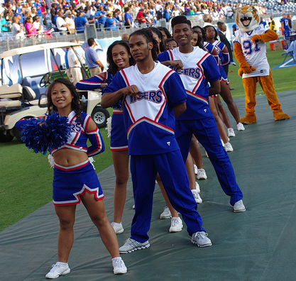
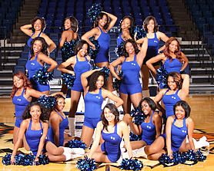
TSU Spirit
Cheerleaders
Tiger Gems

Slide 9
National Pan-Hellenic Council
9 Black Greek-Lettered Organizations
Nationally Founded in 1930, Chartered at TSU in 1975
Hold campus and community programming and service projects
Membership intake in spring and fall semesters

Slide 10
Questions?

