Slide 1
Banner 9 Basic Navigation
OTS Applications Team

Slide 2
Before We Begin…
Purpose:
This session is an intro to Banner 9, basic Banner 9 navigation, and other Banner 9 functionality common to all modules. The approach is generic in order to assist a wide variety of users.
Reminders
Everyone is muted during presentation.
Please post questions in the chat.
There will be a Q&A at the end of the session.
This is the last live session. The recording will be posted.
A PDF will be posted with the PowerPoint slides.

Slide 3
Agenda
Finding Banner 9 Links and Information/Videos
Banner 9’s New Look and Benefits
The Menu Bar
Searching for Forms/Pages
Next Block => GO
RollBack => Start Over
Options => Related or Tools
Record Maintenance (Insert, Delete, Copy)
Viewing Data
Error Messages
Query => Filter
Searching
Inactivity
Other Resources

Slide 4
Finding Banner 9 Links and Information http://www.tnstate.edu/banner

Slide 5
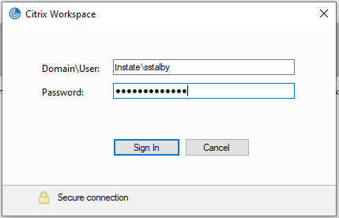
Accessing Banner 9 While Working Remote
Login to Citrix Workspace Domain\User: tnstate\<yourusername> Example: tnstate\jsmit301 Use the same login credentials as myTSU
Click the Banner 9 Icon

Slide 6
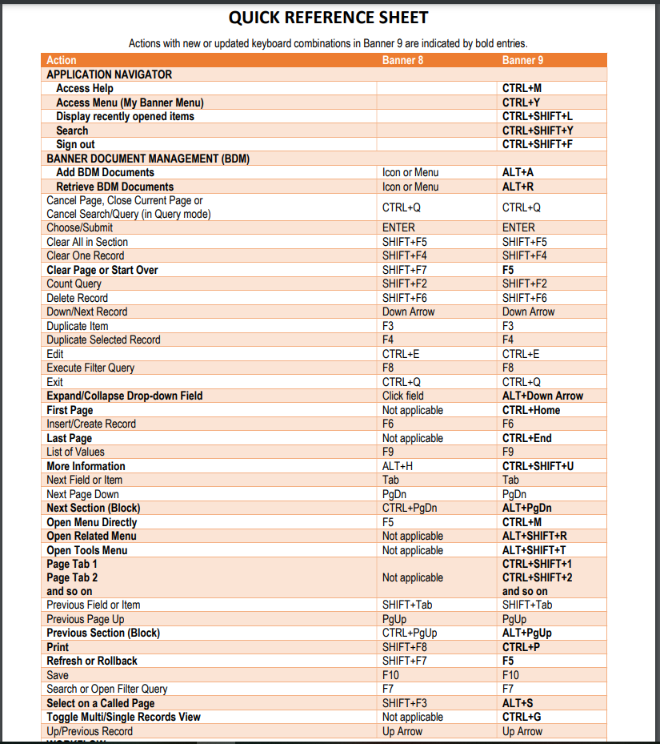
Banner 8 vs Banner 9 Keyboard Shortcuts
F10 still saves, F7 still starts a query, F8 still executes a query
Visit the link below for the full list:
http://www.tnstate.edu/banner/Banner%209%20Quick%20Reference%20Sheet.pdf

Slide 7
Banner 9’s New Look
Banner 8 Home
Banner 9 Home

Slide 8
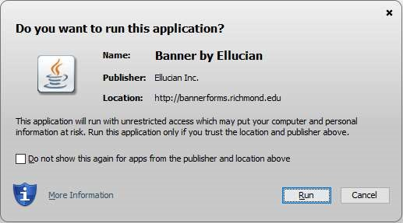
Huge Benefit of Banner 9: No More Java!

Slide 9
Benefit: No Banner-Specific Password Just log in with your regular credentials (TNState Username and Password, the same one that you use to log onto your computer, Outlook, or myTSU)
Banner 8 Login
Banner 9 Login

Slide 10
Benefit: Use any web browser! Internet Explorer is no longer required.

Slide 11
Key Terminology Changes

Slide 12
Banner 9 Menu Bar
Sidebar Menu (Expands Sidebar)
Home Screen
Applications Menu
Search
Recently Opened Pages
Help
Favorited Pages
Sign Out
Name of the Logged In User

Slide 13
Applications Menu
Banner 8
Banner 9

Slide 14
Searching for Forms/Pages % = Wildcard Character
Banner 8
Banner 9

Slide 15
Directly Accessing Forms/Pages
Banner 8
Banner 9

Slide 16
Next Block Banner 9 – Use the Go Button Next Section – You can also use the Navigation Arrows or ALT + PgDn Keys
Banner 8 – Next Block
Banner 9 – Go or Next Section

Slide 17
Rollback Banner 9 - Click the ‘Start Over’ Button or the F5 Key
Banner 8
Banner 9 – Start Over (Top Right Corner)

Slide 18
Options Menu (Banner 8) => Related Menu (Banner 9)
Banner 8
Banner 9 (Top Right Corner)

Slide 19
Tools (Top Right Corner) Contains various utilities, including Print, Export, and Item Properties.

Slide 20
Record Maintenance Record maintenance is accomplished using the buttons at the top of the section to be edited or added to. The Keyboard Shortcuts for record maintenance are unchanged. Insert Record = F6 Delete Record = SHIFT+F6 Duplicate Record = F4

Slide 21
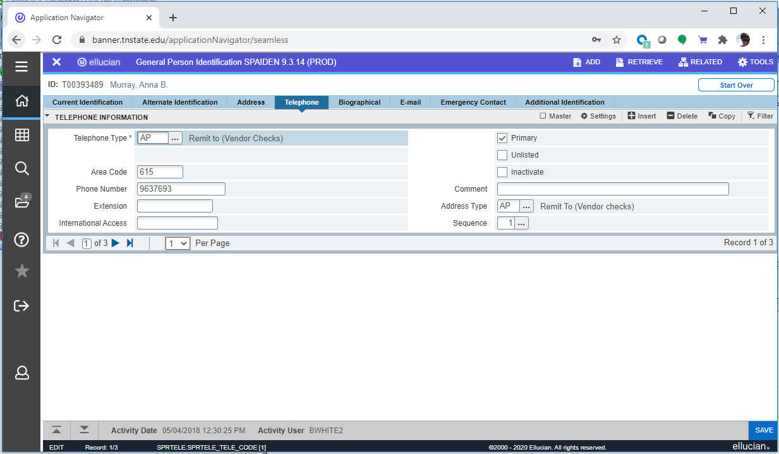
Viewing Data

Slide 22
Message/Notification Types Notifications will sometimes pop up at the top right of the screen. You can click the yellow square, the notification hopper, to hide the message(s) or click the square to open the hopper and display the message(s). There are four notification types:

Slide 23
Query => Filter Filtering is the new way of limiting the results shown on the Form/Page. It works similarly to entering Query criteria in Banner 8. In Banner 9 you specify the field and the value you’re looking for and click Go to activate the filter. Recall that the wildcard character (%) can be used here.
Banner 8
Banner 9

Slide 24
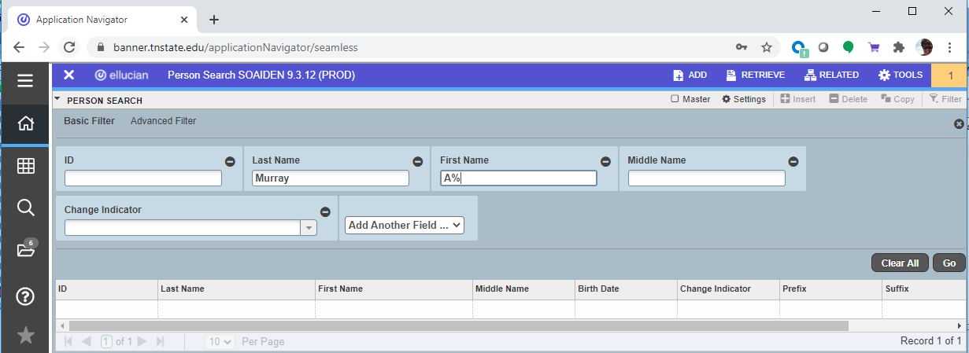
Searching/Adding a Person or Vendor
Banner 8
Banner 9
Click on the ellipsis (…) next to the field to initiate a search
Enter the desired criteria in the search field(s) then click Go.
The buttons the yellow arrows point to are for adding a new record. When adding new records, please carefully check to be certain you’re not creating a duplicate record.

Slide 25
Searching/Adding a Person or Vendor You can also press TAB when in the ID block to bring up a search entry field.
Pressing TAB brings up a search entry field:
After typing the search criteria, pressing enter will bring up further options (left).
Clicking “Press to See Results” shows the following:

Slide 26
Inactivity As in Banner 8, you will be logged out of Banner 9 after 30 minutes of inactivity. In Banner 9, however, a warning message will now display after 25 minutes and give you the option to extend your session if you are still at your screen. Clicking ‘Extend’ will refresh your session for another 30 minutes of inactivity. You only see this screen if you are doing nothing in Banner for 25 minutes straight. It will not interrupt you during normal use of Banner 9.

Slide 27
Other Resources
OTS has a website dedicated to the upgrade of Banner 9 with information and useful resources: http://www.tnstate.edu/banner/
Banner 9 Access URL: https://banner.tnstate.edu/applicationNavigator
Ellucian Banner 9 Intro Video: https://www.youtube.com/watch?v=6Mqqy0lez_c
For specific questions about a particular form or process please contact the appropriate office for assistance.
If you discover something that does not work properly or get an unexpected error then please navigate to ServiceNow(SNOW), log in with your TNSTATE email and password, and submit a ticket. If you need instructions on how to submit a ticket, click with details about the issue so that someone can look into it.
Color wheel for personal preferences: https://htmlcolorcodes.com/

