Slide 1
Banner 9 Basic Navigation
OTS Applications Team

Slide 2
Zoom notes before we begin
Purpose:
This training is a Banner basics review of Banner 9 and the navigation and other functionality crosses over all modules. The approach is “generic” to cover navigation and usage of Banner 9 in order to assist a wide variety of users.
Reminders
90+ attendees
All muted
Questions – please post in chat
There will be time at the end of the session
More sessions in the future
Will post recorded session
PDF contains slides
Important
If internet issues are encountered during the training, this session will be rescheduled.

Slide 3
Agenda - Banner 9 Basic Navigation
Finding Banner 9 link and information/videos
Banner Gets a New Look and Benefits
Menu Bar
Menu
Search for Forms/Pages
Next Block = GO
RollBack = Start Over
Options = Related or Tools
Tools
Record Maintenance (insert,delete,copy)
See Data
Error Messages
Query = Filter
Search for a person or vendor
Searching
Inactivity
Other Resources

Slide 4
Finding Banner 9 and information http://www.tnstate.edu/banner

Slide 5
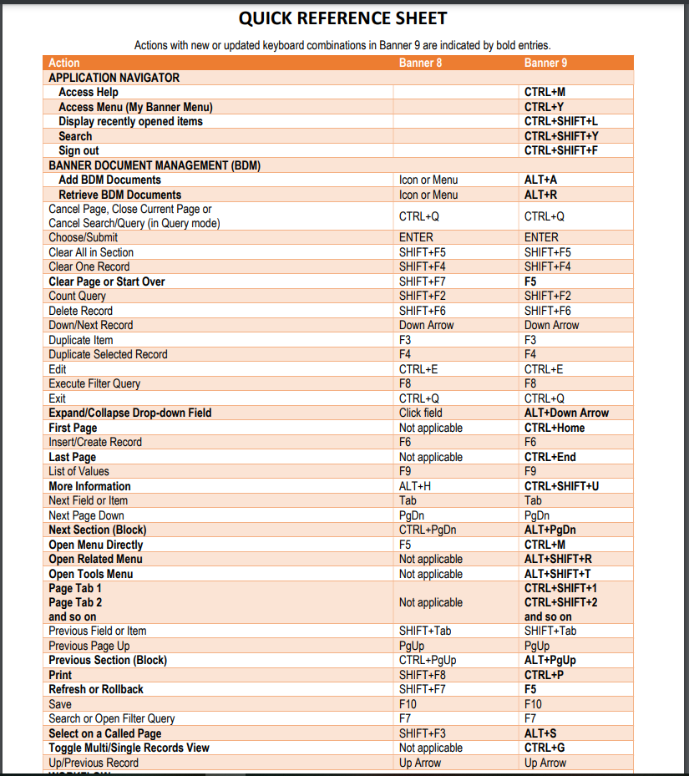
Banner 8 vs Banner 9 keys http://www.tnstate.edu/banner/Banner%209%20Quick%20Reference%20Sheet.pdf
F10 still saves, F7 still starts a query, F8 still executes query, etc

Slide 6
Banner Gets a New Look
Banner 8 Menu
Banner 9 Menu

Slide 7
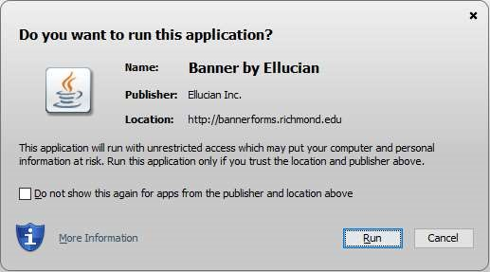
Benefit: No more Java!

Slide 8
Benefits: No Banner-specific password Just log in with your regular credentials (TNState Username and password – same one that you use to log onto your computer, into Outlook and mytsu)
Banner 8 login
Banner 9 login

Slide 9
Benefit: Any browser you like! No longer tied to Internet Explorer!

Slide 10
Banner 9 Menu Bar
Banner Menu Button – Opens up sidebar
“Home Screen” Button
Applications
Search
Recently Opened Pages
Help Button
Favorites
Sign Out of Banner
Personal settings

Slide 11
Menus
Banner 8
Banner 9

Slide 12
Search for Forms/Pages
Banner 8
Banner 9

Slide 13
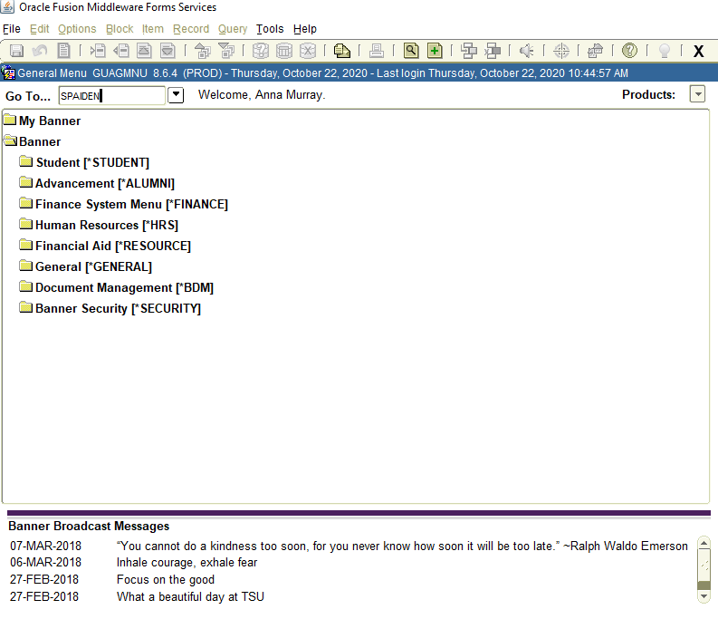
Direct access to form
Banner 8
Banner 9

Slide 14
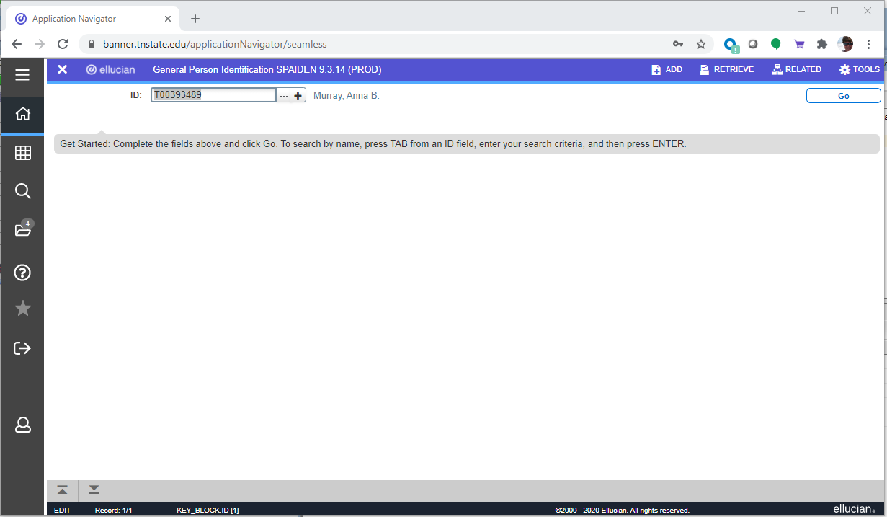
Next Block Banner 9 - Click the ‘Go’ button, the ‘Next Section’ navigation arrow, or use ALT+PgDn
Banner 8
Banner 9

Slide 15
Rollback Banner 9 - Click the ‘Start Over’ button OR use F5
Banner 8
Banner 9

Slide 16
Options = Related or Tools
Banner 8
Banner 9

Slide 17
Tools Contains various utilities, including Print and Export and item properties.

Slide 18
Record Maintenance Record maintenance is accomplished using the buttons at the top of the section to be edited. Shortcut keys for record maintenance are unchanged [Insert record = F6; Delete record = SHIFT+F6; Duplicate record = F4]

Slide 19
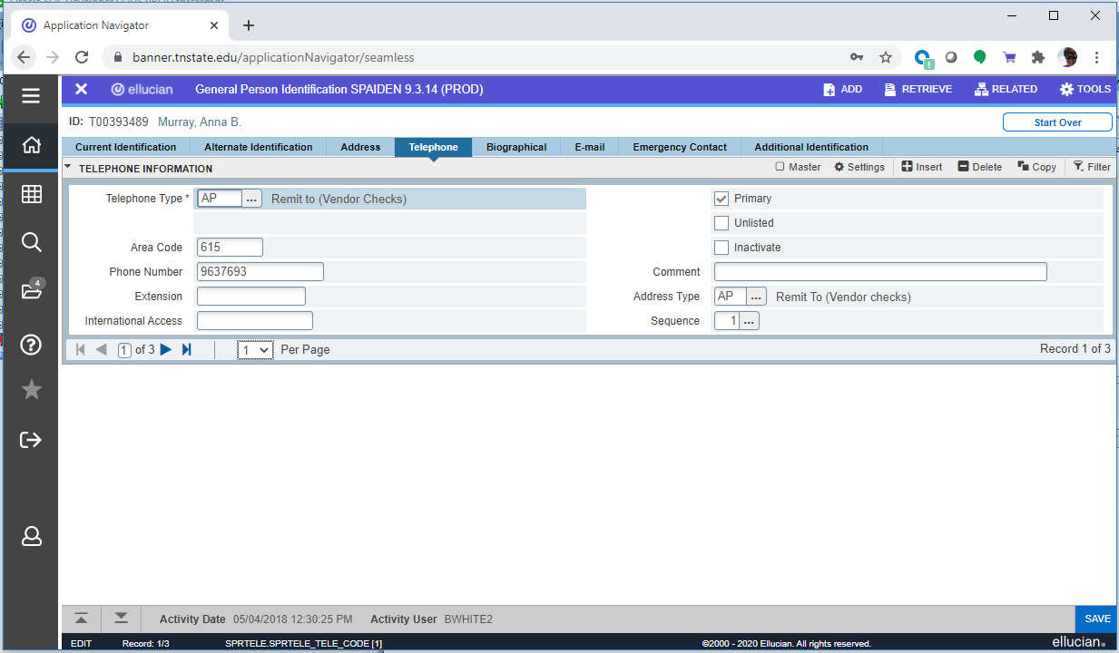
See Data

Slide 20
Error Messages Error and informational messages will sometimes pop up at the top right of the screen. You can click the yellow square to hide the message and click again to display the message again. Messages will cover ‘Go’ or ‘Start Over’ buttons, so hide them before clicking buttons.

Slide 21
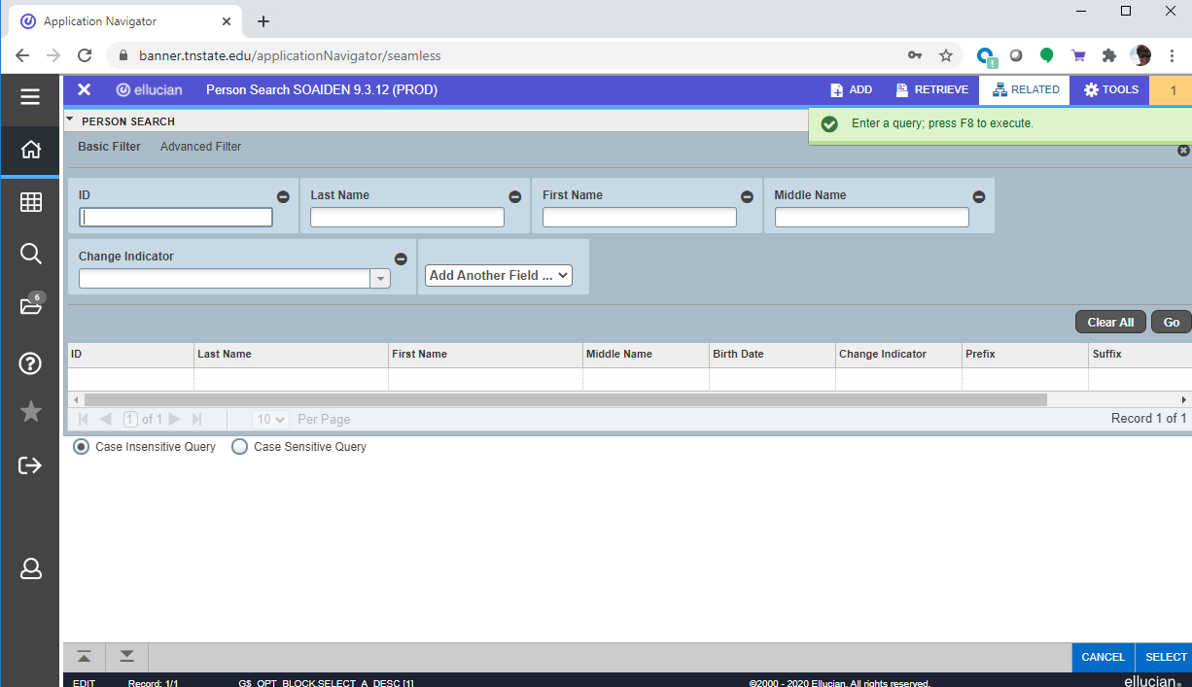
Query = Filter Filtering is the new way of limiting the results shown on the form. It works similar to entering query criteria, except that you specify the field and the value to use in a different way.
Banner 8
Banner 9

Slide 22
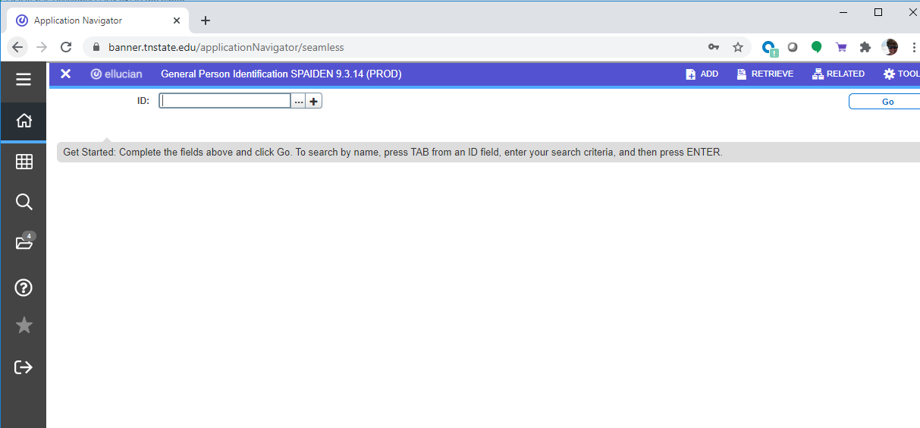
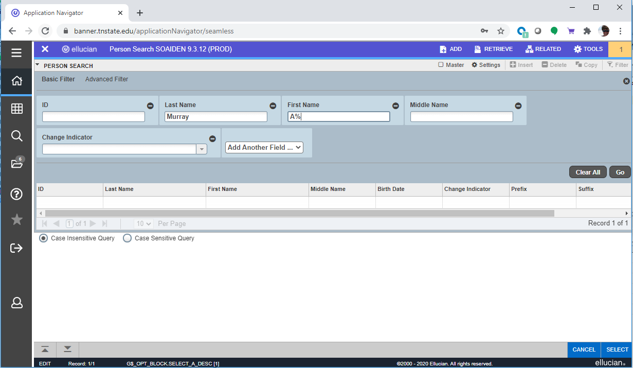
Search for a person or vendor
Click on the ellipsis button next to the field to initiate a search
Enter as many search field criteria or remove then click the ‘Go’ button.

Slide 23
Searching Alternatively, you can press TAB when in the ID block, which will cause a second entry field to appear.
Press TAB from the ID field for the search field to pop
This pop-up window allows you to see results

Slide 24
Inactivity
As is currently the case, you will be logged out of Banner after 30 minutes of inactivity. However, a warning message
will now display after 25 minutes letting you know that you will be logged out if you don’t extend your session.
Clicking on ‘Extend’ will give you a fresh 30 minutes.

Slide 25
Other Resources
OTS has a website dedicated to the upgrade to Banner 9 with information and useful resources: http://www.tnstate.edu/banner/
Banner 9 URL: https://banner.tnstate.edu/applicationNavigator
Youtube https://www.youtube.com/watch?v=6Mqqy0lez_c
For specific questions about a particular form or process, contact the appropriate office for assistance.
If you discover something that doesn’t work properly or you get an unexpected error, please navigate to ServiceNow(SNOW), log in with your TNSTATE email username and password, and submit a ticket. If you need instructions on how to submit a ticket, click with details about the issue so that someone can look into it.
Color wheel for personal prefences: https://htmlcolorcodes.com/

