Slide 1
Tennessee State University
SACS Monitoring Report
Assembly
Dr. Portia H. Shields
President
January 31, 2011

Slide 2
President’s Opening Remarks
A conversation about our plan to address issues raised by the SACS Commission on Colleges and to share with you the specific plans for developing the monitoring report. We will introduce the Leadership Team and Steering Committee that will guide us through this process.

Slide 3
SACS Leadership Team
Dr. Timothy Quain
Dr. Peter O. Nwosu
Dr. G. Pamela Burch-Sims

Slide 4
Reaffirmation Steering Committee
Qualifications
Responsibilities
Membership
Dr. Timothy Quain

Slide 5
Steering Committee: Qualifications
Attended the SACS Summer Quality Institute on Assessment

Slide 6
Steering Committee: Qualifications
Attended one or more annual meetings of the Commission on Colleges (SACS)

Slide 7
Steering Committee: Qualifications
Regularly serve as evaluators on SACS reaffirmation and substantive change committees or on specialized accreditation committees

Slide 8
Steering Committee: Qualifications
Knowledgeable of and experienced with specialized accreditations

Slide 9
Steering Committee: Qualifications
Knowledgeable of and experienced with assessment in one or more of the sub-areas in SACS Comprehensive Standard 3.3.1

Slide 10
Steering Committee: Qualifications
Demonstrated ability to work collaboratively to produce quality work under stressful conditions with demanding deadlines

Slide 11
Steering Committee: Responsibilities
Consult with University faculty and other personnel to gather information, request clarification, and conduct follow up;

Slide 12
Steering Committee: Responsibilities
Evaluate the quality of materials submitted;
Provide guidance to faculty and unit heads for improving the quality of materials submitted;

Slide 13
Steering Committee: Responsibilities
Compile assigned sections of the report;

Slide 14
Steering Committee: Responsibilities
Work with the Leadership Team and the full Steering Committee to revise various drafts of the report; and

Slide 15
Steering Committee: Responsibilities
Provide for review of the draft report by faculty and other campus constituents.

Slide 16
Steering Committee: Membership
Dr. Ronald Barredo
College of Health Sciences
Dr. Yildiz Binkley
Libraries and Media Centers

Slide 17
Steering Committee: Membership
Dr. Rebecca Dixon
College of Arts and Sciences
Dr. Mary Dale Fitzgerald
College of Health Sciences

Slide 18
Steering Committee: Membership
Dr. William Hytche
Student Affairs
Dr. Oscar Miller
College of Arts and Sciences

Slide 19
Steering Committee: Membership
Dr. Samantha Morgan-Curtis
WRITE Program Director
Dr. Sharon Peters
Extended Education

Slide 20
Steering Committee: Membership
Dr. Johnnie Smith
Athletics
Ms. Amy Boles Wood
Financial Aid

Slide 21
Plan of Action
Timeline
Communications Plan
Dr. Peter Nwosu

Slide 22
Institutional Effectiveness
Planning
Assessment
Resource Allocation
Process through which an institution demonstrates how well it succeeds in accomplishing its mission and meeting its overall objectives and alignment of resources.
Notes:
Institutional Effectiveness is a process through which an institution demonstrates how well it succeeds in accomplishing its mission and meeting its overall objectives. This process allows Tennessee State University to define its expected outcomes based on the mission, vision and core values of the University. Therefore, the process of Institutional Effectiveness involves planning, assessment, and the effective use of the assessment results for continuous improvement.

Slide 23
Key Elements of Institutional Effectiveness
Core Requirement 2.5
Comprehensive Standard 3.3.1

Slide 24
Comprehensive Standard 3.3.1
Comprehensive Standard 3.3.1.1: Educational Programs
Comprehensive Standard 3.3.1.2: Administrative Support Services
Comprehensive Standard 3.3.1.3: Educational Support Services
Comprehensive Standard 3.3.1.5: Community/Public Service

Slide 25
Outline of the Monitoring Report

Slide 26
Introduction
Contextualization
  Recent history of assessment at TSU
  Structural challenges related to comprehensive assessment
  Developing a culture of comprehensive assessment

Slide 27
B. Description of Institutional Planning
  Mission; AMP; SP; TBR SP; CCTnA interrelationships
  Explicit explanation of connection to CR 2.5

Slide 28
Institutional Effectiveness - Core Requirement 2.5
Role of Assessment in Achieving Mission
Interrelationships between the plans

Slide 29
C. Ongoing Assessment at the University
  Professional Accreditations
  Academic audit (non-accreditable programs)
  Program review
  Performance Funding (Major Field Testing; NSSE, Alumni, Employer Survey, Sr. Exit Exam etc.)
  General Education Outcomes Assessment
  Link all of the above to Student Learning

Slide 30
D. Enhanced assessment plan and significance of Compliance Assist in documenting assessment activities
E. Examples from Compliance Assist

Slide 31
III Comprehensive Standard 3.3.1
A. Comprehensive schema to describe the sections
B. Descriptions and examples
3.3.1.1: Academic Programs

Slide 32
  3.3.1.2: Administrative Support services
THEC audit
SLAs - e.g. CIT; BF; RSP;
POs e.g. EDC; Internal Audit; IPA; Alumni Affairs
SLO/PO- e.g. Athletics

Slide 33
3.3.1.3: Educational Support Services
Academic Enrichment; AMP Committee Report
Library survey data
Common reader program
Student support services

Slide 34
3.3.1.5 Community/Public Service
National Survey of Student Engagement (NSSE)
Carnegie Engaged University application to demonstrate use of results

Slide 35
IV. Summary
Strengths
B. Continuing Improvement

Slide 36
Timetable for Developing
SACS Monitoring Report
University-wide Assembly
January 31, 2011
1st Business Meeting of Steering Committee
  February 1, 2011, every week thereafter

Slide 37
Timetable for Developing
SACS Monitoring Report
Preliminary Draft Sections Due
March 15, 2011
Full Preliminary Draft to Steering Committee Review from Leadership Team
March 22, 2011

Slide 38
Timetable for Developing
SACS Monitoring Report
External Review by Consultants
March 22, 2011
Steering Committee Approves Revised Draft
March 29, 2011

Slide 39
Timetable for Developing
SACS Monitoring Report
Revised Draft to Cabinet for review
April 1, 2011
Revised Draft to President for review and approval for posting
April 8, 2011

Slide 40
Timetable for Developing
SACS Monitoring Report
Revised Draft posted on myTSU for faculty/staff review and comment
April 15, 2011

Slide 41
Timetable for Developing
SACS Monitoring Report
University-wide Assembly for comment on posted Draft
April 29, 2011

Slide 42
Timetable for Developing
SACS Monitoring Report
Steering Committee revises draft based on input from the University-wide Assembly and web posting
May 11, 2011

Slide 43
Timetable for Developing
SACS Monitoring Report
Leadership Team prepares manuscript for submission to President
June 1, 2011

Slide 44
Timetable for Developing
SACS Monitoring Report
President approves and submits to SACS
June 30, 2011

Slide 45
Communication Plan: Engaging the Community
Inclusion
Use of multiple channels
  Internal - myTSU site; University-wide Assembly
  External – web presence

Slide 46
Documenting Assessment & Improvement
Linking Assessment to Mission & Planning
Dr. G. Pamela Burch-Sims

Slide 47
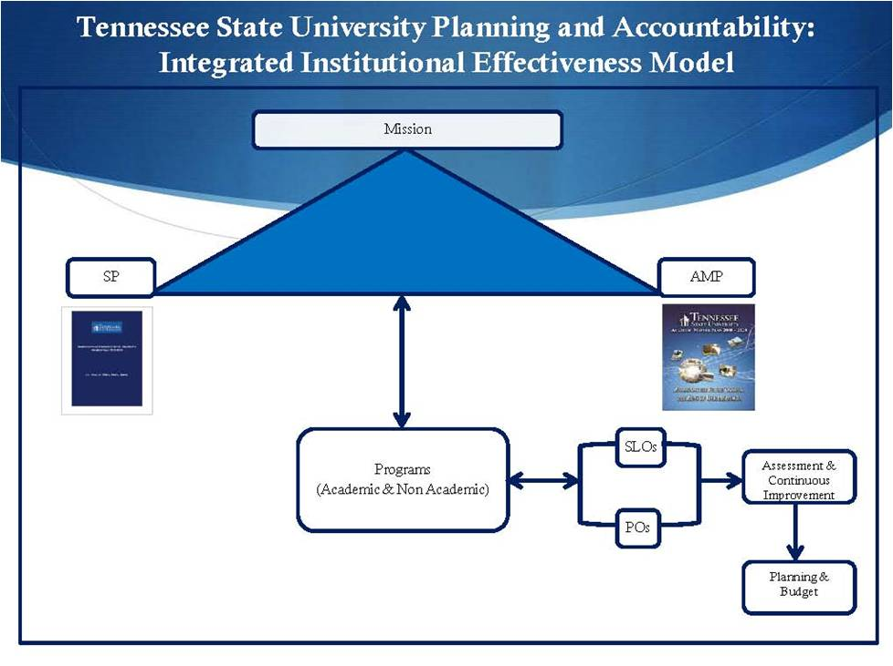
The Key Components of Institutional Effectiveness
Integrated Assessment and Improvement Model

Slide 48
The Key Components of Institutional Effectiveness
Common Assessment and Improvement Framework : Six-Steps
Step 1: Formulate Assessable Expected Outcome
Step 2: Determine/Establish Criteria for Success
Step 3: Measure Performance on Expected Outcome using Direct and Indirect Methods of Assessment

Slide 49
The Key Components of Institutional Effectiveness
Common Assessment and Improvement Framework
Step 4: Analyze and Summarize Results of Assessment Activity in Step 3
Step 5: Develop/Refine Improvement Plan Based on Assessment Results
Step 6: Document Changes/Improvements Resulting from the Action Plan

Slide 50
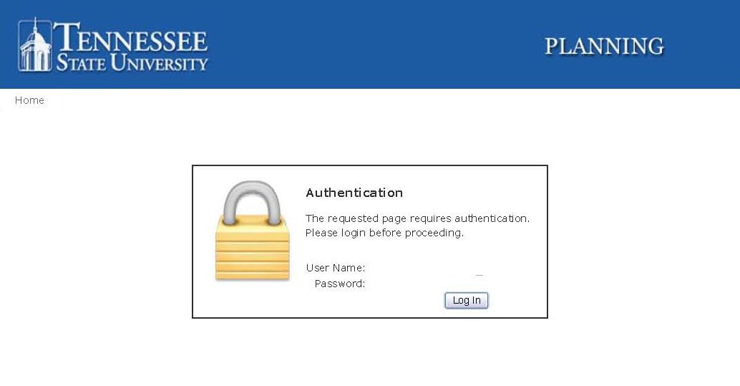
The Key Components of Institutional Effectiveness
Effective Online Documentation System
www.tnstate.edu/complianceassist

Slide 51
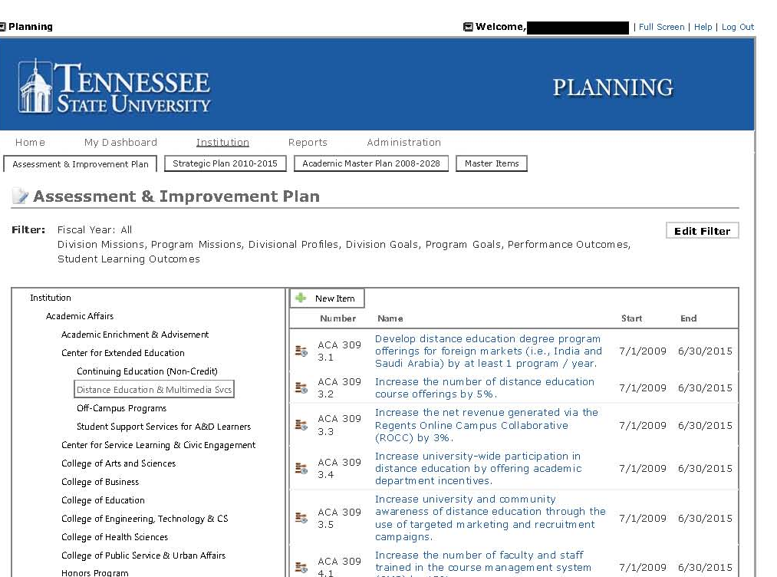
Click on Assessment & Improvement Plan
Find your unit, click on unit, then sub-unit

Slide 52
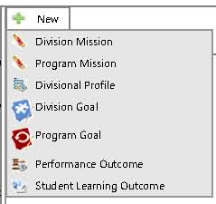
Click + NEW to add Profile, Goals, Performance Outcomes , or Student Learning Outcomes

Slide 53
Performance Outcome

Slide 54
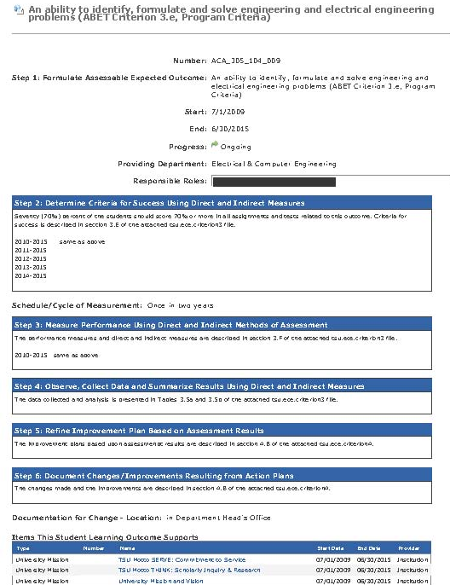
Student Learning Outcome

Slide 55
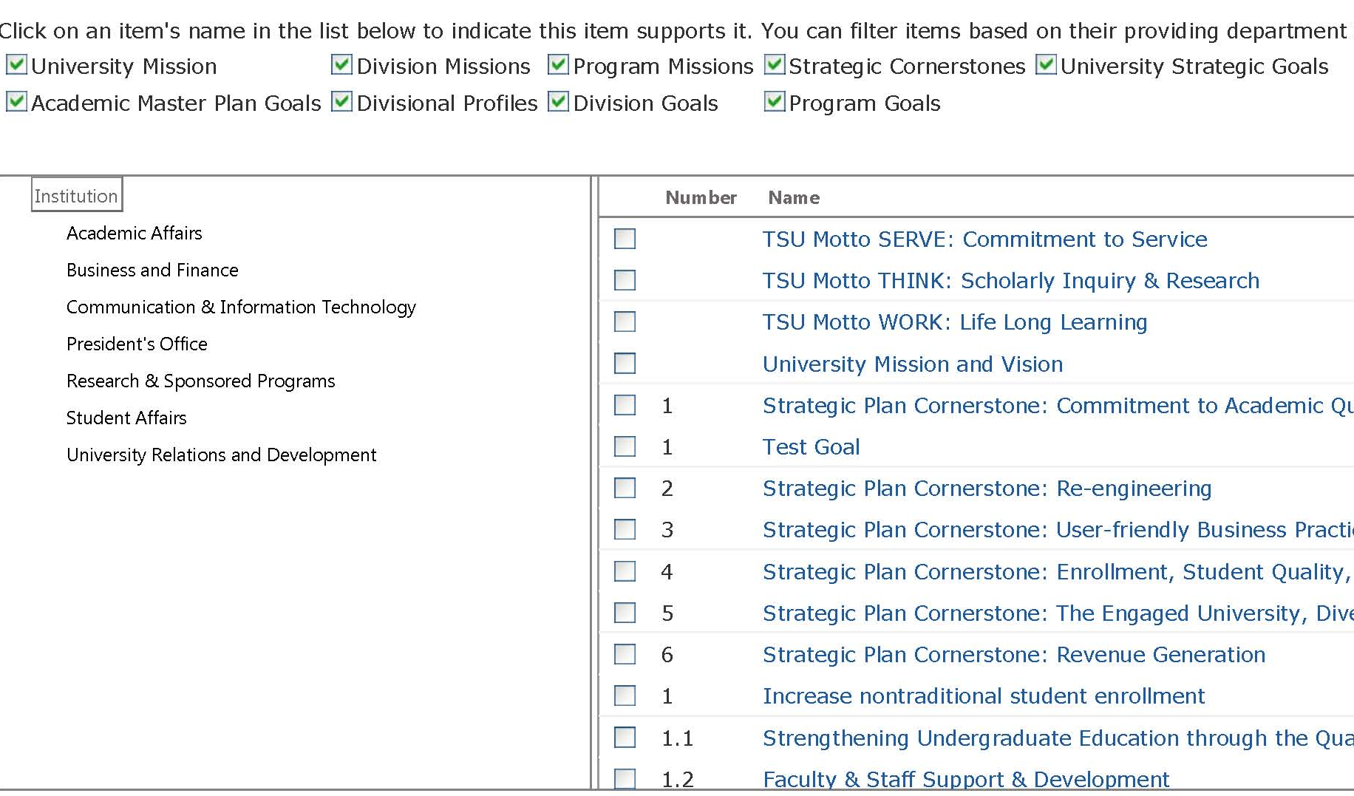
Outcome Links to University Mission,
Strategic Plan & Academic Master Plan

Slide 56
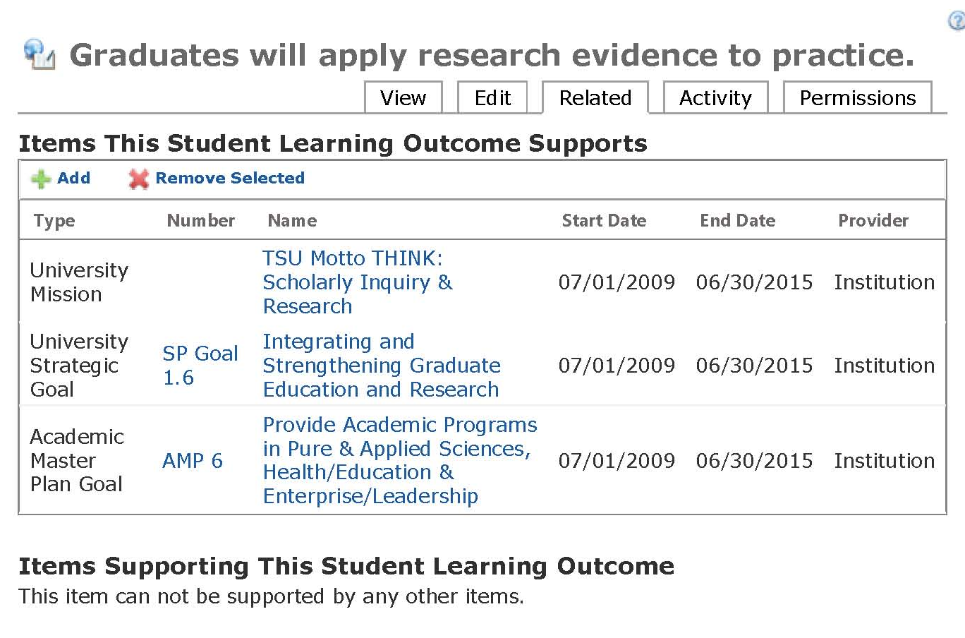
Outcome Links to University Mission, Strategic Plan & Academic Master Plan

Slide 57
Benefits of Compliance Assist
User-friendly online system
Documents assessment & use of assessment results for improvements
Documents linkage of Outcomes to the University’s mission and planning documents (SP; AMP, Etc)
Provide external stakeholders “proof” of progress on Institutional Effectiveness
Unit AP Code: ACA
Unit Key Code: 313
Sub-Unit Code: 100

Slide 58
Questions & Answers

