Slide 1
Advising Workshop
February 15, 2019
Alisa L. Mosley
Academic Affairs
amosley@tnstate.edu

Slide 2
Purpose of the Workshop
To discuss the importance of advising
To review our role in Academic Affairs
To discuss those “sticky” points that thwart matriculation

Slide 3
Relationship of Advising to SACSCOC and THEC
Several standards are related to SACSCOC
Placement of students
Achievement
Program quality
Financial literacy
Complaint process
Progression in credit hours
30, 60, 90, GRADUATION
Number of undergraduate and graduate degrees awards per FTE

Slide 4
Don’t do this…
https://www.youtube.com/watch?v=EVmLV7swH2k

Slide 5
How did you learn about academic advising?
Went through a certificate or degree program
Mentored through senior colleagues so they wouldn’t have to do it
Placed in a corner and figured it out

Slide 6
What is the true role of advising?
A. Course selection
B. career trajectory

Slide 9
Top Degree Producers at TSU
Arts and Sciences
Communications
Criminal Justice
Health Sciences
Psychology
Business

Slide 11
Are they done yet?
Yes
No

Slide 12
How do we begin?

Slide 13
What should happen during a visit with a student?
Discussion of career goals
Permanent placement
Graduate/Professional schools
Encouragement of students to engage in high impact practices
Discussion of potential areas of concern
Withdrawals in key courses
Financial aid

Slide 14
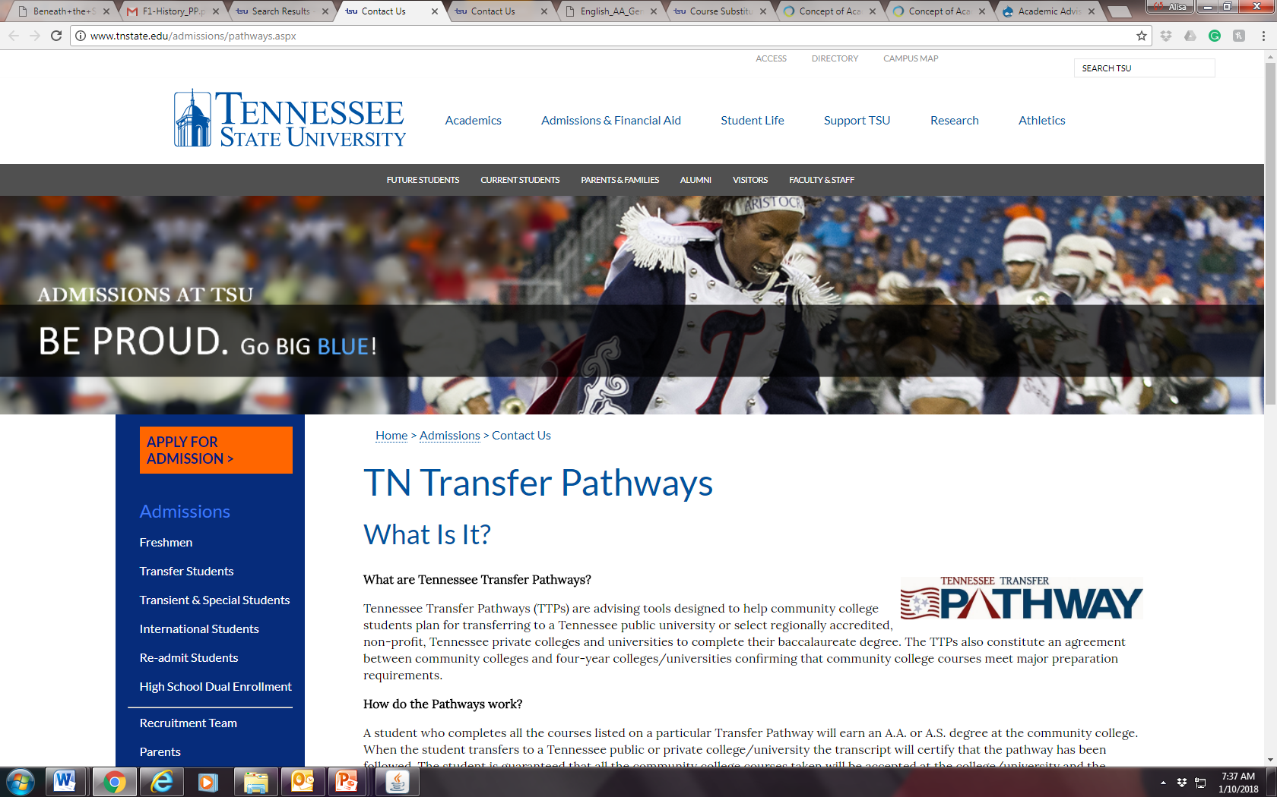
Sticky Areas of Concern
General Education
Transfer Pathways
Submission of Senior Standing Forms
DegreeWorks
International transcripts

Slide 15
Z Grades versus T Grades
What year did we stop including transfer grades in the GPA
Summer 2013
Spring 2014
Fall 2015
It has not stopped.
Please do not advise students to take classes elsewhere to improve their GPA!

Slide 16
Other Areas of Conversation
Food insecurity
Mental health challenges
Financial aid (SAP) [what is SAP]
Allegations of discrimination or harassment
Financial problems
Homelessness

Slide 17
Can a student have a good GPA and measure poorly on SAP?
Yes
No

Slide 18
What’s the magic percentage for Satisfactory Academic Progress?
25%
50%
66%
75%

Slide 19
Substitution Forms

Slide 20
Placement Activities
Who’s in your five?
Who do you know?
Who can you call?
Who’s coming to campus?
Who’s in your inbox?
Who can you say you helped?

Slide 21
Questions?

