Slide 1
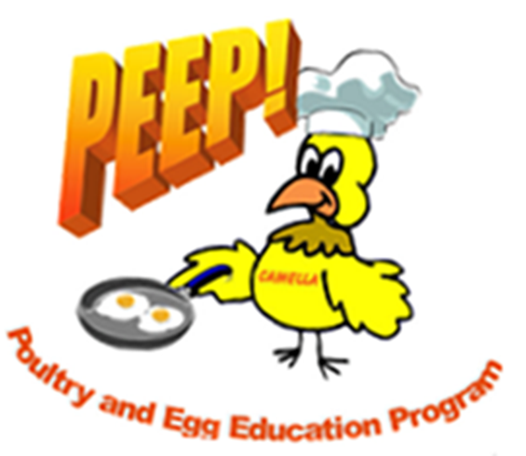

Slide 2
Objectives
Identify safe cooking practices and precautions of eggs and egg dishes.
Explain why it is important to use a thermometer instead of a visual cue to check for doneness of egg dishes.
Practice using a food thermometer on egg dishes.

Slide 3
Vocabulary
Casserole: A dish cooked in an oven containing multiple ingredients
Egg Dish: Any recipe containing eggs (Examples: Casserole, Quiches, Pies)
Danger Zone: Between 40ºF and 140ºF

Slide 4
Vocabulary
Doneness: The degree of how completely cooked a dish is
Food Thermometer: Special thermometer used to measure the temperature of food
Calibrate: To adjust
Salmonella: Bacteria that can be found in eggs and cause illness

Slide 5
Objective 1
Identify safe cooking practices and precautions of eggs and egg dishes.
Cook eggs until yolks and whites are firm.
Runny eggs are still undercooked.
Never consume raw or undercooked eggs.
Consumers can buy pasteurized eggs that have been treated to eliminate harmful bacteria.

Slide 6
Objective 2
Explain why it is important to use a thermometer instead of a visual cue to check for doneness of egg dishes.
Use thermometer to check doneness of quiche, pies, casseroles, and other dishes containing eggs.

Slide 7
Objective 2
Visual cues or toothpicks can be misleading when checking doneness.
Make sure your thermometer is calibrated and reading correct temperatures.
Insert the thermometer into the thickest portion of the dish (should be 160°F or higher)

Slide 8
Summary
Eggs are used in many dishes.
They contain harmful bacteria, it is important that food safety precautions are followed.
Thermometers are more accurate than visual cues.

