Slide 1
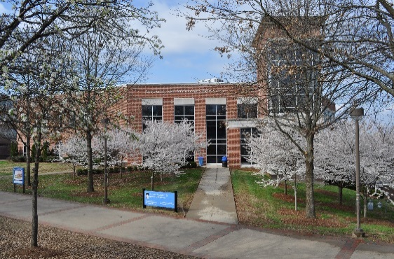
Guide To Collaborative Institutional Training Initiative (CITI) Program
Tennessee State University Institutional Review Board
Office of Research and Sponsored Programs
Developed by Monique M. McCallister, Ph.D.

Slide 2
What is the CITI Program?
CITI is a volunteer organization whose goal is to develop and distribute high quality, peer reviewed educational resources designed to raise awareness to the Responsible Conduct of Research for all members of the research team.
CITI maintains an educational website where participating organizations can design and roll out a customized curriculum for their investigators, students staff and administrators.
www.citiprogram.org

Slide 3
June 2000 DHHS Mandates Training in Human Subjects Protection
A. TERMS OF THE FEDERALWIDE ASSURANCE (FWA) FOR INSTITUTIONS WITHIN THE UNITED STATES. Announced Dec. 2000; implemented, 2005
Educational Training
OHRP strongly recommends that the Institution and the designated IRB(s) establish educational training and oversight mechanisms (appropriate to the nature and volume of its research) to ensure that research investigators, IRB members and staff, and other appropriate personnel maintain continuing knowledge of, and comply with, the following: relevant ethical principles; relevant federal regulations; written IRB procedures; OHRP guidance; other applicable guidance, state and local laws; and institutional policies for the protection of human subjects. Furthermore, OHRP recommends that a) IRB members and staff complete relevant educational training before reviewing human subjects research; and b) research investigators complete appropriate institutional educational training before conducting human subjects research.

Slide 4
CITI Courses
Human Subjects Protection
Biomedical Sciences
Social and behavioral Sciences
International Research
Good Clinical Practice & ICH
14 modules
HIPS
18 modules
Lab Animal Welfare
Basic Courses
Species Specific Courses
Responsible Conduct of Research
105 modules and case studies
4 Disciplines
Bio-Safety

Slide 5
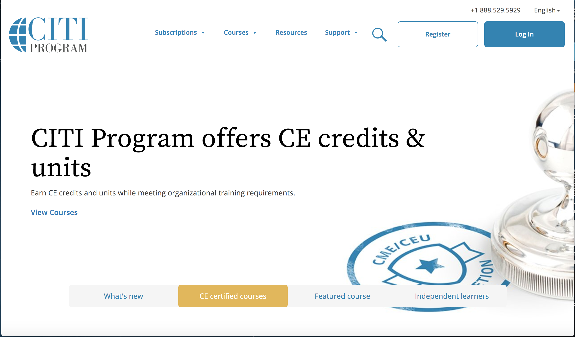
CITI Programing Main Page
On the main page click “Register” on the top of the right hand side of the page.

Slide 6
REGISTRATION PROCESS

Slide 7
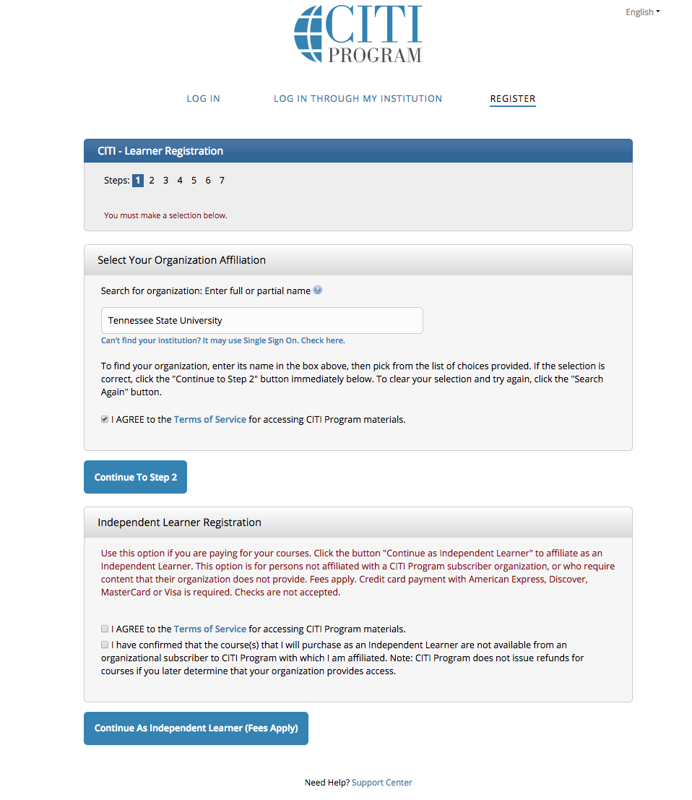
Page 1
There is a 7 step (page) process to register: The seven pages are:
First you will be asked to name your organization affiliation (Tennessee State University).
Select that you agree to the terms and condition
Click Continue to Step 2

Slide 8
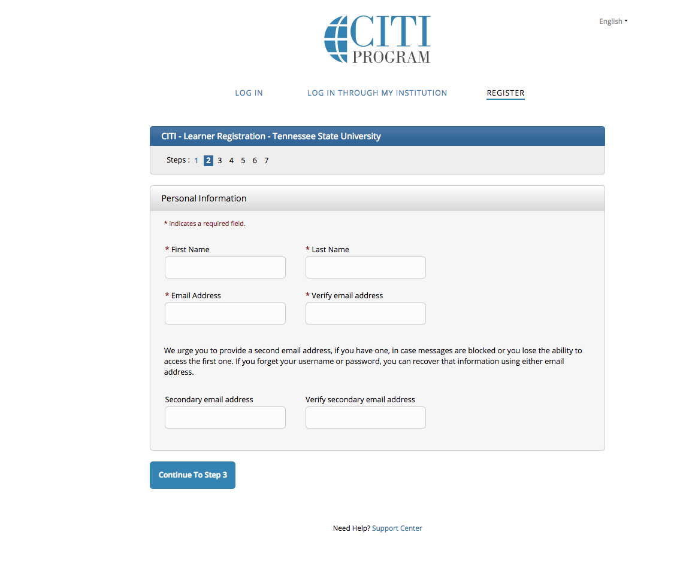
Page 2
Next you will be asked to provide your name and e-mail.
Then Click Continue to Step 3

Slide 9
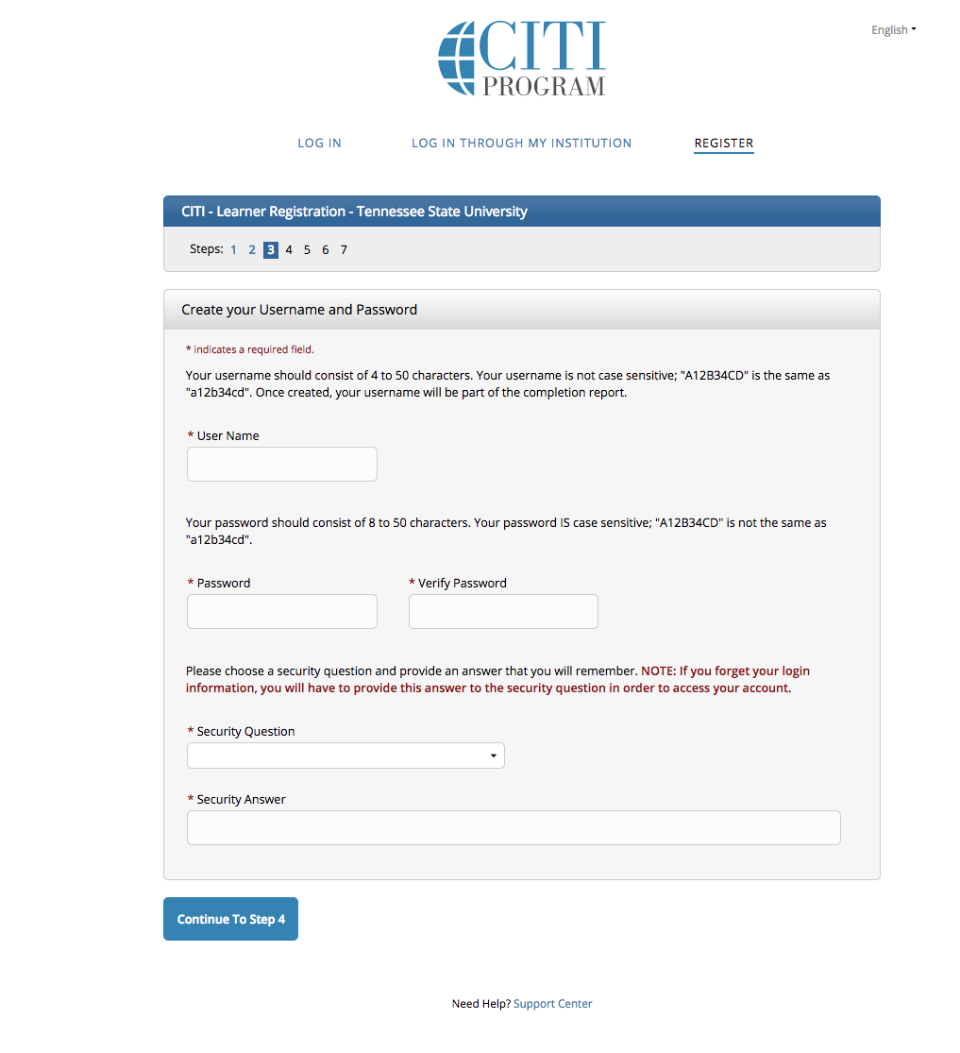
Page 3
Create User name
Create a password
Then Click Continue to Step 4

Slide 10
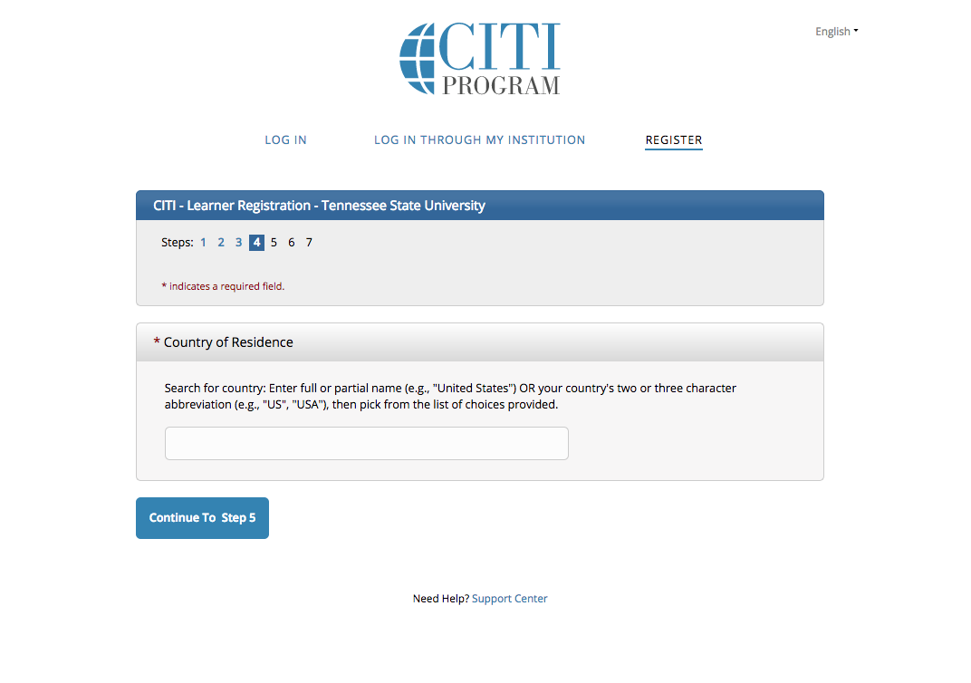
Page 4
Country of residence (Type USA)
Then Click Continue to Step 5

Slide 11
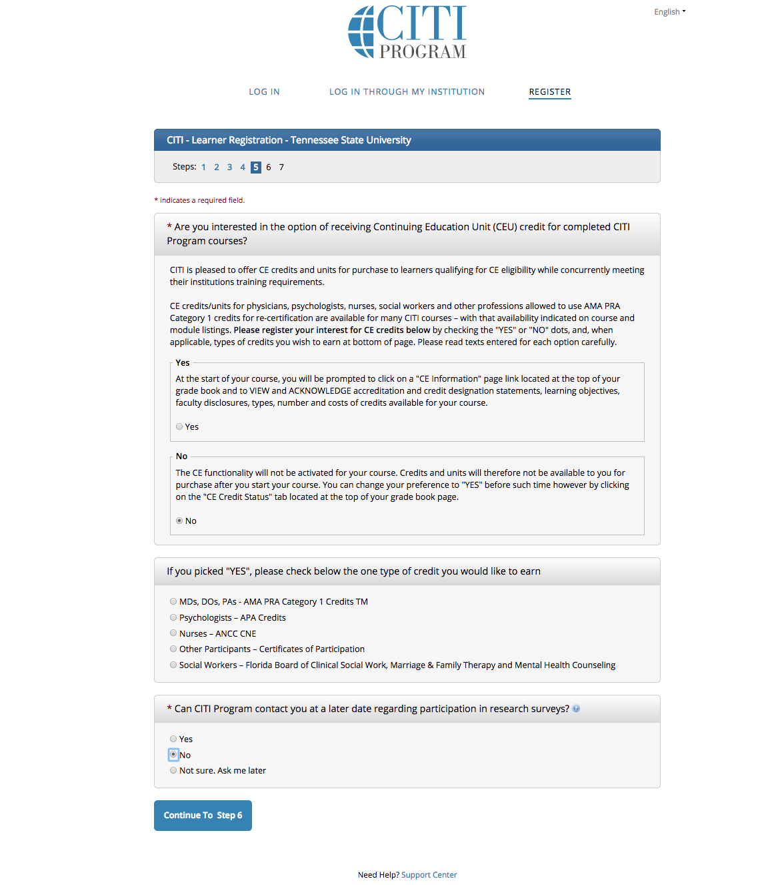
Page 5
CEU credits
Choose the “No” Option
Choose the “No” Option for the the question concerning CITI contacting you for future participation in their research surveys.
Then Click Continue to Step 6

Slide 12
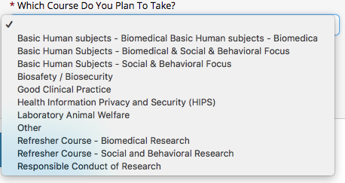
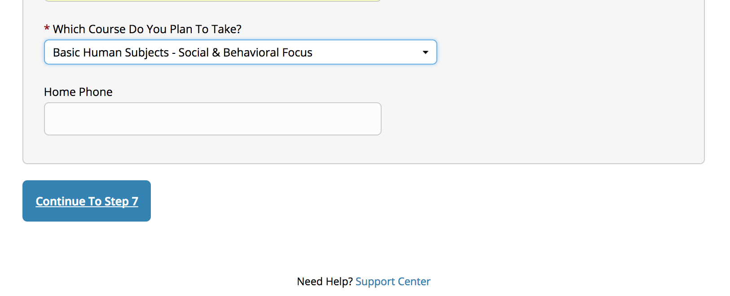
Page 6
Complete your school information.
Select the Course that is applicable to you field of study

Slide 13
Scope Of Work Definitions
Biomedical Science
A set of applied sciences or formal science, or both, to knowledge, interventions or technology that are use in healthcare or public health.
Behavioral Science
A branch of science (such as psychology, sociology or anthropology) that deals primarily with human action and often seeks to generalize about human behavior in society.

Slide 14
Scope Of Work Definitions
Social Science
Provide a perceptive framework to study the process of social system through impacts of social organization on structural adjustment of the individual groups.
Includes fields like sociology, economics, public health, anthropology, demography and political science.

Slide 15
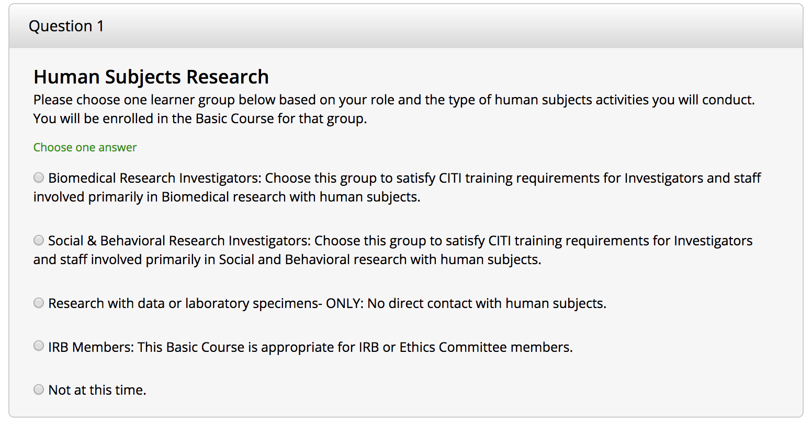
Select Curriculum
Question 1: Human Subjects Research

Slide 16
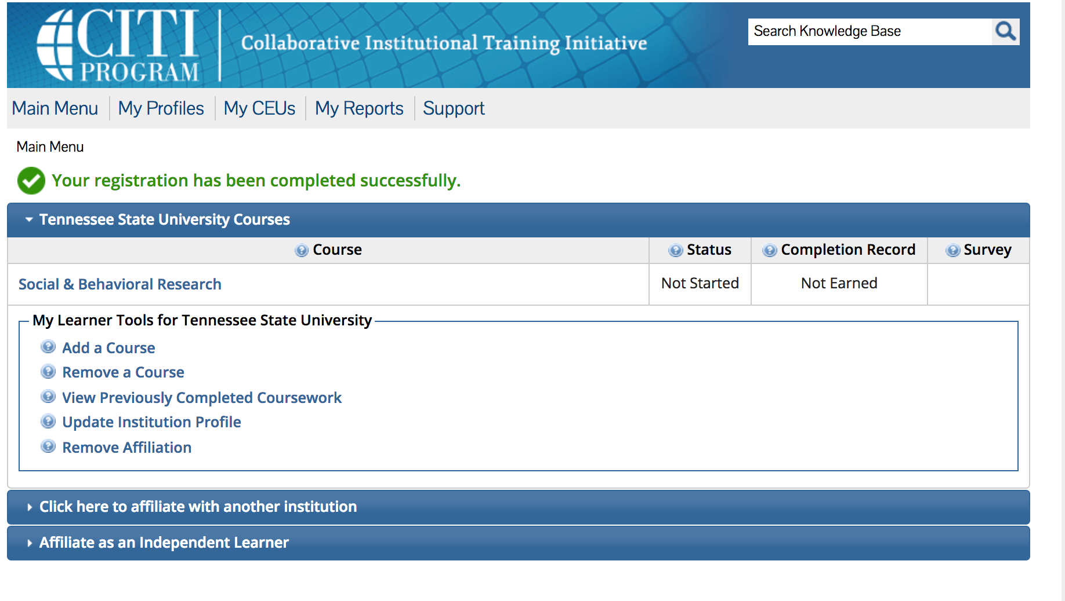
Complete Registration
After you select the course, go to the bottom of the page and click on the “Complete Registration” button.
You should then see this page: Click the link and take the training listed in the “Required Modules.”

Slide 17
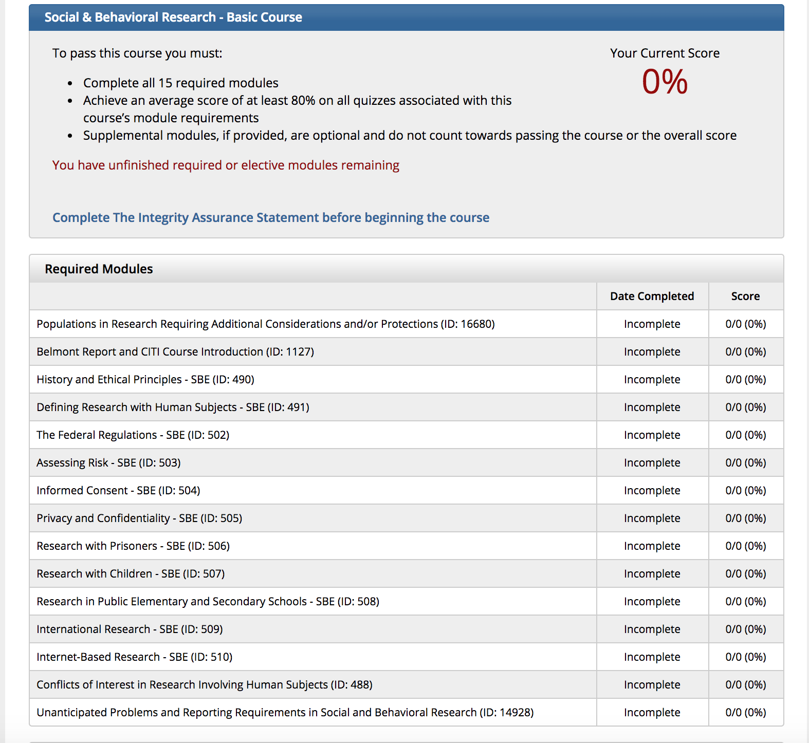
Required Modules
After you finish the modules it will give you the option to print out the Completion Report.
Print and scan or screen print the Completion Report and e-mail it to IRB@tnstate.edu

Slide 18
Research with Data or Laboratory Specimen Course.
If you are not in direct contact with Human Subjects.
Research is Category 4 Exemption
Works with:
Existing data
Documents
Records
Pathological specimens
Diagnostic specimens

Slide 19
Select Curriculum
Question 1: Human Subjects Research

Slide 20
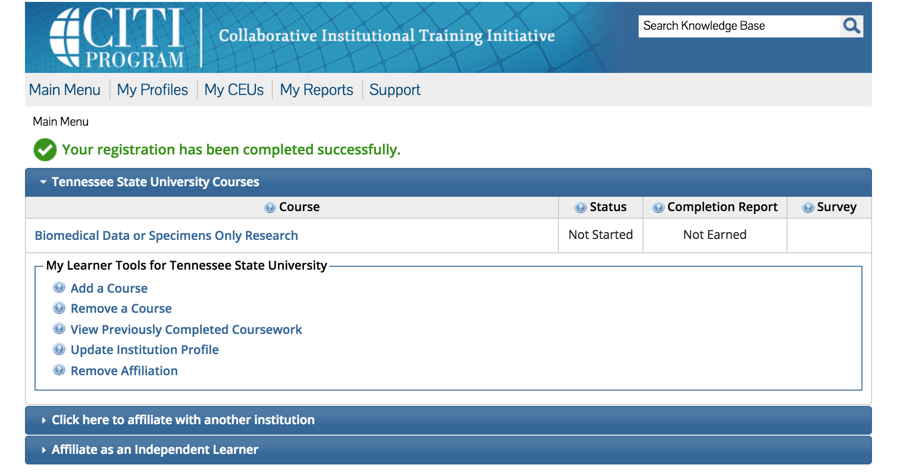
Complete Registration
After you select the course go to the bottom of the page and click on the “Complete Registration” button.
You should then see this page: Click the link and take the training listed in the “Required Modules.”

Slide 21
Required Modules
After you finish the modules it will give you the option to print out the Completion Report.
Print and scan or screen print the Completion Report and e-mail it to IRB@tnstate.edu

Slide 22
Print a copy of your Completion Report/ Certificate
Click on “View/Print” to create a PDF

Slide 23
Questions?
For more information
Email irb@tnstate.edu

