Slide 2
Outline
Install Java
Change Security Files in Java
Install keystore explorer
Generate keys and certificate
Use keystore explorer to convert keystore from JKS to BKS
Write code
Set up emulator

Slide 3
Install JDK
http://www.oracle.com/technetwork/java/javase/downloads/jdk7-downloads-1880260.html
Install the first JDK package. Current version is 7u79
Make sure that you have only one JDK installed in your laptop!!
Please follow this link to set JAVA_HOME in your laptop https://kaanmutlu.wordpress.com/2013/04/26/setting-the-java_home-in-windows-7-64-bit/
Make sure to replace the java home directory with yours!!!

Slide 4
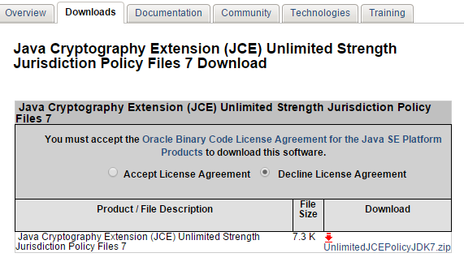
Change Security Files in Java - 1
http://www.oracle.com/technetwork/java/javase/downloads/jce-7-download-432124.html
Download unlimitedJCEPolicyJDK7.zip

Slide 5
Change Security Files in Java - 2
unzip unlimitedJCEPolicyJDK7.zip file and copy local_policy.jar and us_export_policy.jar into your_java_home\jre\lib\security, remember there are already two files with the same names, just overwrite them.

Slide 6
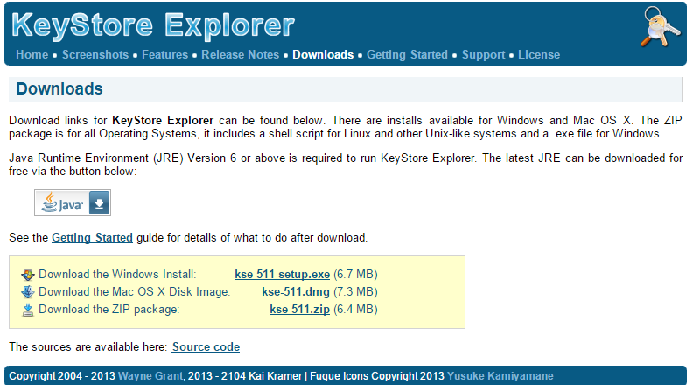
Install Keystore Explorer
This software is used to change the type of keystore (JKS, by default) to the type that android can use (BKS).
http://keystore-explorer.sourceforge.net/downloads.php

Slide 7
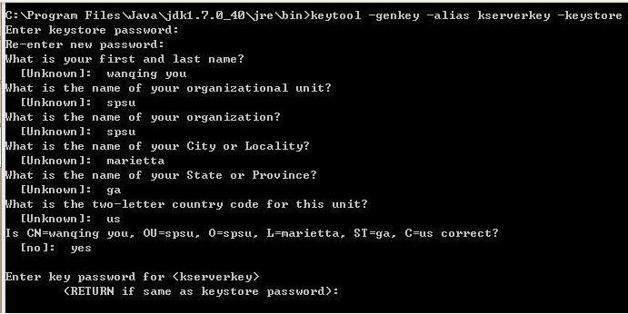
Generate Keys - 1
1) keytool -genkey -alias kserverkey -keystore c:/bksserver.keystore
This commend will generate a keystore for server. Please use 123456 as password

Slide 8
Generate Keys - 2
2) keytool -export -file c:/bksserver.crt -alias serverkey -keystore c:/bksserver.keystore
3) Before doing this step, please copy bcprov-jdk16-146.jar into ‘your_home_jdk_path/jre/lib/ext’, then modify the ‘java.security’ file (in ../security directory), adding a new line:
security.provider.11=org.bouncycastle.jce.provider.BouncyCastleProvider
Then, run this command:
keytool -importcert -keystore c:/cacerts.bks -storetype BKS -file c:/bksserver.crt -provider org.bouncycastle.jce.provider.BouncyCastleProvider -trustcacerts

Slide 9
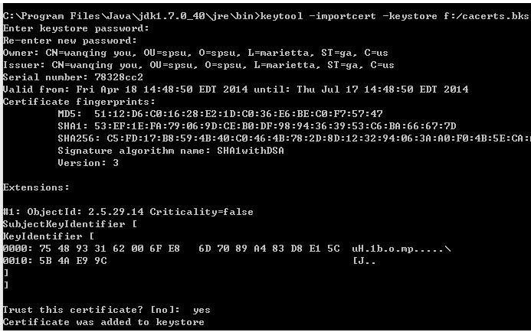
Generate Keys -3
When finishing this command, please remove bcprov-jdk16-146.jar from your_home_jdk_path/jre/lib/ext !!!!!

Slide 10
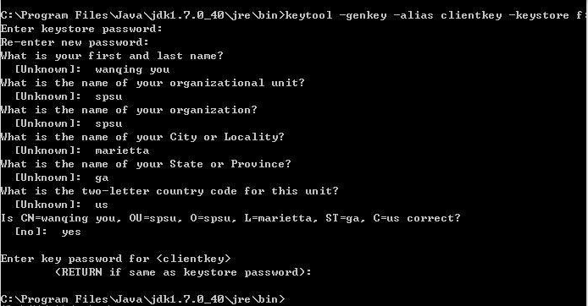
Generate Keys -4
4 ) keytool -genkey -alias clientkey -keystore c:/bksclient.keystore

Slide 11
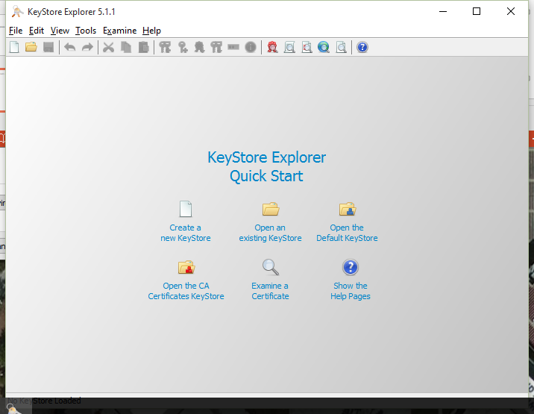
Use keystore explorer to convert keystore from JKS to BKS
Open keystore explorer and agree what it shows to you
Click open an existing keystore in the middle

Slide 12
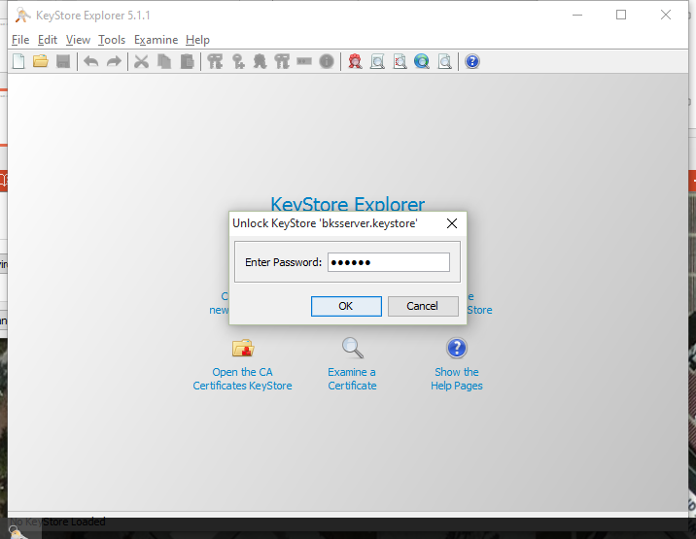
Use keystore explorer to convert keystore from JKS to BKS
Select the keystore you just generated in d:/ disk (bksserver.keystore), and input the password (123456), then click tools-> change type -> click BKS, and ctrl+s save, do it for another keystore (bksclient.keystore)

Slide 13
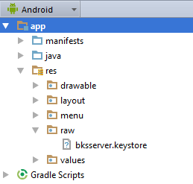
Write Code
Please refer to the two projects: client and server
1) copy bksserver.keystore into server project

Slide 14
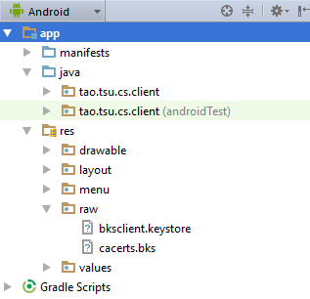
Write Code
Please refer to the two projects: client and server
1) copy bksclient.keystore and cacerts.bks into client project

Slide 15
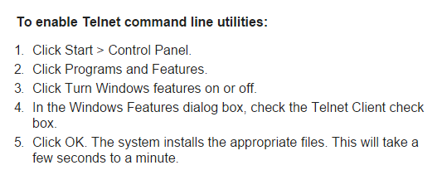
Set up emulator
Turn on telnet tool in windows

Slide 16
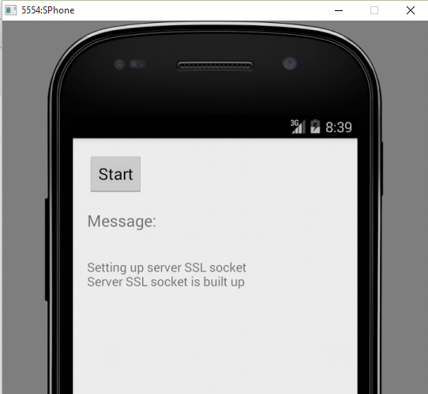
Set up emulator
Run the server project, and start one emulator, remember the number on left top cornor 5554:
Open cmd, and run
telnet localhost 5554
Then enter such command:
redir add tcp:8193:8192

Slide 17
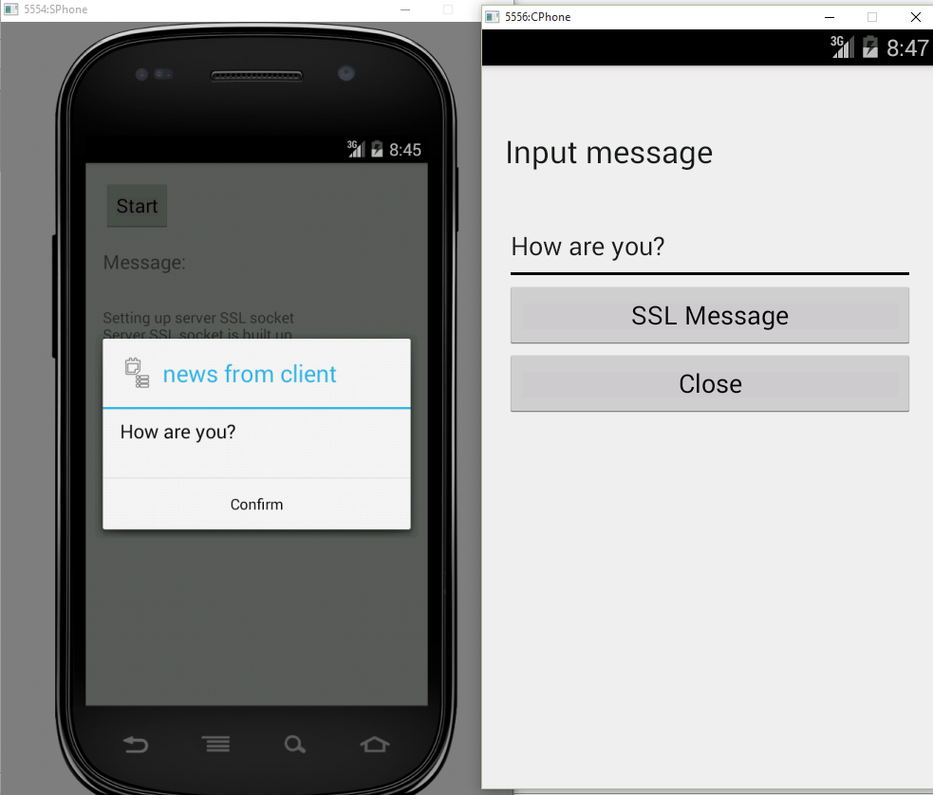
Start application
Then start client project.

