Slide 1



Cryptography and SSL Security Protocol in Transport Layer
Wei Chen, Professor
Tennessee State University
Module for NSF project – Collaborative Research: Enhancing Curriculum and Faculty development on Information Assurance and Security through Real World Relevant Portable Laboratory, NSF DGE-1438924, 2015

Slide 2
Outline
Introduction to cryptography
  Confidentiality
  Integrity and Authentication
SSL security protocol for transport layer
  SSL
    Handshake protocol
    ChangeCiperSpec Protocol
    Alert Protocol
    Record Protocol

Slide 3
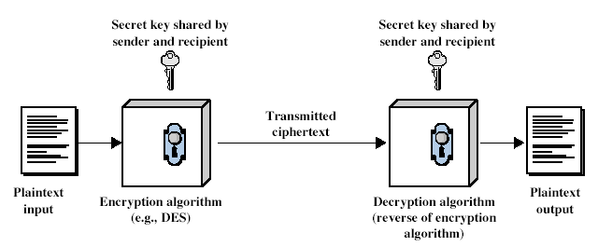
  Confidentiality
Cryptography
  Confidentiality: Assure that information including data and privacy are not unauthorized disclosed. Confidentiality can be realized by symmetric/asymmetric cryptography.
General Idea of Symmetric Cryptography
Encryption by symmetric/secret key key

Slide 4
  Confidentiality
Cryptography
  Cryptography using block cipher
  An simple example of block cipher (n = 2)
Sender
Receiver
n bits
n bits
Plaintext: x | Ciphertext: y= f(x)
00 | 01
01 | 00
10 | 11
11 | 10
Plaintext
Plaintext
Encryption
Decryption
  Encryption: y = (x k1) k2)
  Decryption: x =(y k2) k1)
  where k1 = 10 & k2 = 11, is bitwise collusive or
Ciphertext
Ciphertext
n bits
n bits
Keys for cryptography

Slide 5
Cryptography
Symmetric Cryptography
(DES: Data Encryption Standard)
A round in DES

Slide 6
Encryption & Decryption in DES (16 rounds)
LD17=LE0 | RD17=RE0
LE0 | RE0
LD16=RE0 | RD16=LE0
Encryption at 16th round
F
k1
F
k1
LE1 | RE1
LD15=RE1 | RD15=LE1
LE14 | RE14
LD2=RE14 | RD2=LE14
Decryption at 1st round
F
k15
F
k15
LE15 | RE15
LD1=RE15 | RD1=LE15
F
k16
F
k16
LE16 | RE16
LD0=RE16 | RD0=LE16
LE17 | RE17

Slide 7
Encryption & Decryption in DES - Continue
Cryptography
Initial and final permutations
Reversible. If ith bit is permuted to jth bit in initial permutation, then jth bit is permuted in ith bit in final permutation.
Encryption and decryption function F
1. Expansion P-box: divide 32 bits to 8 blocks with 4 bits each
2. S-box (S-box 1 – S-box 8): divide 48 bits to 8 blocks with 6 bits
each; change 6 bits to 4 bits: bit 1 and bit 6 are used to determine
the row and bit 2 to bit 5 determine the column.
S-box 1 0 1 2 3 4 5 6 7 8 9 10 11 12 13 14 15
0 14 04 13 01 02 15 11 08 03 10 06 12 05 09 00 07
1 00 15 07 04 14 02 13 10 03 06 12 11 09 05 03 08
2 04 01 14 08 13 06 02 11 15 12 09 07 03 10 05 00
3 15 12 08 02 04 09 01 07 05 11 03 14 10 00 06 13
Example for 110000: first and last bits 01 = decimal 1, second to fourth bits 1000 = decimal 8; therefore, it is change to decimal 03 at row 1 and column 8; decimal 03 = binary 000011.
3. Straight p-box: reversible.
16 07 20 21 29 12 28 17
01 15 23 26 05 18 31 10
02 08 24 14 32 27 03 09
19 13 30 06 22 11 04 25
from bit 32
from bit 1
32 bits
Expansion P-box
48 bits
48 bits
S-box
32 bits
Straight P-box
32 bits

Slide 8
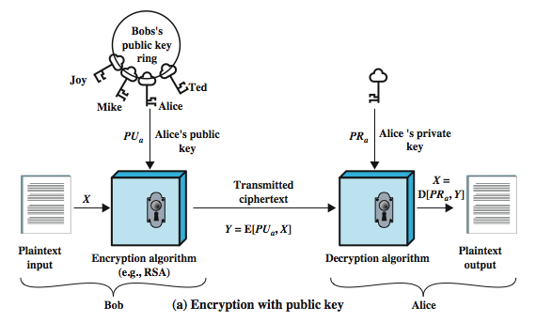
Cryptography
General Idea of Asymmetric Cryptography

Slide 9
Cryptography
Asymmetric Cryptography (RSA: Rivest-Shamir-Adleman))
Example of choosing keys
Select two primes p =17, q=11
n =pq=187
Φ(n)=(p-1)(q-1)=160
Select e such that e is relatively prime to Φ(n) and e < Φ(n). Chose e = 7.
Determine d such that de=1(mod 160) and d < 160. d can be calculated using extended Euclid’s algorithm:
d = 23 (23*7=161≡1(mod 160))
Encode
Decode
88
11
88

Slide 10
Cryptography
General Approach in RSA
Sender
Plain text P
Decimal text
Public key e, n
transmit
Receiver
Private key d
Public key n

Slide 11
  Integrity
Cryptography
  Integrity: Assure that information are not unauthorized modified or destructed
Modification Detection Code (MDC) using hash function
General idea: Alice uses a hash function to create a fingerprint from the message. She sends the message and the fingerprint to Bob over the insecure channel. Bob separates the message from the fingerprint. He than makes a new fingerprint from received message. If the two fingerprints match, the message is integreted and has not been modified.
Alice
Bob
Message
M
M
insecure
channel
M
M
y
y
Hash
Hash
y’
Same?
Y
y = h(M)
y
Accept
Fingerprint
N
Reject

Slide 12
Authentication
Cryptography
  Authentication: Assure that the information arriving came from a trusted source (users are who they declared).
Message Authentication Code (MAC) using hash function and key
General idea: Alice uses a hash function to create a MAC from the concatenation of the key and the message. She sends the message and the MAC to Bob over the insecure channel. Bobo separates the message from the MAC. He than makes a new MAC from the concatenation of the message and the secret key. If the two MACs match, the message is authentic and has not been modified.
secret key
used for authentication

Slide 13
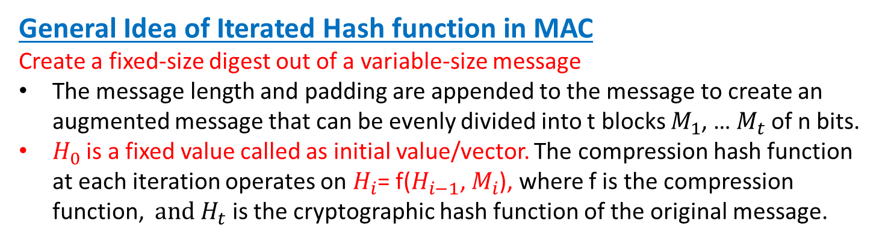


Hashing
Cryptography
General Idea of Iterated Hash function in MAC
Create a fixed-size digest out of a variable-size message
The message length and padding are appended to the message to create an augmented message that can be evenly divided into t blocks $M_{1}$, … $M_{t}$of n bits.
$H_{0}$ is a fixed value called as initial value/vector. The compression hash function at each iteration operates on $H_{i}$= f($H_{i−1}$, $M_{i}$), where f is the compression function, ${ and H}_{t}$ is the cryptographic hash function of the original message.
$$H_{1}$$
$$H_{2}$$
1
2
t

Slide 14
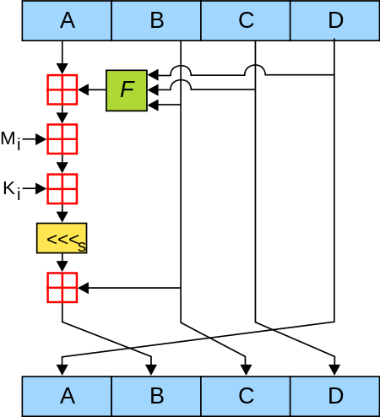
Iterated Hash functions in MAC
Cryptography
  MD5 (Message Digest)
  MD5 was designed by Ron Rivest in 1991 to replace an earlier hash function MD4. A block size is 512 bits digested to the message of size 128. The maximum message size is bits (by repeating the following process 55 times).
128-bit
64 operations (32-bit message ×64 = 512-bit), grouped in four rounds of 16 operations.
Four nonlinear functions: one for each round.
One round (16 operations):
  (i) Mi (1≤i≤16) denotes a 32-bit block of the message input
  (ii) Ki denotes a 32-bit constant, different for each operation
  (iii) <<<s denotes a left bit rotation by s places and varies for each operation
  (iv) denotes addition modulo
  Functions in four rounds :
32-bit
One MD5 operation

Slide 15
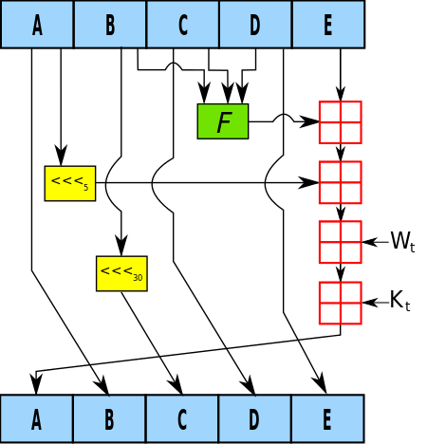
Cryptography
  2. SHA-1 (Security Hash Algorithm)
  SHA-1 produces a message digest based on principles similar to MD5 message digest algorithm, but has a more conservative design. The maximum message size is bits. A block size is 512 bits digested to the message of size 160.
SHA-1 consists of four rounds with 20 operations in each round. Four functions are used for four different rounds.
One operation within the SHA-1 compression function: A, B, C, D and E are 32-bit words of the state; F is a nonlinear function that varies;
<<<n denotes a left bit rotation by n places;
n varies for each operation; Wt is the expanded message word of round t; Kt is the round constant of round t; denotes addition modulo .
One operation

Slide 16
Outline
Cryptography
  Confidentiality
  Integrity and Authentication
SSL security protocol
  SSL
    Handshake protocol
    ChangeCiperSpec Protocol
    Alert Protocol
    Record Protocol
  TSL

Slide 17
Transport Layer Security Protocol: SSL
SSL security protocol
SSL Architecture
Services:
  Fragmentation: divide data into blocks of 2^14 bytes or less
  Compression
  Massage integrity and authentication: use a keyed-hash function to create a MAC.
  Confidentiality: provide confidentiality for data and MAC by using cryptography.
  Framing: add a header to the encrypted payload.
Key exchange algorithms: null, RSA, …, etc.
Encryption/Decryption algorithms: Null, RSA, DES, …, etc.
Hash algorithms: Null, MD5, SHA-1
Sessions and Connections: A session is an association between a client and a server. After a session is established, the two parties have common information (session identifier, certificate authenticating each other, compression method, cipher suite, master secrete and etc). For two entities to exchange data, a connection has to be created. A session can consist of many connections.

Slide 18
SSL security protocol
Structure of SSL Protocol
Application Layer
Handshake Protocol
ChangeCipherSpec Protocol
Alert
Protocol
SSL Protocol
Record Protocol
Transport Layer
Handshake protocol: negotiate encryption and MAC algorithm, authenticate the server and the client each other, and exchange information for building the cryptographic secretes which are used in Record Protocol.
ChangeCiperSpec Protocol: defines the process of moving values between the pending and active states.
Alert Protocol: reporting errors and abnormal conditions.
Record Protocol: carries massages from the upper layer; provides confidentiality and message integrity (using secrete keys provided from handshake protocol).

Slide 19
SSL security protocol
Record Protocol
– Provide message confidential and integrity; it receives shared secret keys from Handshake Protocol for encryption and MAC
Hash Algorithms
NULL
MD5
SHA-1
Encryption Algorithms
NULL
RSA
DES
……

Slide 20
SSL security protocol
Handshake protocol for connection
– Four phases: Negotiate an encryption and MAC algorithm, authenticate the server and the client each other, and exchange information for building the cryptographic secretes (six different keys: client/sever authorization keys (2), encryption keys (2), initialization vectors (2)).

Slide 21
SSL security protocol
Handshake protocol: phase 1 & phase 2
Cipher suite
The combination of key exchange, hash and encryption algorithms. e.g., SSL_RSA_WITH_DES_CBC_SHA is the cipher suite using RSA for key exchange, DES for encryption, and SHA-1 for hush.

Slide 22
SSL security protocol
Handshake protocol: phase 3 & phase 4

Slide 23
SSL security protocol
Handshake protocol – Continue
Header for Handshake Protocol
0 8 16 24 31
Protocol: 22
Version
Length:
Length field 1:
2 bytes
… Length:
Type:
Length….
Length field 2:
3 bytes
… Length
1: client_hello
2: server_hello
…
20: finished

Slide 24
Handshake protocol – Continue
pre-masters,
server/client
random numbers
Cryptographic parameter generation
The client and server exchange one random number each (Phase I).
The client and server exchange one pre-master secret each using a key exchange algorithm (Phase II and III).
A 48-byte master secrete is created from pre-master secret by applying two hash functions.
4. The master secret is used to create variable-length key material by applying the same hash functions with different constants. The module is repeated until key material of adequate size is created.
5. Six different keys are extracted from the key material.
master secret
key material

Slide 25
SSL security protocol
Cryptographic parameter generation
The client and server exchange one random number each (Phase I).
The client and server exchange one pre-master secret each using a key exchange algorithm (Phase II and III).
A 48-byte master secrete is created from pre-master secret by applying two hash functions (SHA-1 & MD5).
pre-masters,
server/client
random numbers
master secret

Slide 26
SSL security protocol
4. The master secret is used to create variable-length key material by applying the same hash functions with different constants. The module is repeated until key material of adequate size is created.
master secret
key material

Slide 27
SSL security protocol
5. Six different keys are extracted from the key material.
key material

Slide 28
SSL security protocol
ChangeCiperSpec Protocol
Define the process of moving values between the pending active states.
Pending state – keeps track of the parameters and secrets.
Active state – holds parameters and secrets used by the Record Protocol to sign/verify or encrypt/decrypt messages.
Each state holds two sets of values: read (inbound) and write Carries messages from the upper layer to transport layer (outbound).

Slide 29
SSL security protocol
ChangeCiperSpec Protocol - Continue
Header for ChangeCiperSpec Protocol
0 8 16 24 31
Protocol: 20
Version
Length: 0
… Length: 1
CCS: 1

Slide 30
SSL security protocol
Alert Protocol
Reporting errors and abnormal conditions
Header for Alert Protocol
0 8 16 24 31
Protocol: 22
Version
Length: 0
Length: 1
Level:
Description

Slide 31
Transport Layer Security Protocol: TSL
SSL security protocol
TSL protocol is the IETF standard version of the SSL protocol
Version: SSLv3.0 is compatible with TLSv1.0
Cipher Suite: TSL does not support Fortezza for key exchange or for encryption/decryption.
Generation cryptographic secrets: TLS is more complex. It first defines two functions: the data-expansion and the pseudorandom.
Alert protocol: TLS doesn’t support NoCertificate in SSL. It also adds some new ones.
Handshake Protocol: simplifies the hass used in the CertificateVerify message; uses the PRF to calculate two hashes used for the finished message.
Record Protocol: Use of HMAC for signing the message.

Slide 32
Review Questions
Explain symmetric-key cryptography DES
What is the block size in DES? What is the round-key size in DES? What is the number of rounds in DES?
Why is an expansion P-box needed in DES function? Given an input 11000011101001011100001110100101 to the expansion P-box what is the output?
How many blocks in the S-box? Given an input 101110 to S-box 1, what is the output?
Find S-box 2 – S-box 8 in DES. Given R = 11000011101001011100001110100101 and k = 110000111010010111000011101001011100001110100101. Calculate F(R, k).
Explain asymmetric-key cryptography RSA
Given two primes p = 7 and q = 11, find public keys n, e; and private key d in RSA. Encrypt plaintext P =17 with public keys n, e; and then decrypt the ciphertext to the plaintext by using private key d.
Distinguish message Integrity and message authentication.
How do MDC and MAC work for message Integrity and message authentication, respectively? Explain the difference.
What is the size of blocks in MD5 hash and what is the message size that each block will be digested to? How many rounds and how many operations in each round does MD5 hash define?
What is the size of blocks in SHA-1 hash and what is the message size that each block will be digested to? How many rounds and how many operations in each round does SHA-1 hash define?
Describe what services that SSL provides.
Describe how master secrete is created from pre-master secrete, and how key materials are created from master secrete SSL?
Explain the relation of session and connection in SSL.
Describe the purpose of four protocols in SSL, respectively.

Slide 33
Project 2: Information Assurance and Security
Laboratory for the project – PLab: Information Assurance and Security Education on Portable Labs
Webpage of PLab: https://sites.google.com/site/iasoncs/home/network-security
Hands-on experiment
Cryptography: public key infrastructure
(1) RSA encrypt
  (2) Hashing
  (3) SSL
Requirement of the project report:
For each Lab experiment:
Describe the purpose of each experiment
Attach the running page of the experiment
Observation from the results to match the purpose of the experiment you described.

Slide 34
References
B. A. Forouzan, “Cryptography and Network Security,” Mc Graw Hill, 2006
W. Stallings, “Cryptography and Network Security,” Pearson, 2014

