Slide 1
Lecture 5: Shared-memory Computing with Open MP

Slide 2
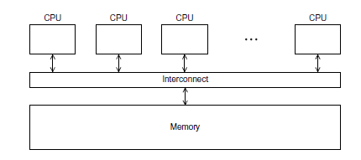
Shared Memory Computing

Slide 3
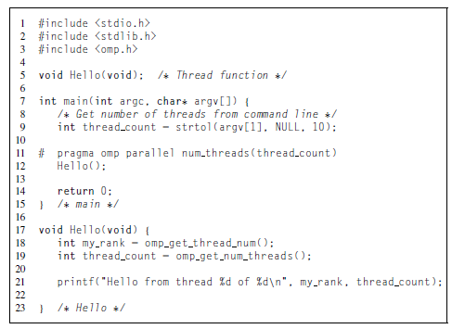
Getting Started: Example 1 (Hello)
Example 1
#include "stdafx.h"

Slide 4
Getting Started: Example 1 (Hello)
Set the compiler option in the Visual Studio development environment
Open the project's Property Pages dialog box.
Expand the Configuration Properties node.
Expand the C/C++ node.
Select the Language property page.
Modify the OpenMP Support property.
Set the arguments to the main function parameters in the Visual Studio development environment (e.g., int main(int argc, char* argv[])
In Project Properties (click Project or project name on solution Explore), expand Configuration Properties, and then click Debugging.
In the pane on the right, in the textbox to the right of Command Arguments, type the arguments to main you want to use. For example, one two

Slide 5
In case the compiler doesn’t support OpenMP
# include <omp.h>
#ifdef _OPENMP
# include <omp.h>
#endif

Slide 6
In case the compiler doesn’t support OpenMP
# ifdef _OPENMP
int my_rank = omp_get_thread_num ( );
int thread_count = omp_get_num_threads ( );
# e l s e
int my_rank = 0;
int thread_count = 1;
# endif

Slide 7
OpenMP: Prevailing Shared Memory Programming Approach
Model for shared-memory parallel programming
Portable across shared-memory architectures
Scalable (on shared-memory platforms)
Incremental parallelization
Parallelize individual computations in a program while leaving the rest of the program sequential
Compiler based
Compiler generates thread program and synchronization
Extensions to existing programming languages (Fortran, C and C++)
mainly by directives
a few library routines
See http://www.openmp.org

Slide 8
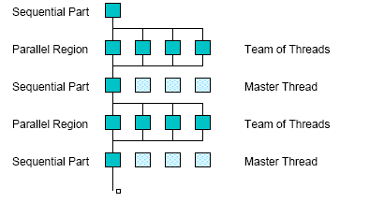
OpenMP Execution Model
fork
join

Slide 9
OpenMP uses Pragmas
Pragmas are special preprocessor instructions.
Typically added to a system to allow behaviors that aren’t part of the basic C specification.
Compilers that don’t support the pragmas ignore them.
The interpretation of OpenMP pragmas
They modify the statement immediately following the pragma
This could be a compound statement such as a loop
#pragma omp …

Slide 10
OpenMP parallel region construct
Block of code to be executed by multiple threads in parallel
Each thread executes the same code redundantly (SPMD)
Work within work-sharing constructs is distributed among the threads in a team
Example with C/C++ syntax
#pragma omp parallel [ clause [ clause ] ... ] new-line
structured-block
clause can include the following:
private (list)
shared (list)

Slide 11
Programming Model – Data Sharing
// shared, globals
int bigdata[1024];
void* foo(void* bar) {
// private, stack
int tid;
/* Calculation goes
here */
}
Parallel programs often employ two types of data
Shared data, visible to all threads, similarly named
Private data, visible to a single thread (often stack-allocated)
int bigdata[1024];
void* foo(void* bar) {
int tid;
#pragma omp parallel \
shared ( bigdata ) \
private ( tid )
{
/* Calc. here */
}
}
OpenMP:
shared variables are shared
private variables are private
Default is shared
Loop index is private

Slide 12
OpenMP critical directive
Enclosed code
– executed by all threads, but
– restricted to only one thread at a time
#pragma omp critical [ ( name ) ] new-line
structured-block
A thread waits at the beginning of a critical region until no other thread in the team is executing a critical region with the same name.
All unnamed critical directives map to the same unspecified name.

Slide 13
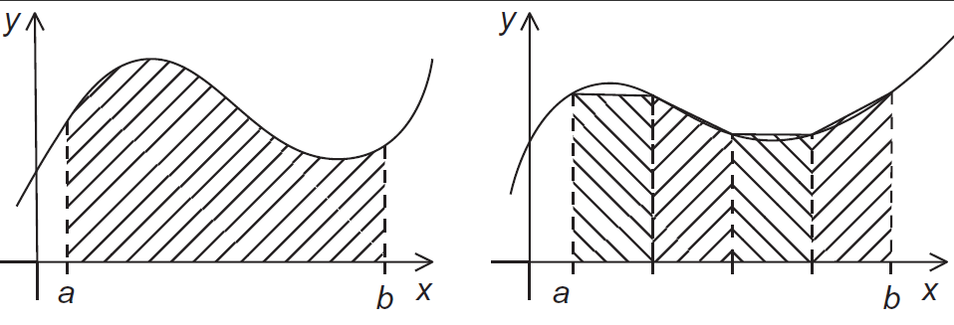
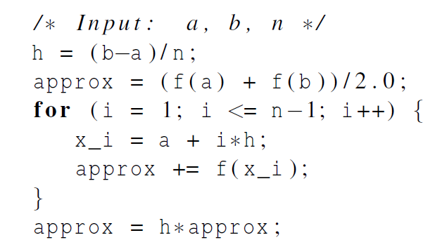
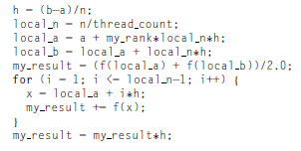
Example 2: calculate the area under a curve
The trapezoidal rule
my_rank
= 0
my_rank
= 1
Serial program
Parallel program for my_rank

Slide 14
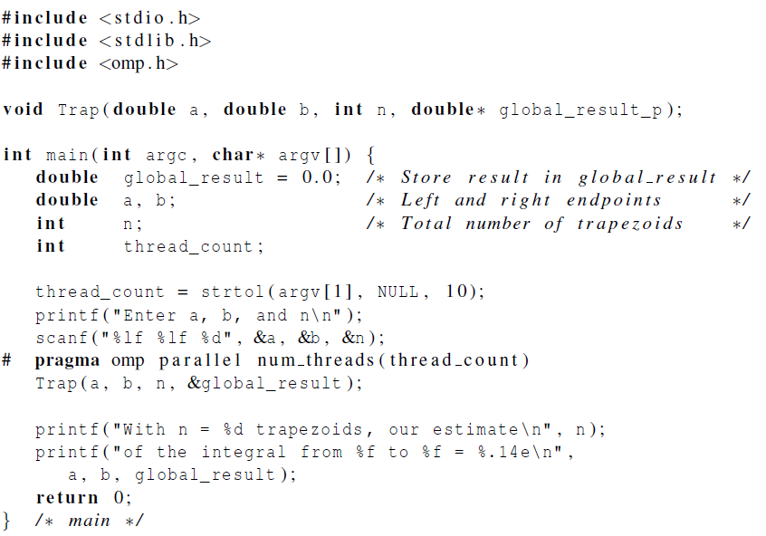
Example 2: calculate the area under a curve using critical directive

Slide 15
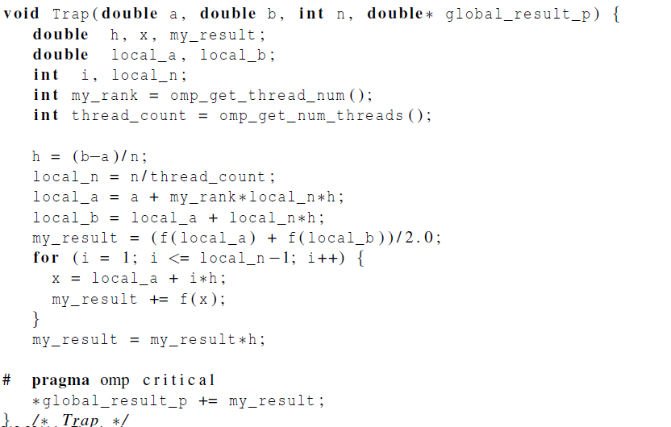
Example 2: calculate the area under a curve using critical directive

Slide 16
OpenMp Reductions
OpenMP has reduce operation
sum = 0;
#pragma omp parallel for reduction(+:sum)
for (i=0; i < 100; i++) {
sum += array[i];
}
Reduce ops and init() values (C and C++):
+ 0 bitwise & ~0 logical & 1
- 0 bitwise | 0 logical | 0
* 1 bitwise ^ 0
FORTRAN also supports min and max reductions

Slide 17
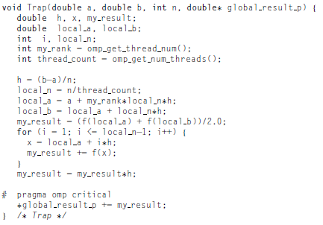
Example 2: calculate the area under a curve using reduction clause
Local_trap
Local_trap

Slide 18
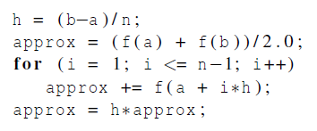
Example 2: calculate the area under a curve using loop

Slide 19
Example 3: calculate π
#include "stdafx.h"
#ifdef _OPENMP
#include <omp.h>
#endif
#include <stdio.h>
#include <stdlib.h>
#include <windows.h>
int main(int argc, char* argv[]) {
double global_result = 0.0;
volatile DWORD dwStart;
int n = 100000000;
printf("numberInterval %d \n", n);
int numThreads = strtol(argv[1], NULL, 10);
dwStart = GetTickCount();
# pragma omp parallel num_threads(numThreads)
PI(0, 1, n, &global_result);
printf("number of threads %d \n", numThreads);
printf("Pi = %f \n", global_result);
printf_s("milliseconds %d \n", GetTickCount() - dwStart);
}

Slide 20
Example 3: calculate π
void PI(double a, double b, int numIntervals, double* global_result_p) {
int i;
double x, my_result, sum = 0.0, interval, local_a, local_b, local_numIntervals;
int myThread = omp_get_thread_num();
int numThreads = omp_get_num_threads();
interval = (b-a)/ (double) numIntervals;
local_numIntervals = numIntervals/numThreads;
local_a = a + myThread*local_numIntervals*interval;
local_b = local_a + local_numIntervals*interval;
sum = 0.0;
for (i = 0; i < local_numIntervals; i++) {
x = local_a + i*interval;
sum = sum + 4.0 / (1.0 + x*x);
};
my_result = interval * sum;
# pragma om critical
*global_result_p += my_result;
}

Slide 21
A Programmer’s View of OpenMP
OpenMP is a portable, threaded, shared-memory programming specification with “light” syntax
Exact behavior depends on OpenMP implementation!
Requires compiler support (C/C++ or Fortran)
OpenMP will:
Allow a programmer to separate a program into serial regions and parallel regions, rather than concurrently-executing threads.
Hide stack management
Provide synchronization constructs
OpenMP will not:
Parallelize automatically
Guarantee speedup
Provide freedom from data races

Slide 22
OpenMP runtime library, Query Functions
omp_get_num_threads:
Returns the number of threads currently in the team executing the parallel region from which it is called
int omp_get_num_threads(void);
omp_get_thread_num:
Returns the thread number, within the team, that lies between 0 and omp_get_num_threads(), inclusive. The master thread of the team is thread 0
int omp_get_thread_num(void);

Slide 23
Impact of Scheduling Decision
Load balance
Same work in each iteration?
Processors working at same speed?
Scheduling overhead
Static decisions are cheap because they require no run-time coordination
Dynamic decisions have overhead that is impacted by complexity and frequency of decisions
Data locality
Particularly within cache lines for small chunk sizes
Also impacts data reuse on same processor

Slide 24
Summary of Lecture
OpenMP, data-parallel constructs only
Task-parallel constructs later
What’s good?
Small changes are required to produce a parallel program from sequential (parallel formulation)
Avoid having to express low-level mapping details
Portable and scalable, correct on 1 processor
What is missing?
Not completely natural if want to write a parallel code from scratch
Not always possible to express certain common parallel constructs
Locality management
Control of performance

Slide 25
Exercise
Read example 1 - 3. Compile example 1 and 3 and run them, respectively. Paste the result pages in your report.
(2) (optional) Revise the programs in example 3 using reduction clause and using loop, respectively.
(3) For n = 100000000 in example 3, get the running time when the number of threads is 1,2,4,8,16, respectively, find the speed-up rate (notice what the ideal rate should be), investigate the change in the speed-up rates, and discuss the reasons.
(optional) Suppose matrix A and matrix B are saved in two dimension arrays. Write OpenMP programs for A+B and A×B, respectively. Run them using different number of threads, and find the speed-up rate.

