Slide 1
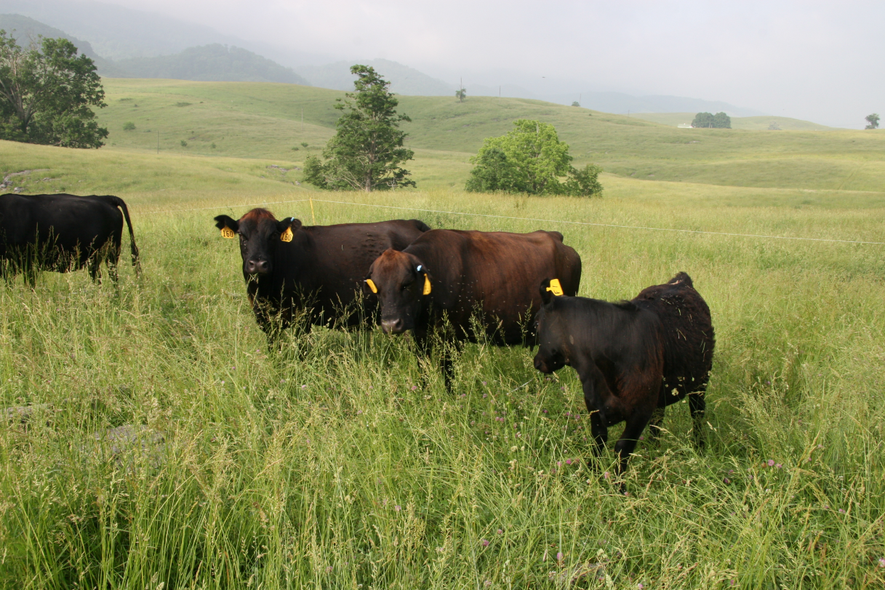
Grazing Management to Improve Soil Health
Greg Brann and Mike Hubbs, TACD

Slide 2
Goal:
At the end of this lesson you will be able to:
Incorporate soil health principles into grazing systems
Identify management strategies to integrate soil health into grazing systems
Discuss the impact that grazing has on soil health and function
Gain an understanding of stocking density and its importance to soil health
Understand grazing principles that improve soil health

Slide 3
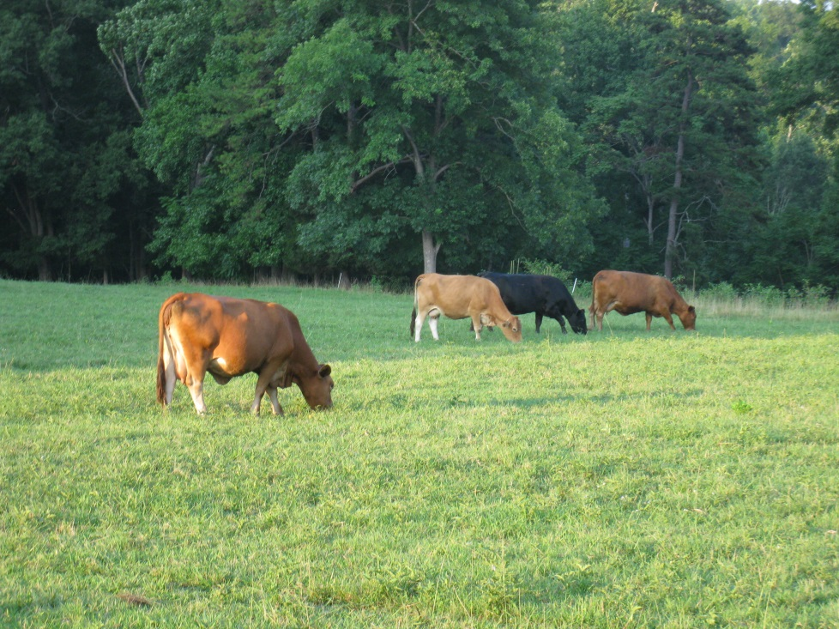
Does Grazing impact soil health?
Positive Benefits
Manure
Managed Grazing
Positive and Negative
Urine
Negative
Poor Grazing Management
Notes:
Grazing management has a tremendous impact on the soil health and function necessary for high production. These impacts include:
Manure can accelerate the building of organic matter and improve soil health if considered as part of a good grazing system. This begins as residue is broken down in the stomach of livestock.
Urine does recycle nutrients but the greater amounts on each “spot” can be a shock to the soil system.
Poor grazing management as we might guess leads to overgrazing, poor nutrient distribution, less microbial activity, more runoff, etc…
Grazing management focuses on the hoof and mouth action of the cows…

Slide 4
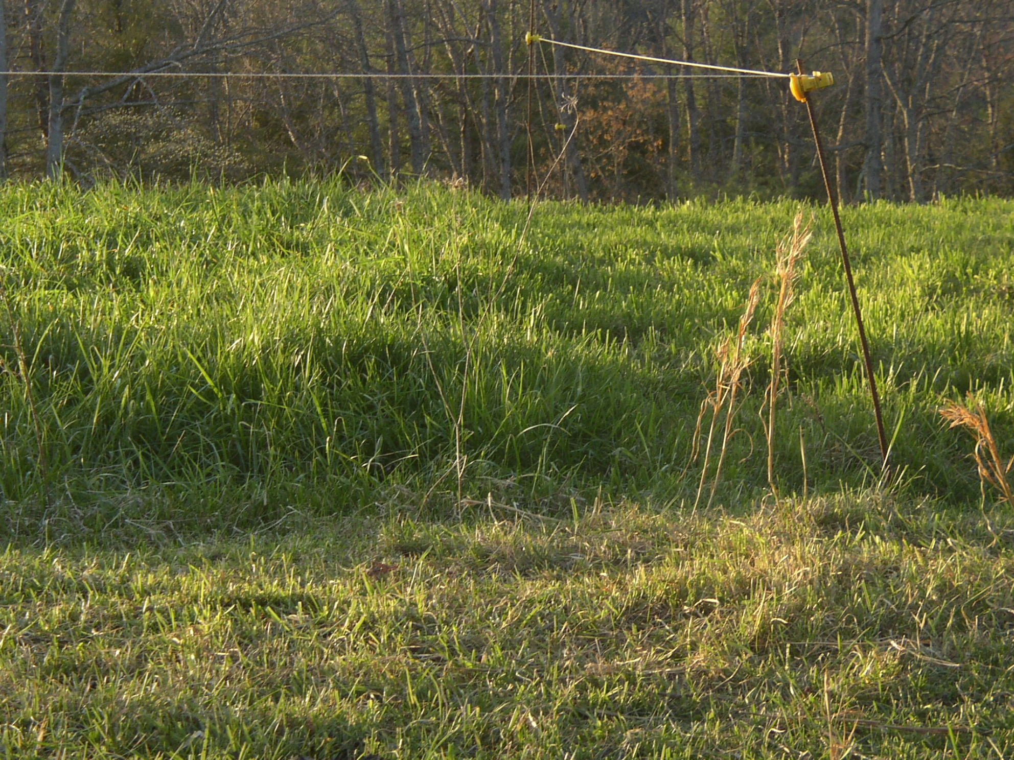
Notes:
Here is a slide of what we would like to do, turn the livestock in at a certain height. Take half, leave half

Slide 5
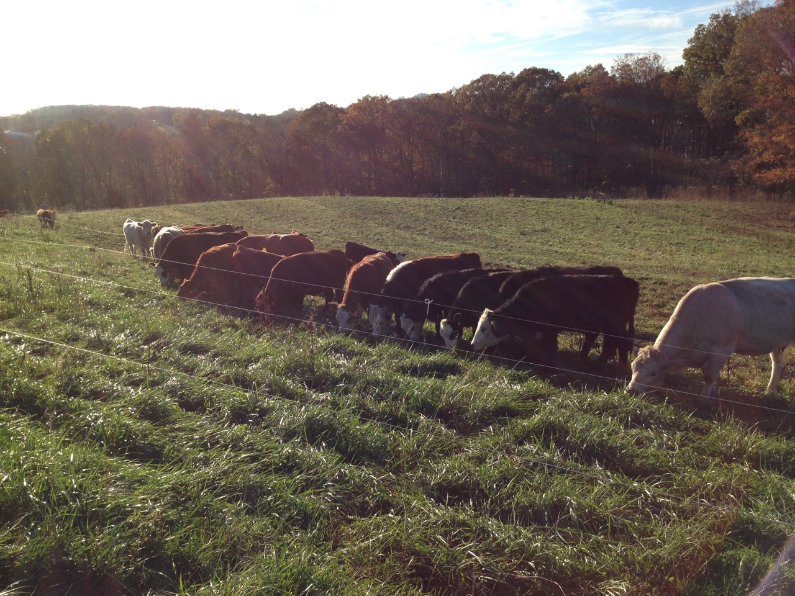
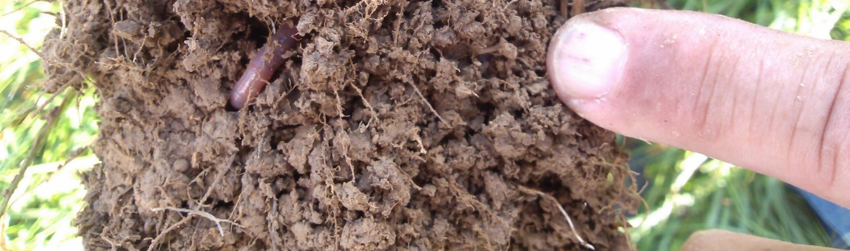
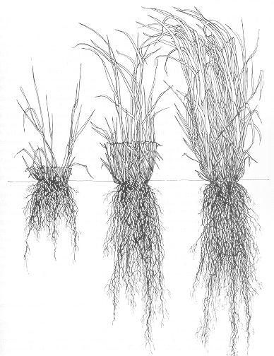
Adaptive Grazing for Healthy Soil
Notes:
We want to allow for the roots to recover (roots shown above). The photosynthesis collected by the remaining leaf area will produce carbon and some of that carbon is exuded by the roots and helps enhance the soil biology.

Slide 6
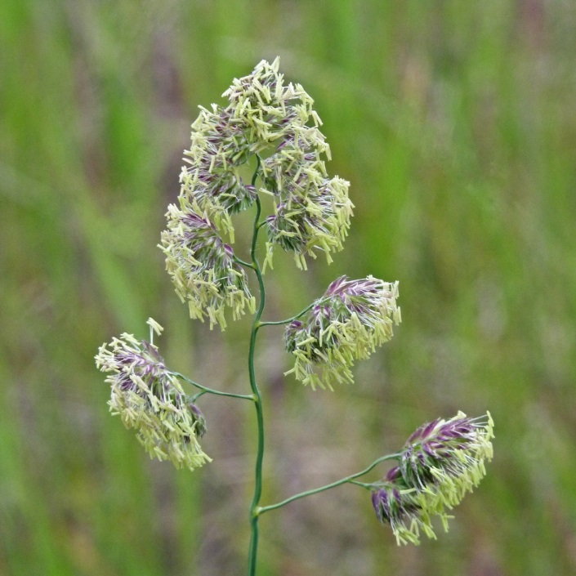
Orchardgrass Cutting Height Study by the University of Kentucky
Ray Smith and Associates
4 year old field of Benchmark Plus
3 Cutting Heights
  4 inches
  2 inches
  ½ inches
4 Fertilizer Rates (3 applications)
  0 N and 0 K
  60 N and 0 K
  0 N and 100 K
  60 N and 100 K
Notes:
These are some results out of the University of Kentucky looking at different cutting heights and fertilizer rates.

Slide 7
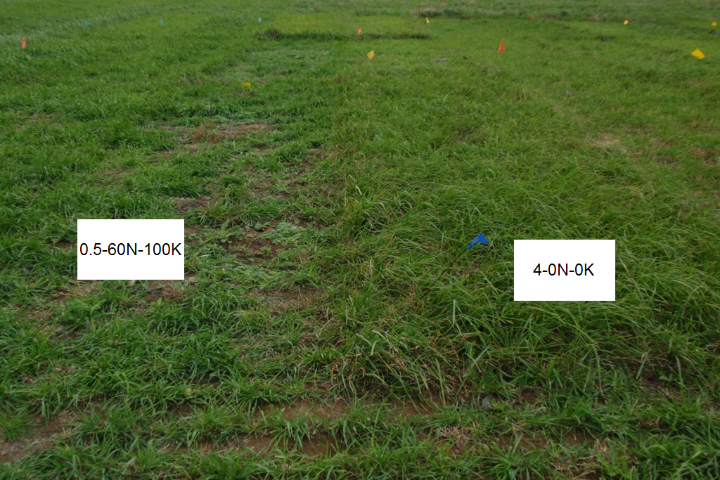
Notes:
As you can see after 30 days, the half inch cutting height with 60N and 100K is much shorter than the 4 inch cut with no nitrogen or potassium. Therefore, the cutting/grazing height of grass is more important than the nutrients. It takes grass to grow grass.

Slide 8
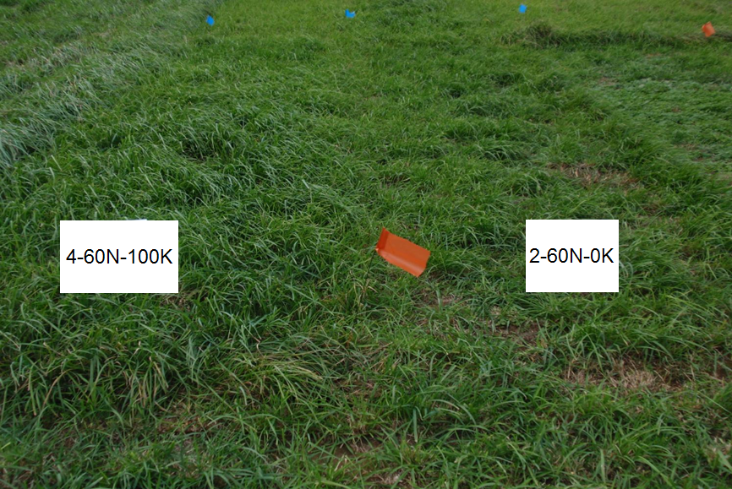
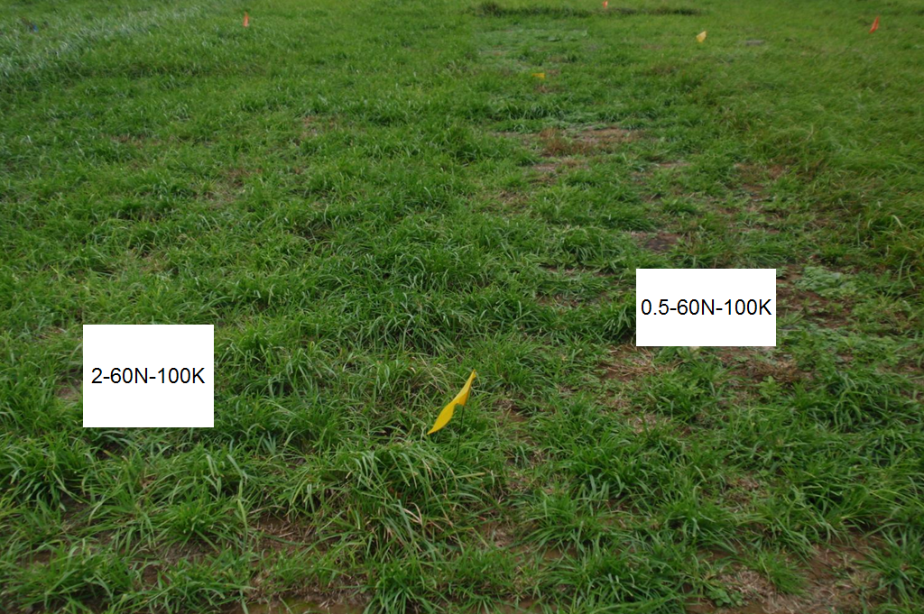
Notes:
This shows a similar trend where all plots had the same amount of fertilizer but the 4 inch cutting/grazing height had good recovery, the 2 inch cutting height has less recovery and little recovery from the half inch cutting height.

Slide 9
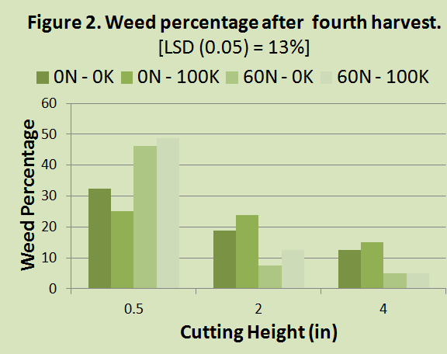
Notes:
On weed percentage after the fourth harvest, you have a greater number of weeds with the half inch cutting height than the others, particularly with those that have the higher rates of nitrogen. When you overgraze, the ground is more bare, temperatures are higher, leading to greater weed pressure.

Slide 10
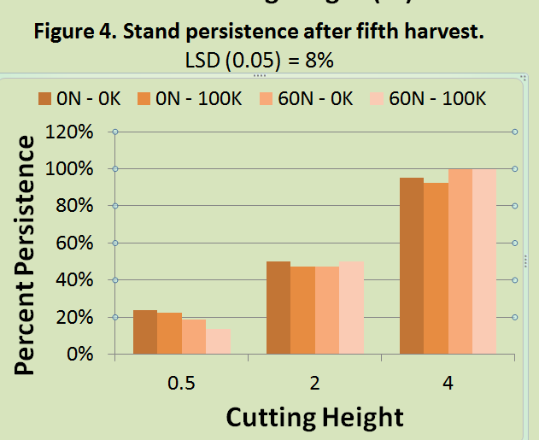
Notes:
With stand persistence after the fifth harvest, you see greater persistence with higher cutting height and no effect from nitrogen or potassium. If we can stop grazing at 4 inches, particularly with cool season grasses, there’s a lot of benefits.

Slide 11
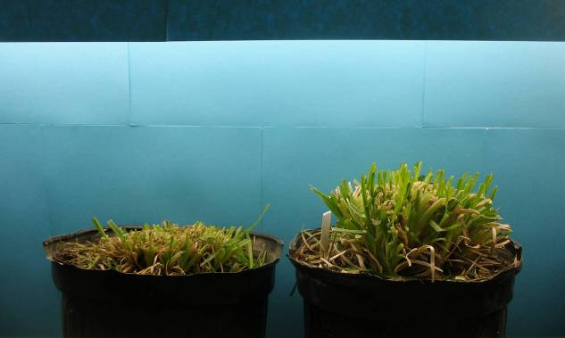
Day 1
(24 hours after clipping)
1” Continuous 3.5” Rotational
Notes:
This is another study where in the pot on the left, orchardgrass was clipped down to a 1 inch height on a daily basis for 30 days and with the pot on the right was clipped down to 3.5 inches after a 30 day recovery period. The next few slides show what the daily recovery looked like over time.

Slide 12
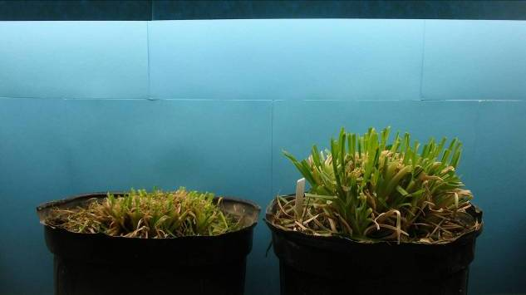
Day 2
1” Continuous 3.5” Rotational
Notes:
Here is Day 2.

Slide 13
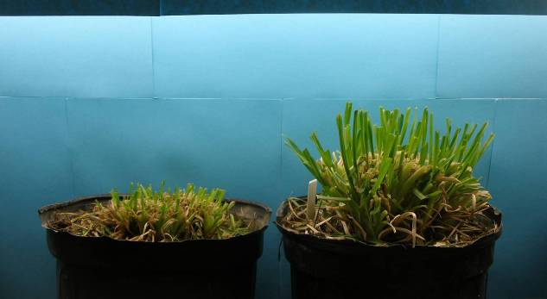
Day 3
1” Continuous 3.5” Rotational
Notes:
Day 3

Slide 14
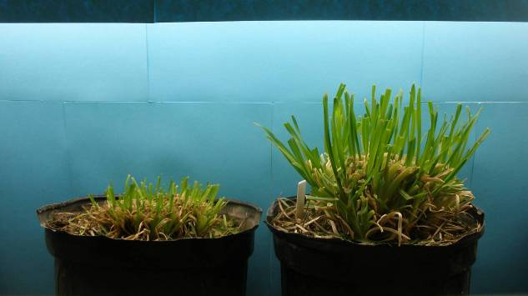
Day 4
1” Continuous 3.5” Rotational
Notes:
Day 4

Slide 15
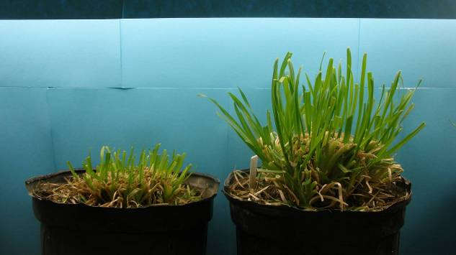
Day 5
1” Continuous 3.5” Rotational
Notes:
Day 5

Slide 16
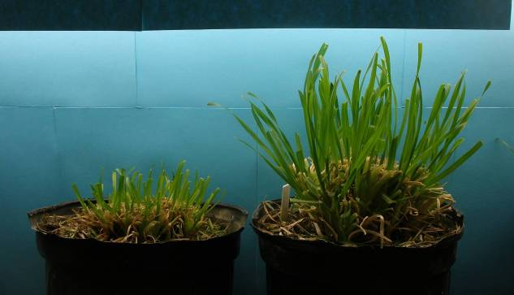
Day 6
1” Continuous 3.5” Rotational
Notes:
Day 6. You can see the 3.5 inch that had a 30 day recovery period prior to the experiment is recovering much quicker than the one inch continuous clipping. It all comes back to photosynthesis and the leaf area that is available for photosynthesis. If we don’t have good leaf area, we can’t capture sunlight. This is true whether we are talking about cover crops or grazing management. Photosynthesis produces the energy for the plant. Some of the carbon that is produced is released through the roots and feeds the biological organisms in the soil. This is the cycle for grazing management. If we overgraze, this cycle shuts down, the microorganisms in the soil shut down or become dormant until carbon is available again.

Slide 17
Effect of post-grazing residual on pasture daily growth rate
(MU-FSRC)
Time to grow 1 ton = 64 days
Time to grow 1 ton = 64 days
Time to grow 1 ton = 40 days
Time to grow 1 ton = 40 days
It takes grass to grow grass !
Notes:
This slide shows it takes about 50% longer to grow a ton of feed if the pasture is grazed down to 2” compared to 4”.

Slide 18
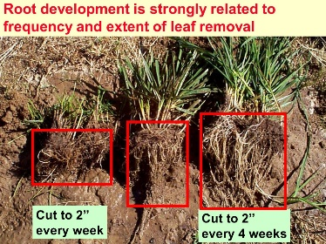
Notes:
In this study they cut it down to 2 inch height, which is shorter than is normally recommended, and varied the frequency of the cutting. The one on the left is cut every week and you can see the root development is much less than the one on the right that was only cut every four weeks. Therefore, if an area is overgrazed, continuously grazed, the roots will be stunted because there is less carbon ending up in the roots because there is less photosynthesis in the shoots. This is why you can take a rainfall simulator over an overgrazed pasture and see almost as much water erosion as from cropland.

Slide 19
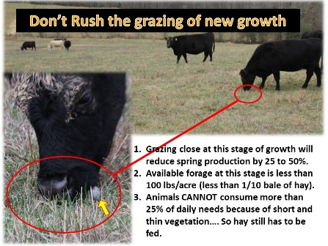
Notes:
In this slide you can see the points identified where grazing close at this stage can reduce spring production by 25 to 50%. Available forage at this stage is less than 100 lbs per acre, less than one tenth of a bale. Animals cannot consume enough so you might as well feed hay at this stage and rest the pasture. You’re not getting any benefits out of it.

Slide 20
Ergovaline levels- Varying Heights and Dates
University of Kentucky
Most tall fescue is infected with a fungal endophyte, Neotyphodium coenophialum toxic to animals. This endophyte could produce ergot-like alkaloids such as Ergovaline resulting in:
*Poor daily gains
*Low conception rates
*Poor offspring survival
*Elevated body temperatures
*Loss of blood flow to the extremities, causing "fescue foot" and other symptoms
Variety | April 19 | May 17 |  |  | June 21 | August 4 | Nov. 11
 | 3+ inches | 0-3 inches | 3+ inches | Seed | 3+ inches | 3+ inches | 3+ inches
KY 31+ | 19 | 1717 | 569 | 1505 | 807 | 536 | 431
Notes:
This study shows different ergovaline levels from the fungal endophyte in tall fescue. Basically, managing at 3 inches or higher produces less of this toxin. With endophyte fescue you can also dilute it with legumes or other species.

Slide 21
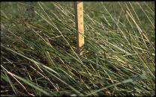
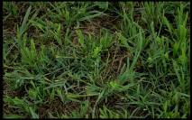
Notes:
This slide shows the beginning and termination heights for different forage species. Most of the forages have a beginning height of 5 to 8 inches and bermudagrass can be grazed a little lower than the others. With the native warm-seasons you have much higher beginning and termination heights. The growing point on many of the warm-season grasses is at 6 inch height so you don’t want to go below that if you are cutting for hay or grazing or you will start to lose your stand.

Slide 22
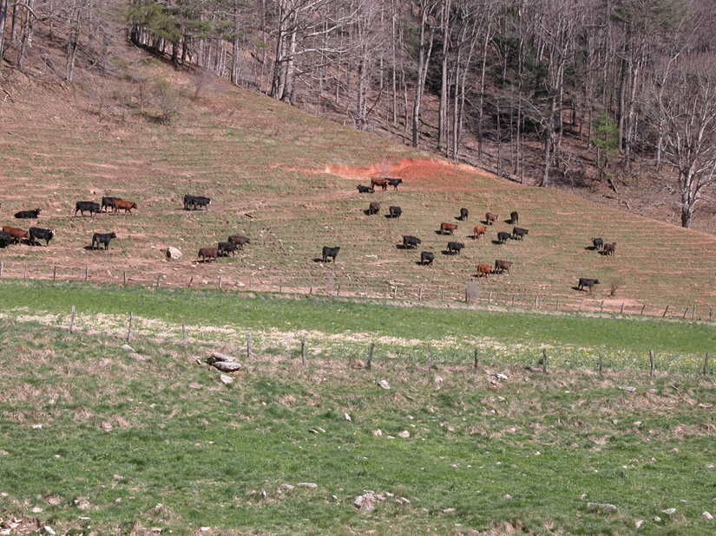
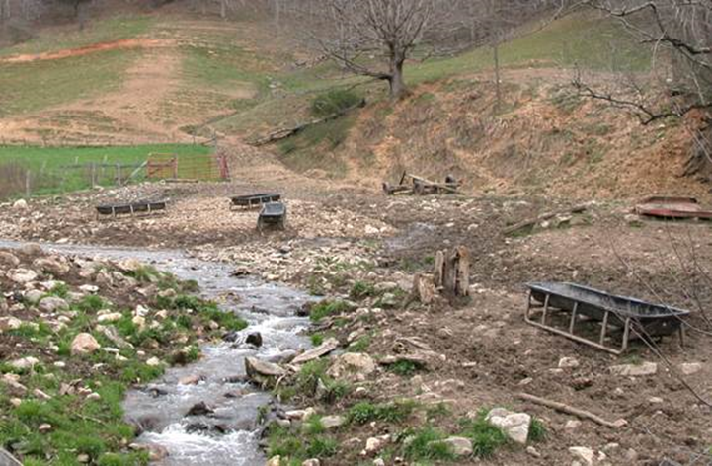
Notes:
In overgrazing, there are effects below ground as well as the obvious stresses on forages . Negative changes in aggregation, bulk density, and soil carbon. Here we see the increase in SOC as stocking rate increases (positive changes) to a point, then the SOC retreats as it is overstocked. This all relates back to the leaf area and carbon production mentioned in some of the previous slides. Also, note as pastures are hayed and all the carbon is removed, SOC would typically decrease significantly. Research by Alan Franzluebbers. 1 Mg per hectare equals about 892 lbs per acre.

Slide 23
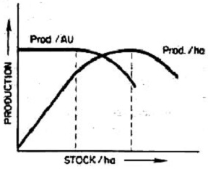
High performance per animal and per acre
Anecdotal Observation Acres/Cow
5 4 3 2
Prod/AU = Production/ Animal Unit (1,000 cow)
Prod./ha = Production/hectare or production/acre
STOCK/ha = Stocking rate per hectare or acre
Target Area
Typically: Stocking Rate Acres/Cow (1200 lb cow)
    High 2 or less
    Moderate 3
    Low 4 or more
Stocking Rate is dependent on
Management and Land Capability
Figure 2. Effects of increasing stocking rate on
pounds of production/animal and
production/area of land (from Conner 1991).
Notes:
This slide shows the relative production based on stocking rate. The stocking rate is dependent upon productivity, rainfall, the animals and management. As your management increases, you can get more to the right side of the graph. Some producers in Tennessee get up to 2 acres per cow or less but they are moving them on a daily basis or twice daily

Slide 24
Lower Stocking Rate for Profit Every Year
Prices are Up and Down
High stocking rate
Stocking Rate adjusted to match low forage production period of Year
Lower feed bill
Better cows
Better body condition
Higher conception rates
Fewer bulls
Notes:
It’s a good idea to start out your stocking rate adjusted to match the low forage production period of the year to make sure you have the management skills and a lower feed bill. A lot of the profit margin is based on the feed bill. Anytime we can cut back on hay, we are putting more profit in our pocket.

Slide 25
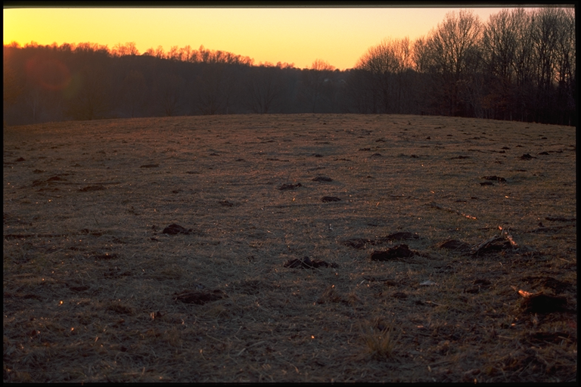
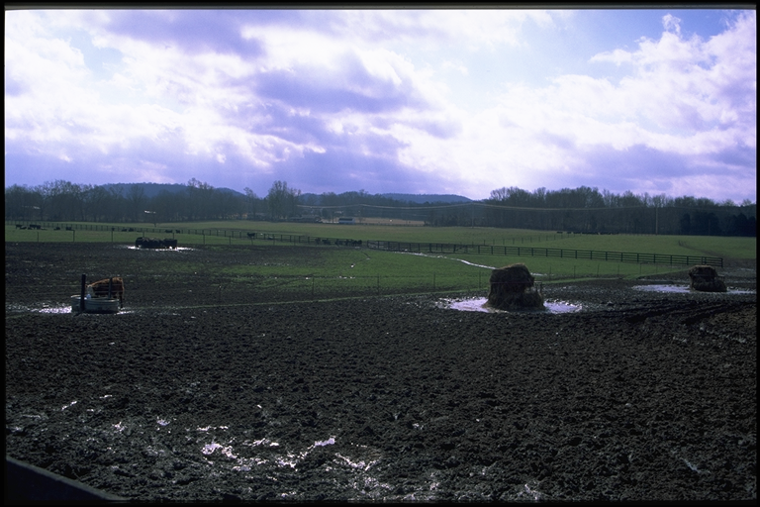
Fine Line between maximum production and total disaster
Notes:
As long as we have time, roots and cover we avoid disaster. If not, it is a disaster.

Slide 26
Manure Improves the:
Reduce Bulk density
Increase OM
Increase Aggregate stability
Increase infiltration
Increase Water holding capacity
Pore size distribution
Increase buffering capacity
Increase chemical activity
Cation exchange capacity
N, P, K
moderate soil pH
Increase biogeochemical nutrient cycling
Physical
Chemical
OM
Biological
Reduce soil toxicosis
Increase microbial biomass
Increase soil organisms diversity
Increase enzymatic activity
Increase nutrient and vitamin concentration in plants
Notes:
Manure can have many positive impacts on the physical, chemical, and biological properties of soils. These are all related to organic matter because manure is organic matter. The soil is less compacted when we have active carbon on the soil. The soil’s ability to resist water pressure (aggregate stability) is better when we have organic matter. The nitrogen and carbon in manure becomes available for organisms to build soil organic matter which improves the physical properties described. Biological: Manure can increase biological activity, total number and diversity of microorganisms due to nutrient and carbon concentrations. Chemical: Manure contains valuable amounts of nutrients. Manure leads to stable organic matter. This has high cation exchange capacity (CEC) potential which allows for greater nutrient retention and provides increased buffering capacity making soils more resistant to changes in things like pH. Some manures can raise pH due to higher calcium concentrations while manures can reduce acidification compared to inorganic fertilizers due to the stable conversion of nutrients like nitrogen to plant usable forms (organic N to ammonium).

Slide 27
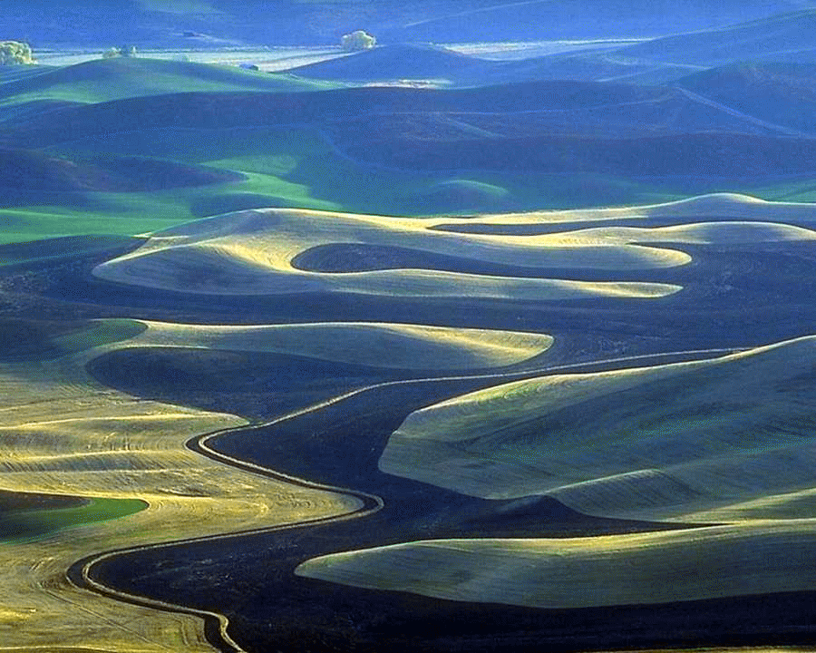
Carbon Cycle
Source: Unruh & Fick, Cornell, Univ. T97-1
Notes:
Now look at this carbon cycle. Without animal inputs, the cycle is less complex with Photosynthesis to plants to respiration back to CO₂. With herbivores introduced, soil microorganisms take the carbon in manure which has been altered by processes (including gut microorganisms) in livestock and further decompose to soil organic matter and plant available nutrients. So, livestock convert the forages to forms that soil organisms can use more efficiently (in the right conditions) and into stable organic matter. The process is enhanced.

Slide 28
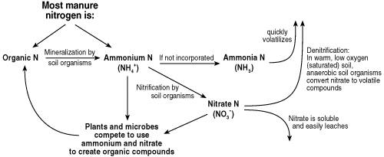
Manure
Notes:
So, nitrogen in the organic state (ON) or as it’s mineralized to ammonium (NH₄) state is very stable and does not readily leach. Healthy soil systems are better at recycling N to stable ON due to a healthy, diverse population of microorganisms. Plus: NH₄ is plant available and not as subject to leaching. Converting to nitrate (NO₃) (also plant available) is a natural process but NO₃ is highly leachable. But, again, in healthy forages systems, both microorganisms and plants will use greater amounts of available nitrogen. This is good news! The N stays in the system. Losses to the atmosphere and water can be low compared to urine…

Slide 29
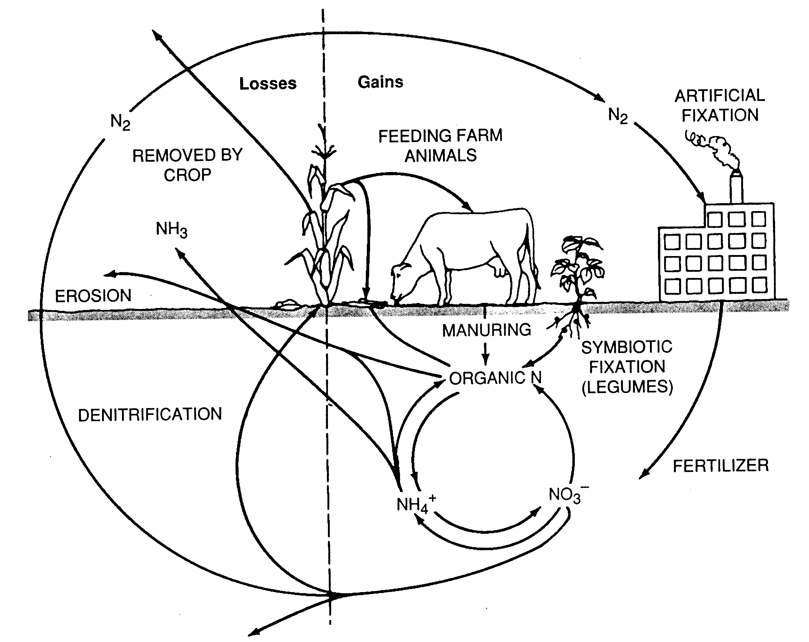
Nitrogen Cycle
Notes:
Let’s look once more at the nitrogen cycle and the potential for manure to aid in the cycling of N. Nitrogen is broken down in manure from stable organic nitrogen (ON) to ammonium (mineralized), then to nitrates (nitrification). Increases in biological activity from manure organic matter increases uptake of nitrogen into the bodies of microorganisms. This stabilizes N and improves the cycling. So, let’s take a look at the way herbivores, plants, and soil biology can work together and mimic nature so all can benefit.
Then we will look at what happens when this breaks down as a result of poor management or when herbivores are not present.

Slide 30

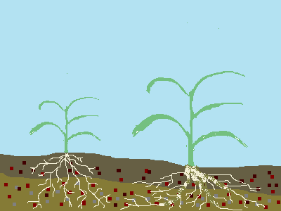
The Fast Nutrient Cycle
Note the location of Nitrogen and Carbon within the plant and the C:N Ratio. All living things try to maintain a ratio of C:N.
N
N
N
N
N
N
N
N
N
N
N
N
N
N
C
C
C
C
C
C
C
C
C
C
C
C
C
Notes:
So here is actual footage of the process that is considered the Fast Nutrient Cycle. The grasses here are between the 3rd leaf stage and flower. Notice that the new growth grows on top of the plant. This new growth is high in nitrogen and low in carbon, i.e. high in protein.
Notice the carbon to nitrogen ratio is in balance to what the grass desires. All living things try to maintain a ratio of carbon to nitrogen. If this ratio is changed in any direction the organism will react in some manner to get the ratio back. For example, if you consume more protein than carbon for long periods you will get a craving for carbon. And visa versa. But we are able to walk to the store and get what we need (a bag of chips or French fries from McDonalds, which are high in carbohydrates) to keep our ratio in balance. But a plant can’t walk to the store. So what will a plant do if it’s C:N ratio is disrupted? Let’s see.

Slide 31

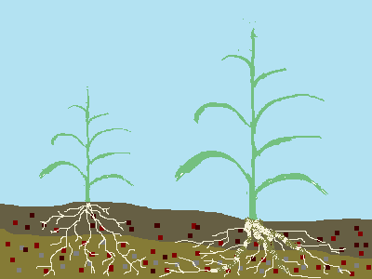
N
N
N
N
N
N
N
N
N
N
N
N
N
N
C
C
C
C
C
C
C
C
C
C
C
C
C
Notes:
Oh no, here comes Gertrude, notice how she is only taking the tops of the plants and then moving to the next plant. Why doesn’t she graze the lower portion of the grass plant? Because it is the highest quality forage available, right? The bottom half of the plant is higher in carbon and low in protein and is less digestible than the tops. Gertrude is in high demand of protein, she is milking her calf and is trying to get in condition to reproduce again. She is seeking highly digestible crude protein so see selects the tops and moves to the next plant. This is nothing new to the plants. They evolved under this type of strategy. With large herds of bison grazing through the area, they took the tops and moved on. If the plants put the highest quality feed on the bottom and the top was poor quality what would happen to that plant? It would be overgrazed and doomed to die. Let’s watch this actual footage to see if this is really the case.

Slide 32

N
N
N
N
N
N
N
N
N
N
N
N
N
N
C
N
C
N
C
C
C
C
C
C
C
C
C
C
C
C
Notes:
Notice how Gertrude is taking the top of this plant. Lets see if she will graze it to the bottom or if she will go to the next plant. What do you think? Why? She will go after the highest nutrition first which is the tops, right. Let take a look and see…

Slide 33
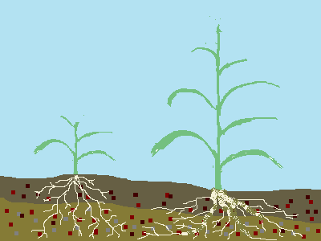
N
N
N
N
N
N
N
N
N
N
N
C
C
C
C
C
C
C
C
C
C
C
C
C
C
C
Notes:
Wow, notice how she took the top and move to the next grass plant.

Slide 34

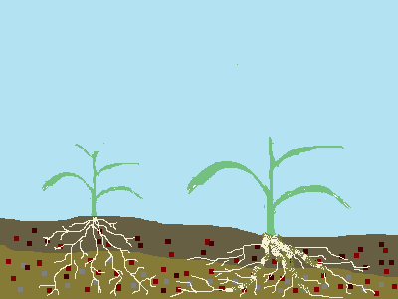
Again note the C:N Ratio and tillering
N
N
N
N
N
N
N
C
C
C
C
C
C
C
C
C
C
C
C
C
C
C
Notes:
Notice the auxiliary tiller has been activated. Which is slower growing which is ok because it slows down the plants from going to seed and shutting down for the rest of the year. All living things want to reproduce. Plants have two methods: Their first choice is sexual reproduction, or seed production, but if that is interrupted by grazing or other types or defoliation, then it will go to asexual reproduction….tillering, as we see here. It takes more sun energy to make seed production than leaf production. If we can stop the plant from going to seed we will force it to go to tiller. We will force the plant to grow longer, absorbing more energy from the sun, capturing more carbon from the air.
Also note the C:N Ratio. The plant has lost a lot of Nitrogen to the cow. So there is an imbalance of Carbon to nitrogen. More carbon than nitrogen. What’s a plant to do????

Slide 35
N
N
N
N
N
N
N
C
C
C
C
C
C
C
C
C
C
C
C
C
C
C
Notes:
There is also something happening in the root zone. Let’s take a look.

Slide 36
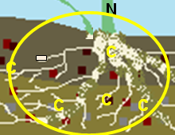
Notes:
Notice all the carbon. Not much nitrogen.. Any thoughts on what the plant can do to get more nitrogen??? Let’s get a closer look.

Slide 37

The Fast Nutrient Cycle
Turn over rate of 12 -16x per year
C₆H₁₂O₆
NH₄⁺
NO3-
C₆H₁₂O₆
NO₃⁻
NO3-
Notes:
Roots slough off and are broken down by microbes which release N to the plant roots.

Slide 38
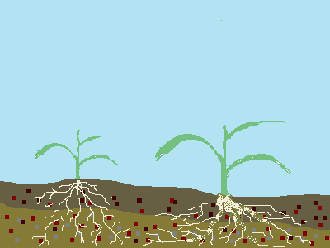
Oh no, Gertrude’s Back?
N
N
N
N
N
N
N
C
C
C
C
C
C
C
C
C
C
C
C
C
Notes:
Oh no, here comes Gertrude again!! What is the next part of the plant she will eat? Yes, the factory. Let’s watch and see.

Slide 39
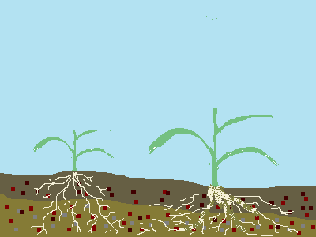
N
N
N
N
N
N
N
C
N
C
N
C
C
C
C
C
C
C
C
C
C
C
C
Notes:
Yep, she sure did take the factory off. Now what?

Slide 40
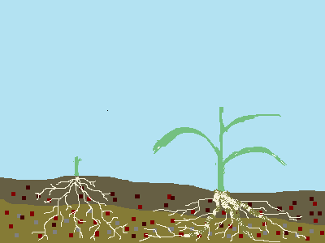
N
N
C
C
C
C
C
C
C
C
C
C
C
C
C
C
C
Notes:
Oh no, she is now going after all of our factories. There goes take half leave half. What could we have done to avoid this? Yes, we should have moved her to the next pasture before this occurred.
But what is going to happen to the symbiotic relationship between the animal, the plant and the microorganisms? Let see.

Slide 41
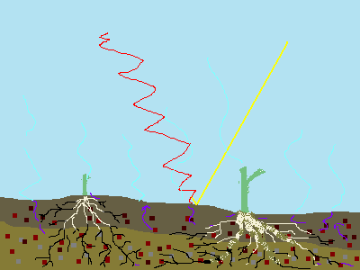
Now what does the plant do?..... Feed the microbes?
HOT Soil Temperatures
Excessive soil moisture loss due to high levels of evaporation and transpiration
N
RIP
Billy Microb
N
RIP
Sue Microb
C
RIP
Joey Microb
C
RIP
Sam
Microb
C
C
C
C
Roots stop growing and even shrink from this excessive defoliation
C
C
C
C
C
C
C
C
C
Notes:
We now have removed the solar panels from the plants, created hot soil temperatures, increased moisture loss, shut down our roots and possibly shortened them. Due to the hot soil temperatures and dry conditions we have caused all of our workers to go dormant and even die. Let’s go to live footage and see what actually happens..

Slide 42
Now what does the plant do?..... Feed the microbes?
Let’s take a look at what is happening below the soil surface…….
N
N
C
C
C
C
C
C
C
C
C
C
C
C
C
C
C
Notes:
Ask the audience what they think the plant response will be. Will it excrete sugars to the microbe? Once they have explained what the think will happen, go to the next slide to watch and see.

Slide 43
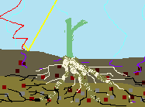
Stored Carbon in Carbohydrate form is used to power the plants ability to grow new leaf tissue since the plant is no longer solar powered.
RIP
Sam
Microb
RIP
Sue
Microb
Soil is drying up and the microbes are dying or going dormant due to the harsh conditions
CH₂O
CH₂O
CH₂O
CH₂O
CH₂O
CH₂O
C
Very little Carbon, if any, is used to feed the soil microbes. The plant can’t afford this loss, it is trying to survive at this point, it needs to get mature leaves tapped back into sun energy.
B.A.D. HETRICK, G.W.T. WILSON, AND C.E. OWENSBY JOURNAL OF RANGE MANAGEMENT 43(4), July 1990
Notes:
The polysaccharides are used to make new tillers since the plant is no longer solar powered. It is running on stored carbohydrates. It can’t afford to give carbon to the microbes that it needs to grow new leaves. It will do this first and hopefully get them to maturity before you know who comes back. If Gertrude does come back what do you think she will be after then? The old growth or this lush new growth? Yes the new growth probably before it becomes mature. That is if there is any moisture left to make new growth.

Slide 44


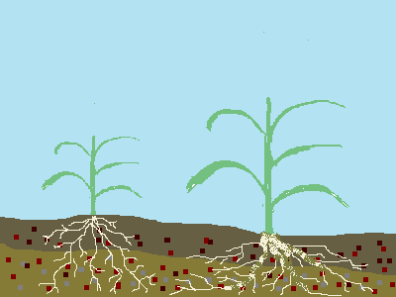
The Slooooooow Nutrient Cycle
The Nitrogen is either volatilized or translocated to the seeds as concentrated protein. The leaves and stem are mostly made up of carbon and calcium skeletal
N
N
C
N
C
N
N
N
N
C
C
N
C
N
C
N
C
N
C
N
C
N
C
N
C
N
C
C
C
C
C
C
C
C
C
C
C
C
C
Notes:
So here is actual footage of the process that is considered the Slow Nutrient Cycle. The grasses here are in the boot to flower stage. Notice that the new growth still grows on top of the plant and is still high in nitrogen and low in carbon (ie. high in protein). But as time goes on the plant goes to seed production robbing the plant of it’s protein and concentrating it in the seed. The carbon to nitrogen ratio is still in balance to what the grass desires. There is no need for the plant to trade sugar for nutrients when it is in a couch potato mode.

Slide 45

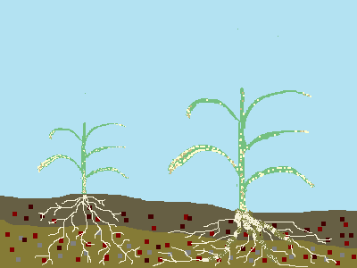
The Slooooooow Nutrient Cycle
What is the C:N Ratio of these leaves and stems?
N
Does it matter?
N
C
C
N
N
C
C
C
C
C
C
Why doesn’t it matter?
C
C
C
C
C
C
C
C
C
C
C
C
C
C
C
C
Notes:
The slow nutrient cycle occurs if grazing occurs after the flower stage if at all. CRP would fall into this cycle, any nongrazed areas of your pastures or pastures that are grazed after the flower stage. Most of the nitrogen leaves the plant either by concentrating protein in the seeds or volatilizes from the leaves and stems.
If grazed at this time, there will be no sugar hand outs to the microbes because the plant has produced seed and has shut down. There is no reason for the plant to give up carbohydrates to grow. It has accomplished its mission and is resting for the rest of the growing season. So what will the microbes have to eat? Where can they get their carbon? Let’s watch and see.

Slide 46
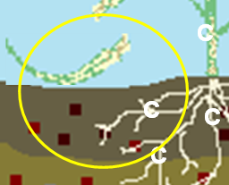
The Slow Nutrient Cycle
NH₄⁺
NO₃⁻
Notes:
As leaves fall to the ground, the microbes break them down and it releases nutrients.

Slide 47
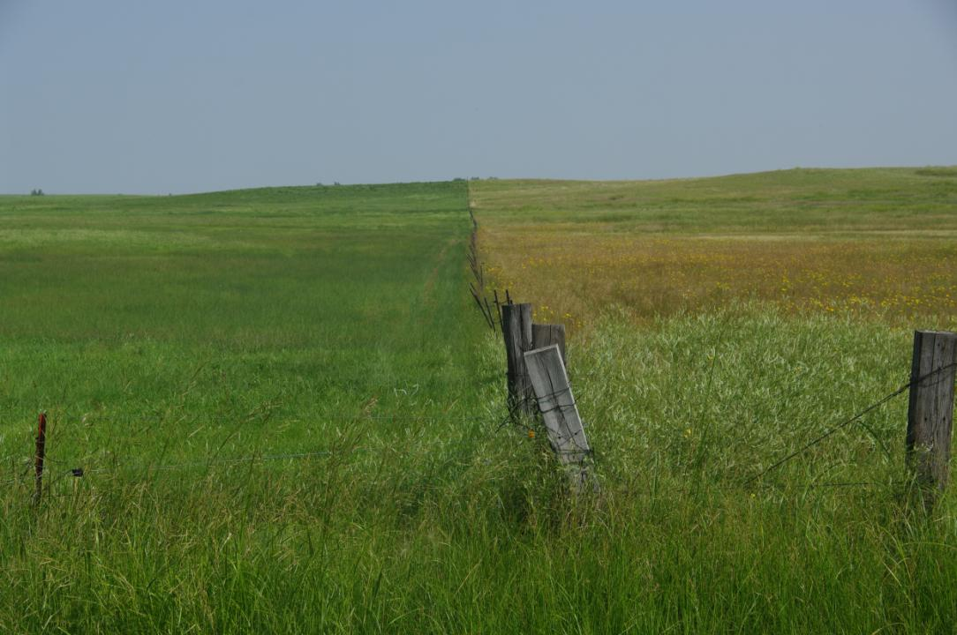
30 Days Recovery
Ungrazed
Notes:
Conclusions: Let’s look at how this might look above ground. Under well managed systems, where nutrients are consistently cycled and carbon is effectively added, grazing is a beneficial practice. Here, there is a positive relationship between soil biology, livestock, and plants. After grazing, plants release exudates including sugars. Bacteria feed on these exudates and release nitrogen back to the plant for its use. Forages are meant to be grazed. Look at the ungrazed system on the right. Here processes have slowed down. Higher C/N ratio plant residues are decomposed much slower. No manures are added to assist in the decomposition. Therefore nutrients are cycled much slower.

Slide 48
Soil Health Principles
Growing Living Roots Throughout the Year
Keep the Soil Covered
Diversify with Crop Diversity
Manage more by Disturbing Less
Notes:
Let’s look at our 4 soil health principles as they relate to our perennial grazing systems.
Living roots will keep making carbon for microbes.
Keeping the soil covered will help insulate the microbes from extreme temperatures.
The more diversity we have aboveground, the more diversity we have belowground.
An example of a disturbance in pasture is overgrazing.

Slide 49
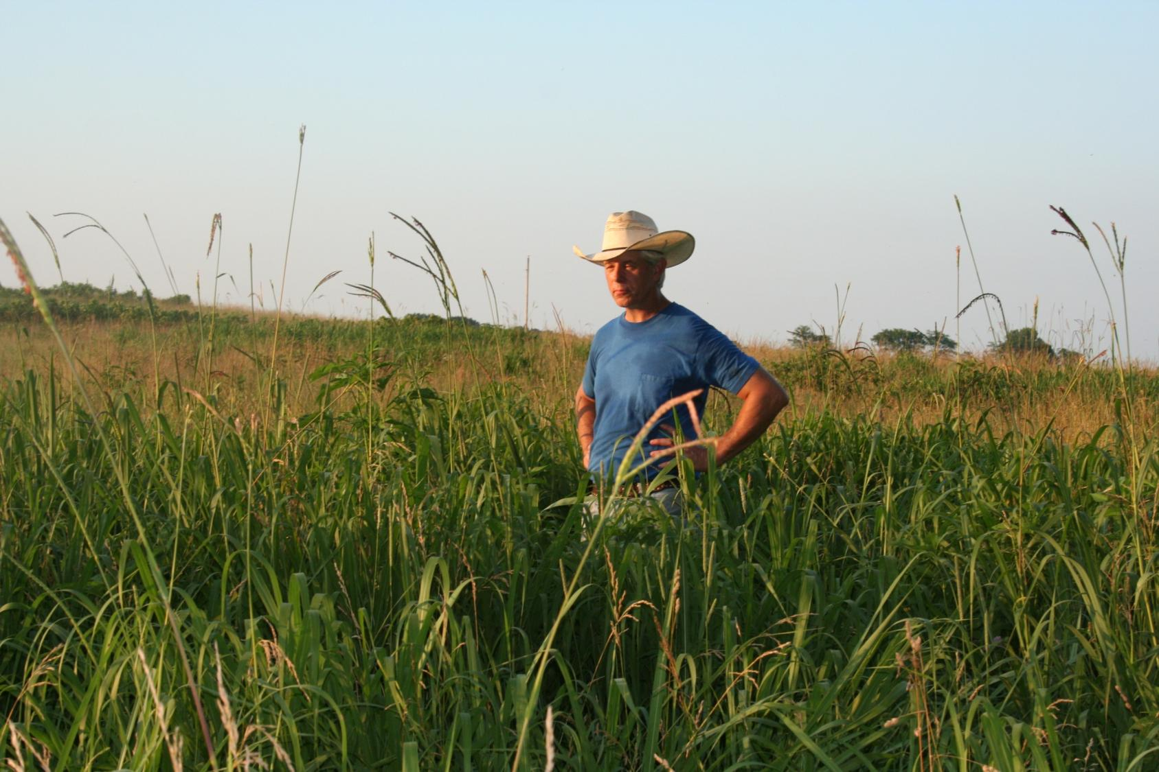
Rest Periods allow for taller more mature forage
Notes:
49
Let’s look at Mark Brownlee’s operation. He lives in Missouri. Mark had been rotating twice daily at about 100,000 stock density. This is a good example of what having residue can help do. Mark allows forages to grow taller and more mature before using the livestock to trample residue onto the soil surface.
Livestock have eaten weeds that were showing up in Mark’s pasture, confining them in a small area makes them less selective, aids in weed control

Slide 50
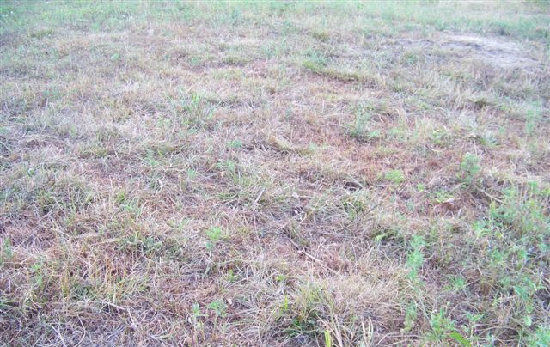
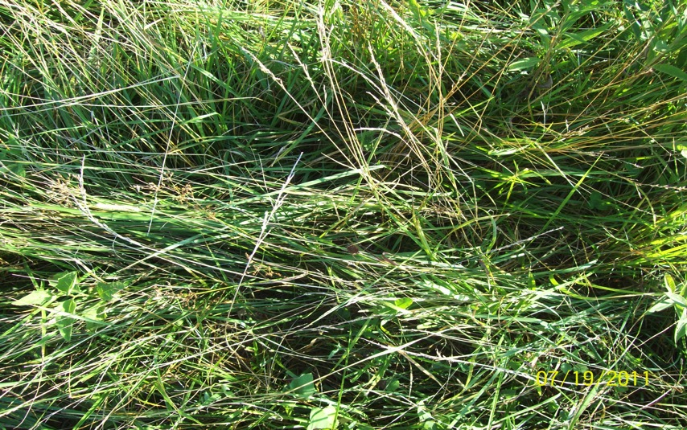
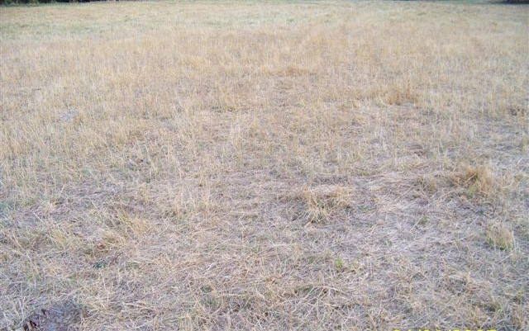
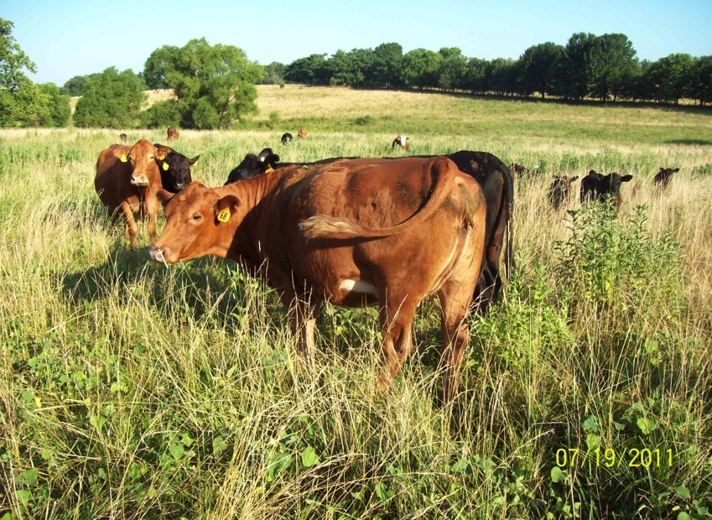
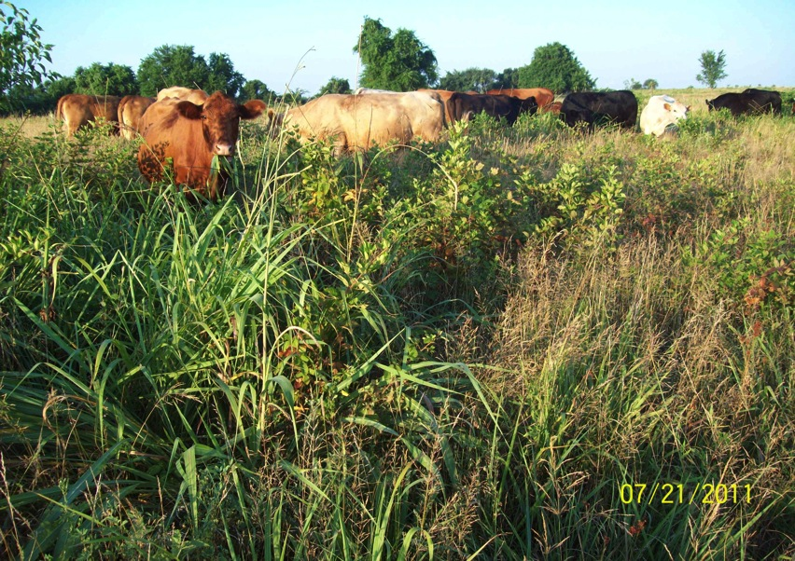



2011 Drought
Neighbor’s Pastures
Mark Brownlee’s Pastures
Notes:
This is from the 2011 drought. Compare the neighbor’s farm next door. Cooler and moister conditions at the surface and below the soil surface allowed the forages to thrive in stressful conditions.

Slide 51




Diversity above = Diversity Below
Notes:
We all know that diversity in our pasture systems is good for livestock, but it also increases biological diversity below ground. More diversity in plants and microorganisms leads to healthier systems that are more resilient and resistant to drought and pest issues while improving nutrient cycling and overall system health. Diversity is not always just about adding annuals into the system. It can mean diversity of perennial species as well. In this photo, there are several examples. Common introduced cool season mixtures could include several grasses and legumes. In many locations warm season mixtures are more prominent.
According to Greg Brann, weeds are opportunities. Opportunities to train cattle to eat weeds through management systems like mob grazing.

Slide 52


Mid-Atlantic Grasses/Legume mix
Midwest Range
Notes:
Here are a couple of good examples of healthy diverse systems. On the left are mostly introduced grasses and legumes from the mid Atlantic region of the US, similar to Tennessee. Also in there are some species we might consider weeds but are very nutritious readily grazed. On the right is a range system from the Midwest. These are primarily native species. Both systems can be enhanced and thrive with grazing management. Sometimes new seeding is required but many times there is a healthy seedbank within the soil to provide adequate diversity.

Slide 53

Lambsquarter are considered weeds by most, but actually have a high protein content (18%)
Notes:
Some things we think of as weeds are actually nutritious and readily eaten by livestock. This is an infestation of lambsquarter. This herd loved it. They were not forced to eat things they didn’t want and were readily moved from one temporary paddock to another. The protein content was about 18%

Slide 54

After Grazing
Before Grazing
Notes:
Here is the before grazing and after grazing photo. On the left, the cattle ate the leaves and left the stems. The weed was controlled through proper management. Again, this is diversity not always considered.

Slide 55

Notes:
This slide shows other examples of plants and their crude protein contents. You can see some of the weeds can have crude protein contents that are similar to cultivated forages. The point is don’t always dismiss a plant as just a weed that must be chemically eradicated when in many cases it is highly nutritious and desired by livestock.

Slide 56


Ray’s Crazy Mix
Soybeans 15 lb (Osage and Derry)
Cow pea, 12 lbs (Chinese)
Sorghum Sudan 8.5 lbs
Pearl Millet 5 lbs (NutriMil)
Sunflower 4 lbs (Peredovik type)
Graza Radish 2.5 lb
Burkank Turnip 1.5 lb
T-Raptor Hybrid Brassica 1.5 lb
Notes:
Annuals seeded onto perennial pasture land is popular now as a practice for a variety of reasons. This was an old fescue field. The producer’s goal was to renovate it and later put in a perennial warm season grass to offer some good grazing for the summer. In the late spring, the existing stand was terminated, you can even use a disturbance like overgrazing to get rid of the existing stand. The above mix was drilled and growing animals were put on at the stage shown above. Cattle gained over a pound per day which was a lot better than the old fescue during the summer. Much of the residue was trampled. The diversity from these annuals gives the system an instant boost and adds to the biological diversity below ground. After a couple of years of cool and warm season annual mixes, the field will be seeded in perennial forages.

Slide 57

What about Disturbance?
Hoof
Plant
Manure
Soil
Notes:
Disturbance in pasture systems is not always bad. It can be beneficial when the hoof, plant, manure, and soil interact. But it must be in a well managed system to avoid detrimental effects to all the resources. Negative impacts can include compaction, reduced forage quality, increased weed pressure, and decreased water quality due to high concentrations of nutrients coupled with erosion.
As mentioned previously, overgrazing can be used as a transition for seeding. Month prior to end of seeding date.

Slide 58

Impact of Biological Disturbance from Overgrazing
Disturbance stimulates weeds populations\
Diminishes Fungal biomass and spores-
Reduces infiltration- inefficient water cycle
Increases soil temperature
Diminishes the habitat of the soil engineers and other diverse soil organisms
Increases the usage of chemical inputs
Notes:
If you overgraze too much though you can get this result. Weeds become the “first responders” (see ambulance) after overgrazing but these weed are not the diversity we want. Discuss any of the outcomes listed.

Slide 59

Effects of Grazing Animals on Plants and Soils
Defoliation
  Selective grazing
  Duration and time of grazing
  Frequency and intensity of defoliation
Sward pulling
Treading
  Effects on plants
  Effects on soils
Manure & urine recycling
Notes:
Grazing animals can impact plants and soils. Management can determine if it is good or bad. Here are some of the effects and what to consider. Higher density grazing with shorter duration can reduce selectivity. Again, allowing plants to be repeatedly grazed without restoring energy and leaf area diminishes plant health and thus its collaboration with soil biology. Allowing animals to “tread” on areas of pasture for long periods can cause extensive damage to plants and soil. Pore space can be severely reduced. However, what if the time on an area is short with larger amounts of residue placed on the soil surface by the animal hoof. It could actually be a positive outcome. Let’s look at some ways to mimic nature and use livestock in a positive manner.

Slide 60


Where are some of the best soils in the United States?
How did nature make all that prairie soil in the first place?
Notes:
The bison roamed around eating the grass. Primarily it was warm season grass and forbs but there was a tremendous amount of diversity. There is still discussion about exactly how the bison grazed. There were a lot of factors that came into play. Time of year, growing or dormant grasses, available water, what areas burned, what didn’t burn, lots of things. Some writings and accounts say they were in small groups grazing only in the burned areas for the entire year. These burned areas would have been grazed pretty hard while unburned areas were almost ungrazed and then the next year they moved to another burned area. There are also accounts of large herds numbering in the hundreds of thousands. As you can imagine when a large herd like this moved through an area everything probably got grazed and/or trampled pretty hard. In either of these scenarios the grasslands were severely grazed and then rested for a long period of time, severely grazed and then rested. It was this type of management that developed some of the most fertile soils in the world. I think we can use different forms of this type of management to repair our eroded and worn out soils.

Slide 61

High Density Grazing
Grazing by relatively large numbers of animals at a high stock density for a short period of time
  Paddock Number: Infinite
  Grazing Period: Minutes – 1 day
  Rest period: 14 days – 210 days
  Stock Density: 50,000 lbs – 500,000 + lbs.
  Utilization: 30 – 70%
Use animal impact as a tool to improve the land
Grazing a taller fully rested plant vs immature plant. (late 2nd stage into phase 3)
Notes:
Here’s the definition of High Density Grazing that we can use.
Paddock number: can be an infinite number with the size adjusted for the time of the year to account for the amount of forage that is available
Grazing period: short periods require more management to move, but have the potential for higher soil health returns
Rest Period: the longer the better, has benefits beyond the forage, can be used to break pest cycles
Stock density: can be adjusted by how large you make the paddocks
Utilization: need to keep in mind that the “micro herd” needs some forage too
Hoof action (trampling) is what helps to feed the soil microbial community
Grazing taller forage takes a change in paradigm as to how we typically look at forage management

Slide 62
Normal Growth Pattern
Growth Phases
1
2
3
Slow
growth
Rapid
growth
Slower
growth
Notes:
The latter part of stage 2 is the target for high stock density grazing. Earlier stage 2 is what is used in a more traditional system, where C/N ratios are lower. So, with higher C/N ratio material, livestock move thru faster while trampling some of the material flat onto the surface, much like a roller crimper would do on cropland.

Slide 63

High Density Grazing
Ideally, 50-60% consumed, 30-40% trampled, 10% standing residual
More litter for microbes.
Higher organic matter in and on the soil
Better manure distribution.
Faster mineral recycling.
More drought proof.
More diversity of forages.
Increased stocking rate
Notes:
While a larger percentage of the total live biomass is trampled compared to traditional systems, much of this is higher lignin with a high C/N ratio. More of this material is trampled and some farmers might feel that a lot of forage is being wasted. When we have things like recovery time, good soil biology, organic matter, that is building up a bank that pays the dividends shown on the slide. With all these soil health improvements, theoretically stocking rates could be increased due to improved yields.

Slide 64

High Density Grazing
150,000 lbs./ac.
Notes:
Here is an example from Doug Peterson in Missouri. This is a density of about 150,000 pounds. (density=pounds of animal on a specific area for a specific amount of time) Lots of forage. Utilization was around 50%. Most of what was left was stems.
“We DID NOT want to be hard on the cows. We did not want to restrict intake or make them eat something they did not want to. “

Slide 65


Ultra High Density Grazing
600,000 lb/ac 15 minutes apart
Notes:
Here are a couple of pictures that show Ultra High Density Grazing. This is around 5-7 hundred thousand pounds stock density. The pictures were taken 15 minutes apart. These stockers are moved every 30 minutes.

Slide 66



Building Soil Health
Notes:
Here is a field that was allowed to rest from March through Aug in 2008. Then it was grazed/trampled at a stock density of about 150,000 lbs per acre. Not the half a millions pounds like the slide before but significant.
Did the cattle “waste” some grass? Well, they didn’t eat it all but it was all used for a specific purpose. It was trampled onto the surface of the soil creating a layer of mulch, just like the hay pile, that allowed the clover to germinate and grow. In case you are wondering there has not been any clover broadcast on this field, no lime and no fertilizer of any kind for many, many years if ever.. A USDA soil microbiologist said that it typically takes a couple of years for the soil microorganisms to really begin to respond to the increase in decaying plant material. It has been managed for two years in this manner. It is likely that because of the trampling the natural nutrient cycle is starting to really kick in and that is why we are seeing the clover increase. This is closer to the 10 to 20% standing that is recommended.
This is a close up of another field on a different farm. This one has not had any lime or clover added in at least 20 years maybe not ever. It was hayed for 20+ years and now this is the 3rd year for this field to be “mulched” in this manner. What will all this clover do? Besides improving the nutritional value of what the livestock are eating it will let us tap into a free nitrogen source, the air.
There are a couple of things you have to notice. First there is not any bare soil. There is still a lot of green grass. This means the soil stays cooler and they are still able to carry on photosynthesis

Slide 67


South Dakota Ranch
Notes:
This is a rancher in western South Dakota. He is also using some higher density grazing. He uses temporary fencing to more frequently move livestock. The photo on the left gives an idea of the extent of his ranch. Cattle are not really restricted to the small area you see. They are just ready to move to the next paddock as you see being done in the right photo. In just a few years of using this management style, this rancher has noticed improved forages with better diversity of species while the cattle are easier to handle.

Slide 68


Stockpiling Forage with Strip grazing
Same field the following spring
Notes:
Extending the grazing season by stockpiling forages and strip grazing is a form of high density grazing as livestock “advance” as the fence is moved. Plus the living root is enhanced by the fall/late summer growth (stockpiling).
This is a look at that same stockpiled/stripgrazed pasture the next spring. Diversity has improved. The producer had never seen vetch in this pasture before. The hoof, soil, plant, residue, interaction has stimulated dormant seed to germinate.

Slide 69

North Dakota High Stock Density Impact on Soil Biology
High density Grazing 2-years
West Side of Shelterbelt
Total Biology – 6105 ng/g soil
Actinomycetes – 213 ng/g soil
Bacteria – 4417 ng/g soil
Fungi – 786 ng/g soil
Mycorrhiza – 230 ng/g soil
No high density Grazing
East Side of Shelterbelt
Total Biology – 4228 ng/g soil
Actinomycetes – 418 ng/g soil
Bacteria – 3349 ng/g soil
Fungi – 386 ng/g soil
Mycorrhiza – 145 ng/g soil
Notes:
Here is some high density grazing in North Dakota
Look at the biological results from a comparison of those systems in ND. There is a greater balance of biology in this higher density grazing. Look at total biology and greater numbers of Fungi….a soil health indicator! In Tennessee, a cropland with no till and cover crops had a total biology value similar to that on the right and when animals were added it got as high as 6000 ng/g for total biology.

Slide 70




Impact of Manure and Urine recycling
90% N,P,K eaten is
returned to soil
~75% of N and K in Urine
~75% of P in Manure
Manure
Notes:
So let’s go back and look at manure and urine. Remember that most of what goes in comes out the back end. So we need to make the best use out of it as possible.

Slide 71

Note location of feeding area, weeks on end, relative to stream.
400 lbs. P2O5
1100 lbs. N
Stream
Lane to water
Notes:
In this example 30 head are fed for 120 days. This could easily be about 400 pounds of P₂O₅ and 1100 pounds of N deposited on one area. So this could be applied to provide nutrients for forages and be properly recycled instead of becoming a water quality problem as shown here (note the stream in the background).

Slide 72
Manure Distribution
Rotation Frequency | Years to Get 1 Pile/sq. yard
Continuous | 27
14 day | 8
4 day | 4 – 5
2 day | 2
1 day | ??
Twice/day | ???
Notes:
As part of the MU study, they estimated how long portions of the field might go without receiving manure. In continuous grazing, parts of the pasture will only receive manure from the cattle every 27 years. In other words portions of the pasture only receive fertilizer every 27 years. Intensive grazing can reduce this to every 2 years
There is no data for once per day or more than once per day

Slide 73

Manure Piles
Urine
Notes:
Here is an example of manure that is well distributed. Are there any areas of refusal? It has been over 4 months since anything has been on this field. Previous manure piles are gone, urine smell went away. It can take as long as 90 days for just the urine smell to go away. If we were on a 30-45 day rotation do you think we would have had areas they avoided because of manure and urine? You bet we would have. 45-60 days should be okay, sheep no problem.

Slide 74


Safe Pasture
Hayed
Silage
Grazed with other stock for one season
Grazed above 5”
Tilled and planted
14 days from ingestion before Haemonchus contortus sheds infected eggs.. For Ostertagia and Trichostrongylus it’s 21 days.
Most infective larvae in the bottom 5” of grass
5 days to months before larvae become infective dependent on moisture and warmth
Notes:
You also want to keep the grazing height higher to reduce disease from things like infective larvae that can be ingested with grass up to 5 inches tall.

Slide 75


Dung Beetles
Notes:
What about dung beetles? They can move and bury organic matter. These are natural tillers in perennial systems. They can persist in grazing systems but certainly thrive better where internal pesticides are absent.

Slide 76

Types of Dung Beetles
Manure Dwellers
Tunnelers
Tumblers
Notes:
There are three basic kinds of dung beetle. Those that live in the manure, those that move manure directly down and the well known tumblers.

Slide 77

Biological:
Biomass of organisms above ground and below ground within the pasture soil.
Organisms Standing crop biomass lbs/a
Above ground
  1200 Dairy cow¹ or 587
  1200 Beef cow² 450
  Pasture³ 2500
  Total 3,018
Below ground
  Pasture roots⁴ 2500
  Bacteria 2052
  Actinomycetes 2052
  Fungi 6244
  Algae 219
  Protozoa 80
  Nematodes 62
  Mites 65
  Collembola 65
  Earthworms 624
  Other fauna 40
  Total 14,003
Adapted in part from Brady and Weil 2002.
1. Cow producing 40 lbs milk/day 180 days/acre, 50% of forage
standing crop consumed, 5 rotations/year.
2. Cow weaning 600 lb calf 3 acres/year.
3. Cool-season grass-clover pasture, 10 inches tall at grazing.
4. Roots equal top growth at grazing.
(518 avg wt @2.67 ac/cow)
Notes:
This slide shows the difference in the biomass of animals above ground (3,018 lbs) and below ground (14,003 lbs) for a pasture soil.

Slide 78

Chicken on wheels
Notes:
Chickens can be great for natural pest control (fly larvae etc) and they can spread manure with their feet. Wait a few days to put chickens out to give dung beetles time to move manure and lay eggs. Otherwise the chickens will eat some of your beetles. 3 days later after beef.

