Slide 1
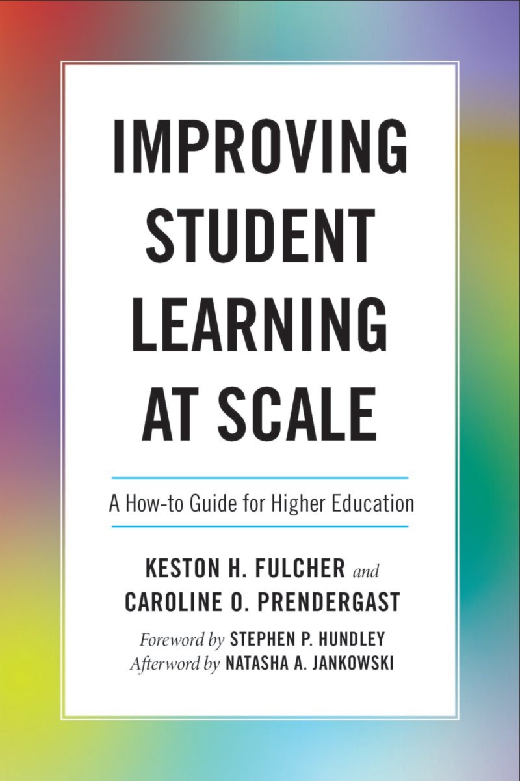
Six Questions to Guide Your Learning Improvement Process
Keston H. Fulcher
Assist from Caroline O. Prendergast
Tennessee State University
February 2022
Notes:
KHF
(5 minutes) Hook, story of when first presenter’s profession was insulted and he had no comeback.

Slide 2
Overview of Today’s Workshop
Conceptualizing and searching for learning improvement
Change vs. Improvement: The Simple Model for Learning Improvement
The six questions & steps for learning improvement
Skipping steps and offering support
Learning Improvement Conversations
Wrap up and Q&A
Notes:
CP (15 minutes , 20min total) Overview and chat introduction

Slide 3
Introduce yourself (name and institution) in the chat!
Notes:
CP (15 minutes , 20min total) Overview and chat introduction

Slide 4
Implied Logic Model for Assessment
Better information about student learning
Better informed pedagogical strategies
Better (and more) student learning
Where’s our evidence?
Notes:
CP (30 minutes, 50 min total) Current state of affairs (i.e., lack of examples of demonstrable learning improvement in higher education, calls for evidence) b. Think. Pair. Share. Why is learning improvement so rare? INTERACTIVE
· For a long time, the field of academic assessment has implicitly (or explicitly) assumed that having access to the right kinds of high-quality data—and developing assessment literacy among higher ed folks—would result in improved student learning. The chain of thought goes better information leads to better pedagogical strategies leads to better (and more) student learning

Slide 5
146 Assessment Reports
How many showed learning improvement?
Notes:
CP (30 minutes, 50 min total) Current state of affairs (i.e., lack of examples of demonstrable learning improvement in higher education, calls for evidence) b. Think. Pair. Share. Why is learning improvement so rare? INTERACTIVE
About a decade ago, Trudy Banta and colleagues set out to find examples of assessment that demonstrated improved student learning. 146 assessment reports were submitted as profiles of best practice from universities around the country. How many do you think actually showed improvement?

Slide 6
9
Banta et al. (2009)
Notes:
CP (30 minutes, 50 min total) Current state of affairs (i.e., lack of examples of demonstrable learning improvement in higher education, calls for evidence) b. Think. Pair. Share. Why is learning improvement so rare? INTERACTIVE
Only 9. Just 6 percent of the reports actually demonstrated that student learning had improved. This throws a wrench into our logic model.

Slide 7
Most colleges and universities…
were using multiple measures to assess student learning outcomes
were not “closing the loop,” or using the information to intentionally modify policy and practice
could not identify ways in which assessment resulted in changes that were linked to improved learning
(Kuh, 2011)
Notes:
CP (30 minutes, 50 min total) Current state of affairs (i.e., lack of examples of demonstrable learning improvement in higher education, calls for evidence) b. Think. Pair. Share. Why is learning improvement so rare? INTERACTIVE
It turns out that most colleges and universities are using multiple measures to assess student learning outcomes, but they’re not closing the loop, or using the information they’re gathering to intentionally change policy and practice. And beyond that, universities are struggling to identify ways in which assessment is helping them make changes that actually improve student learning.
That’s a problem. We’re investing more now in assessment than we ever have, and we’ve reached a point where it’s clear that assessment isn’t a fad that will go away in another decade. But we don’t have the things to show for it—evidence of improved student learning—that we’d hoped we would have

Slide 8
What Now?
Access to high-quality data isn’t the problem
Maybe the problem is our framing
Assessment Frame:
How can we collect more and better data?
Learning Improvement Frame:
How can we better integrate the components of the learning system?
PARADIGM SHIFT
Notes:
CP (15 minutes, 65 min total) Change vs Improvement and the Simple Model for Learning Improvement.
So the problem clearly isn’t access to high-quality data: even when we have that, we aren’t seeing improved learning follow
At JMU, we started thinking a lot more about this problem. We have a robust assessment program here, and we wanted to figure out how that program could contribute to improved student learning. For the better part of the last decade, finding new strategies to improve student learning has been a central focus for our campus Center for Assessment and Research Studies (where we both work)
Eventually, we realized that the way we had been approaching the problem put assessment as the central component. How could assessment be better used? Be better informed? Be better understood by stakeholders? Doing this prevented us from seeing the larger learning system at work. Of course student learning wouldn’t improve just because assessment quality improved. Assessment measures learning, but it doesn’t—on its own—cause learning. Teaching does.
So, the question shifted: how could we better integrate the components of higher education in order to document and demonstrably improve student learning? We began to strengthen our partnership with our campus center for faculty innovation. We began talking to programs about how, exactly, they wanted to see their students improve. And we worked to develop a paradigm that would help guide programs through the process of learning improvement.

Slide 9
The Simple Model for Learning Improvement

Slide 10
Simple Model for Learning Improvement
Assess
Intervene
Re-assess
Notes:
CP (15 minutes, 65 min total) Change vs Improvement and the Simple Model for Learning Improvement.
· As a first step, programs needed to measure student learning. Prior to implementing any changes to their programs, it was crucial to measure students’ knowledge, skills, and abilities upon graduating from the program as it originally stood. Doing so would provide us with a benchmark, a level to which we could compare later measurements.
· The second—and most important step—involved implementing theoretically and empirically informed changes to curricular and pedagogical strategies. In other words, we had to change the ways and the things that students were learning. Importantly, this step couldn’t be left up to a few intrepid faculty who happened to be excited about the project. Instead, we needed to make sure that these changes were implemented program-wide. If we wanted to see program-level learning improvement, we’d need to implement program-wide changes to the learning process. This step was crucial because it required us to break out of the traditional faculty development paradigm in which individual faculty seek assistance in refining or remodeling individual courses. This is great, and we want to continue to encourage these efforts among faculty! But we also envision improvements occurring for all students, not just those lucky enough to end up in the classes of high-achieving faculty members.
· The final step is to re-assess the program after a new cohort of students have had a chance to experience the new interventions, or curriculum, or teaching strategy. Importantly, data should be collected as similarly as they were in the first measurement occasion. This information allows us to compare students who experienced the new program to students who experienced the old program. If we’ve improved student learning, then the students experiencing the new program should perform better than the students who experienced the old program. Anyone in this Zoom room with some measurement and/or assessment chops knows that I’m oversimplifying a bit here, but the point is that we need to compare what we see in the new program to our baseline so that we can determine whether or not improvement has actually occurred.
· We call this three-step process the simple model for learning improvement: assess, intervene, re-assess.
Now, let’s look at an example.

Slide 11
Simple Model for Learning Improvement
New Ethical Reasoning Programming Implemented
2021 Class
2024 Class
Average Ethical Reasoning Score = 2.5
Average Ethical Reasoning Score = 3.5
At this point, only a change.
Now, we can say this change is an improvement.
Notes:
CP (15 minutes, 65 min total) Change vs Improvement and the Simple Model for Learning Improvement.

Slide 12
At Scale
“The Level Problem”
faculty development often focuses on individual faculty members
exposure to improvement initiatives depends on the classes a student takes
Learning improvement at scale
spans an entire academic program
requires coordination across multiple faculty members
has the capability to impact all students who are enrolled in the program
Of course, the real world is more complex…
Notes:
CP (15 minutes, 65 min total) Change vs Improvement and the Simple Model for Learning Improvement.
Of course, this is much more complicated in practice than it is in that snappy little phrase. Once we start getting into the nuts and bolts of managing a learning improvement initiative, things get a little bit more complicated. Now, Keston is going to provide a brief overview of the six-step process we describe in our book.

Slide 13
How To: Six Questions and Six Steps
Notes:
KFH (20 minutes, 95 min total) Overview of the six steps for improvement.

Slide 14
Notes:
KFH (20 minutes, 95 min total) Overview of the six steps for improvement.

Slide 15
1
Is there a critical mass of faculty or student affairs professionals in a program that want to improve?
Notes:
KFH (20 minutes, 95 min total) Overview of the six steps for improvement.

Slide 16
Notes:
KFH (20 minutes, 95 min total) Overview of the six steps for improvement.

Slide 17
2
Is there a clear vision of what improved learning could look like?
Notes:
KFH (20 minutes, 95 min total) Overview of the six steps for improvement.

Slide 18
Notes:
KFH (20 minutes, 95 min total) Overview of the six steps for improvement.

Slide 19
3
With respect to that vision, where is the program now?
Notes:
KFH (20 minutes, 95 min total) Overview of the six steps for improvement.

Slide 20
Notes:
KFH (20 minutes, 95 min total) Overview of the six steps for improvement.

Slide 21
4
What interventions could move the program from the current state to the vision? What evidence do we have that these interventions might be effective?
Notes:
KFH (20 minutes, 95 min total) Overview of the six steps for improvement.

Slide 22
Notes:
KFH (20 minutes, 95 min total) Overview of the six steps for improvement.

Slide 23
5
How will we ensure that the interventions will be delivered as expected?
Notes:
KFH (20 minutes, 95 min total) Overview of the six steps for improvement.

Slide 24
Notes:
KFH (20 minutes, 95 min total) Overview of the six steps for improvement.

Slide 25
6
What is the assessment strategy to determine whether the learning improvement project was effective?
Notes:
KFH (20 minutes, 95 min total) Overview of the six steps for improvement.

Slide 26
Intervene
Assess
Re-assess
Notes:
KFH (20 minutes, 95 min total) Overview of the six steps for improvement.

Slide 27
Question!
What would happen to a learning improvement effort if one of the six steps was skipped?
Notes:
KHF
For each of these breakout sessions, have a worksheet and put on the conference page. also include the visual so they have a list of the six steps

Slide 28
Modeling a Learning Improvement Conversation
Notes:
both: Model this and then also break it down for a few minutes. 10 minute to model, 5 to break down. My example: intro stats techniques in the psych program. My responses will be the “ideal” responses: something clearly defined, a clear set of places in the curriculum where this will be implemented, and a collective will to improve.

Slide 29
Questions….
Who might you start this conversation with?
Do you have an idea about which skills/knowledge domains they might want to improve?
(If you happen to know the program very well,) What courses might be impacted?
How would you approach this conversation?

Slide 30
What Have You Experienced?
Interventions that were…
Poorly designed
Too brief (or too weak) to impact students
Inadequately supported (time, resources, etc.)
Use the chat box to share your experiences!
Notes:
COP & KHF
· Let’s go back to that idea of interventions. Obviously, when we say that we’re choosing or designing interventions, we’re talking about finding a strategy that will work for our chosen objective, that’ll work for our students, and that’ll work for our faculty. We’re operating within real-world constraints for things like time and energy and available time in our courses. So what I want you to do now is think back on times that you’ve seen programmatic or institutional initiatives where the interventions were not well-designed. Maybe they were too ambitious—trying to fit too much into not enough time, or without enough support—or maybe they weren’t ambitious enough (so, perhaps they had lofty goals but could only devote a 50-minute course session to improving something like analytical writing skills). If you’re comfortable doing so, go ahead and add a brief summary of that experience to the chat box. What happened? What do you think the problem was?

Slide 31
Common Solutions
Don’t overextend. Focus on one well-defined objective.
Commit. Methods and measures don’t need to be perfect, but they do need to be reasonable enough to “freeze.”
Use the literature.
Partnerships matter.
Notes:
COP & KHF
· Choose one area to improve. Make it ambitious, but consider whether or not it’s reasonable that you can expect that area to be improved in the amount of time you have. If you’re working across a major program, it’s going to be more amenable to ambitious improvement efforts than if you’re working on a section of gen ed.
· The literature is there to guide you. Knowing what other people have done successfully (or unsuccessfully) can help you determine the appropriate level of ambition for the objectives you’re trying to improve. Particularly if you’re working in a domain that has a rich tradition of SoTL.
· Partnerships matter, both with centers for teaching excellence (if you have them) and the progams you’re looking to work with. If we want to achieve program-level improvement, then we can’t usually rely on one or two go-getters. We need to build relationships with lots of people in the program. This might mean starting with the programs that you already know well, where a larger proportion of faculty have participated in assessment workshops, etc.

Slide 32
Where can you start?
Notes:
Partnerships and will to improve
Buy our book

Slide 33
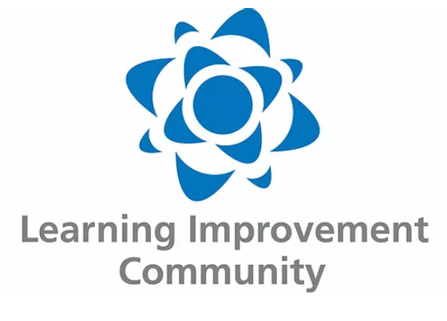
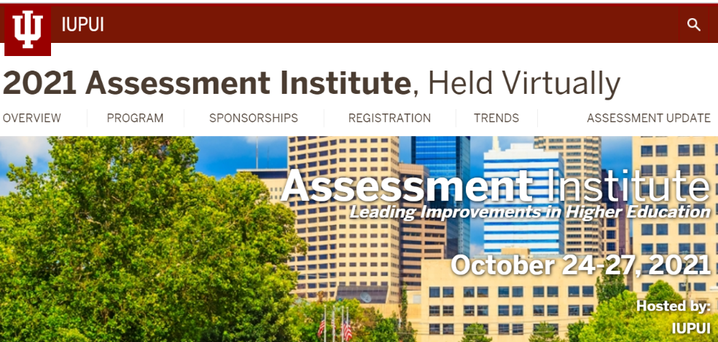
Resources
Notes:
KF

Slide 34
Q&A

Slide 35
Contact Me
Keston: fulchekh@jmu.edu

Slide 36
References
Banta, T.W., Jones, E.A., & Black, K. E. (2009). Designing effective assessment: Principles and profiles of good practice. San Francisco, CA: Jossey-Bass.
Fulcher, K. H., Good, M. R., Coleman, C. M., & Smith, K. L. (2014, December). A simple model for learning improvement: Weigh pig, feed pig, weigh pig. (Occasional Paper No. 23).
Fulcher, K.H. & Prendergast, C.O. (2021). Improving student learning at scale: A how-to guide for higher education. Sterling, VA: Stylus.
Kuh, G. (2011). Foreword. In Blaich, C., & Wise, K. From gathering to using assessment results: Lessons from the Wabash national study. Occasional Paper # 8. Champaign, IL: National Institute for Learning Outcomes Assessment.

